Slide 1
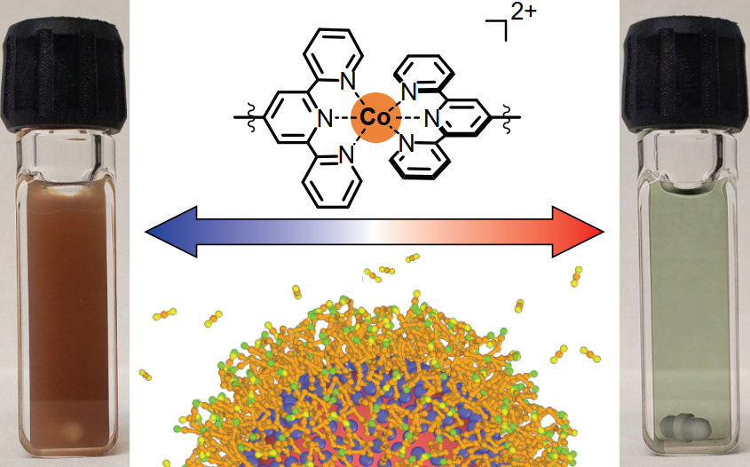
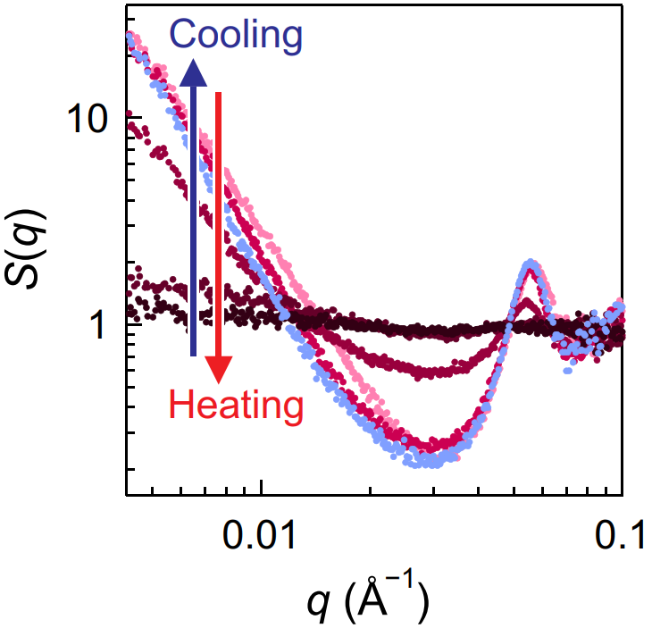
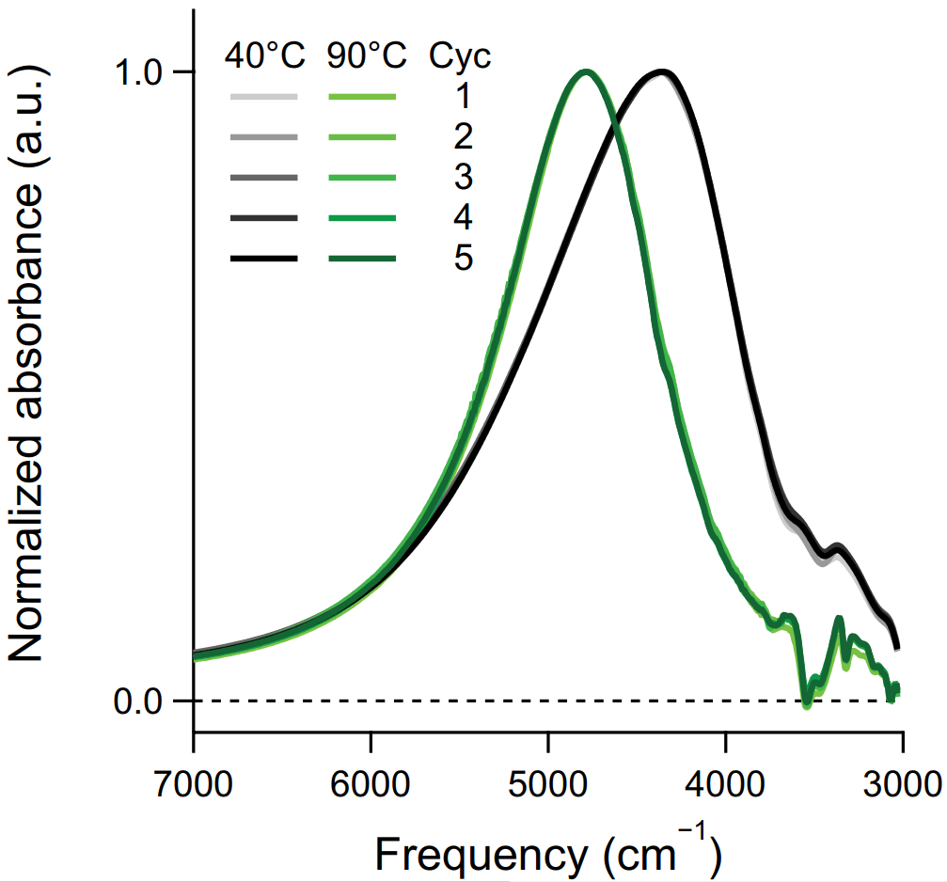
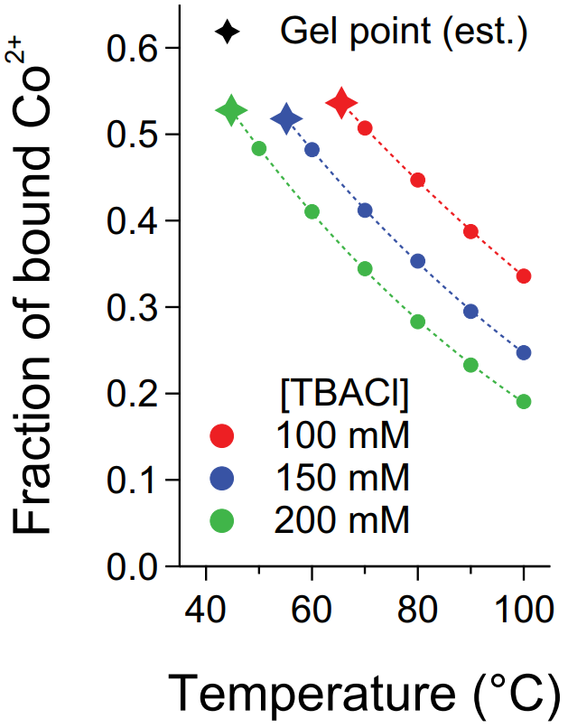
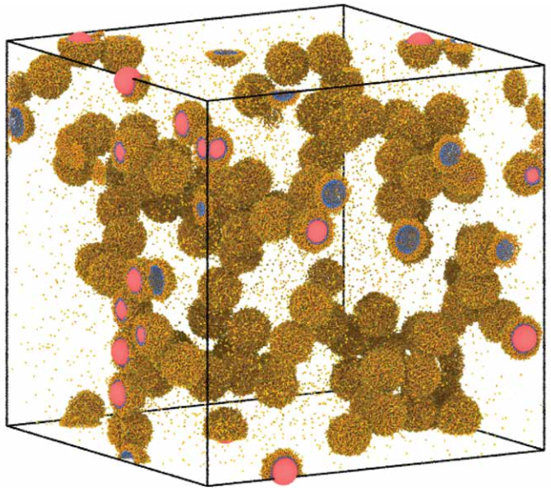
Colorimetric Quantification of Linking in Thermoreversible Nanocrystal Gel Assemblies
DMR 1720595
Edward T. Yu, University of Texas at Austin
Most colloidal assembly techniques are irreversible and rely on direct nanocrystal to nanocrystal bonding. By using molecular linkers that can form reversible bonds, gelation can be controlled based on thermodynamic principles.
This work demonstrates that a metal coordination linkage can be applied to realize the reversible gelation of colloidal nanocrystals using temperature as an external trigger. Additionally, the gelation temperature was controlled by the concentration of the counter anion.
The optical properties of nanocrystals changed substantially when they were assembled into gels, exibiting potentials as switchable optical materials.
Colorimetric linking chemistry enabled the quantification of linking in situ, providing microscopic insights for gelation.
Molecular dynamics simulations were used to understand temperature-dependent bonding motifs such as effective bonds, redundant bonds, and self-loops.
[Jiho Kang, Stephanie A. Valenzuela, Emily Y. Lin, Manuel N. Dominguez, Zachary M. Sherman, Thomas M. Truskett, Eric V. Anslyn, Delia J. Milliron. Colorimetric quantification of linking in thermoreversible nanocrystal gel assemblies. Science Advances 2022, 8, eabm7364.]
Notes:
This highlight demonstrates the gelation assembly of colloidal nanocrystals using uniquely developed ligands that can form a metal coordination linkage. Metal ions that are paired with ligand functional groups were used to control the assembly of nanocrystals from a stable dispersion to full spanning gel networks. The metal coordination linkage was reversed using temperature as an external trigger and enabled thermally switchable nanocrystal gel networks. Additionally, based on thermodynamic principles, the gelation temperature was tuned by changing the concentration of the counter anion. in situ small angle x-ray scattering was used to monitor the themoreversible gel assembly. Over repeated cycles, the optical properties of nanocrystals changed substantially when they were assembled into gels and returned to their original state when the assembly was reversed. The distinct optical signature from the metal coordination linkage allowed to quantify bonding spectroscopically and establish structural and thermodynamic bases for assembly. Molecular dynamics simulations were used to understand temperature-dependent bonding motifs and phase behavior of nanocrystals, providing microscopic insights of our programmable nanocrystal networks.
Publication citation for this work:
Kang J.; Valenzuela, S. A.; Lin, E. Y.; Dominguez, M. N.; Sherman, Z. M.; Truskett, T. M.; Anslyn, E. V.; Milliron. D. J. Colorimetric quantification of linking in thermoreversible nanocrystal gel assemblies. Science Advances 2022, 8, eabm7364.

