Slide 1
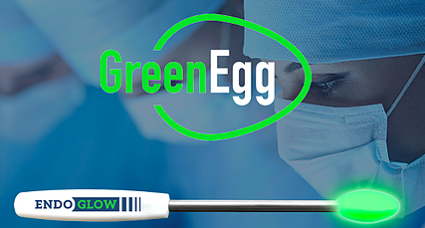
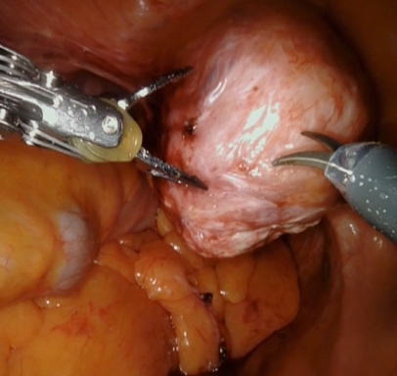
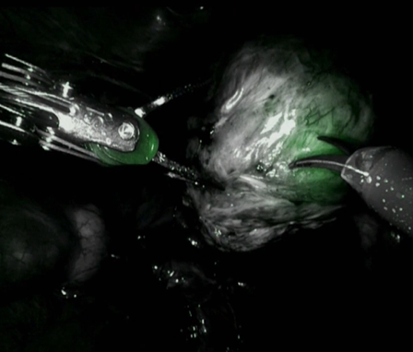
Materials Research Science and
Engineering Centers
Frank W. Wise, Cornell University
DMR 1719875
To visualize subsurface tissue, surgeons often inject dye molecules into the blood of the patient. When illuminated with near-infrared light that can pass through tissue, the molecules fluoresce to provide some visible indication of the deeper tissue. Existing dye molecules are toxic, so an alternative is desired.
EndoGlow (Rochester NY), is a small business that produces a medical device to enhance visibility during minimally-invasive surgical procedures. The GreenEggTM
is a light source that can be used to illuminate subsurface tissue. It is based on dye molecules embedded in polymers. Endoglow faced challenges in the development of their manufacturing process, so they approached the experts at CCMR for assistance. Dr. Genggeng Qi, a Cornell polymer scientist, collaborated with Endoglow to develop a process to protect the dye during high-heat injection-molding manufacturing operations that would also maintain brightness while the product is in use. The process is now in Endoglow manufacturing of medical products for gynecological and urological surgeries.
Comparison of surgical views using visible light vs. lighting under near infrared (NIR) light with the Tissue Reveal Technology, illuminating subsurface tissue (green).
Optimizing Tissue Reveal TechnologyTM for Surgeries

