Slide 1
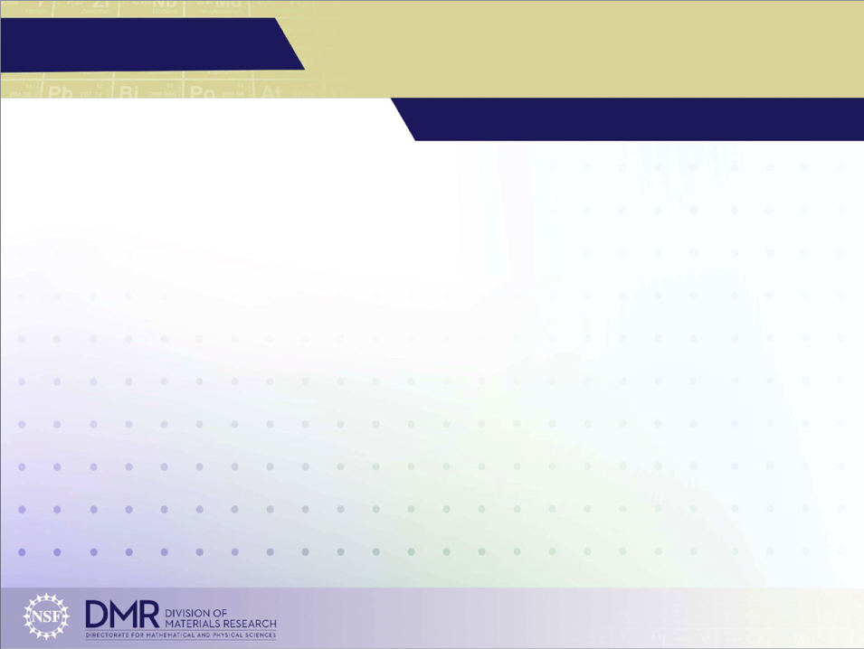
MEM-C IRG-2: Defect-Induced Magnetic Skyrmion in Two-Dimensional
Chromium Tri-Iodide Monolayer
DMR 1719797
Daniel R. Gamelin, University of Washington
Chromium iodide monolayers, which have different magnetic properties in comparison to the bulk chromium iodide, have been shown to form skyrmionic states in applied electromagnetic fields or in Janus-layer devices. We demonstrate that spin-canted solutions can be induced into monolayer chromium iodide by select substitution of iodide atoms with isovalent impurities.
Several concentrations and spatial configurations of halide substitutional defects are selected to probe the coupling between the local defect-induced geometric distortions and orientation of chromium magnetic moments. This work provides atomic-level insight into how atomically precise chemical doping can be used to create and control complex magnetic patterns in chromium iodide layers and lays out the foundation for investigating the field- and geometric-dependent magnetic properties in similar two-dimensional materials.
Figure 1. The canted spin states for each of the Cl doped systems. The four configurations considered have (a) six iodine atoms replaced around a chromium center, (b) three Cl replacing the iodine above the chromium atomic plane, (c) three Cl replacing two iodine above and one iodine below the chromium atomic plane, and (d) one Cl replacing a single iodine atom. Magnetic vectors are shown by black vectors on each Cr atom. The difference between the canted spins and the collinear spins perpendicular to the crystal plane are shown by the cones (where green cones are spins above the layer and red cones are spins beneath the layer).
Beck, R. B.; Lu, L.; Sushko, P. V.; Xu, X.; Li, X. JACS Au, 2021, 1, 1362-1367.
Notes:
We show that upon substituting select I atoms in a CrI3 monolayer with Cl atoms, localized spin-bubble states form. These spin states arise from the lattice distortions induced by the ionic radii mismatch between the host and the defect species. While distortions are driven by the difference in the X-Cr bond lengths, the interactions between these distortions can induced long-range directional lattice polarization that may enable coupling between spatially-separated spin-bubble states. It was noted that, when these spin-bubble systems formed they were topologically protected. They were significantly more stable than either the cost of a spin-flip or the stabilization noted by electric-field induced skyrmions. This work provided an important step toward manifesting skyrmions at conditions that would be useful for spintronic applications by potentially reducing the field required and increasing the operating temperature through controlled doping of CrI$_3$ monolayers.

