Slide 1

Exploiting emergent scale invariance
2022 Intellectual Merit
DMR 1719490
James P. Sethna, Cornell University
Beer foam coarsens with time – the older bubbles at the top have stolen gas to grow large. Foams, igneous rocks, pyrex… all settle into a stable morphology as they coarsen: on the right the top 2D bubble pattern looks the same as the older bubbles below, except they are smaller. Simple arguments show in this case that the length scale (rulers at lower left) grows with the square root of time, but all other details (what fraction of the bubbles have eight sides, the size distribution of the bubbles…) are universal and yet not predicted by theory.
With Durian at Penn, we have discovered new rules that govern bubble growth and the resulting patterns. The distribution of bubble sizes can be described by their moments – the average <A^{p}> of the p^{th} power of the areas. The average number of sides of a bubble <n> is six, by Euler’s theorem, but the weighted probability <<n>>_{p} = <n A^{p}> measures the degree to which smaller bubbles have fewer sides. Using a bubble growth law derived by von Neumann in 1952, we derived an infinite series of relations for the evolution and stationary values of <A^{p}> in terms of the area-weighted side moments <<n>>_{p}. This could be the first step, at least for 2D foams, toward a complete theoretical prediction of the universal patterns exhibited by systems that coarsen in time.
Notes:
Average Evolution and Size-Topology Relations for Coarsening 2d Dry Foams
Anthony T. Chieco, James P. Sethna, Douglas J. Durian
Accepted for publication.
My grant renewal proposes outreach on the ‘physics of food’, and mentions three exercises on the physics of beer developed in 2021. I reached out to Durian for feedback, and in the process we discovered these new relations. He and his student Chieco followed through, deriving the relations and testing them experimentally.

Slide 2
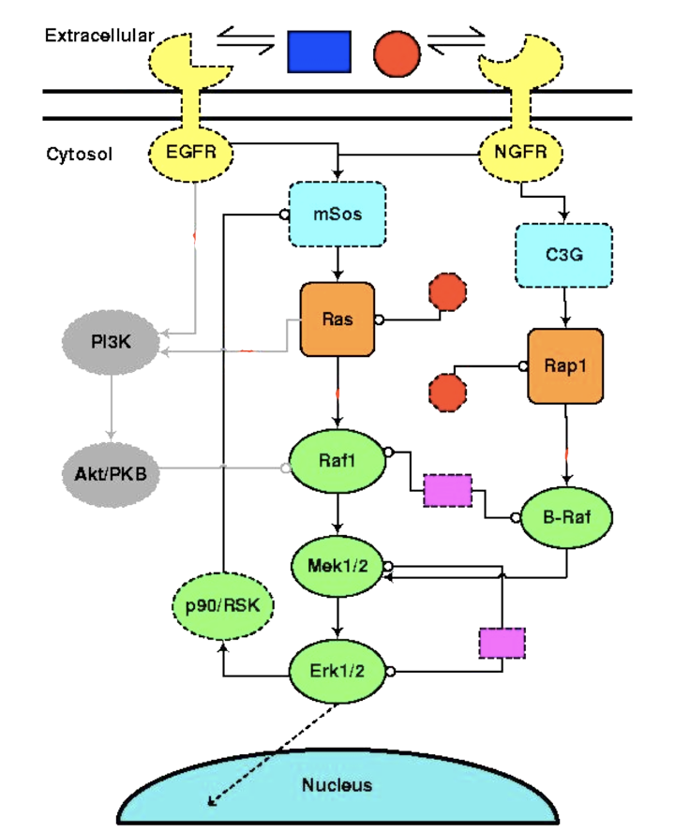
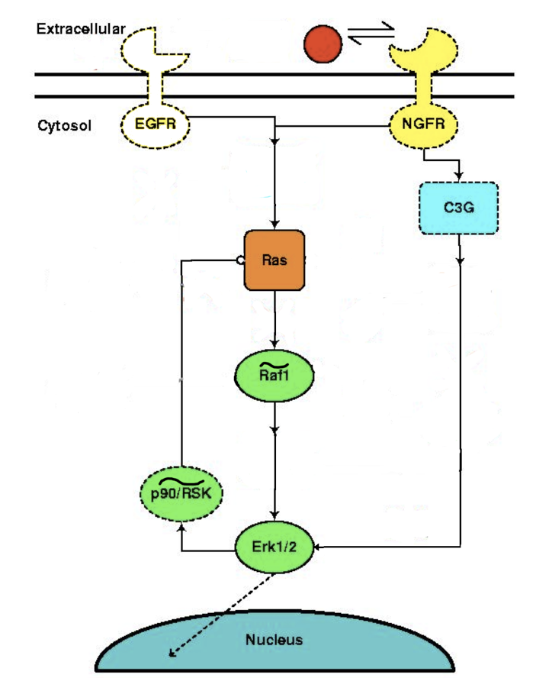
Using our sloppy model theories to improve drug safety
2022 Broader Impacts
DMR 1719490
James P. Sethna, Cornell University
Our information geometry work on ‘sloppiness’ in multiparameter models was inspired by a systems biology model (right-hand panel). Our work has had broad applications in biology, engineering, industry, and now public policy.
Jane Bai (regulatory review scientist at the FDA) approached me in fall 2021 about whether our work could be applied to quantitative systems pharmacology – allowing the FDA (and the drug manufacturers) to distill how the drugs work from the bewildering signal transduction networks submitted in the drug approval process. This was an ideal application of MBAM, invented by former group member Transtrum. At left is Transtrum’s use of information geometry to systematically and automatically simplify our original model into a comprehensible form with equivalent fits to the available data. He presented to FDA and industry representatives a similar model reduction for a blood coagulation model of interest to the FDA.
Negative feedback
Upregulation
Notes:
The blood coagulation model is discussed in
A quantitative systems pharmacology model of blood coagulation network describes in vivo biomarker changes in non-bleeding subjects.
Lee D, Nayak S, Martin SW, Heatherington AC, Vicini P, Hua F
Journal of thrombosis and haemostasis : JTH , 12/ 2016 , Volume 14 , Issue 12 , pages: 2430-2445 , PubMed ID: 27666750
MBAM (the Model Boundary Approximation Method) was introduced in
M. K. Transtrum and P. Qiu, “Model reduction by manifold boundaries,” Phys. Rev. Lett., vol. 113, Aug 2014.
They follow geodesics to the boundaries of the model manifold, where they then derive a simpler model with one fewer parameter. The new model equations and rate constants can be written explicitly in terms of the old model, making the new model not a ‘black box’, but capable of making predictions from new experiments varying parameters that have been combined into ‘renormalized’ combinations.
MBAM is also discussed in
https://physics.byu.edu/faculty/transtrum/mbam

