Slide 1
Predicting wrinkle patterns in thin materials
2022 Intellectual Merit
DMR 1654102
Joseph D. Paulsen, Syracuse University
We are all familiar with the wrinkled texture of a raisin or a candy wrapper. Studying the arrangement of wrinkles in polymer films can lend insight into these and other materials that wrinkle, from textiles to biological tissues to synthetic skins.
We studied the formation of complex wrinkle patterns when a curved sheet is pressed flat. Working closely with mathematician Tobasco and theoretical physicists Katifori & Todorova, we showed that all the patterns can be predicted using just two simple rules.
These rules could be used to design detailed wrinkle patterns for smart surfaces.
Tobasco, Timounay, Todorova, Leggat*, Paulsen, & Katifori, Nature Physics 18, 1099 (2022).
*undergraduate researcher
We discovered two simple rules for predicting the wrinkle patterns in curved sheets that are pressed flat. Rule 1 (for saddle-shaped sheets, left column): Wrinkles follow paths of quickest exit to the nearest boundary point. Rule 2 (for sphere-shaped sheets, right column): For special points in the sheet that have two or more closest exit points (blue lines) wrinkles connect these exit points (green lines).
Notes:
The figure is adapted from an image in the Nature Physics article from this year. It shows ultrathin (~100 nm) polymer films that are ~1 cm in width, which we form on curved substrates and then transfer to a flat bath of water. When the curved metric of the sheet is forced to live near the planar metric of the water bath, complex wrinkle patterns emerge. We now understand how the layout (the partitioning of the pattern into domains and directions of wrinkles within the domains) is selected.

Slide 2
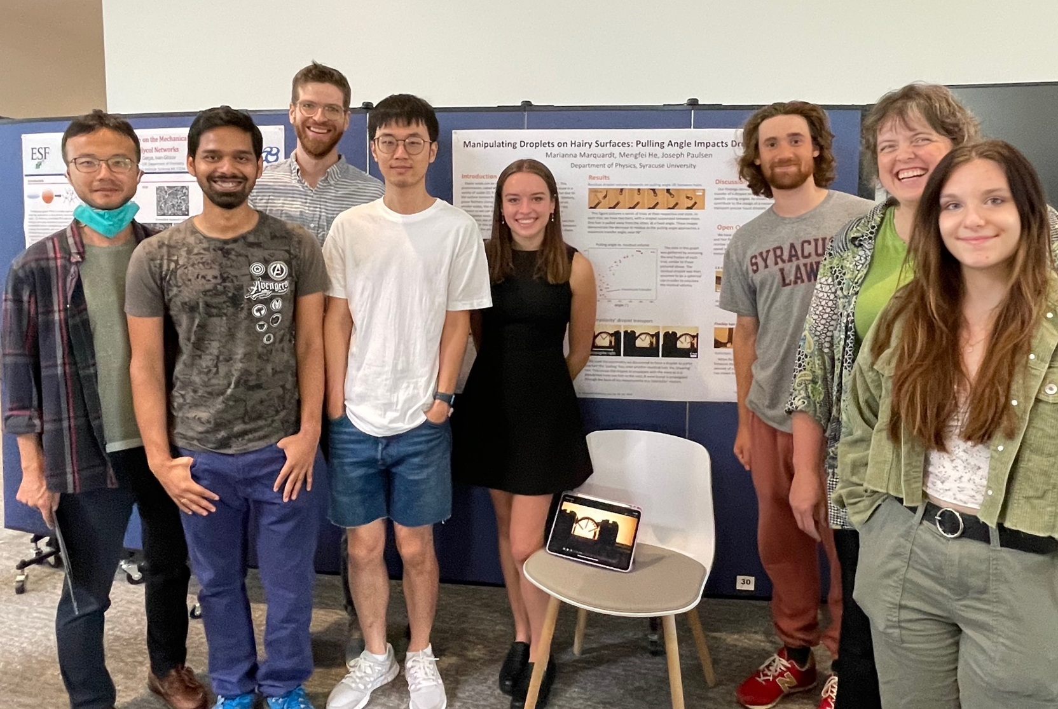
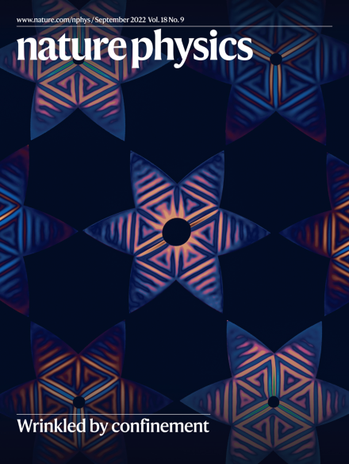
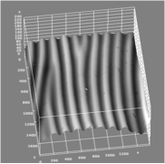
Predicting wrinkle patterns in thin materials
2022 Broader Impacts
DMR 1654102
Joseph D. Paulsen, Syracuse University
High school physics teacher Anne Huntress spent six weeks in the Paulsen Lab creating and characterizing topological defects in wrinkle patterns (lower right). She is sharing her experiences with her public high school students in central New York.
Two undergraduates and a high school student conducted summer internships, researching the interplay of geometry and mechanics in thin materials.
Our work on confinement-induced wrinkling was conveyed to a broad audience by articles in Quanta Magazine, New Scientist, and Physics Today.
Left: Paulsen Group in Summer 2022 at a summer REU poster presentation. Upper right: Journal cover for a paper we published this year. Lower right: Results by high-school teacher Anne Huntress from Summer 2022, showing the topography of a wrinkle pattern containing topological defects (“dislocations”).
Notes:
Our work on confinement-induced wrinkling was featured on the cover of Nature Physics (Cover Design: Amie Fernandez).

