Slide 1
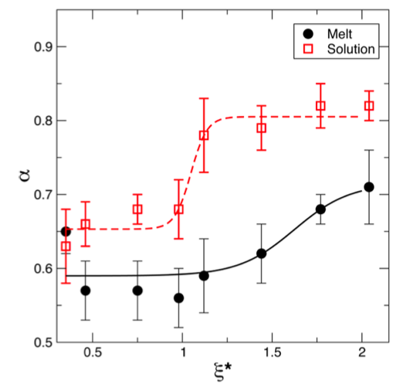
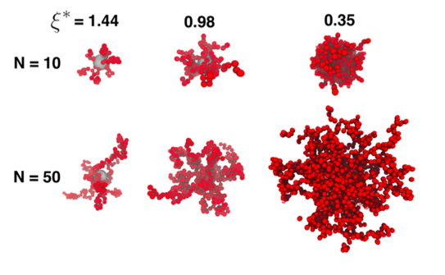
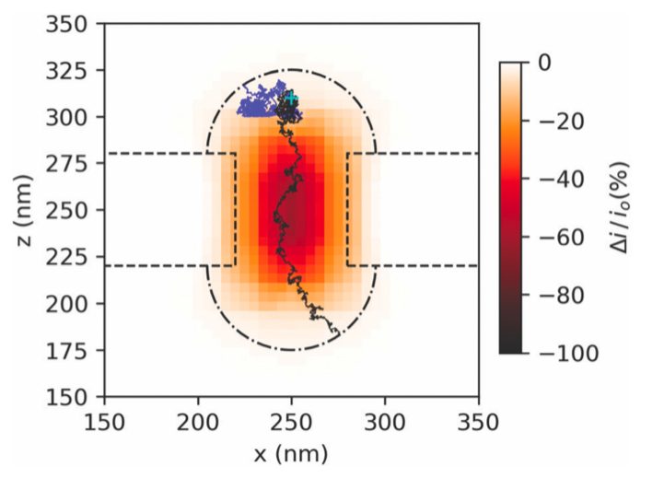
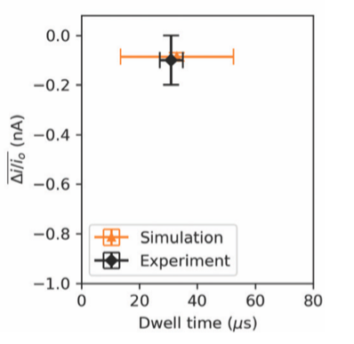
Polymer-Grafted Nanoparticles: Relaxation Times & Translocation
2022 Intellectual Merit
DMR 1651002
Michael-Jon A. Hore, Case Western Reserve University
The area of polymer dynamics focuses on the time-dependent behavior of polymer chains and is relevant to the transport and mechanical properties of polymeric materials. We previously measured with neutron spin echo spectroscopy that portions of grafted polymers close to the nanoparticle surface relax about 2–3 times longer than portions that are farther away. We sought to explain this behavior using computer simulations since it affects nanoparticle diffusion/translocation and energy dissipation. Our key findings include:
A single polymer brush exhibits both solution-like (Zimm) relaxations as well as melt-like (Rouse) relaxations depending on how confined the chains are.
The longest relaxation times of grafted polymers scale inversely with the confinement strength – explaining the factor of 2–3 difference between the inner and outer regions of the brush.
Dynamic Monte Carlo, when combined with Machine Learning techniques, is appropriate for accurately and quantitatively describing the translocation behavior of nanoparticles through confining nanochannels.
More Confinement
A
B
Behaves as Solution
Behaves as Melt
Longer Polymers
(A) Simulation snapshots showing the appearance of polymer-grafted nanoparticles as a function of chain length and confinement strength. (B) Summary of polymer dynamics showing a transition between solution- and melt-like behavior as confinement strength increases. (C) Nanoparticle translocation trajectories from Dynamic Monte Carlo simulations. (D) Comparison between blockade signals from experiments, and DMC showing excellent agreement.

Slide 2
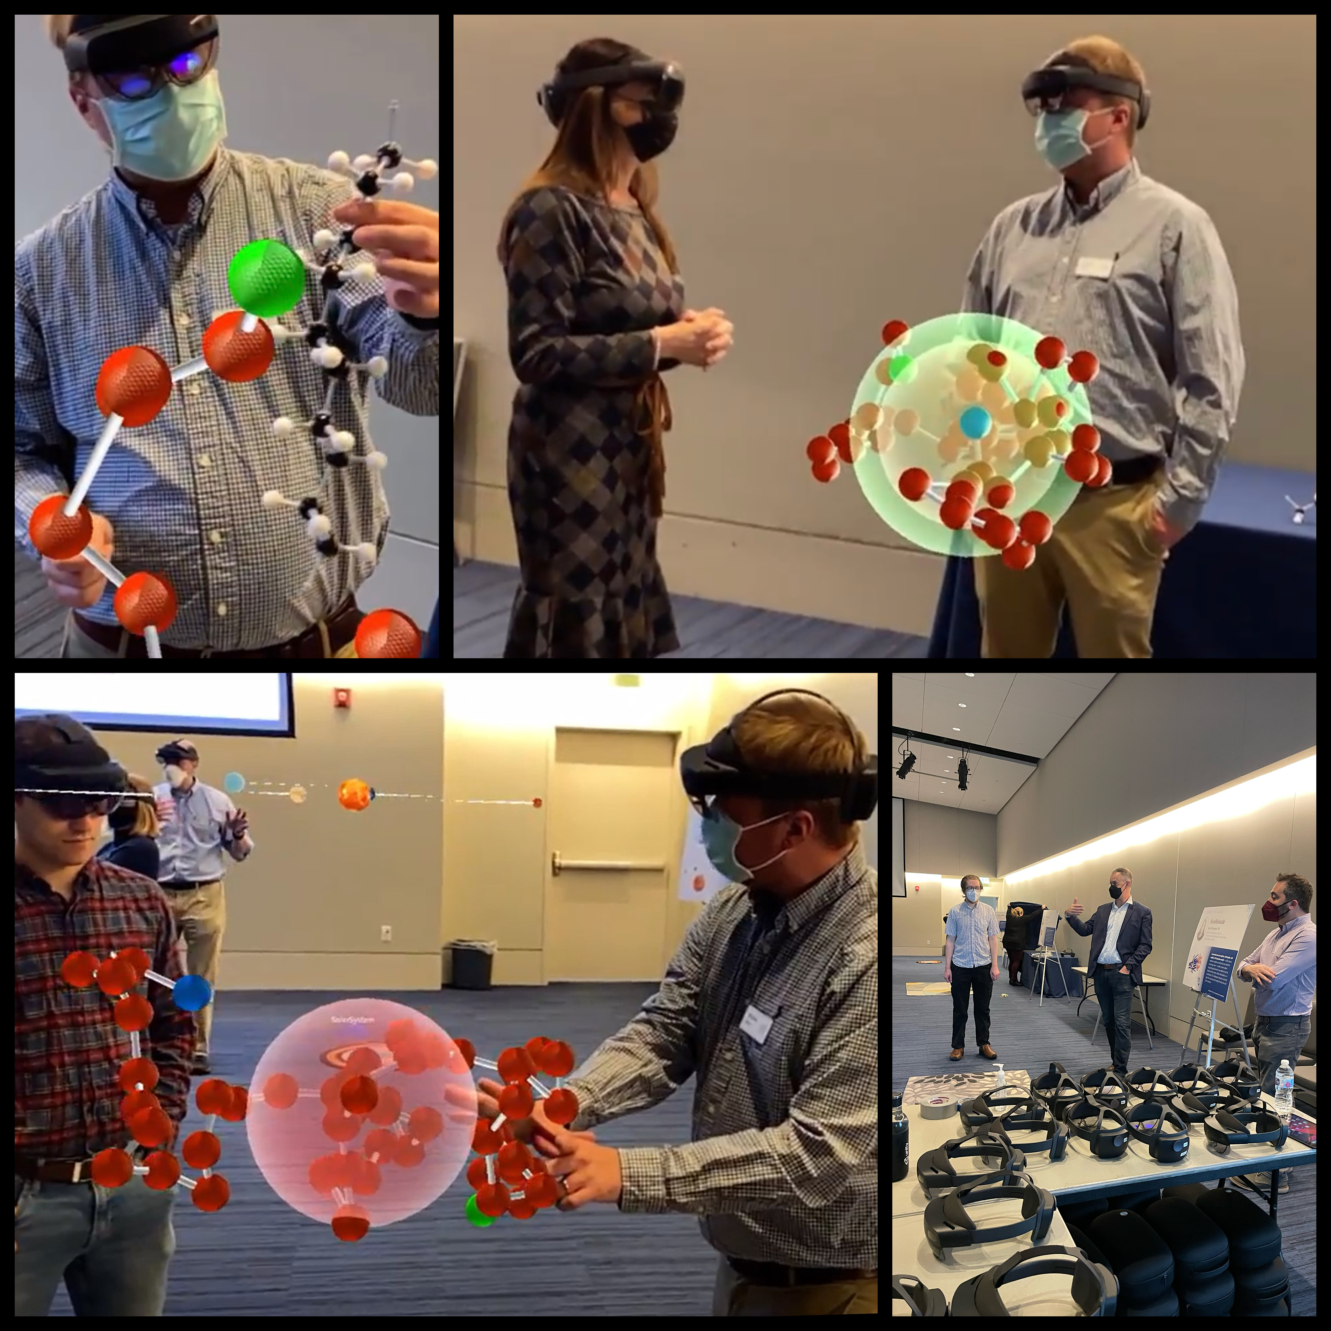
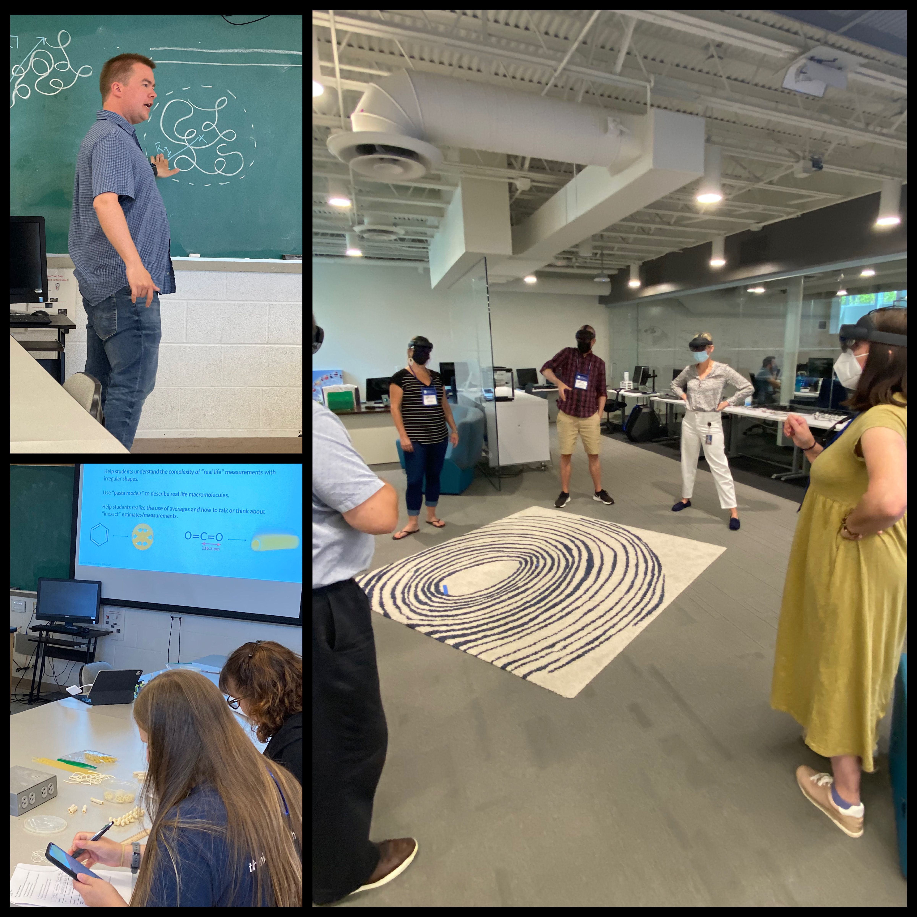
HoloPolymer: Polymer Physics in Mixed Reality
2022 Broader Impacts
DMR 1651002
The Microsoft HoloLens is a Mixed Reality headset that superimposes holographic images on a user’s view of a physical space. The visualizations can be shared between headsets so that people in the same space can view and interact with the same holograms. This award has supported the PI’s development of a Mixed Reality application (HoloPolymer) that simulates a polymer chain using Langevin dynamics. The application was completed during the 2021-2022 academic year. Major highlights include:
The PI demonstrated the HoloPolymer application to over 300 attendees of the Mixed Reality ShowCASE at CWRU, where visitors were able to see and interact with a freely-jointed polymer chain. Attendees included undergraduate students, faculty, and members of the local community.
Local K-12 science teachers attended a day geared towards assisting them in incorporating concepts from science and engineering into their classroom. As part of this workshop, they visited the Interactive Commons at CWRU and observed the behavior of polymers in Mixed Reality with HoloPolymer and learned about polymer shapes and sizes.
Michael-Jon A. Hore, Case Western Reserve University
Above: (Left) The PI participates in CWRU’s first annual Mixed Reality ShowCASE. Photos are taken from the Microsoft HoloLens headset and show the PI talking with attendees about polymer conformation with the interactive, Mixed Reality representation shown in the foreground. (Right) The PI participates in the Introduction to Innovation program at CWRU, teaching local K-12 science teachers key concepts relating to polymer conformation.

