Slide 1
Funding : Gregory S. Boebinger, DMR 1644779; L.J. Mueller (NSF CHE-1710671; NIH GM097569); J.R. Long (NSF CHE-1229170; NIH GM122698)
Imaging enzyme active site chemistry using multiple fields up to 35.2T: NMR crystallography of tryptophan synthase
Jacob B. Holmes,¹ Viktoriia Liu,¹ Bethany G. Caulkins,¹ Eduardo Hilario,¹ Rittik K. Ghosh,¹ Joana Paulino,² Xiaoling Wang,² Gwladys Riviere,³ Frederic Mentink-Vigier,² Joanna R. Long,³ Michael F. Dunn,¹ Leonard J. Mueller ¹
1. University of California – Riverside; 2. National MagLab; 3. University of Florida
The determination of active site protonation states is critical for a full mechanistic understanding of enzymatic transformations; however, hydrogen atom positions are challenging to extract using the standard tools of structural biology.
Here we make use of an integrated approach using high-magnetic-field solid-state NMR, X-ray crystallography, and first-principles computation that enables the investigation of enzyme catalysis at a fine level of chemical detail. The X-ray crystal structure provides a coarse framework upon which models of the active site are built using first-principles computational chemistry and various active site chemistries are explored. These competing computed models are differentiated based on their agreement with experimental chemical shift restraints measured at multiple magnetic fields of 9.4T, 14.1T, 21.1T, and 35.2T – the latter being uniquely available at the MagLab.
A detailed three-dimensional picture of structure and reactivity emerges, highlighting the fate of the substrate L-serine hydroxyl leaving group and the reaction pathway back to the preceding transition state. Subsequent characterization of the complex with the inhibitor benzimidazole shows it bound in the active site and poised for, but unable to initiate, the subsequent bond formation step. The chemically-rich structure from this NMR-assisted crystallography is key to understanding why this inhibitor does not react, while the natural substrate indole does.
Top: The protein tryptophan synthase showing the active site (red) with hydrogen atoms.
Left: The chemically-detailed view of the tryptophan synthase active site showing the position of hydrogen atoms (colored white), including anisotropic displacement parameters .
Facilities and instrumentation used: NMR Facility: 14.1T/600MHz (DNP) and 21.1T/900MHz; DC Facility: 36T Series Connected Hybrid
Citation: Holmes, J.; Liu, V.; Caulkins, B.; Hilario, E.; Ghosh, R.; Drago, V.; Young, R.; Romero, J.A.; Gill, A.; Bogie, P.; Paulino, J.; Wang, X.; Riviere, G.; Bosken, Y.; Struppe, J.; Hassan, A.; Guidoulianov, J.; Perrone, B.; Mentink-Vigier, F.; Chang, C.; Long, J.R.; Hooley, R.; Mueser, T.; Dunn, M.; Mueller, L., Imaging active site chemistry and protonation states: NMR crystallography of the tryptophan synthase α-aminoacrylate intermediate, Proceedings of the National Academy of Sciences of the USA (PNAS), 119 (2), e2109235119 (2022) doi.org/10.1073/pnas.2109235119

Slide 2
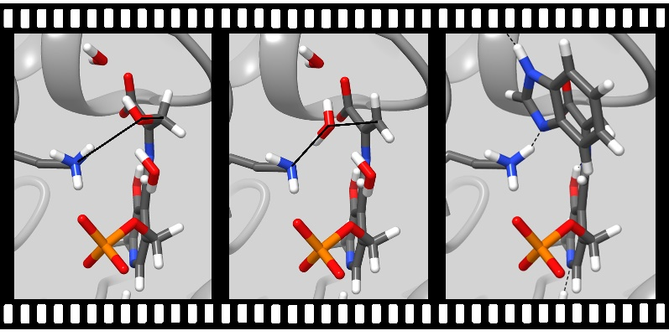
Imaging enzyme active site chemistry using multiple fields up to 35.2T: NMR crystallography of tryptophan synthase
Jacob B. Holmes,¹ Viktoriia Liu,¹ Bethany G. Caulkins,¹ Eduardo Hilario,¹ Rittik K. Ghosh,¹ Joana Paulino,² Xiaoling Wang,² Gwladys Riviere,³ Frederic Mentink-Vigier,² Joanna R. Long,³ Michael F. Dunn,¹ Leonard J. Mueller ¹
1. University of California – Riverside; 2. National MagLab; 3. University of Florida
Funding : Gregory S. Boebinger, DMR 1644779; L.J. Mueller (NSF CHE-1710671; NIH GM097569); J.R. Long (NSF CHE-1229170; NIH GM122698)
What is the finding? A new integrated technique for mapping out atom placements in the active site of enzymes has been developed that reveals atomic-resolution images of the unfolding reaction.
Why is this important? Hydrogen comprises half of the atoms in a protein. One drawback to many structural probes is the inability to determine the positions of hydrogen atoms. Without seeing the hydrogens, creating a true picture of how molecules fit together - and their chemical interactions - is impossible. By bringing together the techniques of high-magnetic-field solid-state nuclear magnetic resonance, X-ray crystallography, and computational chemistry, the full atomic detail of the active chemical site of tryptophan synthase is revealed. This new chemical resolution helps unlock the potential for finding better matches for new therapeutics that target these sites.
Why did this research need the MagLab? The chemical resolution of the images depends upon the strength of the magnetic field and the sensitivity of the NMR probes used to acquire the signals. The MagLab’s leading NMR probe technology development and world-record 35.2T magnetic field strength of the series connected hybrid magnet provides the sharpest possible images of the chemically active site using NMR crystallography.
Top: The protein tryptophan synthase showing the active site with hydrogen atoms. Bottom: Reaction pathway in tryptophan synthase showing the position of hydrogen atoms (colored white).
Facilities and instrumentation used: NMR Facility: 14.1T/600MHz (DNP) and 21.1T/900MHz; DC Facility: 36T Series Connected Hybrid
Citation: Holmes, J.; Liu, V.; Caulkins, B.; Hilario, E.; Ghosh, R.; Drago, V.; Young, R.; Romero, J.A.; Gill, A.; Bogie, P.; Paulino, J.; Wang, X.; Riviere, G.; Bosken, Y.; Struppe, J.; Hassan, A.; Guidoulianov, J.; Perrone, B.; Mentink-Vigier, F.; Chang, C.; Long, J.R.; Hooley, R.; Mueser, T.; Dunn, M.; Mueller, L., Imaging active site chemistry and protonation states: NMR crystallography of the tryptophan synthase α-aminoacrylate intermediate, Proceedings of the National Academy of Sciences of the USA (PNAS), 119 (2), e2109235119 (2022) doi.org/10.1073/pnas.2109235119

