Slide 1



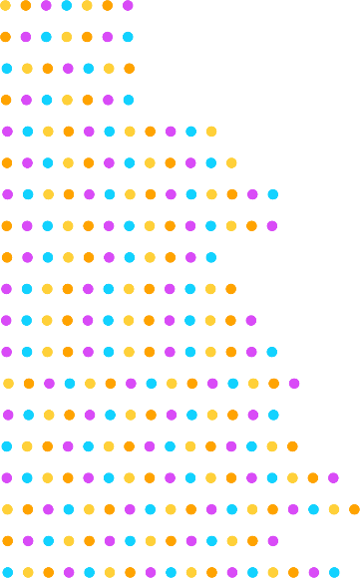

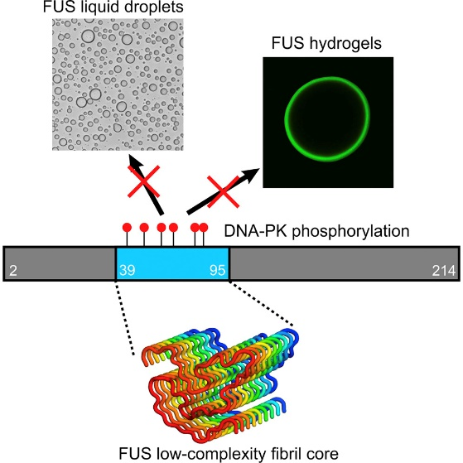
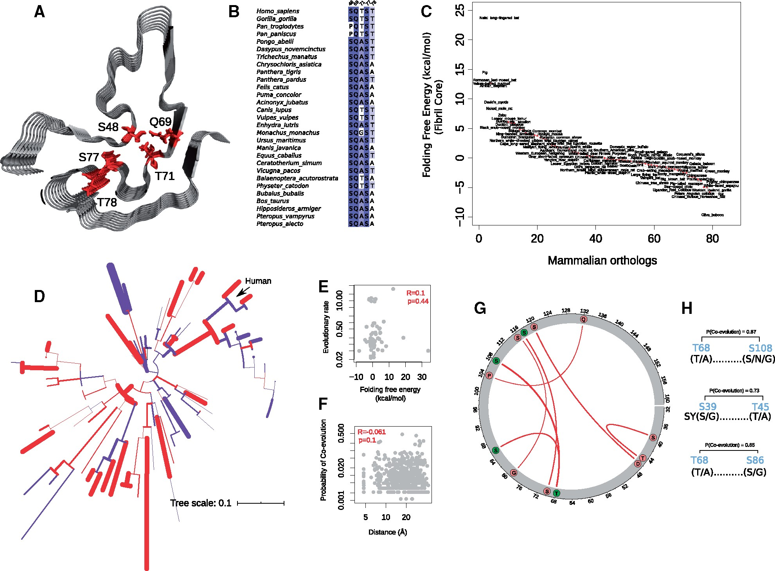
NMR users studying three-dimensional structures of large biological molecules, such as proteins and nucleic acids, frequently deposit data in the Protein Data Bank to ensure that it is Findable, Accessible, Interoperable, and Reusable.
Data users from Harvard and the University of Zurich accessed solid-state NMR data previously collected from the MagLab’s 900MHz ultrawide bore NMR magnet that describes the molecular structure of self-assembling fibrils formed by the RNA-binding protein, “FUS”. Mutations in FUS are associated with ALS disease pathology involving its ability reversibly form phase-separated liquid compartments at sites DNA damage. The NMR experiments revealed that formation of the liquid and hydrogel states of FUS is controlled by phosphorylation and stabilized by hydrogen bonding among a core region of 57 amino acids (Figure A).
The accessed data were used to examine the effects of naturally occurring amino acid substitutions that change the stability of the fibril core (Figure B) and predict differences in the Gibbs free energy of FUS folding among mammals (Figure C). This new work provides evidence that natural selection has stabilized the liquid forming potential of FUS and minimized the propensity of cytotoxic liquid-to-gel phase transitions during 160 million years of mammalian evolution.
Effects of Natural Selection on the Phase-Separation Properties of
an RNA-Binding Protein in Mammals
Pouria Dasmeh^{1,2,3}, Andreas Wagner^{1,3}
1. Institute for Evolutionary Biology and Environmental Studies, University of Zurich;
2. Dept. of Chemistry and Chemical Biology, Harvard University; 3. Swiss Institute of Bioinformatics
Funding: European Research Council #739874, Swiss NSF #31003A 172887. Original data collected under the MagLab’s NSF/DMR-1644779.
A
C
Phylogenetic
Tree
ΔG More stable
ΔG Less stable
B
PDB ID: 5W3N
Facilities and instrumentation used: NMR-MRI/S 900MHz 105 mm bore magnet
Data User Citation: Molecular Biology and Evolution, 2021, Vol 38 (3), 940–951, https://doi.org/10.1093/molbev/msaa258
Original Citation: Cell, 2017 171 (3), 615-627.e16, https://doi.org/10.1016/j.cell.2017.08.048
Dataset: Protein Data Bank ID 5W3N

Slide 2
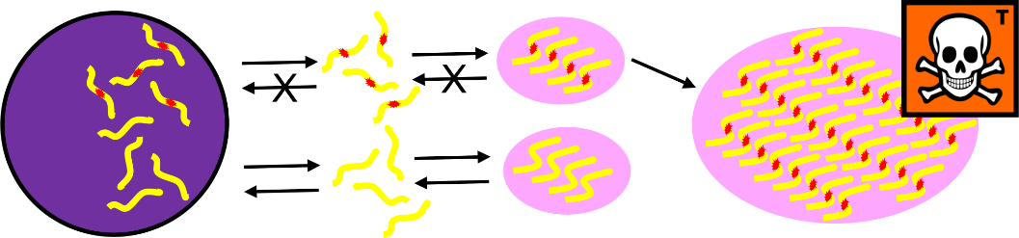
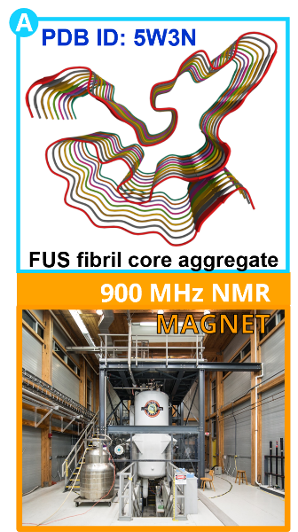
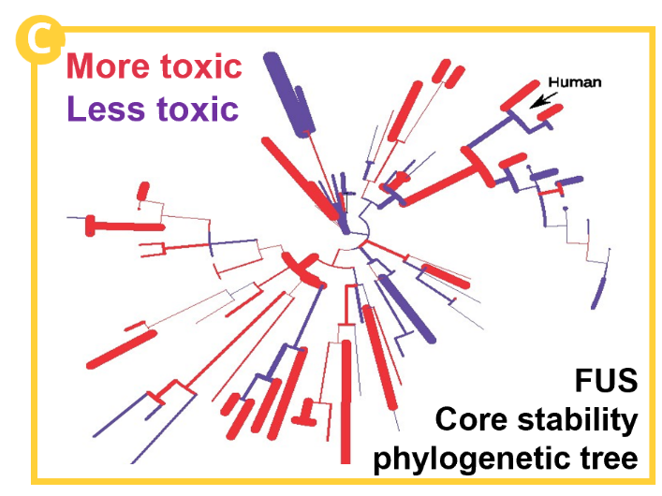
What is the development? Data users from Harvard and the University of Zurich accessed FAIR data from the Protein Data Bank generated by the MagLab’s NMR Facility, data that describes the molecular structure of the RNA-binding protein, “FUS” (Figure A). The data were used to examine the effects of naturally occurring mutations that change the structure of its fibril core among mammals dating back 160 million years.
Why is this important? These proteins form liquid compartments, or “granules”, where they perform a variety of vital functions. NMR experiments revealed that formation of these granules is controlled by the way the FUS fibril core domain is folded. Normally, the granules are short-lived, but mutations in FUS cause the core domain to permanently adopt the granule-favored structure. Over time, they accumulate and form toxic aggregates (Figure B) — a hallmark of ALS. Evolutionary biologists accessed the NMR data to explore ways that evolution and natural selection have influenced the structure of FUS and its aggregate forming potential (Figure C). This helps to identify and understand evolutionary patterns of disease-causing proteins and suggests new strategies for deepening our understanding of important biological systems so that we can improve our quality of life.
Why did they need the MagLab? The original data taken on the MagLab’s world-unique 900MHz ultrawide bore magnet served as a scaffold upon which evolutionary biologists could model and study the RNA-binding protein “FUS” from other species, living and extinct.
Effects of Natural Selection on the Phase-Separation Properties of
an RNA-Binding Protein in Mammals
Pouria Dasmeh^{1,2,3}, Andreas Wagner^{1,3}
1. Institute for Evolutionary Biology and Environmental Studies, University of Zurich;
2. Dept. of Chemistry and Chemical Biology, Harvard University; 3. Swiss Institute of Bioinformatics
Funding: European Research Council #739874, Swiss NSF #31003A 172887. Original data collected under the MagLab’s NSF/DMR-1644779.
B
Come back home when you’ve finished your work!
No! We like it here in the granule!
mutant FUS
nucleus
diffuse
granules
toxic aggregate
A
normal FUS
Okay we will!
C
Facilities and instrumentation used: 900MHz 105 mm bore magnet
In the MagLab’s NMR-MRI/S Facility
Data User Citation: Molecular Biology and Evolution, 2021, Vol 38 (3), 940–951, https://doi.org/10.1093/molbev/msaa258
Original Citation: Cell, 2017 171 (3), 615-627.e16, https://doi.org/10.1016/j.cell.2017.08.048
Dataset: Protein Data Bank ID 5W3N

