Slide 1
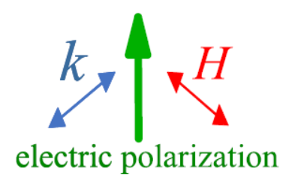
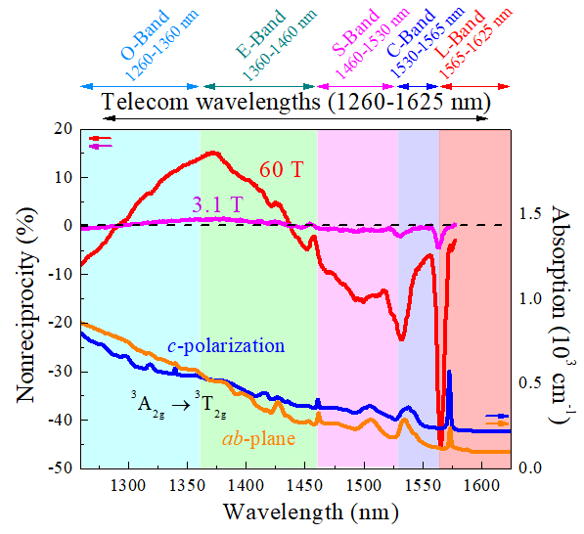
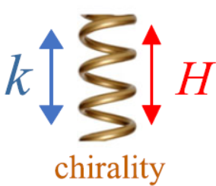
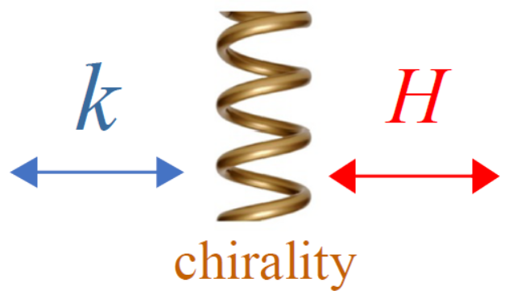
Facilities and instrumentation used: 65 T pulsed magnets at the Pulsed Field Facility
Citation: K. Park, M. Yokosuk, M.M. Goryca, J. Yang, S. Crooker, S.-W. Cheong, K. Haule, D. Vanderbilt, H.-S. Kim, J.L. Musfeldt, Nonreciprocal directional dichroism at telecom wavelengths, Nature Quantum Materials (npj), 7 (1), 38 (2022)
doi.org/10.1038/s41535-022-00438-6
One-way optical transparency at telecommunications wavelengths
K. Park¹, M. O. Yokosuk¹, M. Goryca², J. J. Yang³, S. A. Crooker²,
S.-W. Cheong⁴, K. Haule⁴, D. Vanderbilt⁴, H.-S. Kim⁵, and J. L. Musfeldt¹
University of Tennessee; 2. NHMFL, Los Alamos National Laboratory; 3. New Jersey Institute of Technology; 4. Rutgers University; 5. Kangwon National University;
Funding Grants: J. L. Musfeldt (DMR-1629079 ); S.-W Cheong, K. Haule, D. Vanderbilt (DMR-1629059);
Gregory S. Boebinger, DMR 1644779; H.-S Kim (NRF-2020R1C1C1005900 & KSC-2020CRE-0156).
Ultra-low symmetry combined with strong spin-orbit coupling gives rise to many unique properties in materials, including nonreciprocal directional dichroism, often called “one-way transparency” or an “optical diode effect”. Here, a material is highly transmitting for light in the +k direction but nearly opaque for light in the -k direction.
Because of the need to break time-reversal symmetry, switching the direction of an external magnetic field can also induce one-way transparency. Ni₃TeO₆ is a perfect platform for exploring these effects because this magnet is both chiral and polar, thus supporting nonreciprocity in a number of different measurement geometries, shown in Figs. (a-c).
In this work, MagLab users investigated nonreciprocal directional dichroism in Ni₃TeO₆ using optical spectroscopy, high-magnetic-field techniques, and first-principles electronic structure methods. In addition to uncovering the Ni toroidal moment (T = P x M) and broad band optical effects, these measurements revealed that nonreciprocity persists across the entire range of telecommunications wavelengths (see Fig.d). As such, in addition to considering applications in high-efficiency optical diodes and rectifiers and high-fidelity holograms, these findings open the door to photonics applications – particularly in the area of secure fiber optic telecommunications.
(a)
(d)
(b)
(c)
Figure: Three different measurement configurations for which one can realize nonreciprocity in Ni₃TeO₆: (a) toroidal; (b) magnetochiral; and (c) transverse magnetochiral. (d) Nonreciprocity at 60 teslas in the toroidal configuration (red line) spans the entire range of telecommunications wavelengths, reaching levels of nearly 50% at some wavelengths. The signal at 1550nm is important for photonics applications and is tunable depending upon the measurement geometry.
Notes:
How to compress files size:
On PowerPoint, you can save the attached image (Right click on an image -> Select “Save as picture” -> Then you save the image as PNG). PNG is the image compression without losing the image quality. You replace the original image with the PNG one on PowerPoint. This should reduce the PowerPoint file size.
One thing to be careful about is that you should enlarge your image a bit on PowerPoint before saving so is to avoid losing much resolution.

Slide 2
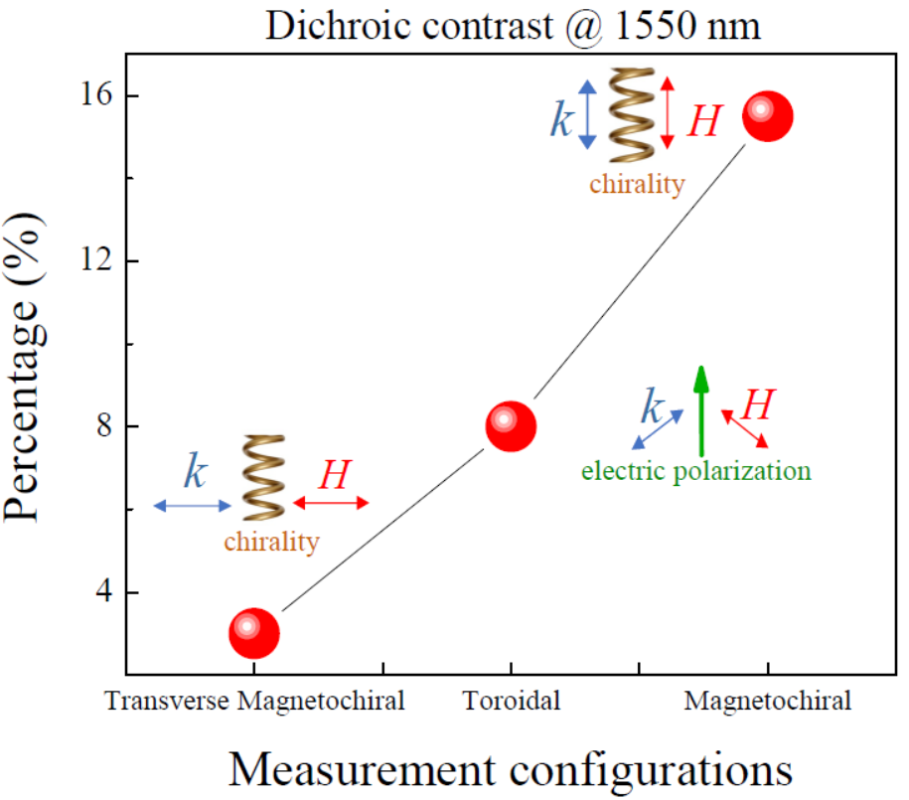
One-way optical transparency at telecommunications wavelengths
K. Park¹, M. O. Yokosuk¹, M. Goryca², J. J. Yang³, S. A. Crooker², S.-W. Cheong⁴, K. Haule⁴, D. Vanderbilt⁴, H.-S. Kim⁵, and J. L. Musfeldt¹
University of Tennessee; 2. NHMFL, Los Alamos National Laboratory; 3. New Jersey Institute of Technology; 4. Rutgers University; 5. Kangwon National University;
Funding Grants: J. L. Musfeldt (DMR-1629079 ); S.-W Cheong, K. Haule, D. Vanderbilt (DMR-1629059);
Gregory S. Boebinger, DMR 1644779;; H.-S Kim (NRF-2020R1C1C1005900 & KSC-2020CRE-0156).
What is the finding? Magneto-optical spectroscopy in 60 tesla pulsed magnetic fields revealed differences between forward and backward light transmission in the chiral, polar magnet Ni₃TeO₆. Depending upon the geometry of the measurement (see Figure), researchers can dramatically vary the dichroic contrast at 1550nm – a very important wavelength for fiber optic telecommunications.
Why is this important? Symmetry plays a crucial role in determining the properties of materials. Usually, light transmission is the same if you shine a light through a material forward or backwards. This is due to the preservation of the symmetry. When symmetry breaks, interesting “optical diode effects” can be observed. The one-way transparency in Ni₃TeO₆ is one of the consequences of broken symmetries. Ni₃TeO₆ is a magnet that hosts both chirality and polarity, making it a superb platform for unraveling optical diode effects in different geometries. This effect takes place in an extremely useful range of the electromagnetic spectrum, paving the way for photonic applications in fiber optic telecommunications.
Why did this research need the MagLab? An intense magnetic field is required to break time-reversal symmetry, which is key to observing the one-way transparency.
Figure: Nonreciprocity of Ni₃TeO₆ at 1550 nm in three different measurement configurations. The magnetochiral geometry provides the maximum signal at this wavelength, suggesting that future applications should focus on chirality.
Facilities and instrumentation used: 65 T pulsed magnets at the Pulsed Field Facility
Citation: K. Park, M. Yokosuk, M.M. Goryca, J. Yang, S. Crooker, S.-W. Cheong, K. Haule, D. Vanderbilt, H.-S. Kim, J.L. Musfeldt, Nonreciprocal directional dichroism at telecom wavelengths, Nature Quantum Materials (npj), 7 (1), 38 (2022)
doi.org/10.1038/s41535-022-00438-6

