Slide 1
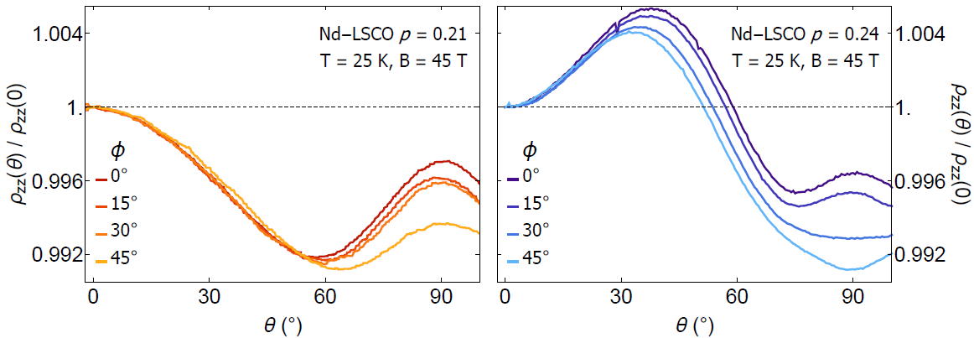
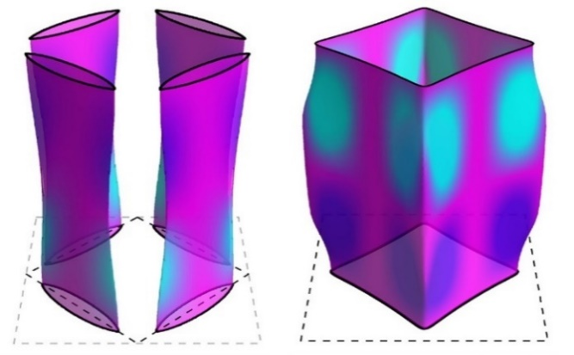
Fermi surface transforms at the onset of the pseudogap state in a cuprate superconductor
Fermi surface transforms at the onset of the pseudogap state
in a cuprate superconductor
Y. Fang¹, G. Grissonnanche^{1,2}, A. Legros^{2,3}, S. Verret², F. Laliberté²,
C. Collignon², A. Ataei², M. Dion², J. Zhou⁴, D. Graf⁵, M.J. Lawler¹, P.A. Goddard⁶, L. Taillefer^{2,7} & B.J. Ramshaw^{1,7}
1. Cornell University; 2. Université de Sherbrooke; 3. Université Paris-Saclay; 4. University of Texas at Austin;
5. National High Magnetic Field Laboratory; 6. University of Warwick; 7. Canadian Institute for Advanced Research
Funding Grants: Gregory S. Boebinger, DMR 1644779, Florida State Univ.; B.J. Ramshaw (NSF DMR-1752784); J.-S. Zhu (MRSEC DMR-1720595)
The nature of the pseudogap phase remains an unsolved problem in cuprate high-temperature superconductivity. The topology of the Fermi surface of the pseudogap state remains an open question of fundamental importance to determining whether this metallic phase might be defined by any of a number of reported broken symmetries.
MagLab users measured the angle-dependent magneto-resistance (ADMR) to calculate the Fermi surface of a superconducting cuprate crystal both inside and outside the pseudogap phase. Outside the pseudogap phase, the ADMR reveals a complete Fermi surface consisting of a single large pocket, as one expects in the absence of long-range order. Within the pseudogap phase, however, the ADMR data are qualitatively different, revealing a transformation of the Fermi surface in the pseudogap state. The ADMR data are most consistent with a pseudogap Fermi surface that consists of four small hole pockets, thereby accounting for the drop in carrier density across the pseudogap transition that has been found in several cuprates.
The Fermi surface transformation at the onset of the pseudogap phase suggests that antiferromagnetism plays a role in the physics of the pseudogap phase, an idea long expressed but never demonstrated. This may ultimately hold the secret to how electrons pair in cuprate superconductors.
Angle-Dependent Magneto-Resistance (ADMR) data at a temperature of T=25K and at a magnetic field of B=45T from the cuprate superconductor Nd-LSCO as a function of magnetic field angle θ. The data were taken (left) inside the pseudogap phase at carrier concentration p = 0.21, and (right) outside the pseudogap phase at p=0.24.
Fermi surfaces calculated from ADMR data (left) inside the pseudogap phase at p=0.21, showing four small pockets (resembling those that would be created by antiferromagnetism) and (right) outside the pseudogap phase at p=0.24, showing the single large pocket of a simple metal.
Facility used: 45T Hybrid magnet in the DC Field Facility.
Citation: Fang, Y.; Grissonnanche, G.; Legros, A.; Verret, S.; Laliberté, F.; Collignon, C.; Ataei, A.; Dion, M.; Zhou, J.; Graf, D.E.; Lawler, M.J.; Goddard, P.A.; Taillefer, L.; Ramshaw, B.J., Fermi surface transformation at the pseudogap critical point of a cuprate superconductor, Nature Physics, 5, 2022 (2022) doi.org/10.1038/s41567-022-01514-1

Slide 2
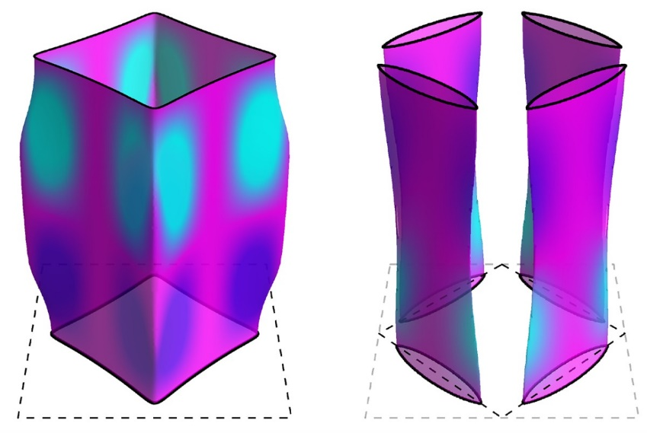
Fermi surface transforms at the onset of the pseudogap state
in a cuprate superconductor
Y. Fang¹, G. Grissonnanche^{1,2}, A. Legros^{2,3}, S. Verret², F. Laliberté²,
C. Collignon², A. Ataei², M. Dion², J. Zhou⁴, D. Graf⁵, M.J. Lawler¹, P.A. Goddard⁶, L. Taillefer^{2,7} & B.J. Ramshaw^{1,7}
1. Cornell University; 2. Université de Sherbrooke; 3. Université Paris-Saclay; 4. University of Texas at Austin;
5. National High Magnetic Field Laboratory; 6. University of Warwick; 7. Canadian Institute for Advanced Research
Funding Grants: Gregory S. Boebinger, DMR 1644779; B.J. Ramshaw (DMR 1752784); J.-S. Zhu (MRSEC DMR 1720595)
What is the finding? The ‘Fermi surface’ provides a map that shows where in energy/momentum space all the electrons are to be found in a metal. In high-temperature superconductors, MagLab users found that the Fermi surface transforms at a certain “critical point,” the carrier concentration that corresponds to the onset of the pseudogap state.
Why is this important? There have long been hints that magnetism and superconductivity are inter-twined in high-temperature superconductors. This experiment shows that this magnetism appears at the onset of the pseudogap state. The magnetism transforms the Fermi surface into four small pockets, dramatically reducing the number of charge carriers when the pseudogap state forms. This experiment provides direct evidence that the critical point associated with the onset of the pseudogap is also associated with the onset of magnetism, a clue that might help solve the mechanism of high temperature superconductivity in the cuprate superconductors.
Why did this research need the MagLab? The MagLab’s 45T hybrid magnet was essential to suppress superconductivity and to bend the electron trajectories sufficiently to reveal the structure of the Fermi surfaces in the samples studied. MagLab techniques enable magnetoresistance measurements with noise levels less than 0.1% of the signal measured as the sample is rotated around two different axes.
(Left): The Fermi surface of a simple metal, consisting of a single pocket of carriers, measured in a copper-oxide high-temperature superconductor that is not in the pseudogap state. (Right): At lower carrier concentrations, the pseudogap state forms in the material. The data find that the Fermi surface breaks up into four small pockets in the pseudogap state. This discovery connects the onset of magnetism to the disappearance of charge carriers observed in the pseudogap state.
Facility used: 45T Hybrid magnet in the DC Field Facility.
Citation: Fang, Y.; Grissonnanche, G.; Legros, A.; Verret, S.; Laliberté, F.; Collignon, C.; Ataei, A.; Dion, M.; Zhou, J.; Graf, D.E.; Lawler, M.J.; Goddard, P.A.; Taillefer, L.; Ramshaw, B.J., Fermi surface transformation at the pseudogap critical point of a cuprate superconductor, Nature Physics, 5, 2022 (2022) doi.org/10.1038/s41567-022-01514-1

