Slide 1
Role of Chain Structure in Polymer Crystallization
2022 Intellectual Merit
DMR 1607786
Rufina G. Alamo, Florida State University
Recently synthesized long-chain aliphatic polyesters are chemically recyclable semicrystalline polymers with high molecular mass (20K < Mw < 250k Da) and mechanical properties similar to those of polyethylenes. Understanding their solidification / crystallization behavior from the melt is important for critical structure-property relationships needed in tuning industrial melt processing conditions of these and similar sustainable polymers.
Using standard and fast calorimetry and x-ray diffraction, we discovered minima in the crystallization rate at temperatures where the crystals transition from thicknesses with a quantized number of repeating units (from 2 to 3 and from 3 to 4 repeats), as shown in the schematics. The rate minima is observed in both, nucleation and growth rates.
The minima are interpreted as a “self-poisoning” feature. At temperatures approaching the rate minima from above, polyester stems with a non-integer number of monomer repeats attach temporarily to the integer lateral growing surface halting or decreasing productive growth until they expand to complete the layer.
The rate minima are “kinetic traps” of relevance in processing from the melt. At the rate minima the level of crystallinity is low.
Crystallization rate minima were found in low and in high molecular mass polyesters.
Crystallization Rate Minima of Polyethylene Brassylate
(Aliphatic Polyester 2,13) at Temperatures Transitioning Between Quantized Crystal Thicknesses
Marxsen, S.F., Alamo, R.G. et al Macromolecules 2022, 55, 3958-3973

Slide 2
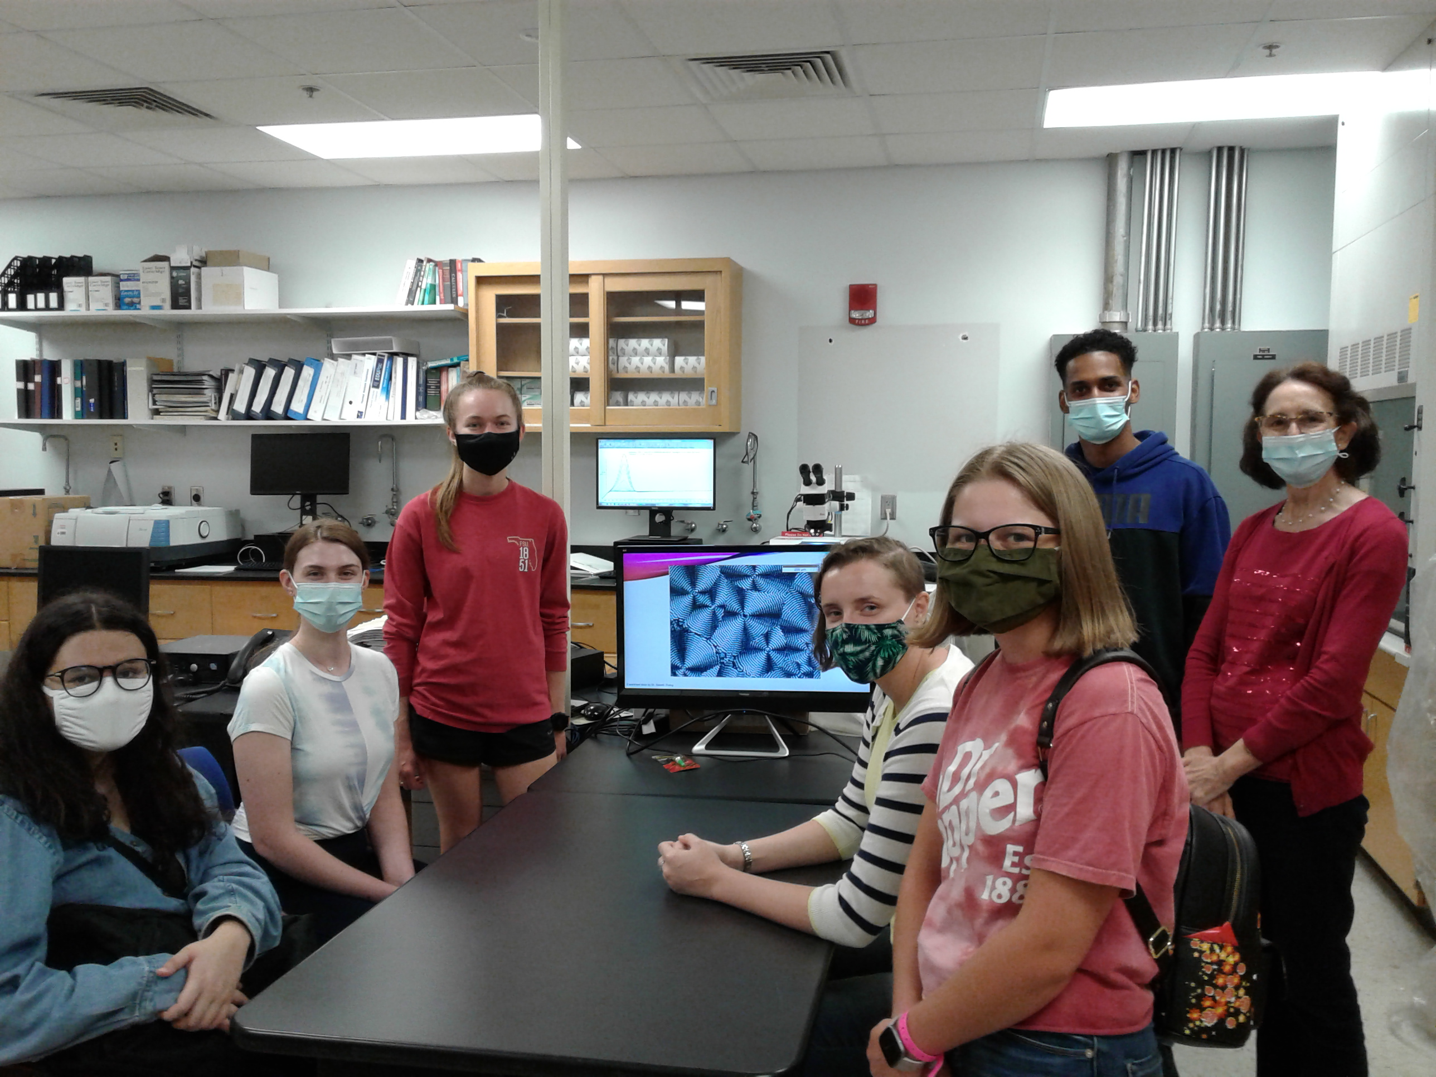
Role of Chain Structure in Polymer Crystallization
2022 Broader Impacts
DMR 1607786
Education at postgraduate, graduate and
undergraduate level:
PhD students: Stephanie Marxsen (5th year),
Carlos Germosen (graduated in Fall 2021)
REU students: Justice Ene, Clay Kramer, Nickolas Boid
Rufina G. Alamo, Florida State University
The picture shows one of the visiting groups of WIMSE girls in Spring 2022. Graduate students S. Marxsen, Carlos Germosen and PI teach students how polymer crystals develop large banded spherulites during growth.
Participation of underrepresented groups:
Carlos Germosen, Defended MS on fast scanning calorimetry of precision polyethylene-like materials.
Justice Ene worked in FSC with Carlos Germosen in Fall 2021. He started PhD program in 2022.
Participation in National on-Site and Virtual Meetings:
PI and graduate students gave talks at National ACS, APS and NATAS meetings. S Marxsen was selected to present her research at the ACS Excellence in Graduate Polymer Research.
Outreach:
The PI continues lecturing in polymers in the Fall and Spring semester to freshman and junior FSU female students who participate in WIMSE (Women in Math, Science and Engineering), an FSU program focusing on the retention of women in STEM education. PI delivered seminars at the CEMS department of Minnesota and at the Polymer Journal Club in Tallahassee.

