Slide 1
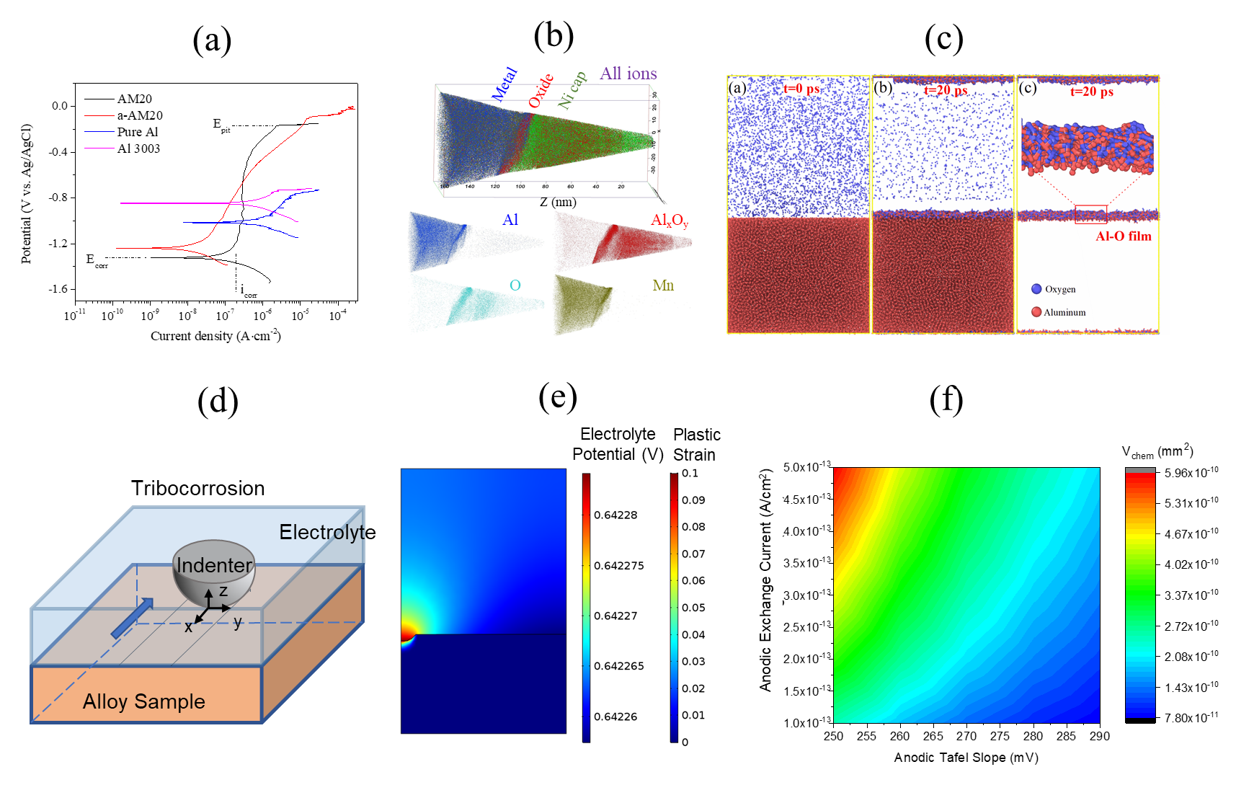
CAREER: Effects of Alloy Concentration on the Tribocorrosion Resistance of Al−TM Supersaturated Solid Solutions
DMR 1856196
2020 Intellectual Merit
Wenjun Cai, Virginia Polytechnic Institute and State University
Tribocorrosion is a new research area that emerged recently, driven by increased demand for wear- and corrosion-resistant materials from biomedical implants, nuclear power generation, marine and offshore industries, etc. In the United States, wear and corrosion are estimated to cost nearly $300 billion per year. This project investigates how alloying elements and their concentration affect the tribocorrosion resistance of aluminum (Al) alloys, with the larger goal of developing new nanostructured or amorphous Al alloys with improved tribocorrosion resistance.
Key findings of this year include:
The addition of a non-passive metal, such as Mn, in solid solution with Al, was found to simultaneously enhance strength and corrosion resistance, leading to the formation of a lightweight and tribocorrosion metal, that could be potentially used under complex and corrosive service conditions.
Atom probe tomography characterization and molecular dynamics simulations were coupled to explore the origin of passivity in Al-Mn alloy, which identified that Mn enhanced passive film protectiveness without participating in the surface oxidation [1].
For the first time, an experimentally validated 3D finite element model for tribocorrosion was developed to predict tribocorrosion kinetics and rate maps as a function of mechanical and electrochemical properties of metals [2].
Notes:
Publications:
[1] J. Chen, J. Xiao, J. Poplawsky, F. M. Michel, C. Deng, W. Cai*, “The Origin of Passivity in Aluminum-Manganese Solid Solutions”, Corrosion Science, 2020, 173, 108749. (doi: 10.1016/j.corsci.2020.108749)
[2] K. Wang, Y. Wang, X. Yue, W, Cai*, “Multiphysics modeling and uncertainty quantification of tribocorrosion in aluminum alloys”, Corrosion Science, 2021, 178, 109095, https://doi.org/10.1016/j.corsci.2020.109095
* Denote corresponding author.

Slide 2
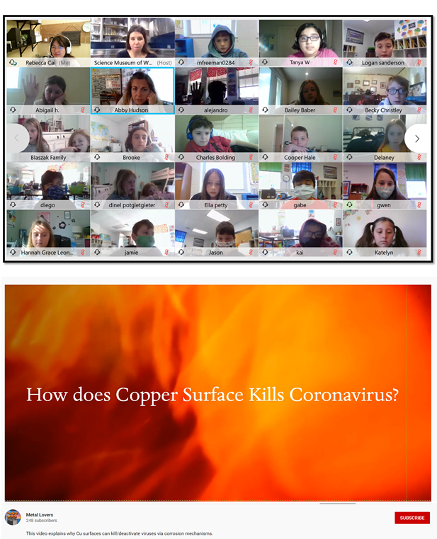
CAREER: Effects of Alloy Concentration on the Tribocorrosion Resistance of Al−TM Supersaturated Solid Solutions
DMR 1856196
2020 Broader Impacts
Wenjun Cai, Virginia Polytechnic Institute and State University
Key broader impact activities:
The projects has provided research opportunities for one undergraduate and two graduate students in an interdisciplinary fields of materials science, corrosion, and physical metallurgy.
The lab tour and hands-on demo has created STEM exposure to local K-12 students and their teacher.
A virtual meet-the-scientist outreach activity engaged local 5th-graders to know more about what does a materials scientist do.
The created YouTube videos and published journal papers have provided exposure to science and technology for a more board general public on metal corrosion and tribocorrosion. Specifically, during the pandemic, a video about “How does copper surface kill Covid19?” was published on the PI’s YouTube channel to explain how copper corrosion helps to deactivate coronavirus [1].
(a)
(b)
Notes:
[1] Published YouTube video link: https://www.youtube.com/watch?v=KpJIhN1VbLM&t=18s

