Slide 1
Atomic Structure and Growth of Helical Nanostructures
DMR 1848079
2020 Intellectual Merit
Mary C. Scott, University of California-Berkeley
Design of noble metal core-shell catalysts
We have demonstrated morphological control over noble metal core-shell nanowires (core: AuAg alloy, shell: AgPd alloy)
Demonstrated morphologies are twisted and surface-corrugated
We have measured catalytic performance of the surface corrugated nanowires, and discovered state-of-the-art performance at the oxygen reduction reaction of the brushy nanowires
We are investigating the role of chemical disorder and microstructure on the catalytic behavior
Deciphering underlying mechanism of twisted nanowires
To understand the underlying causes of the twisted vs. straight overall nanowire morphology, we have designed a high throughput analysis pipeline that uses machine learning to isolate crystal regions in images and detect stacking faults.
Input: high resolution electron microscopy data
Output: statistical reduction of microstructural features
Morphological control
control of underlying core structure
+
control of shell morphology
straight wire, brushy surface
twisted wire, smooth surface
Catalytic properties
H₂
O₂
H₂
H₂O
H₂O
nanowires with corrugated AgPd alloy shell show favorable catalytic performance

Slide 2
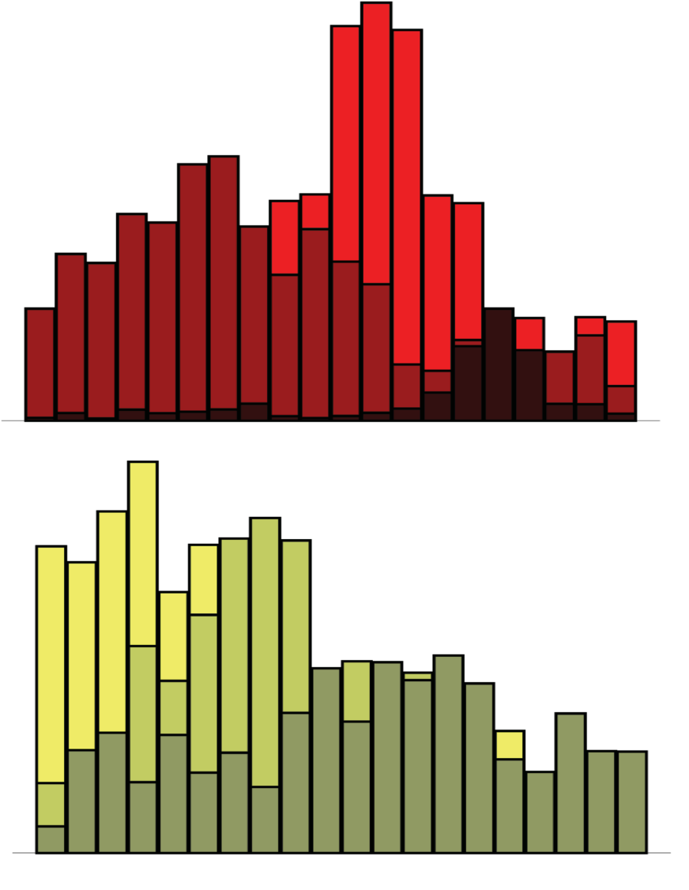
Atomic Structure and Growth of Helical Nanostructures
DMR 1848079
2020 Broader Impacts
Mary C. Scott, University of California-Berkeley
Tool for high throughput analysis of high resolution electron microscopy data
We have used a combination of deep learning and a traditional classifier to build NanoFind: a pipeline to detect stacking faults and twins in nanomaterials
NanoFind outputs information which can be directly fed into existing tools to perform size and shape analysis of nanomaterials
NanoFind is publicly available at https://github.com/ScottLabUCB/HTTEM
Online outreach program underway
To continue outreach efforts during the pandemic, we have initiated an online science club for high schoolers, which mails “science subscription boxes” containing fun and safe science demos to high school students in Oakland.
We continue our partnership with Leadership Public Schools to recruit students in underserved schools in Oakland to participate in this effort.
NanoFind pipeline
Our pipeline uses deep learning to find regions of interest in high-resolution transmission electron microscopy data, combined with easily retrainable classification tools and existing tools for data reduction, to determine statistical distributions of microstructural features
correlation
statistical reduction of data

