Slide 1
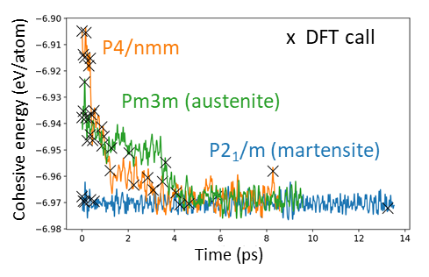
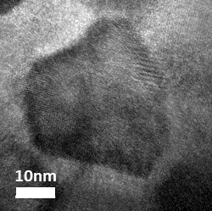
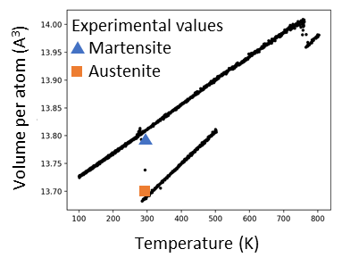
Rational Design of Next-Generation Shape Memory Alloys
DMR 1808162
2020 Intellectual Merit
Joost J. Vlassak, Harvard University
This year, we enhanced our on-the-fly machine learning molecular dynamics method. Our many-body model now captures the fine differences in energy between the different phases of the NiTi alloy. It predicts lattice parameters in excellent agreement with experiment. It is now possible to perform simulations of much larger systems than before to capture realistic microstructures.
NiTiFe is a low-temperature shape memory alloy with possible applications in space exploration. We have studied NiTiFe over a wide composition range and have evaluated the effects of heat treatment on microstructure using micromachined fast-scanning calorimetry sensors. It is now possible to synthesize samples with ultra-fine microstructures and model them directly using our machine learning method.
On-the-fly simulation of NiTi phases
Small grains of Ni₄₄Ti₅₅Fe₁
Large-scale molecular dynamics of reversible transformation
Martensite
Austenite
Notes:
On-the-fly machine learning molecular dynamics: Traditional molecular dynamics simulations need pre-determined interatomic potentials. Developing such potentials require a great deal of effort and expertise. Our on-the-fly molecular dynamics method does not need interatomic potentials to run, because it can learn from ab initio results and build the potentials. Whenever the uncertainty of the molecular dynamics simulation is large, an ab initio simulation is performed (DFT call in top-left figure) to enhance the model. The machine learned model is scalable and can be used on systems of much greater size (bottom figure).
Shape memory alloys: Shape memory alloys can transform between a low-temperature martensitic phase and a high-temperature austenitic phase. If the sample is deformed in the martensitic state, it reverts back to its original shape on heating to the austenitic state. NiTi is a widely used shape memory alloy. Adding Fe to NiTi significantly lowers its transformation temperature. Smaller grain size (top-right figure) can decrease the hysteresis between the forward and reverse transformations.

Slide 2
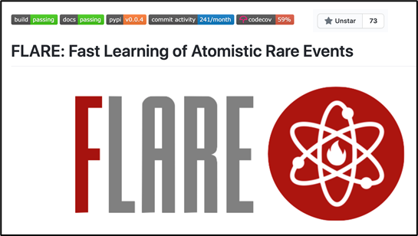
Rational Design of Next-Generation Shape Memory Alloys
DMR 1808162
Joost J. Vlassak, Harvard University
2020 Broader Impacts
Output: We have published research papers on the machine learning method, and on explosive transformations in shape memory alloys. Various aspects of this work have been presented at the MRS, APS, and SES meetings.
Impact: Our on-the-fly machine learning molecular dynamics method (FLARE) is open source and used by a growing community of researchers, with more than 70 stars on the public GitHub page.
Education and outreach: We released interactive tutorials in Google Colab and Jupyter Notebook teaching new users how to use the FLARE software, including a 60-minute tutorial presented at the 2020 APS March Meeting that can be viewed on YouTube. We worked with the Office of Diversity, Inclusion and Belonging to organize open-house events targeting minority undergraduate students.
GitHub page of open-sourced FLARE package
Open-house event

