Slide 1
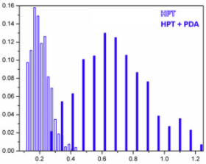
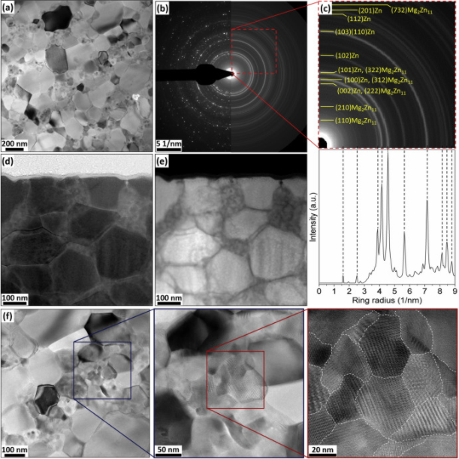
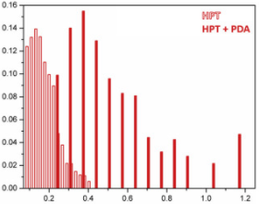
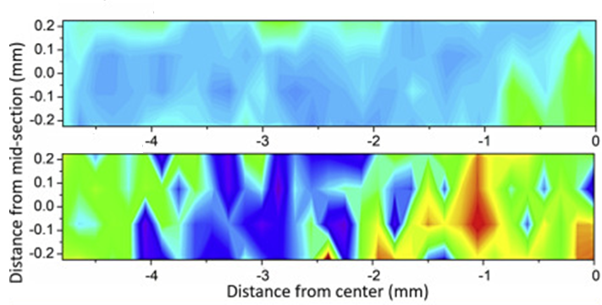
Development of novel high strength biodegradable metals for temporary biomedical implants
DMR 1607942
2020 Intellectual Merit
Our last research efforts provided a direct comparison of the microstructure and the hardness evolution between a Zn–3Mg (wt.%) alloy and its hybrid counterpart, after high-pressure torsion (HPT) and after HPT followed by a post-deformation annealing (PDA) treatment. This work was published in Journal of Alloys and Compounds in 2020.
Carl J. Boehlert, Michigan State University
Alloy
BF-TEM
SAED
Area fraction
We found that both the alloy and the hybrid reached a similar level of grain refinement after HPT processing, however, grain growth followed different trends after PDA. This can be observed in Fig.1
BF-STEM
HAADF-STEM
Grain size (um)
The HPT-processed alloy exhibited clusters of Mg₂Zn₁₁ nanocrystalline domains that coalesced into coarser grains maintaining a unimodal GS distribution after PDA. This can be directly observed by TEM/STEM, as depicted in Fig. 2
Hybrid
Area fraction
HRTEM
The hybrid after PDA displayed a multimodal GS distribution consisting of ultrafine Mg-rich grains containing MgZn₂ and Mg₂Zn₁₁ nanoscale intermetallics, in a matrix of coarser dislocation-free Zn grains.
Grain size (um)
Hardness Vickers (HV)
The hardness values of the alloy were significantly lower in the alloy than in the hybrid after HPT, however, they were more uniformly distributed across the sample diameter. This can be observed in Fig.3
To find out more about this work, visit: https://doi.org/10.1016/j.jallcom.2020.154891

Slide 2
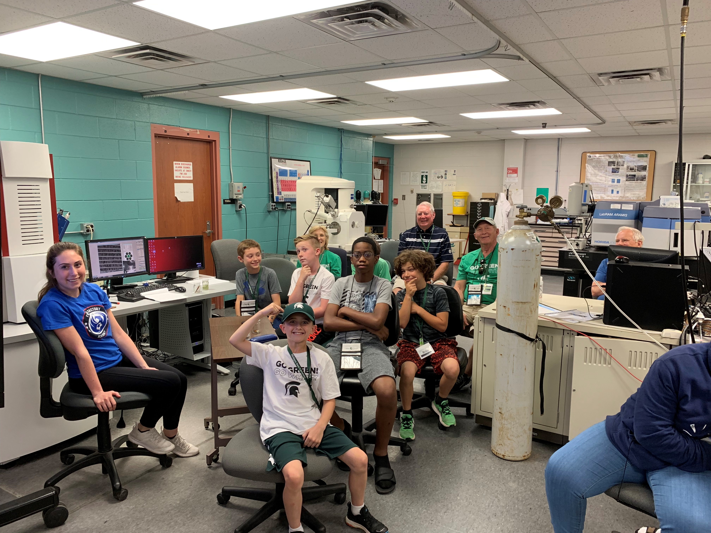
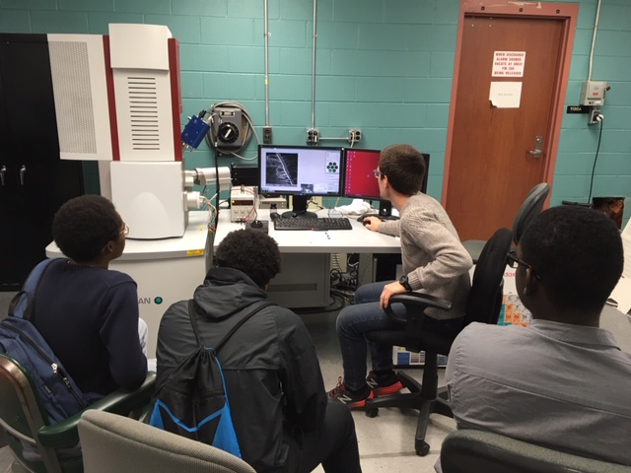
Development of novel high strength biodegradable metals for temporary biomedical implants
DMR 1607942
2020 Broader Impacts
Carl J. Boehlert, Michigan State University
We have had 11 outreach activities in the College of Engineering at Michigan State University (MSU) in the third year of this program and we have had more than 150 K-12 students participate in them (which is about the same as what we had in the previous two years). These activities are a part of the Scanning Electron Microscopy EDucation (SEMED) outreach program (details are available at: http://www.egr.msu.edu/~boehlert/SEMED).
These K-12 students have been educated about scanning electron microscopy and materials science. The MSU volunteers who participate are undergraduate and graduate students as well as faculty and staff and they not only discuss science and technical issues, but they also inform students about issues involving secondary education in STEM fields. The upper picture shows students from Bowers Academy with MSU graduate student, David Hernandez Escobar, running the Scanning electron Microscope (SEM). The lower picture shows a Grandparents University group and with MSU undergraduate student volunteer, Olivia Lauren Garbacik, located at the left hand side.

