Slide 1
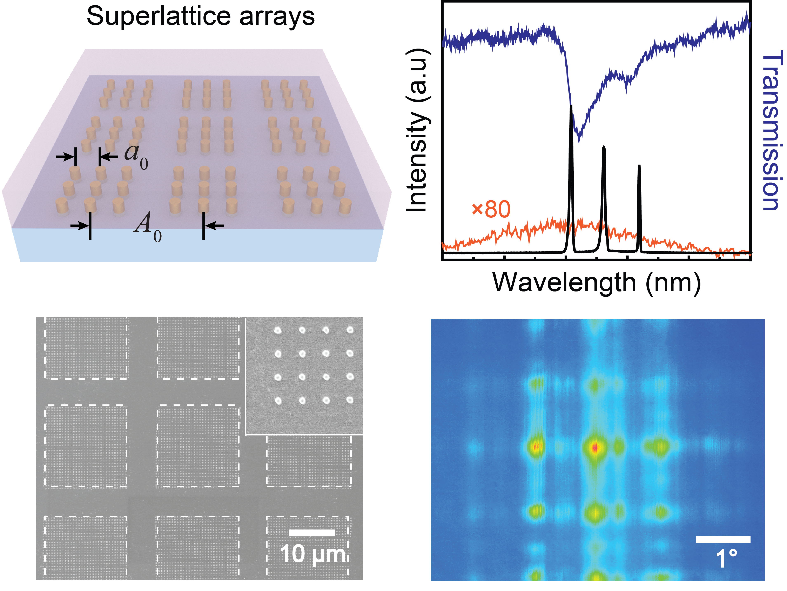
Band-edge Engineering for Controlled Multi-modal Nanolasing in Plasmonic Superlattices
DMR 1608258
Teri W. Odom, Northwestern University
Miniaturized lasers enable medical imaging and optical displays. Compared to conventional lasers, plasmonic nanolasers can break diffraction limit and support ultrasmall mode volumes, but multi-modal nanolasing exhibits both uncontrolled mode spacing and output behavior. Single band-edge states have functioned as high-quality optical feedback for microscale lasers to nanolasers. However, access to more than a single band-edge mode for nanolasing is not possible because of limited cavity designs.
We found that plasmonic superlattices—finite-arrays of nanoparticles grouped into microscale arrays—can support multiple band-edge modes capable of multi-modal nanolasing at programmable emission wavelengths and with large spectral spacings. Moreover, tuning NP size can provide an additional degree of freedom for manipulating the output behavior of different lasing modes. Modeling the superlattice nanolasers with a four-level gain system revealed the accumulation of population inversion at plasmonic hot spots.
Scheme (top left column), SEM image (bottom left) & multi-modal lasing emission (right) of plasmonic superlattice arrays. Multiple lasing modes and emission spots were detected from the superlattice nanolaser, and the mode spacing and emission angle of each can be tailored.
Danqing Wang, Ankun Yang, Weijia Wang, Yi Hua, Richard D. Schaller, George C. Schatz and Teri W. Odom, Nature Nanotechnology (2017) AOP
Notes:
Aim of the Project:
(1) To manipulate multiple band-edges modes in a single plasmonic lattice without varying material components. (2) To achieve multi-modal nanolasing with stable and governed output behavior. (3) To engineer different lasing modes in real-time based on structural designs.
Research Results:
Our work demonstrates an entirely new architecture to achieve multi-modal lasing with control over different peaks in a single device. Nanoparticle superlattices—finite-arrays of metal nanoparticles grouped into microscale arrays—enable access to multiple band-edges as optical feedback for nanolasing. Compared to traditional lasers, the unprecedented characteristics include: (1) Remarkably stable multi-modal lasing over a large range of pump powers. Each lasing mode exhibits distinct local electromagnetic field distributions. Hence, mode competition for the limited gain is minimized at certain regions. (2) Well-controlled multi-modal lasing output. Varying superlattice geometries is a robust way to manipulate the spectral separation, spatial emission angles, and numbers of lasing modes. More than that, tuning nanoparticle size can modulate the output intensity of each lasing peak independently, which is not possible in conventional lasers. (3) Switchable nanolasing from symmetry-broken superlattices. In nanoparticle line patches, we achieved dynamical switching of lasing between a single and multiple modes by simply varying lattice orientation.
Significance of the Results:
Our work brings critical insights into manipulating the lasing emission by engineering the optical band structures of plasmonic nanomaterials. Based on top-down nanofabrication processes, nanoparticle superlattices can be easily scaled and integrated with commercial optical devices. Generating multiple stable and controlled lasing signals from a single device could revolutionize cavity designs in laser industry. In the long term, multi-color nanolasers with engineered outputs could allow encoded, encrypted and faster information flow in optical fibers. These findings could also enable ultra-sensitive sensing in chemical processes, where various molecules can be monitored simultaneously, and multi-color in-situ cellular imaging that allows different dye labels to be all excited and different biological processes to be correlated.
Major Reference(s) – associated with the highlighted research results, if it is not included in the slide itself.
Wang. D; Yang. A; Wang. W; Hua. Y; Schaller. R.D.; Schatz. G.C.; Odom. T.W. “Band-edge Engineering for Controlled Multi-modal Nanolasing in Plasmonic Superlattices.” Nature Nanotechnology 126 (2017), AOP.
Acronyms and symbols:
NP - nanoparticle
SEM – scanning electron microscopy

Slide 2
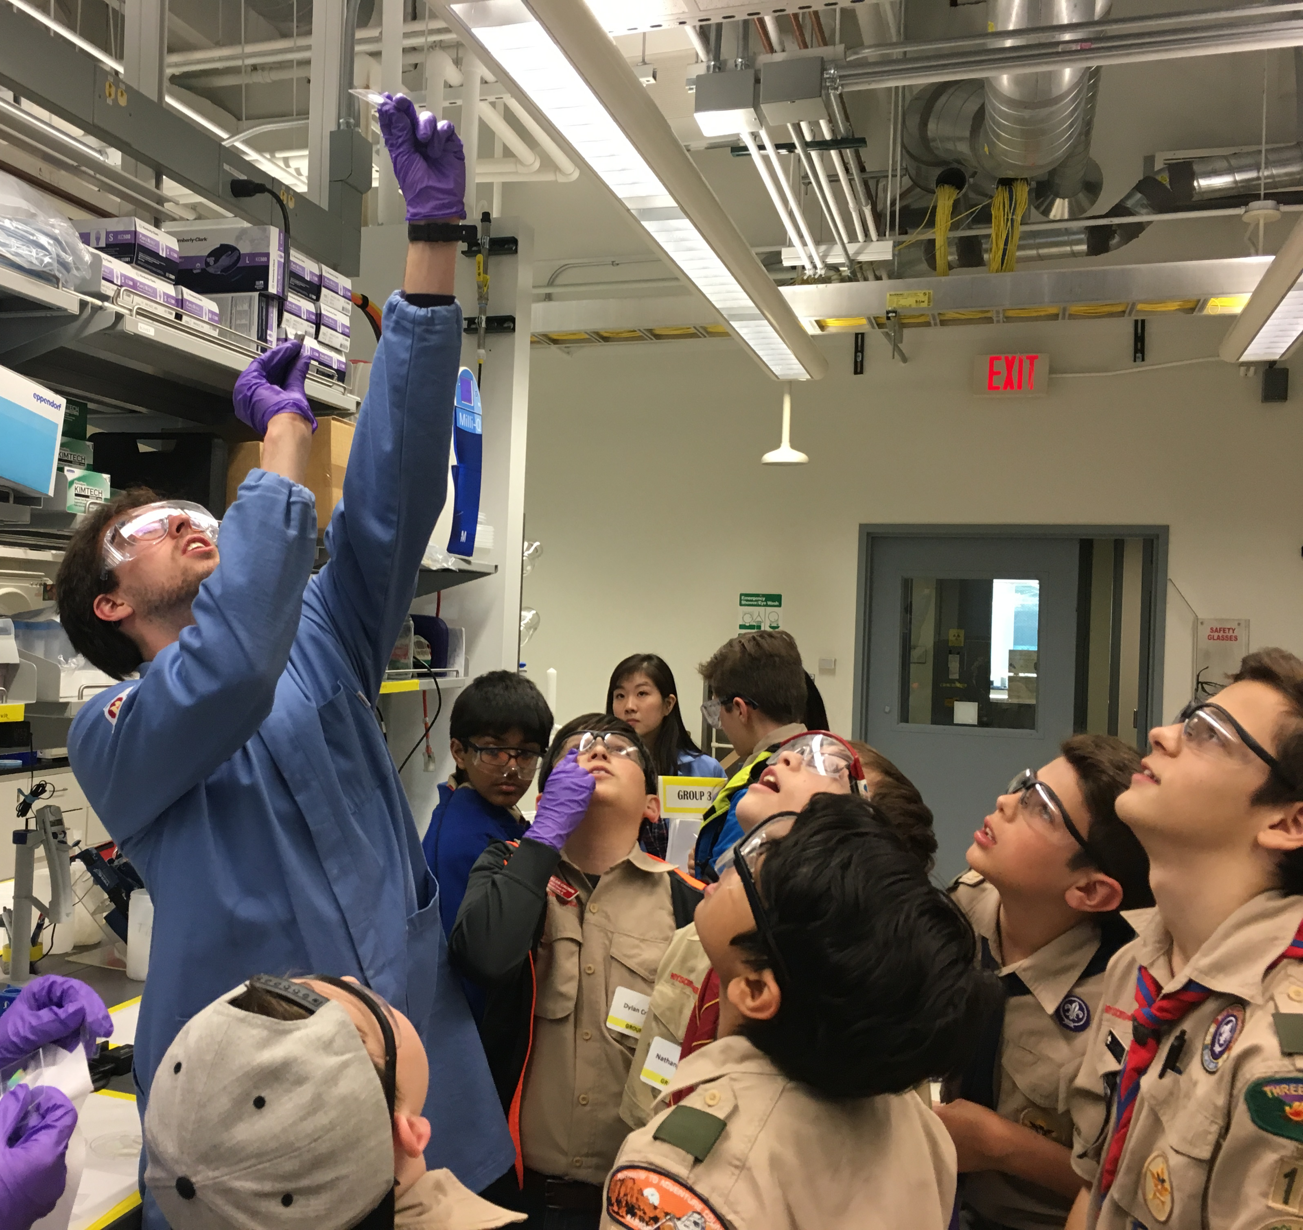
Band-edge Engineering for Controlled Multi-modal Nanolasing in Plasmonic Superlattices
DMR 1608258
Teri W. Odom, Northwestern University
Generating multiple stable and controlled lasing signals from a single device could revolutionize cavity designs in the laser industry. In the long term, multi-color nanolasers with engineered outputs could allow encoded, encrypted, and faster information flow in optical fibers. These findings could also enable ultra-sensitive sensing in chemical processes, where various molecules can be monitored simultaneously. Additionally, multi-color in-situ cellular imaging ensures different dye labels to be all excited and different biological processes to be correlated.
The Odom Group hosted Boy and Girl Scouts from local troops as part of the All Scout Nano Day 2017 at Northwestern University. The hands-on laboratory exercise allowed scouts to fabricate their own micro-gratings by molding a photo-curing polymer against a master, and learn about their interference patterns. These activities aim to encourage children to consider science and engineering as a career and highlight the Odom Group’s expertise in nanofabrication and photonics.
Odom Group members demonstrate interference patterns produced from light passing through the molded micro-gratings to the Girl and Boy Scouts .
Notes:
The Odom members demonstrate interference patterns produced from light passing through the molded micro-gratings to the girl and boy scouts .

