Slide 1
Wetting and Spreading with Soft Materials
DMR 1608097
Karen E. Daniels, North Carolina State University
Oxidation-mediated spreading of liquid metals
Identified and characterized a new class of fingering instabilities, controlled by the competition between fluid surface tension and a shell formed by electrochemical oxidation
Deformation of soft gels due to surface tension
Soft gels are deformed by the surface tension of a liquid in contact; we aim to resolve current controversies surrounding competing models
Developed gel preparation protocols, built new fluorescence apparatus, and wrote automated data analysis techniques for quantifying deformations in thin gel wires
Applications
Controlled spreading is relevant to medical technologies, reconfigurable electronic devices, microfluidic flows, tissue growth, and bacterial biofilms
camera
1 cm
laser
arXiv: 1703.03011
0.5 mm
(top) Sample image of liquid metal undergoing fractal fingering instability (bottom) Composite image of a thin gel wire, with fluorescent spheres used to track internal deformation.
Notes:
In collaboration with Michael Dickey (NCSU Chemical Engineering), we investigated electrochemical spreading of liquid metals (eutectic gallium indium). One paper is in review at Physical Review Letters, will be presented at the Fall 2017 APS-DFD meeting, and a preprint is available at https://arxiv.org/abs/1703.03011
Abstract: We identify and characterize a new class of fingering instabilities in liquid metals; these instabilities are unexpected due to the large interfacial tension of metals. Electrochemical oxidation lowers the effective interfacial tension of a gallium-based liquid metal alloy to values approaching zero, thereby inducing drastic shape changes, including the formation of fractals. The measured fractal dimension (D=1.3±0.05) places the instability in a different universality class than other fingering instabilities. By characterizing changes in morphology and dynamics as a function of droplet volume and applied electric potential, we identify the three main forces involved in this process: interfacial tension, gravity, and oxidative stress. Importantly, we find that electrochemical oxidation can generate compressive interfacial forces that oppose the tensile forces at a liquid interface. Thus, the surface oxide layer not only induces instabilities, but ultimately provides a physical barrier that halts the instabilities at larger positive potentials. Controlling the competition between surface tension and oxidative (compressive) stresses at the interface is important for the development of reconfigurable electronic, electromagnetic, and optical devices that take advantage of the metallic properties of liquid metals.
First-year graduate student Shih-Yuan Chen (NCSU Physics) joined the project in January 2017 and is developing elastocapillary experiments. He has been trained to use the Anton-Paar rheometer purchased by this grant, and is currently being trained to perform experiments using confocal microscopy (at a university facility). He attended the UMass-Amherst summer school in June 2017, and has submitted an abstract for the Fall 2017 APS-DFD meeting.

Slide 2
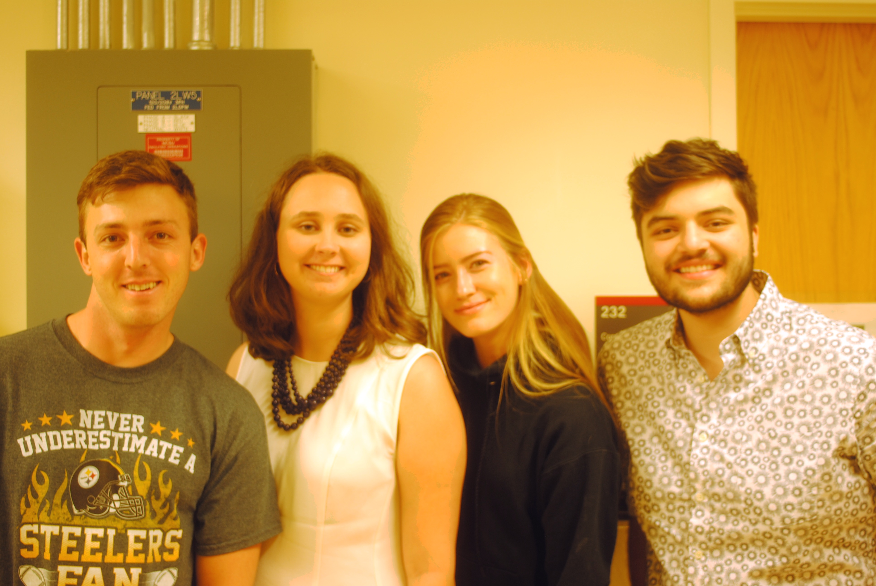
Wetting and Spreading with Soft Materials
DMR 1608097
Karen E. Daniels, North Carolina State University
Undergraduate research by diverse students
Investigated spreading of active/passive mixtures at three length scales: micron (bacteria + colloids), millimeter (beetle larvae + flour), and centimeter (non-living airfoils)
Students trained in lasers, microscopy, microfluidics, diffusing wave spectroscopy, rheology, 3D printing, automated particle-tracking
Formed a weekly reading group to read recent papers on active matter
Presented posters at NCSU symposia
International collaboration with the group of Joshua Dijksman (U. Wageningen, Netherlands) on the airfoil experiments
Collaboration with RT-MRSEC (one student was part of their REU program, supervised by MRSEC grad fellow Scott Lindauer) on bacteria + colloids in microfluidics
2016-2017 undergraduate researchers Chad Province, Emily Brown, Sydney Dorman (on a different project), and Mika Murphy. Not shown: Bjorn Sumner. The group includes students who are (collectively) male, female, LGBT, first generation college, Native American heritage, US Army veteran, parent, NCSU, visiting, physics majors, and chemical engineering major.
Notes:
Key results from the year, obtained by the undergraduates
Built a diffusing wave spectroscopy setup for use in the proposed living active/passive mixture experiments. (Bjorn Sumner)
Development of a new insect system (flour beetle larvae, easy to obtain and care for) to replace the one originally proposed (mites, difficult to obtain and care for), facilitating future experiments. The beetle larvae also live in flour, and the same experiments will be possible using them instead. (Emily Brown)
Collection of DWS data illustrating that the technique works on active/passive mixtures and can quantify the degree of activity (higher for larger concentrations of active particles). (Emily Brown)
3D printing of a non-living active particle, development of image-processing techniques, and observation that geometric friction (roughness) is mon-monotonic control on the amount of collective activity. (Mika Murphy)
Success in adapting existing microfluidics chips to allow experiments on bacteria (previous work was on colloids), using PVP-based solutions to avoid sticking. Measured effective viscosity of the bacterial solutions. Created (or demonstrated lack of creation) of piles of motile/non-motile bacteria. (Chad Province)
Data collection using the active/passive larvae system will continue during the next year, to generate a publication-quality dataset.
The airfoil particles are a re-use the table first built under DMR-0644743 (CAREER award), and are an extension of the originally-proposed work arising from conversations with the Dijksman group (graduate student Marcel Workamp) who visited for 1 month in 2016 and met weekly over Skype with Mika Murphy. A publication is planned, based on work performed at both locations. Data collection will continue during the next year.
The bacteria-colloids work (funded by RT-MRSEC grant DMR-1121107) will be continued by graduate student Scott Lindauer as part of his PhD thesis and a publication now that proof-of-principle has been achieved.

