Slide 1
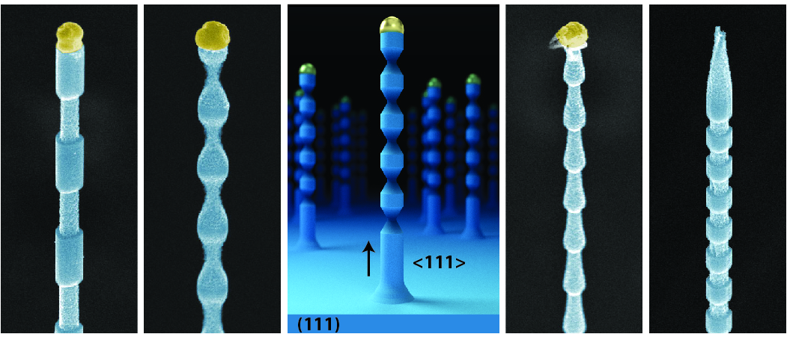
Encoding Precise Morphology in Vertical Silicon Nanowires
DMR 1555001
James Cahoon, University of North Carolina at Chapel Hill
Vertical silicon nanowires have wide-ranging applications from solar cells to bioelectronic probes. However, vertical nanowires are typically limited to a simple cylindrical ‘wire’ geometry, which limits potential applications. Here, we demonstrate vertical silicon nanowires encoded with complex morphology that includes gratings, sinusoids, and sawtooths. These structures are created by encoding dopants with sub 10 nanometer spatial resolution and then wet chemically etching the structures. The inter-related roles of gold, surface chemistry, and dopants are explored to enable the bottom-up synthesis of these complex nanostructures by epitaxial growth on (111) silicon wafers.
“Designing Morphology in Epitaxial Silicon Nanowires: The Role of Gold, Surface Chemistry, and Phosphorus Doping.” ACS Nano. 11, 4453-4462 (2017),
Notes:
Explanatory details.
Vertically-aligned semiconductor nanowires (NWs) have many potential applications for NW-based technologies, ranging from solar cells to intracellular sensors. Aligned NWs can be fabricated by top-down etching of planar wafers or synthesized from the bottom-up using the vapor-liquid-solid (VLS) mechanism to induce epitaxial growth on lattice-matched substrates. The VLS process permits the modulation of dopants along the NW growth axis, which, if combined with dopant-dependent wet-chemical etching, can be used to encode precise morphology. However, the synthesis of vertical and linear NWs with complex morphology is non-trivial, requiring control over multiple interdependent aspects of the VLS process. The aim of this project is to chemically encode complex morphology in order to design nanostructures with various electronic and photonic functionality. In the work highlighted on this slide, we demonstrate sub-10 nm morphology in <111> epitaxial silicon (Si) NWs grown by the VLS mechanism on (111) Si substrates with gold (Au) catalysts. Using silane (SiH4), phosphine (PH3), and hydrochloric acid (HCl) precursor gases at 480 °C, precise morphology (illustrated in the upper image) is encoded through abrupt phosphorus (P) dopant transitions (illustrated by the elemental map of Si, P, and Au in the middle image), which are found to be less than 5 nm in width (as shown by the P dopant transition of 4.6 nm, as shown in the lower image; the number represents a fit to a single exponential function). The results of this work highlight three mechanistic attributes of the growth process. First, NW growth in the <111> direction is found to be unstable at high SiH4 partial pressures and growth rates unless using HCl, which stabilizes NW growth through chlorination of the NW sidewall. Second, aggregated Au deposited on the NW surface by the VLS catalyst is found to be immobile on the chlorinated surface and to impede selective wet-chemical etching by potassium hydroxide (KOH) solution, preventing the design of precise morphology. Third, the aggregation of Au is found to be strongly dependent on the SiH4 partial pressure and NW growth rate, and values exceeding ~100 mTorr and ~150 nm/min, respectively, are required to minimize Au and thereby enable selective wet-chemical etching. Under optimized growth conditions, we find that abrupt, complex, and arbitrary dopant profiles and morphologies can be encoded in vertical Si NWs, and the results indicate that a variety of electronic and photonic applications can be realized with these designed nanostructures.
Image descriptions (also embedded as Alt Text in the images):
Upper image: scanning electron microscopy image and schematic of epitaxial silicon nanowires encoded with various morpologies
Middle image: EDS elemental maps of Si, P, and Au showing abrupt n-i-n transitions at various SiH₄ partial pressures, corresponding to different nanowire growth rates
Lower image: Dopant line profiles showing transitions <5 nm in width.

Slide 2
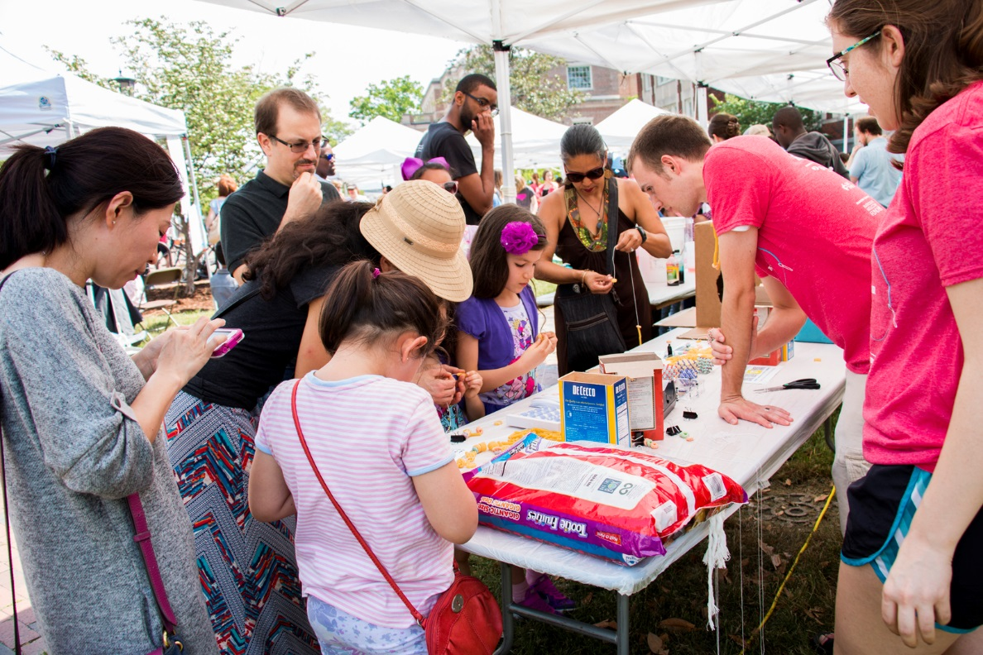
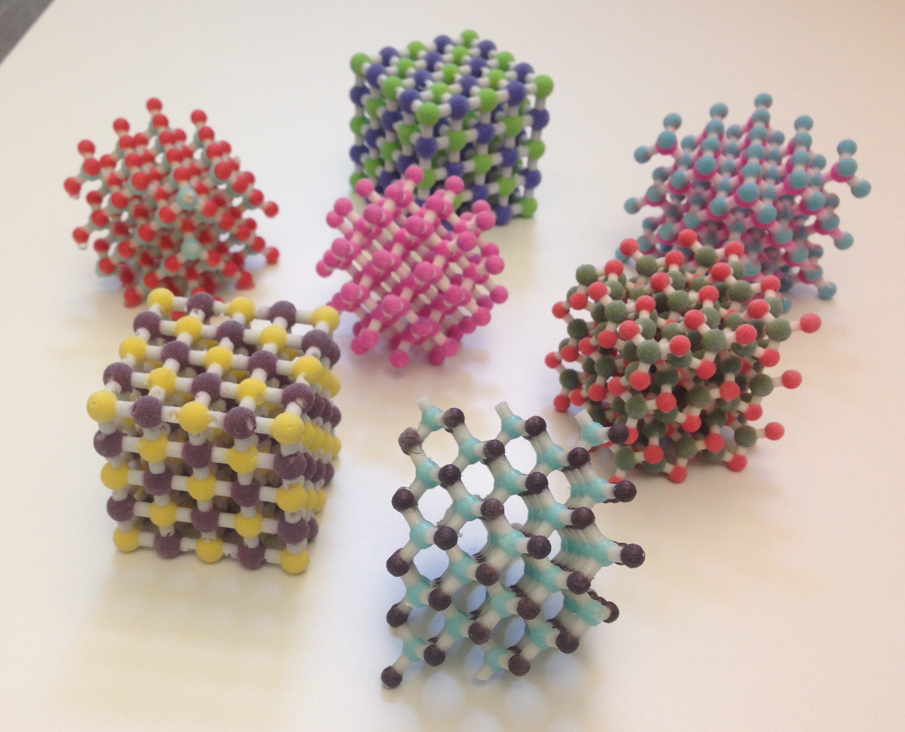
3D printed crystals at the UNC Science Expo
DMR 1555001
James Cahoon, University of North Carolina at Chapel Hill
At the annual UNC Science Expo, we featured multiple items for children and adults that generated a lot of excitement from both groups. We designed an exhibit featuring Morse Code, an idea taken from a fun proof-of-concept in which we chemically doped and selectively etched a silicon nanowire with Morse Code letters spelling “SCIENCE”. In our NC Science Expo exhibit, we taught adults and children about the ENGRAVE technique by using 3D printed models printed by our own full-color gypsum 3D printer.
We also developed the capability to print full-color 3D models of various crystal structures. We used these structures at the Expo, sparking great interest from both children and adults. We are continuing to prepare more of these samples and will distribute them to our UNC chemistry community for various outreach efforts. In addition, we are developing full-color 3D-printed structures for use in the classroom.
Notes:
Image descriptions (also embedded as Alt Text in the images):
Upper image: Photo of the Cahoon group booth at the annual UNC Science Expo open to the public. Shown on the far right are two Cahoon group students, graduate student Jon Meyer and undergraduate student Helen Hansel.
Lower image: Photo of 3D printed crystal structures used at the UNC Science Expo

