Slide 1
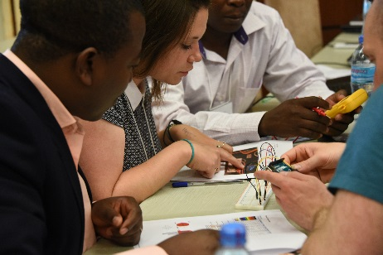
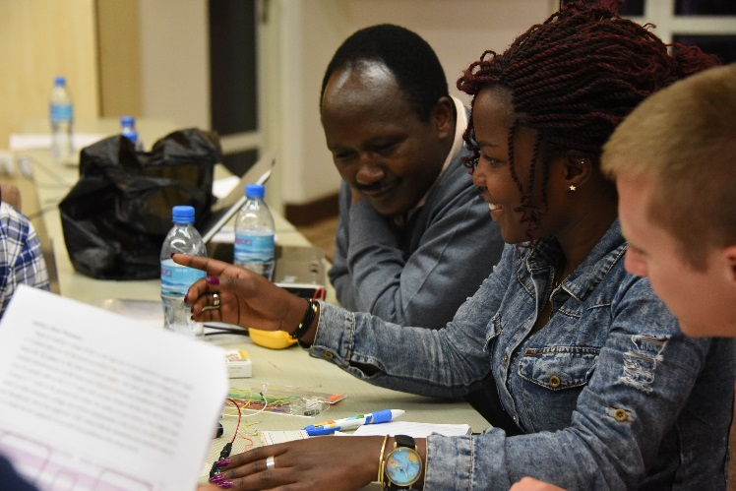
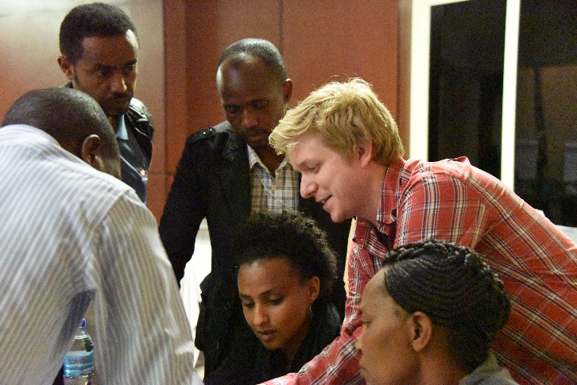
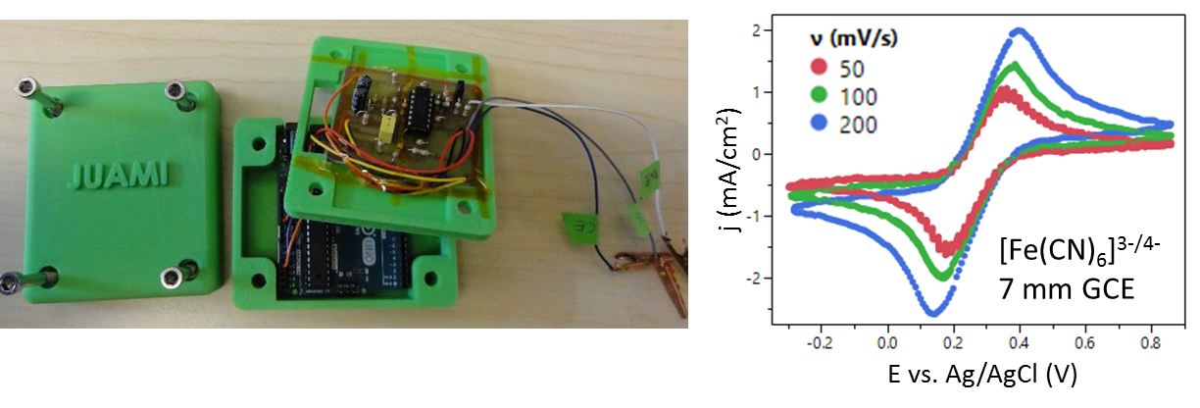
JUAMI: Bridging the Access Divide
XC |cross-cutting activities in materials
DMR 1539724
JUAMI Goals:
Help build research level scientific knowledge and capabilities in Mat. Sci. & Eng. in Africa
Establish US-African collaborations
Teach frontier research topics to young US, African researchers
Mechanism:
Two-week hands-on, highly collaborative workshop (Tanzania, May-June 2016)
37 African & 26 US students (26% female)
Rigorous evaluation
Maintain communication after workshop
Financial support for selected follow-on projects
Selected Outcomes:
98% agreed JUAMI advanced their understanding of the field; the two-weeks were well-spent
73% identified a potential internatl collaborator
Low-cost potentiostat for research & education
Sossina M. Haile, Northwestern University
Notes:
Add additional explanations, references, or more technical notes here.

