Slide 1
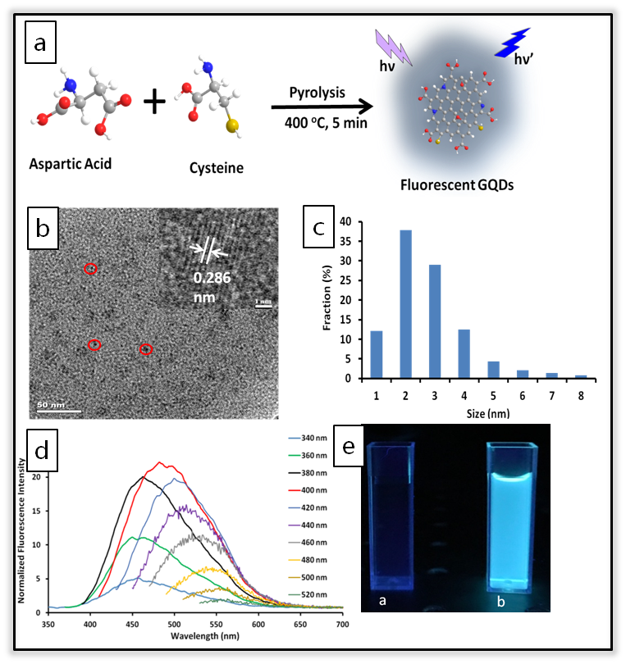
One step synthesis of fluorescent graphene quantum dots through pyrolysis of amino acids
DMR 1523611
Outcome: We have developed a novel method for the synthesis of graphene quantum dots (GQDs) by using two amino acids, which are non-toxic natural materials containing nitrogen groups for easy surface modification. The synthesis process was easy, efficient and no toxic chemicals were involved. The obtained GQDs had a size of 3.26± 1.30 nm and lattice spacing of 0.286 nm.
Impact: These GQDs emitted strong blue fluorescence, demonstrated high photostability and showed tunable emission wavelength by changing the excitation wavelength, which have great potentials in biomedical imaging, designs of biosensors, and etc. Moreover, they had good solubility not only in water, but also in many organic solvents, which may future broaden their applicability. Dissolved in different solvents did not affect their fluorescence emission ability.
Explanation: The study of the mechanism of fluorescence property is currently in progress. It could be related to quantum confinement effect or the defective state emission.
Tatiana Timofeeva, New Mexico Highlands University
a) Schematic illustration of the synthesis of GQDs; b) TEM (inset: HRTEM) image of GQDs and c) their size distribution; d) Fluorescence emission spectra of GQDs obtained with excitation wavelength progressively being increased from 340 to 520 nm; e) Photo of water (a) and GQDs (b) under a UV light of 365 nm.

Slide 2
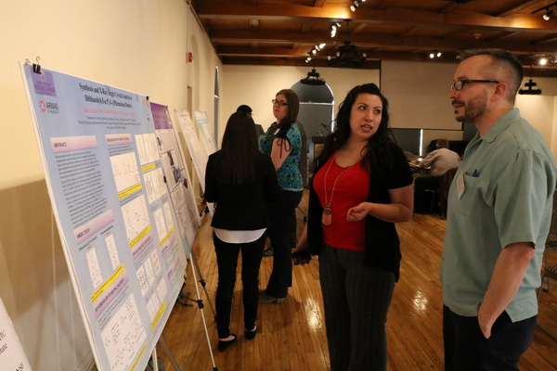
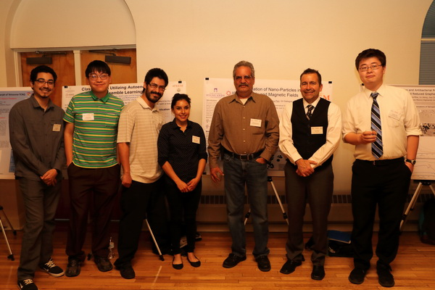
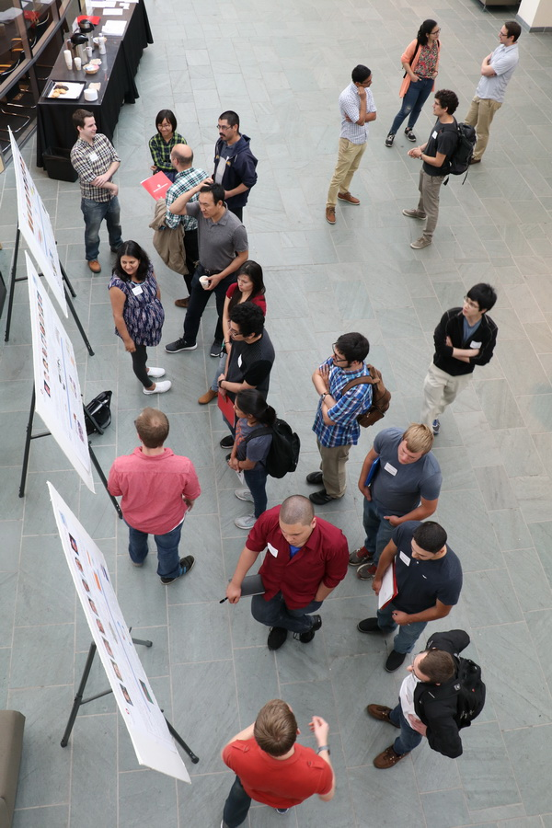
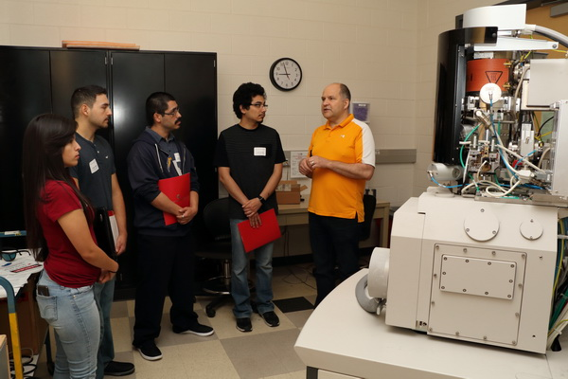
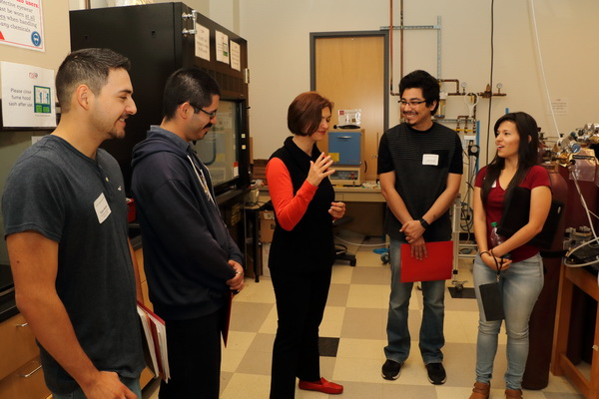
Outreach activities at New Mexico Highlands and Ohio State Universities
DMR 1523611
Collaborative activities of NMHU and
OSU students
Tatiana Timofeeva, New Mexico Highlands University
Graduate student Bianca Valencia talks with a committee member at the NSF Site Visit
Dr. Gil Gallegos with his research group and one of the committee members at the NSF Site Visit
Students participate in the poster session during the Physics of Emergent Materials Workshop at OSU
NMHU students taking a tour of the OSU facilities

