Slide 1
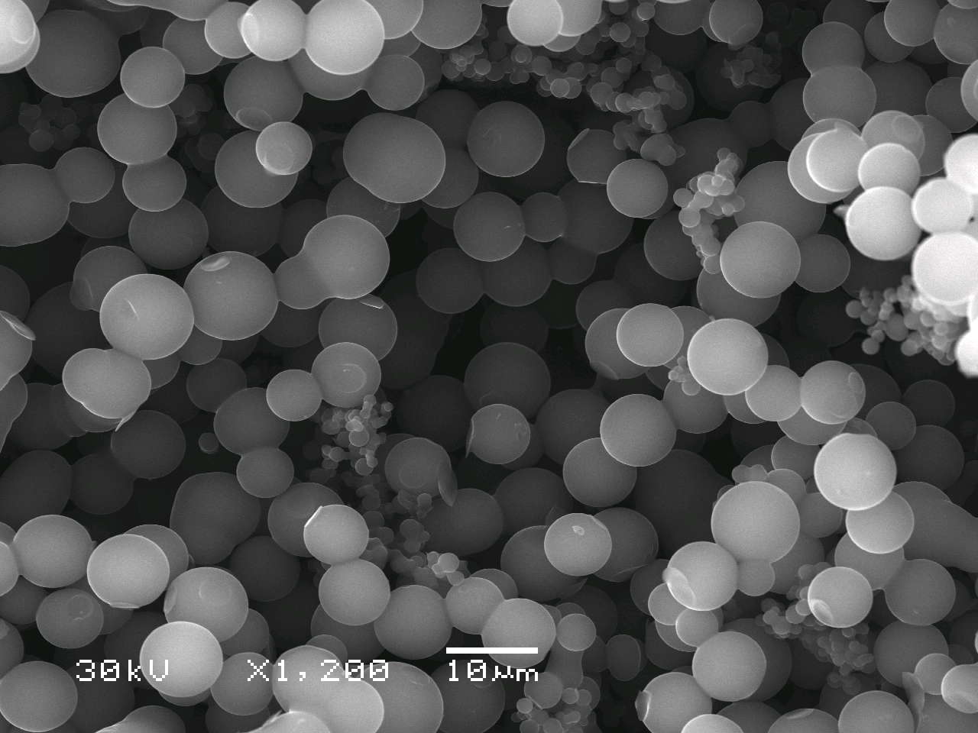
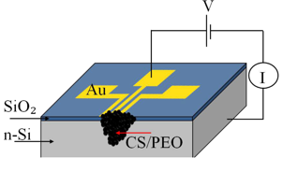
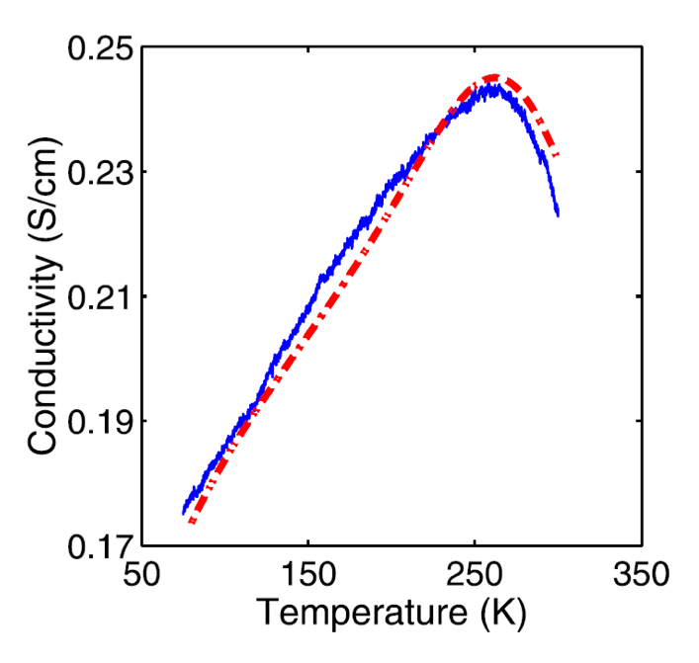
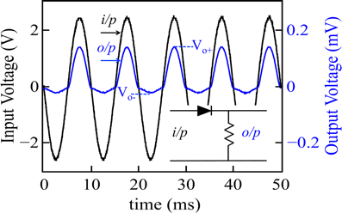
Polymer/Carbon Spheres Composites for Device Applications
DMR 1523463
Idalia Ramos, University of Puerto Rico at Humacao
Intellectual Merit: Carbon-based materials have attracted scientific interest due to their promise to revolutionize the electronics industry. Carbon Spheres (CS) were produced via hydrothermal carbonization of sucrose. A Schottky diode was fabricated using a composite of the highly conductive CS and the polymer PEO (polyethylene oxide). The diode was tested as a half wave rectifier. The simple design and fabrication, and complete exposure of the carbon material to the ambient make these diodes excellent candidates for use in active electronic components including gas/light sensors.
PREM Collaborators: Students: Cesar Nieves, Luis Martínez, José L. Pérez-Gordillo. Faculty: Idalia Ramos, Nicholas Pinto, Natalya Zimbovskaya, Margarita Ortiz (UPRH) and Jorge Santiago (PENN).
References:
Nieves, C. et. al. J. Appl. Phys. 120, 014302 (2016).
Nieves, C. et. al. J. Mater. Sci: Mater Electron 27, 13044 (2016).
Schematic of CS/PEO diode and circuit for electrical characterization
SEM image of carbon spheres
CS/PEO diode tested as half-wave rectifier
Temperature-dependent conductivity of CS/PEO (red-experimental, blue-theoretical )
Notes:
Electrical characterization of the CS/PEO was carried out showing Ohmic current-voltage characteristics and temperature-dependent conductivity in the range 80K < T < 300K. The conductivity reached a maximum value of 0.245S/cm at 258K. The dependence of conductivity on temperature was theoretically analyzed to determine predominating mechanisms of electron transport. It was shown that thermally-induced electron tunneling between adjacent spheres may take on an important part in the electron transport through the CS/PEO composites.

Slide 2
Polymer/Carbon Spheres Composites for Device Applications
DMR 1523463
Idalia Ramos, University of Puerto Rico at Humacao
Broader Impacts: This is the first study demonstrating real applications using conducting carbon spheres fabricated via an easy, rapid, cheap, and green technique.
Hispanic undergraduate students (Cesar Nieves and Luis Martínez,) and High School student, José L. Pérez-Gordillo, participated in all stages of the research. These included, a theoretical study of electronic transport in CS/PEO, implementation of a gas sensor for the detection of aliphatic alcohol vapors, and preparation and characterization of a second device using CS and the conducting polymer (PANi-polyaniline). The results were presented by the students in two international conferences (2016 IMRC in Cancún, México and 2016 Ibersensor in Valparaiso, Chile), and the International Science Fair (ISEF) in Los Angeles, CA (2017).
PREM HS student, José L. Pérez Gordillo, represented Puerto Rico in the 2017 International Science Fair. He developed a sensor for the detection of aliphatic alcohol vapors using the sucrose-based carbon spheres.
Notes:
Current status of students in this project.
Luis Martinez (BS Physics Applied to Electronics) is a graduate student in Physics at UTEP.
Cesar Nieves (BS Physics Applied to Electronics) will begin graduate studies in MSE at Penn State in the Fall 2017.
José L. Pérez-Gordillo graduated from HS and will begin college studies in Physics Applied to Electronics at UPRH in the Fall 2017. He will continue in PREM research.

