Slide 1
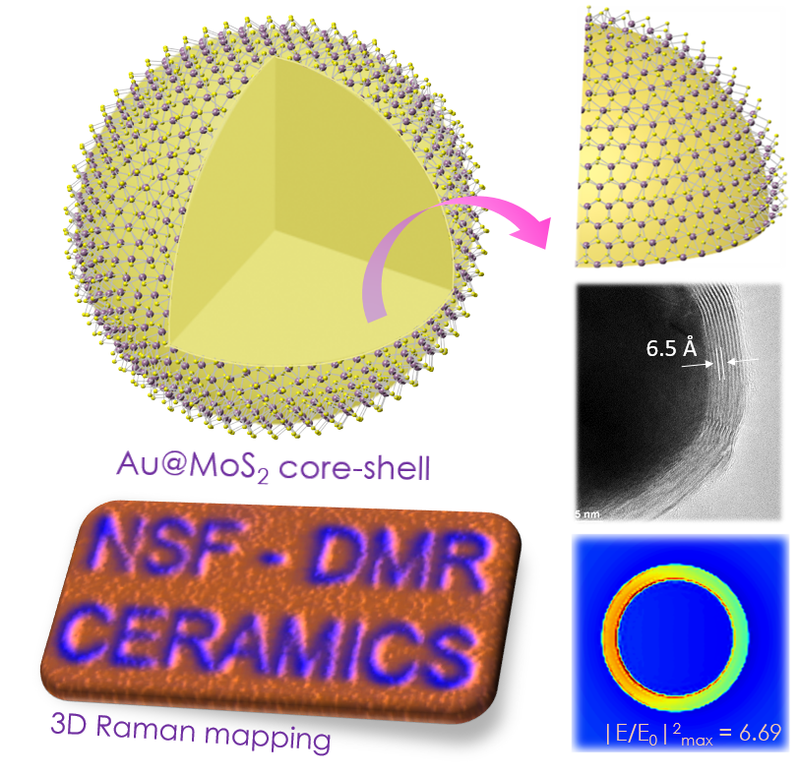
Novel Optical Interactions in Patterned Au@MoX₂ Core-shell Heterostructures Vinayak P. Dravid, Northwestern University, DMR 1507810
Outcome: We have synthesized novel core-shell heterostructures, termed Au@MoX₂; where the Au nanoparticles are snugly and contiguously encapsulated by few atomic layers of ceramic chalcogenides (X), e.g., MoS₂. The heterostructures can be patterned via direct growth of multilayer fullerene-like shells on Au nanoparticle cores. The light-matter interactions between plasmonic structures and MoX₂ (X = S/Se) are unusually strong; thus have appreciable scientific and technological implications.
Impact: The Au@MoS₂ heterostructures exhibit significantly enhanced Raman scattering and photoluminescence (PL) emission. These results suggest tangible prospects for future optoelectronic devices, optical imaging, and energy-environment applications. On the scientific front, we also find evidence for the charge transfer-induced doping effect on the MoS₂ shell, providing a new way to generate carriers in “shells” of chalcogenides.
Explanation: The enhanced light-matter interactions occur due to the physical curvature of MoS₂ shells and the plasmonic effect from the underlying Au nanoparticle core. We attribute the Raman and PL enhancements to the surface plasmon-induced electric field, which simulations show to mainly localize within the shells. The results challenge theoretical calculations and modeling.
a
b
c
d
(a) Schematic showing the structural evolution of Au@MoS₂ core-shell heterostructure. (b) TEM image of the Au@MoS₂ core-shell. (c) Raman map (in 3D) generated from a pre-defined pattern(!). (d) Simulation of electric field distribution on a single Au@MoS₂.
Publication: Yuan Li, Jeffrey D. Cain, Eve D. Hanson, Akshay A. Murthy, Shiqiang Hao, Fengyuan Shi, Qianqian Li, Christopher Wolverton, Xinqi Chen, and Vinayak P. Dravid; “Au@ MoS2 Core-shell Heterostructures with Strong Light-Matter Interactions”, Nano Letters (2016). DOI: 10.1021/acs.nanolett.6b03764

Slide 2
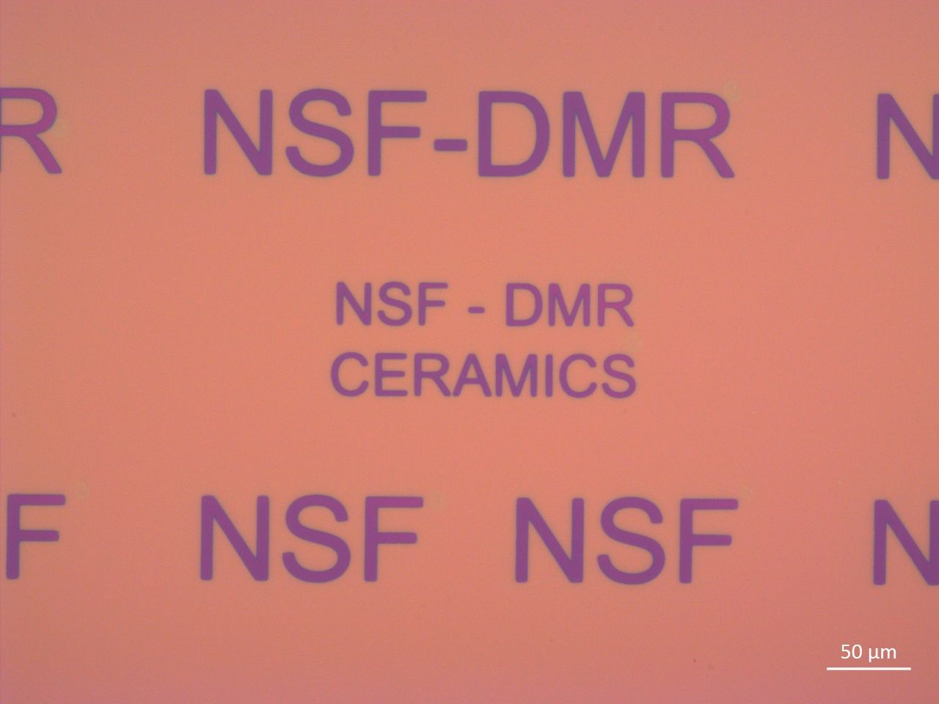
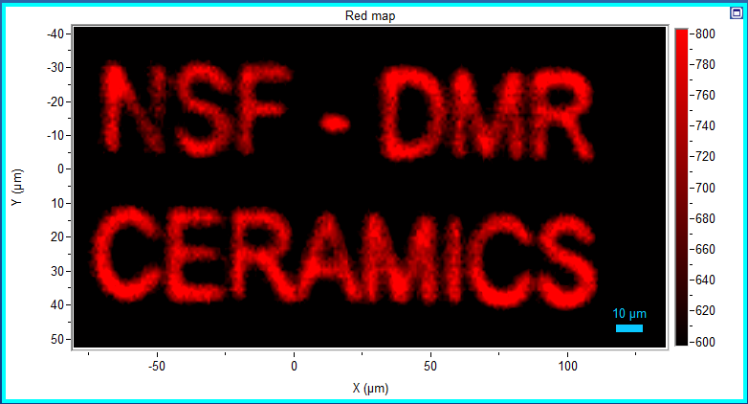
Design
Optical image of Au@MoS₂ pattern
10 µm
Raman mapping

