Slide 1
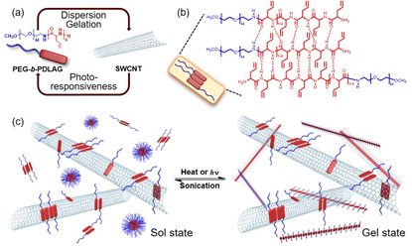
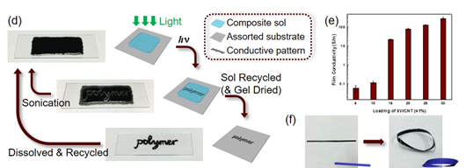
Complex Functional Materials Accessed Uniquely through Selective Macromolecular Interactions
DMR 1507429
We developed a strategy for reversible patterning of soft conductive materials, based upon a combination of peptide-based block copolymer hydrogelators and photo-thermally-active carbon nanotubes. This composite displays photo-responsive gelation at application-relevant timescales, allowing for rapid and spatially-defined construction of conductive patterns, which, additionally, hold the capability to revert to sol upon sonication for reprocessing. Based on the recent interest in printable electronics and reversible printing techniques, this research is anticipated to attract broad interest and inspire further investigations.
Karen L. Wooley, Texas A&M University Main Campus
(a) Functions of the PEG-b-PDLAG and SWCNT composite components. (b) β sheets as constructive units of nanofibrils. (c) Reversible PEG-b-PDLAG/SWCNT sol vs. gel states. (d) Reversible photo-patterning process. (e) Electrical conductivity of composite films (PEG₄₅-b-PDLAG₂₈/SWCNT) as a function of percentage SWCNT incorporation. (f) A printed free standing thin film fabricated into a Möbius strip.
He, X.; Fan, J.; Zou, J.; Wooley, K. L. “Reversible Photo-patterning of Soft Conductive Materials via Spatially-defined Supramolecular Assembly”, Chem. Commun., 2016, 52, 8455-8458, DOI: 10.1039/c6cc03579e.
Notes:
A key to this design is the synergistic effect of reversible thermo-induced supramolecular assembly of the polymers and photothermal conversion of carbon nanotubes, which is believed to be appropriate for expansion to a variety of other systems. A broad scope of applications can be anticipated for this system, including patternable and flexible conductive materials with various dimensions, injectable and near IR curable hydrogels for bioelectronics or tissue engineering, and 3D printing materials for permanent or temporary layers.

Slide 2
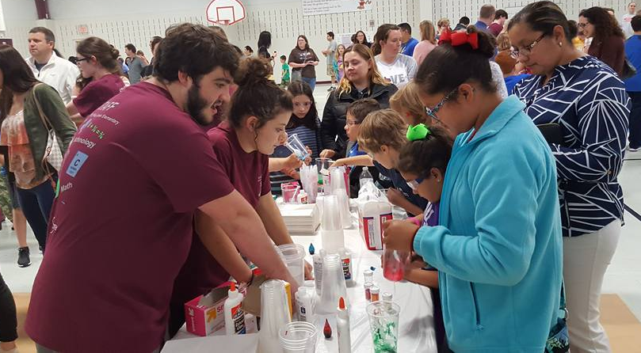
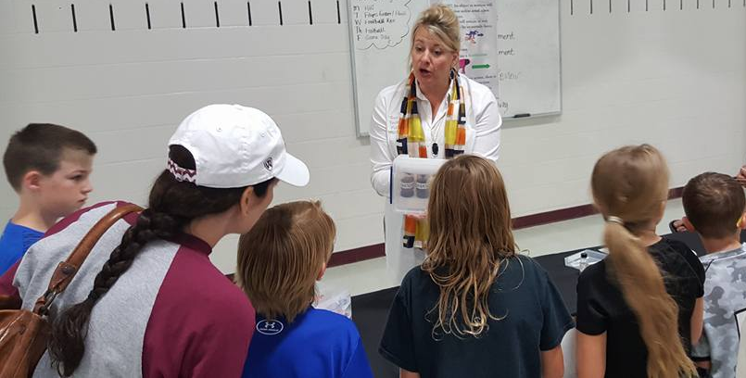
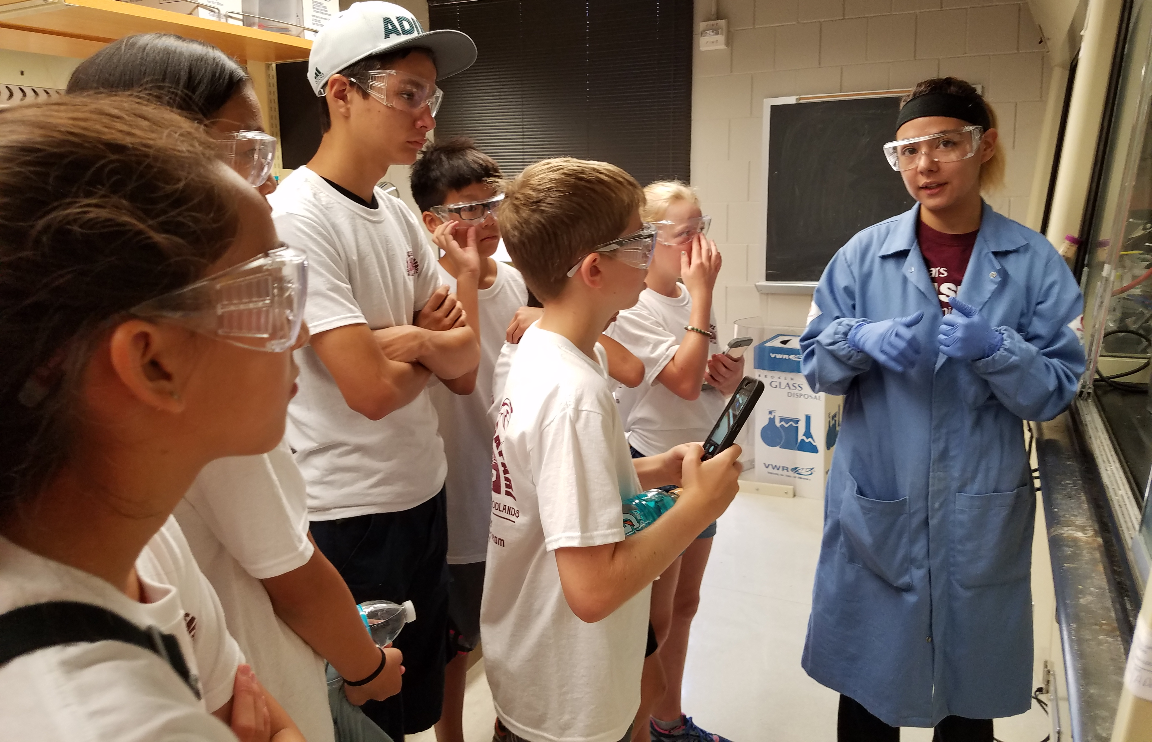
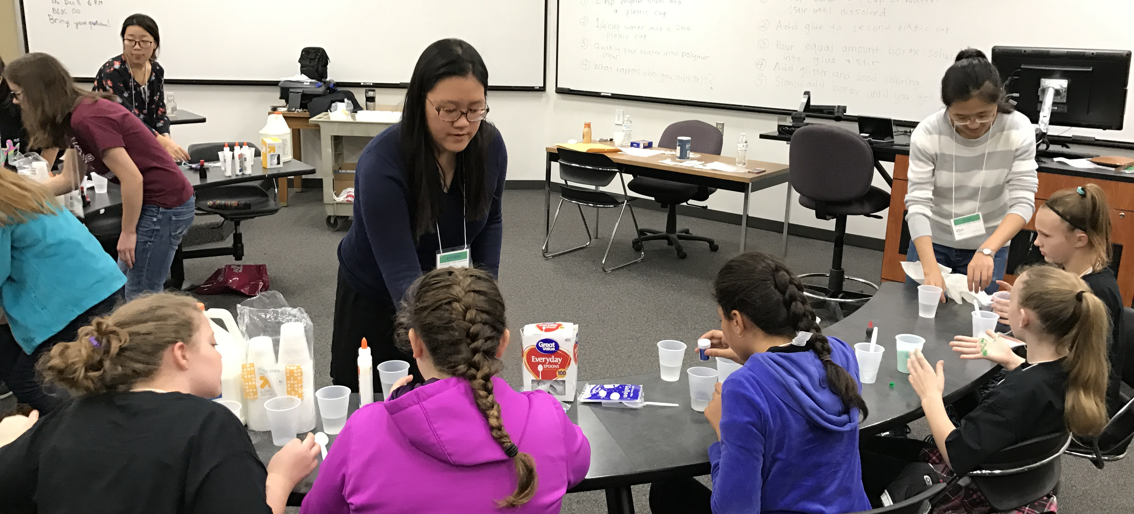
Complex Functional Materials Accessed Uniquely through Selective Macromolecular Interactions
DMR 1507429
Karen L. Wooley, Texas A&M University Main Campus
The PI and her students are actively involved in educational and outreach activities, including hosting visiting students, mentoring undergraduate researchers in the laboratories, and leading polymer-based outreach activities at several local venues. Notably, a Science Night organized by the PI and her research group at a local elementary school in collaboration with two of the elementary school teachers brought together researchers across multiple disciplines at Texas A&M University and local companies to provide ca. 15 engaging science and engineering activities that were enjoyed by hundreds of students and their families in April 2017. In July 2017, the PI and seven of her research group members ran a week-long Nanotechnology Youth Adventure Program for thirteen middle-to-high school students, four of whom are from underrepresented groups. During 2016-2017, the PI also served as an advisor to the inaugural postdoctoral association of chemistry at Texas A&M, contributed to the 2016 NSF Workshop Report “Frontiers in Polymer Science and Engineering”, and organized several symposia.
April 2017
Students and their families engaged with Texas A&M researchers and industrial professionals in an evening of science and engineering activities, organized at Pebble Creek Elementary School (April 2017)
Several of the PI’s Ph.D. students provided demonstrations on polymer materials with real-word applications to middle school students during the Summer Safari at TAMU (August 2016)
The PI’s students led sixth- grade girls in polymer snow and slime experiments during the Expanding Your Horizons event at TAMU
(December 2016)

