Slide 1
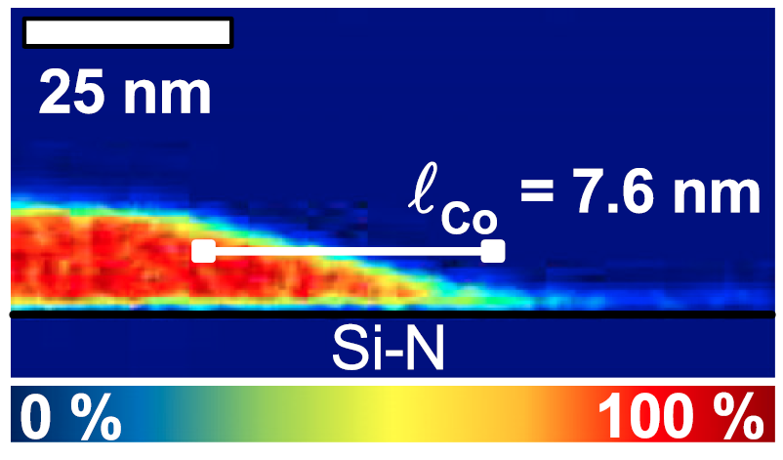
Room Temperature Spin Kondo Effects
DMR 1507048
Christopher Leighton, University of Minnesota-Twin Cities
The Kondo effect is a celebrated and important effect in condensed matter physics where the conduction of electrical current in a metal is profoundly impacted by the presence of minute levels of magnetic impurity atoms. In recent work under this award a “spin” version of the Kondo effect has been studied, where spin currents (magnetic currents that flow with little power dissipation) are similarly affected by tiny levels of magnetic impurities.
Previously this phenomenon has been observed only at cryogenic temperatures, far below room temperature, with little impact on real applications. In the work highlighted here, however, the effect has been demonstrated to occur at room temperature in certain materials, with deep implications for “spintronic” devices aimed at computer memory applications. Most importantly, the developed understanding points to a means to control it in devices, generating substantial application potential.
Cu
Co
Chemical “map” of a nanometric spintronic device made from cobalt (red) and copper (blue). Note the spillover of cobalt atoms into the copper (the horizontal streak) which produces the room temperature spin Kondo effect observed in this work for the first time.
Watts, Jeong, O’Brien, Mkhoyan, Crowell and Leighton
Appl. Phys. Lett. 110, 222407 (2017)
Notes:
The referenced paper focuses on Non-Local Spin Valves (NLSVs), which are devices that enable the measurement of injected pure diffusive spin currents, and thus the spin diffusion length, in non-magnetic metals. A spin Kondo effect occurs when these injected spin currents are highly efficiently relaxed at tiny concentrations (ppm level) of magnetic impurities formed by intermixing. In this work Co impurities intermixing into Cu were shown to generate a room temperature version of this effect, compared to the typical 50 K temperatures. This occurs due to the very high Kondo temperature for Co in Cu. Conventional Kondo effects at room temperature are obscured by phonon scattering, but are clearly seen in spin transport, even above 300 K. In this work this effect was studied vs. temperature, dimensions, etc., and correlated with chemical maps from scanning transmission electron microscopy (as in the figure). The thickness effects in particular are quite surprising, but can be understood within a simple framework. Importantly, the use of non-local-moment-forming metals such as Al is shown to suppress the effect, which is potentially very important for applications. The Co/Cu combination is in fact one of the most likely to be employed in spintronic applications in hard disk drive read heads.

Slide 2
Room Temperature Spin Kondo Effects
DMR 1507048
Christopher Leighton, University of Minnesota-Twin Cities
In addition to the education of undergraduate and graduate students in materials science and physics, which is completely integrated into the research, this project also features outreach to the public.
One example is shown in the image to the right, highlighting the annual Nano Day event at the Science Museum of Minnesota. Here, University of Minnesota faculty (including the PI on this award) go on to the museum floor to give demonstrations and explanations of nanoscience to museum visitors, particularly children. This year the PI is additionally in the planning stages of an expansion of this concept to specifically focus on materials science. The aim is to educate the public about the central role materials play in science and technology, and in the world around them.
www.smm.org/nanoday

