Slide 1
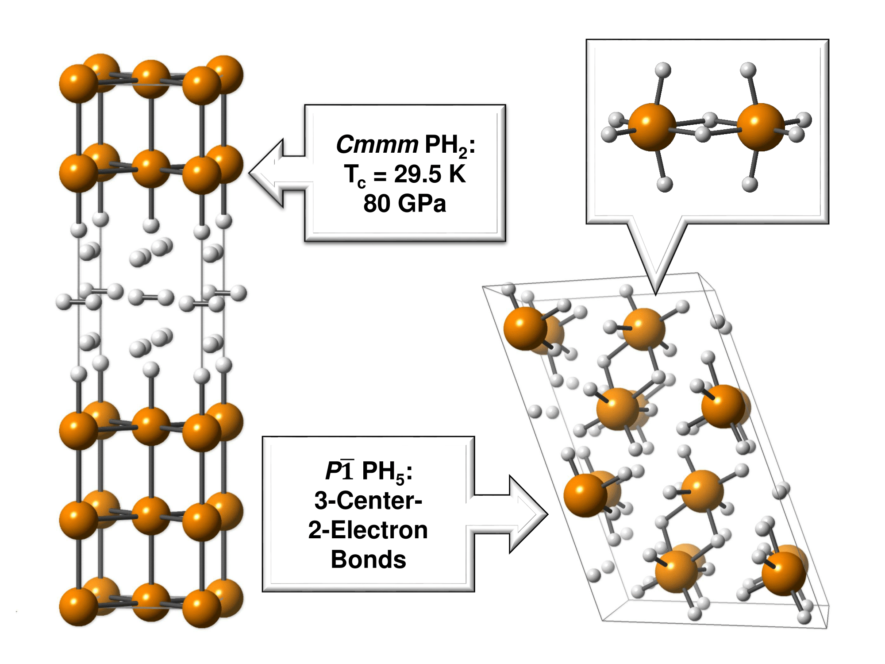
Computational Design of Novel Superconductors
DMR 1505817
Eva Zurek, SUNY at Buffalo
Unlike in a normal material, electricity can flow without resistance in a superconductor. But most materials are superconducting only at very low temperatures. In 2015 experimental researchers found that when hydrogen sulfide (H₂S) was compressed to 150 GPa it underwent a superconducting transition (T_{c}) near 203 K [1]. This is the highest temperature superconductor known to date.
In 2016 this same group found that the resistance of phosphine (PH₃) disappeared upon compression to 83 GPa at 30 K [2]. Our theoretical calculations based on quantum mechanics showed that under pressure decomposition products of phosphine, and in particular PH₂, are likely to be responsible for the observed superconductivity [3]. The superconductivity arises from the vibrations of the phosphorus atoms and the hydrogen atoms bound to them. The H₂ molecules that lie between the hydrogen capped phosphorus layers are mobile, and they help to stabilize the structure. A PH₅ phase, whose structure and bonding resembles that of the iconic molecule diborane was also predicted to be stable.
Illustrations of the superconducting PH₂ structure, and the diborane-like PH₅ structure predicted by quantum mechanical calculations. Phosphorus atoms are gold, hydrogen atoms are white
[1] Drozdov, A. P.; Eremets, M. I.; Troyan, I. A.; Ksenofontov, V.; Shylin, S. I.. Nature, 525, 73
[2] Drozdov, A. P.; Erements, M. I.; Troyan, I. A. http://arxiv.org/pdf/1508.06224.pdf
[3] Bi, T.; Miller, D. P.; Shamp, A.; Zurek, E.: Angew. Chem. doi:10.1002/anie.201701660.

Slide 2
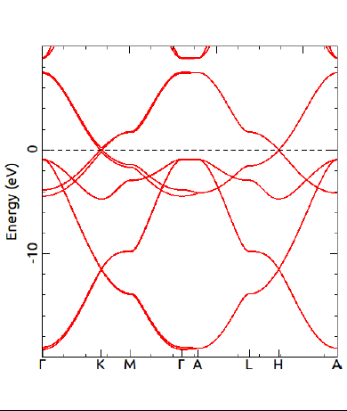
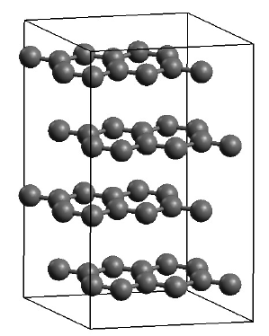
Celebrating Nobel Laureate Roald Hoffmann
DMR 1505817
Roald Hoffmann is an American theoretical chemist who won the 1981 Nobel Prize. Hoffmann’s research has had a tremendous impact on a broad range of problems in organic and inorganic chemistry, spanning molecules to nanosystems to materials. He has done much to bridge gaps between chemistry and physics, as well as to educate and involve the public in science. This year Hoffmann turns 80 years old. The PI is co-organizing a 4 day symposium held as part of the American Chemical Society Meeting in Washington DC to celebrate Hoffmann.
Hoffmann pioneered the use of a semi-empirical theoretical method (extended Hückel theory) for studying molecules and solids. The YAeHMOP program was developed in Hoffmann’s group for this purpose. We have implemented YAeHMOP into Avogadro [1] - an extremely popular program to build, visualize and analyze chemical systems for specialists and non-specialists alike. Computational exercises for undergraduate chemistry students using YAeHMOP in Avogadro [2] have been developed and submitted for publication [3].
Eva Zurek, SUNY at Buffalo
Band structure and structure of graphite calculated and visualized by YAeHMOP + Avogadro
[1] https://avogadro.cc
[2] https://avogadro-yaehmop.github.io
[3] Avery, P.; Ludowieg, H.; Autschbach, J.; Zurek, E. J. Chem. Educ. submitted.

