Slide 1
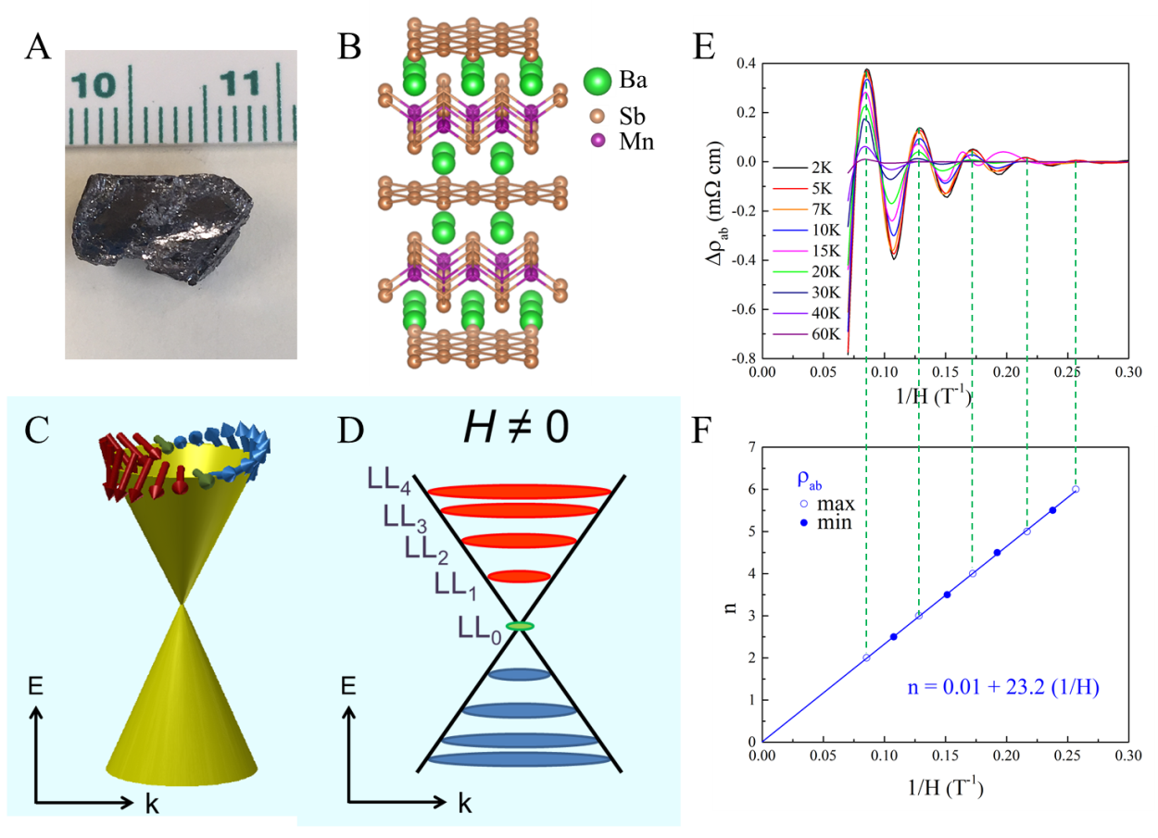
Surface and Bulk Properties of Layered Transition-Metal Compounds: Manifestation of Broken Symmetry
DMR 1504226
E. Ward Plummer, Louisiana State University & Agricultural and Mechanical College
Significant Results: A class of materials that have topological ordering has emerged as a new frontier of condensed matter physics due to experimental confirmation of physical concepts proposed nearly a century ago. Our work shows magnetic semimetal BaMnSb₂ (Figs. A and B) exhibits nearly zero-mass fermoins with high mobility as reflected in Shubnikov-de Haas resistivity oscillations (Fig. E). The oscillation is due to quantized Landau levels (LL) under magnetic field (Figs. C and D), which leads to a nontrivial Berry phase (Figs.C and F).
What is unique is the magnetic ordering, placing BaMnSb₂ in the small Weyl material family. The combination of high mobility and spin ordering makes this material highly desirable for energy-saving device application. The work is reported in PNAS 114, 6256 (2017).

Slide 2
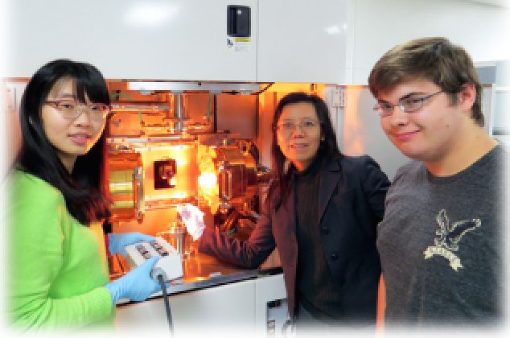
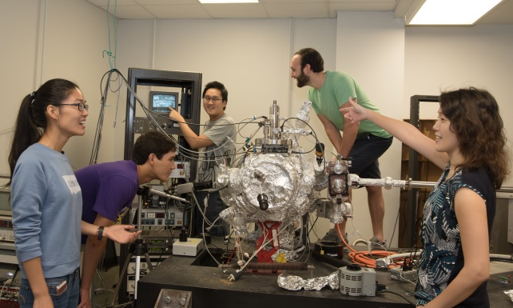
Surface and Bulk Properties of Layered Transition-Metal Compounds: Manifestation of Broken Symmetry
DMR 1504226
E. Ward Plummer, Louisiana State University & Agricultural and Mechanical College
Broader impacts: We had three undergraduate researchers working on single crystal growth (Samuel Dai – a REU student and Lucas Lavoie a LSU student in Fig. A) and characterization (Thomas Abrahams – the 2nd left in Fig. B) of various materials. One is planning to go to Graduate school.
We have graduate students, Ms. Jiayun Pan (Fig. A(left)) Ms. Silu Huang, and Mr. Joel Taylor (2nd right of Fig. B), working on this project. Jiayun finished her thesis work in Dec. 2016, Silu and Joel focus on bulk and surface property measurements of topological materials. Our post-doctoral fellow, Dr. Jisun Kim (most right of Fig. B) worked on this project.
The PI, Plummer, has given a public lecture entitled “Materials for the 21st Century: A Revolutionary—Not Evolutionary Approach”, at high schools, to undergraduates, graduates and, plenary lectures (around the world). The co-PI, Jin, has been giving lectures to undergraduate and graduate students lectures entitled “Materials Today: Investing for the Future”.
A
Rongying
Jin
Lucas Lavoie
Jiayun Pan
B
Joel Taylor
Jisun Kim

