Slide 1
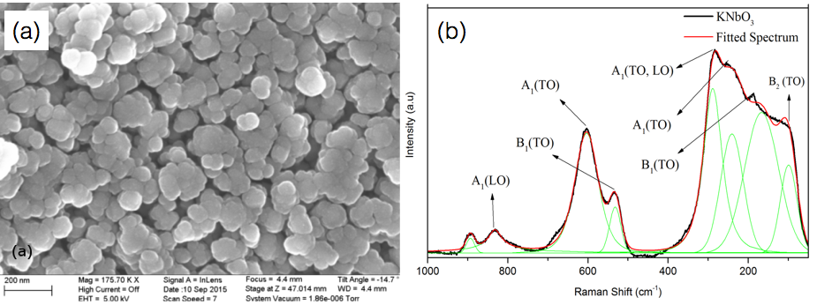
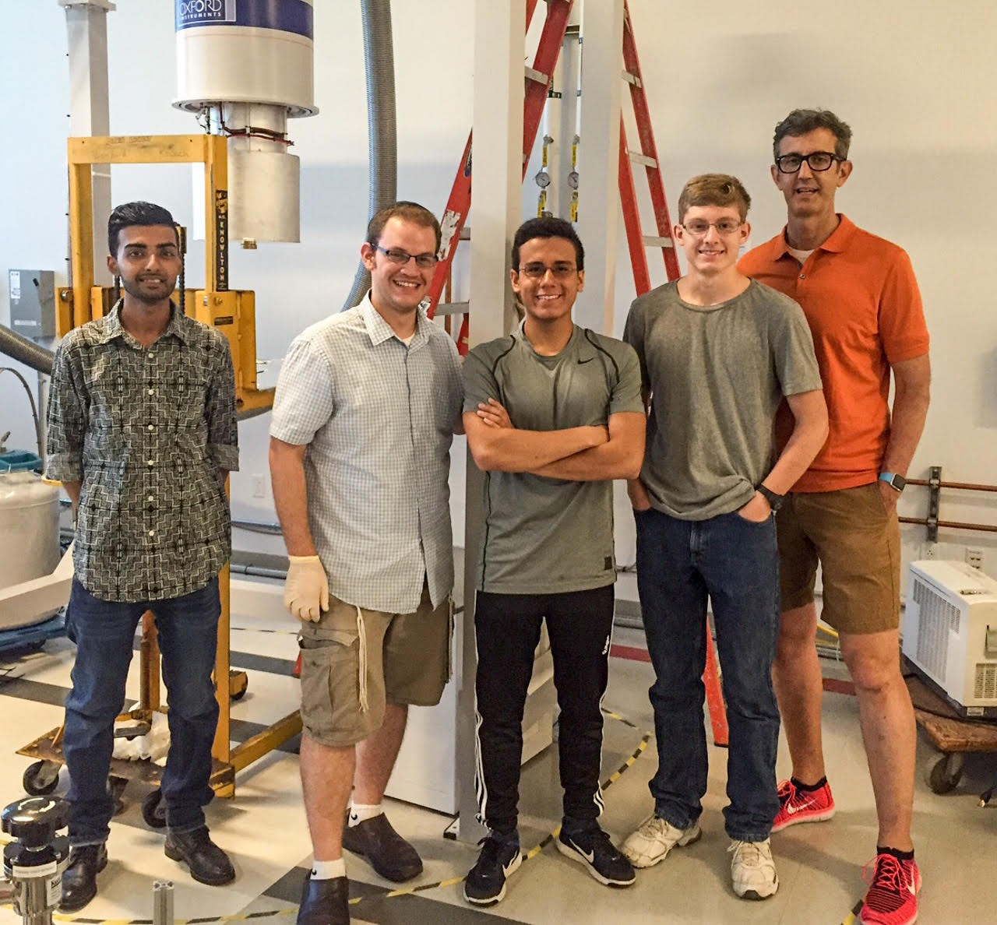
Preparing high dielectric materials and high school students Stephen O’Brien, CUNY City College, DMR 1461499
Outcome: Sometimes “complex” can be a good thing: a chemical solution processing method was used to obtain a set of perovskite compounds of the formula [KNbO₃]_{1-x}[BaNi_{0.5}Nb_{0.5}O_{3-d}]_{x}. This complex oxide, called KBNNO, belongs to a class of visible light absorbing materials that are both ferroelectric (possess strong polarization properties) and photovoltaic, with a tunable bandgap as a function of x. The materials produced were fully crystallized and displayed strong dielectric behavior in nanocomposites.
Impact: Inorganic materials synthesis techniques that can approach low temperature routes akin to chemical solution processing are attractive for their ability to prepare nanocrystalline oxides. These methods can offer thin film integration options more compatible with modern device platforms such as spray coated or printed (2D, 3D) devices and flexible electronics.
Explanation The deployment of a low temperature chemical synthesis technique, effective for making new materials that are multiferroic and/or high dielectric in nature, is a major component of this project. The synthesis of nanocrystalline KBNNO was via potassium, niobium, barium and nickel alkoxides. It provided an approach to doping ferroelectric KNbO₃ with Ba and Ni, which inserts Ba²⁺ onto the A-site, and Ni²⁺ onto the B-site with the addition of oxygen vacancies for charge compensation. KBNNO was previously only synthesized by solid state processing > 1000 °C.
Above. (a) Scanning electron micrograph image of nanocrystalline (20nm) KBNNO (b) Raman spectroscopy was used to probe the structure of KNO and KBNNO.
Below. This project sponsors a summer program for students from the High School for Math Science and Engineering, one of New York City’s specialized schools located in Harlem. HSMSE has a diverse student body, where students of all ethnic and economic backgrounds mingle comfortably. From right: science teacher Tom Henning with Isaac Draper (Junior) and Brandon Fajardo (Sophomore) working on a condensed matter physics project with two graduate students. (7/20/16)
Notes:
Add additional explanatory notes here please.

