Slide 1
Two dimensional van der Waals systems
DMR 1455233
Superconductor/Semiconductor
heterostructures
Enrico Rossi, College of William & Mary
Developed theory to obtain many-electron wavefunction in Superconductor/Semiconductor heterostructures in which Majorana “particles” can be realized and “splitted”. A Majorana particle is its own antiparticle. Majoranas particles are the fundamental blocks for the realization of “topological quantum computers”.
Al
z
InAs
x
Gate
In a TI the electron’s spin is perpendicular to the direction of its momentum. This gives rise to novel spintronics effects. We find that these effects are greatly enhanced in TI/graphene heterostructures
Y
V_{gate} = -0.76V
V_{gate} = -0.86V
V_{gate} = -0.76V
Majoranas
Majoranas
x
Notes:
Superconductor/Semiconductor heterostructures.
Top left figure shows setup of structures
Top right figure shows the profile of the wawefunction in the direction perpendicular to the SC/SM interface (z-direction). We can se large weight in SC.
The bottom figure shows the wavefunction in the direction parallel to the interface for the case when different gate potential are applied along the heterostructure. The result show that for realistic voltages and geometry it should possible to create 4 separate Majorana modes in a SM/SC wire.
TI/Graphene heterostructures.
Top left panel shows the setup
Top right panel shows schematic of spin accumulation for a current in the y-direction.
The bottom left panel shows spin texture on the Fermi surface of the graphene/TI heterostructure.
The bottom right panes shows the ratio between the calculated strenght of the spin-density response to the current for a graphene/TI heterostructure and an isolated Ti. The ratio can be larger than 100 showing that a graphene/TI heterostructure can be very efficient in converting a charge current into a spin polarization.

Slide 2
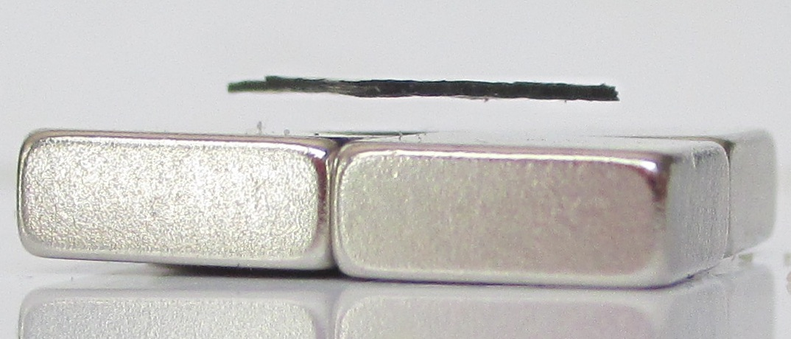
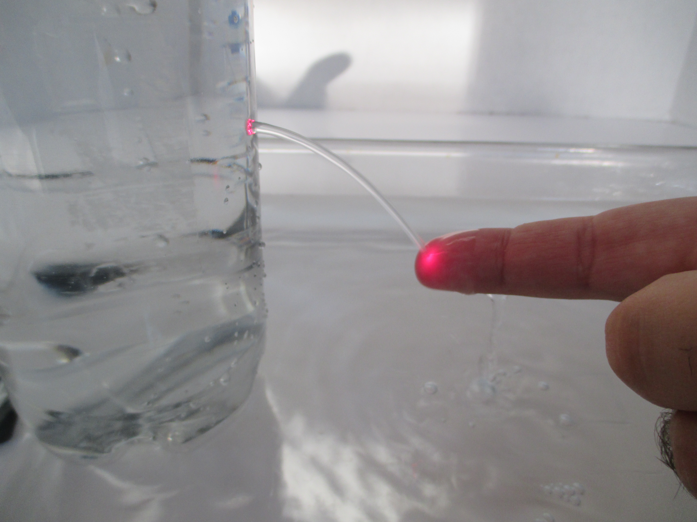
Broader Impacts
DMR 1455233
Physics Briefcase
Completed development and documentation of initial set of portable physics demonstrations.
Created website to present and explain the first set of portable demonstrations
Enrico Rossi, College of William & Mary
Levitating Graphite
Physics-Briefcase-Website
Solid-State Wiki-Book
- Created by students
- Open: continuously updated and revised by students with PI’s supervision
From the Physics Briefcase: a thin flake of graphite levitates above magnets.
Bending light with water
Training of students and postdocs.
One postdoctoral researcher, two graduate students and one undergraduate students were involved in the research supported by the Award.
From the Physics Briefcase:
The laser light out of the hole is guided, "bended", by the water stream that acts as a waveguide
Outreach activities
Public Lecture on the 2016 Physics Nobel Prize
Notes:
Developed first set of portable physics demonstratioons, “Physics Briefcase”
Documented initial set of portable demonstration and created dedicated website: http://physics.wm.edu/~erossi/PhysicsBriefcase.html
Undergraduate student, sophomore, Jacopo Gliozzi accepted to REU program at UCLA to work on a condensed matter project.
Figures show two examples of initial demonstrations in Physics Briefcase:
Levitating Graphite: the repulsive force due to the opposite magnetic fields (the one created by the magnets and the one created by the electrons in the graphite) is strong enough to compensate the gravitational force and make the graphite flake levitate.
Bending light with water: The laser light out of the hole is guided, "bended", by the water stream that acts as a waveguide.

