Slide 1
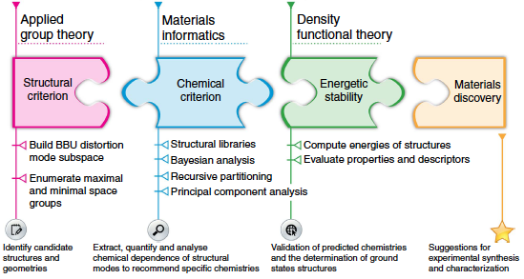
Learning from data to design functional materials without inversion symmetry
DMR 1454688
James M. Rondinelli, Northwestern University
Scientific Achievement
We developed a predictive data-driven workflow to rationally discovery noncentrosymmetric materials. Compositional screening for the Ruddlesden-Popper oxide family using our scheme suggests that the number of noncentrosymmetric structures can be increased 25-fold.
We used density functional theory calculations to assess the structural stability of 17 predicted compositions, two of which are multiferroic
We are working with experimental collaborators to realize these predicted compounds in the laboratory
Significance and Impact
Increasing the number of noncentrosymmetric materials is important to improving material performance of compounds found in actuator, imaging, and data storage technologies. However, identifying such materials has been slow and challenging. We demonstrate that informatics-guided ab inito methods can accelerate the discovery process by uncovering new microscopic mechanisms.
Predictive discovery framework illustrates how the synergistic integration of applied group theory, materials informatics and ab initio calculations can be used to design new functional materials.
P. V. Balachandran, J. Young, T. Lookman, and J.M. Rondinelli
Nat. Comm., 8, 14282 (2017)

Slide 2
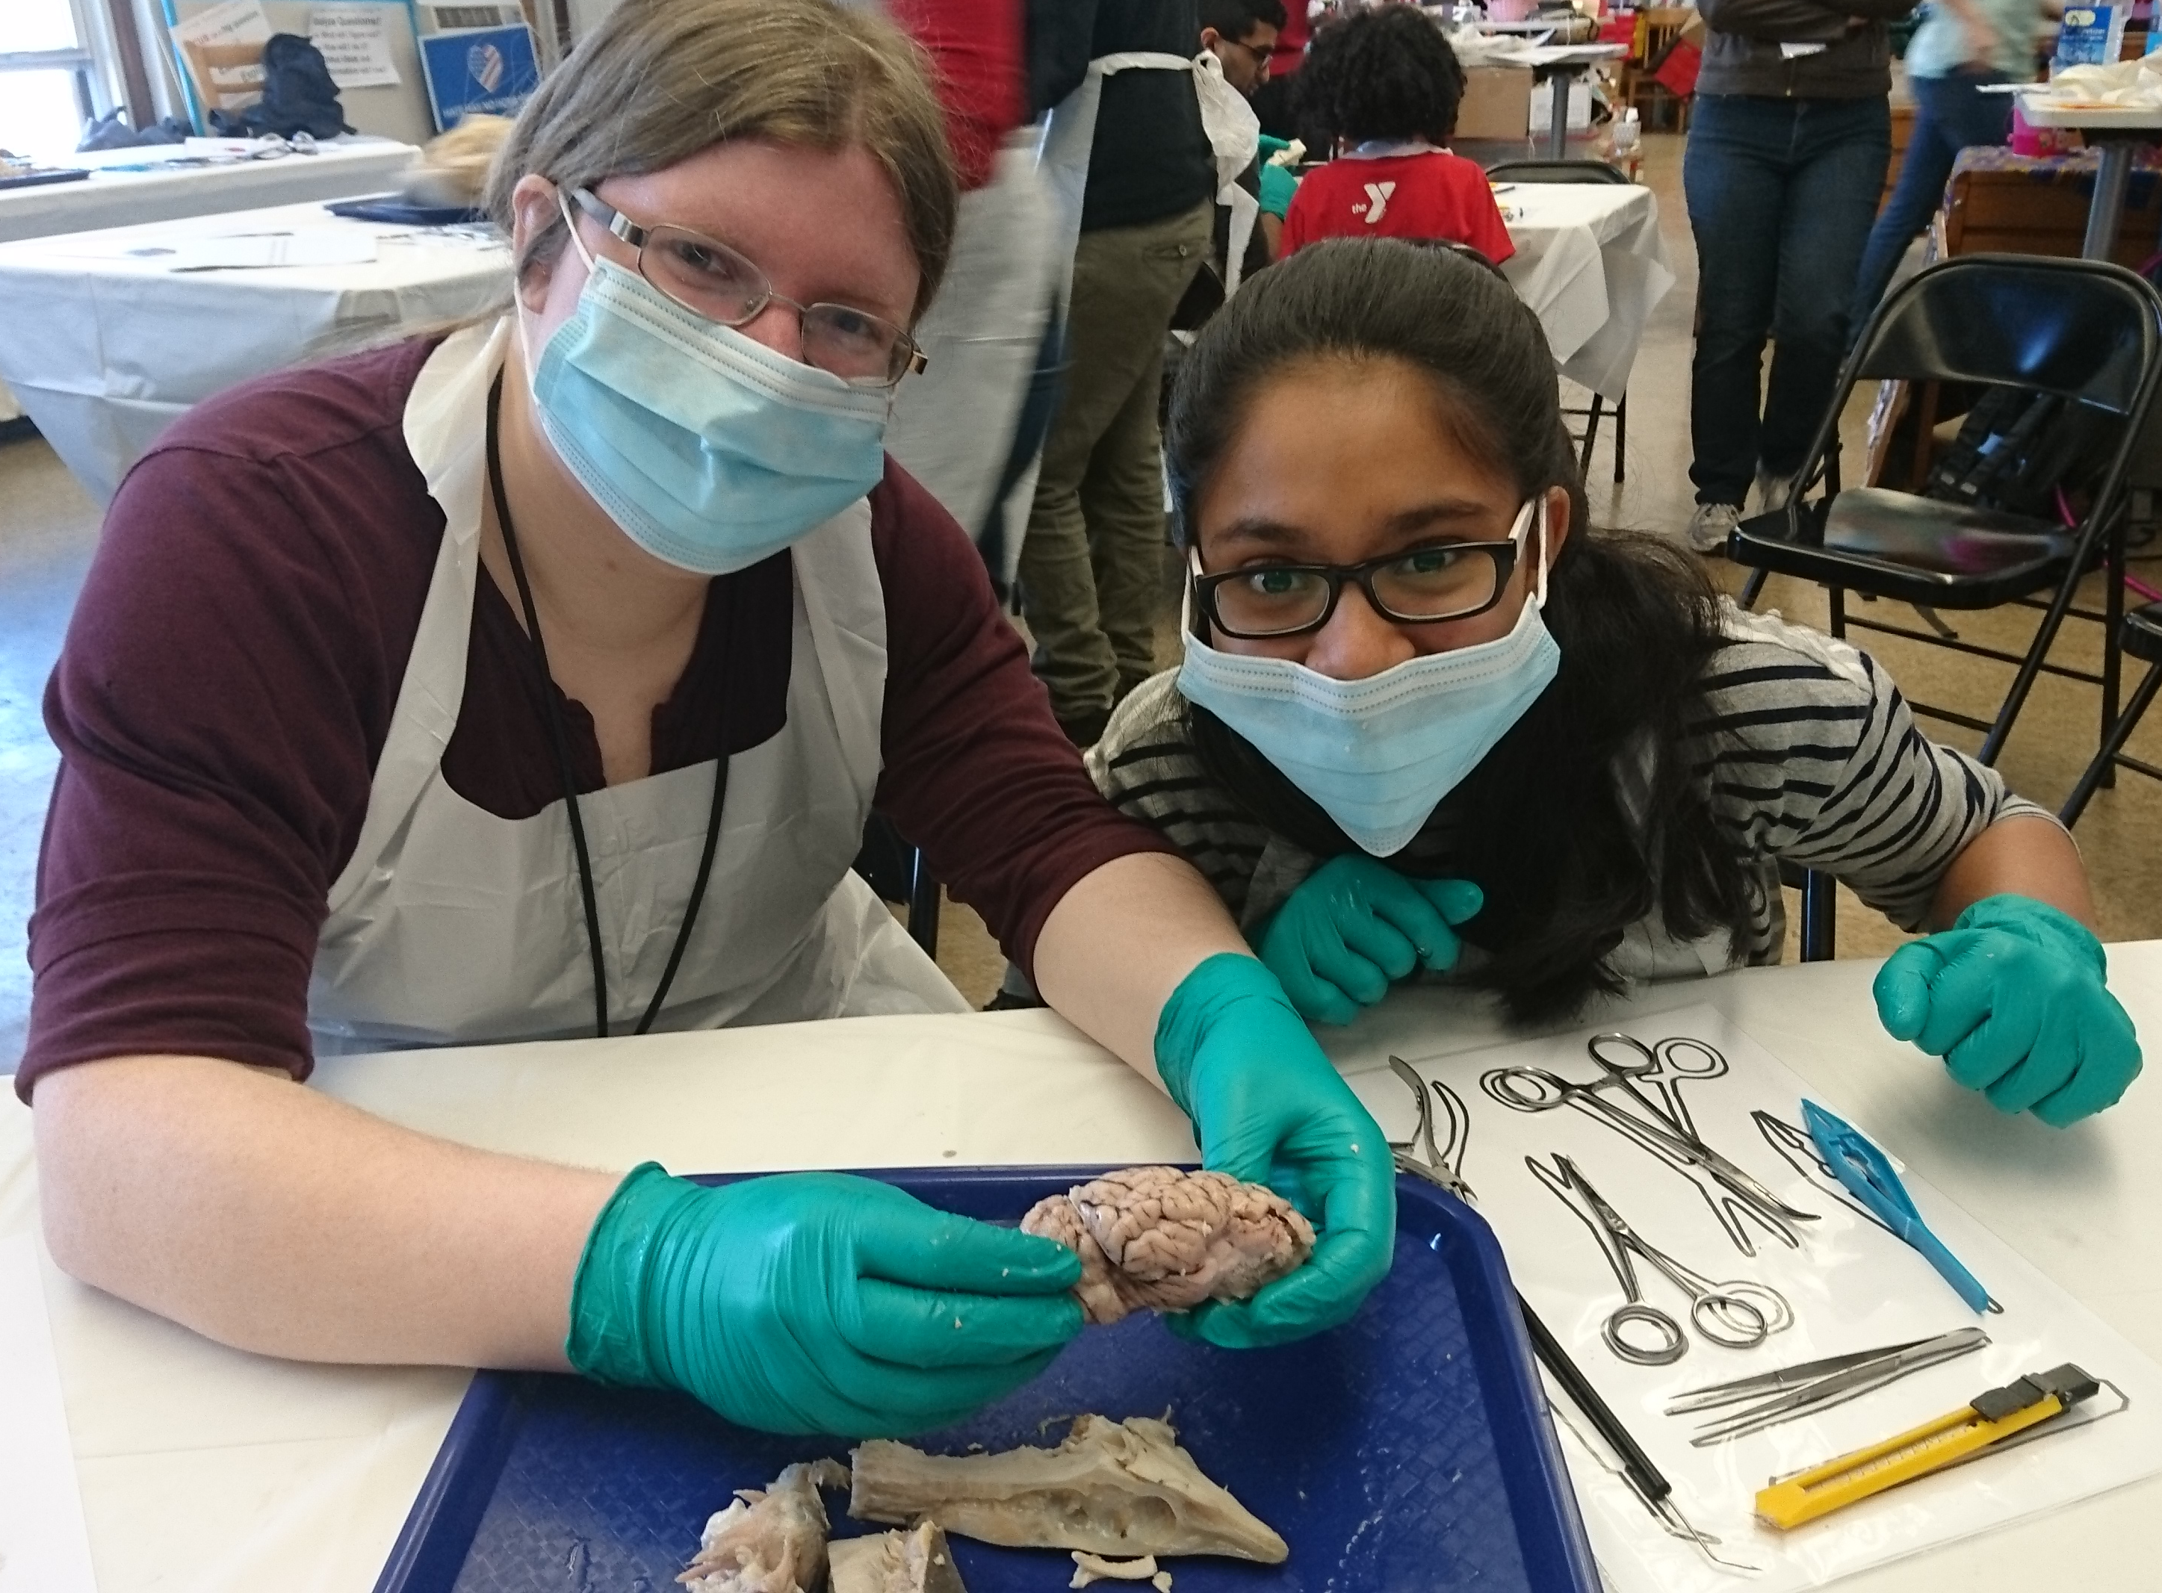
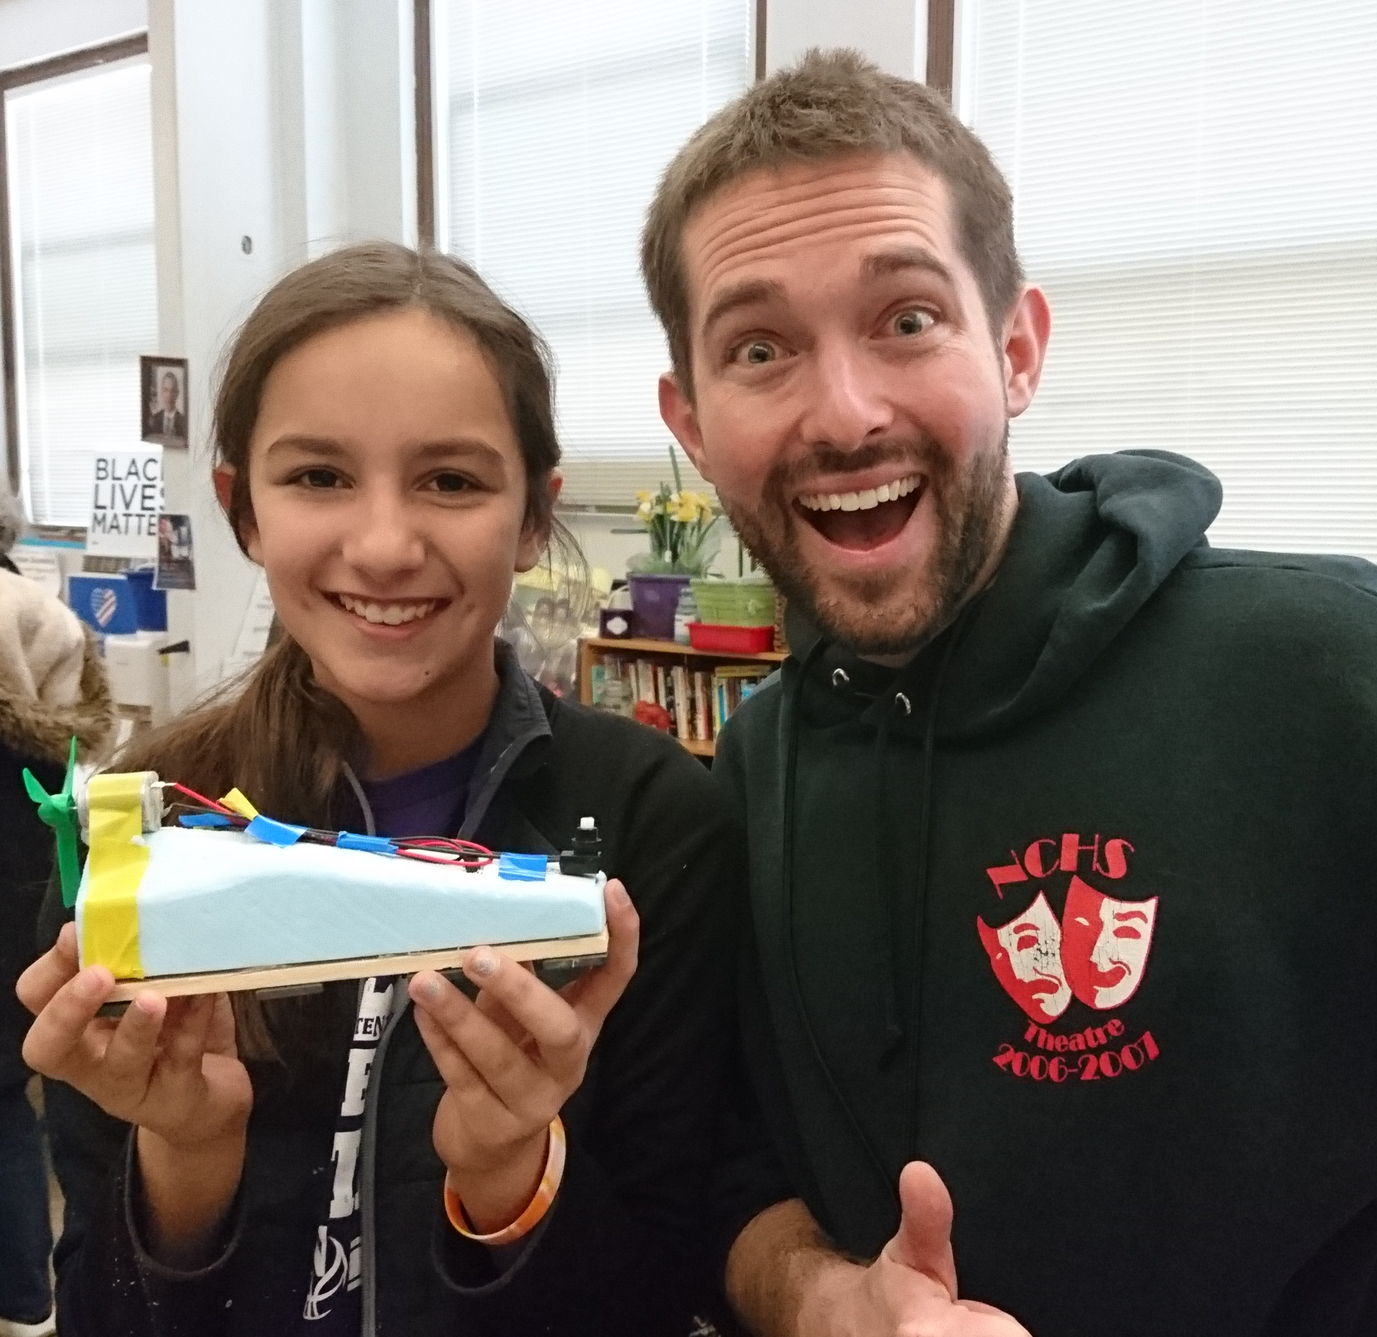
Broadening Participation through Hands-On Curiosity Challenges and Advancing the Workforce
DMR 1454688
James M. Rondinelli, Northwestern University
Graduate students Ms. Jaye Harada, Mr. Nenian Charles, and Mr. Richard Saballos, all supported by DMR-1454688, organized and participated in the engineering challenges program for middle school students, Science in Your Community Center (SICC) Saturdays. The program held once a month in Evanston’s 5th Ward focused on stimulating the interests of students from low income districts in Evanston in STEM careers. About 20 students participated each Saturday.
As a chair of the Undergraduate Curriculum Committee, Rondinelli has been working toward the development of new computation materials science and materials informatics courses.
9 new lectures were developed toward the proposed course
DFT and materials informatics labs were developed to allow students to hands-on practice in both supervised and unsupervised learning machine learning methods
Student volunteers helping participants dissect shark and sheep heads (above left) and create maglev trains for a race (above right)
Dr. Balachandran of Los Alamos National Laboratory (far left) and Ms. Antono of the startup Citrine Informatics (left) shared their expertise by presenting use-case and studies and tutorial exercise to Northwestern undergraduate and graduate students

