Slide 1
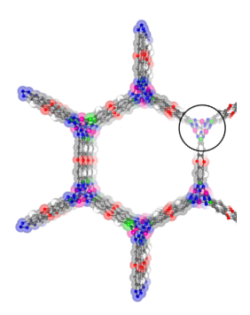
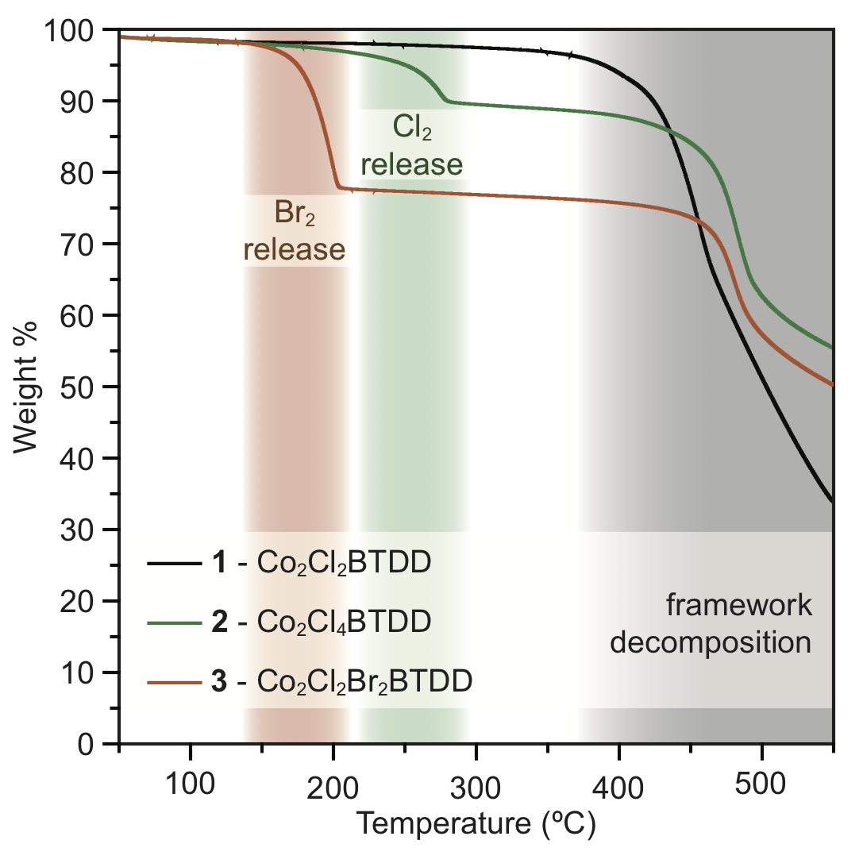
CAREER: Small Molecule Redox Reactivity at MOF Secondary Building Units
DMR 1452612
Mircea Dinca, Massachusetts Institute of Technology
Metal-Organic Frameworks (MOFs) are a broad class of crystalline materials comprised from metal ions and rigid organic molecules. Because of their high porosity, MOFs are useful for adsorbing industrially important gases, such as CH₄, H₂, CO₂. Similar use of MOFs for reversible sorption of gaseous halogens is challenging due to the irreversible structural damage of these highly corrosive substances.
We show here that coordinatively unsaturated Co(II) ions in a robust azolate-based MOF are quantitatively oxidized by Cl₂ or Br₂, producing stable and safe-to-handle Co(III) materials. Thermal treatment of the oxidized MOFs results in the reduction of the Co(III) centers and concomitant release of elemental halogens. The capture and thermal release of the halogens occur with no loss in structural integrity and porosity of the parent MOF even after three oxidation/reduction cycles.
a.
b.
c.
d.
a. Portion of the structure of the parent Co(II) MOF (1) projected along the c axis. b−d. Local coordination environments of the Co centers in 1,2, and 3. e. Termogravimetric analysis plots exhibiting abrupt weight losses corresponding to halogen liberation from 2 and 3.
e.

Slide 2
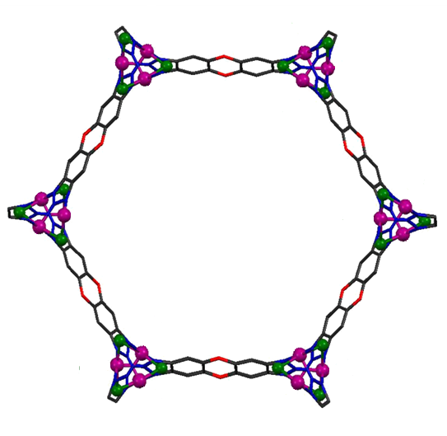
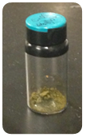
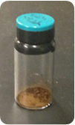
CAREER: Small Molecule Redox Reactivity at MOF Secondary Building Units
DMR 1452612
Mircea Dinca, Massachusetts Institute of Technology
Extreme toxicity, corrosiveness, and volatility pose serious challenges for the safe storage and transportation of elemental chlorine and bromine, which play critical roles in the chemical industry. Solid materials capable of forming stable nonvolatile compounds upon reaction with
elemental halogens may partially mitigate these challenges by allowing safe halogen release on demand.
In this work we present such a material operating via a redox mechanism. We believe that our results provide a blueprint for the design of other porous materials geared toward the capture and storage of noxious, corrosive gases through reversible chemisorptive mechanisms.
+ Cl₂ or Br₂
- Cl₂ or Br₂
Co(II) MOF
Co(III) MOF

