Slide 1
Ferroelastic Domain Walls “Spring” Into Action
DMR 1451219
Overall: This work showed a new way to control electric-field driven response in ferroelectric materials
The Challenge: Considerable work on electric-field driven response of ferroelectrics has been completed, but deterministic and large responses from so-called ferroelastic domains (which have an elastic energy component) were not seen
Intellectual Merit: By creating a compositional gradient (namely a film that goes from PbZr_{0.2}Ti_{0.8}O₃ ⬄ PbZr_{0.8}Ti_{0.2}O₃) Professor Martin and his team demonstrated:
Novel domain structures – needle-like domains that terminate in the film
Coherently strained films with large strain gradients (>10⁴ m⁻¹)
Large/reversible field-driven motion of ferrolastic domains and electromechanical effects
Lane W. Martin, University of California-Berkeley
Top: Cross-section scanning transmission electron microscopy images showing (b) the evolution of the out-of-plane strain and formation of a strain gradient and (c) the coherent strain of the films in the plane.
Right: Schematic illustration of the reversible motion of the ferroelastic domain (red, green domains) and switching processes under applied bias showing domains that grow, shrink, and spring back into place
J. Agar, et al., Highly mobile ferroelastic domain walls in compositionally graded ferroelectric thin films, Nature Mater. 15, 549 (2016).

Slide 2
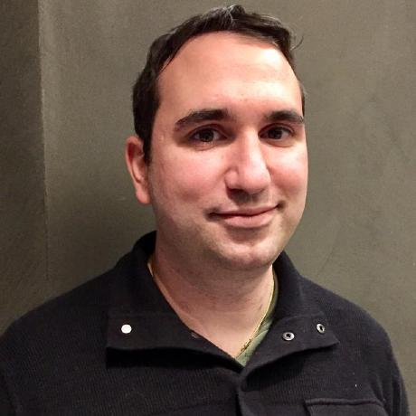
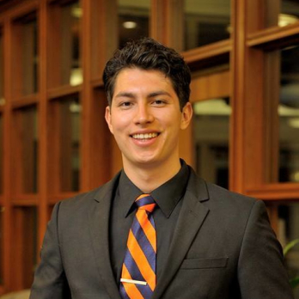
Ferroelastic Domain Walls “Spring” Into Action
DMR 1451219
Overview: Strong and lasting impacts on the recruiting, retention, and training of under-represented minority students in STEM
Highlight: Mr. Gabriel Velarde, first hired as an undergraduate researcher on this program in 2012, grasps his opportunity…
As an undergraduate, Mr. Velarde was a co-author on 4 papers with Prof. Martin and his mentor Mr. Josh Agar
Mr. Velarde turned this success into admission to the Ph.D. program in Materials Science & Engineering at UC Berkeley where he now works with Prof. Martin
Mr. Velarde was also awarded an NSF GRFP in Fall 2017!
Taking a chance on new students and providing sustained support leads to lasting impacts in the field
Lane W. Martin, University of California-Berkeley
Left: Dr. Joshua Agar, former graduate student, lead author of the “springy” domain wall work, and mentor to Mr. Gabriel Velarde.
Right: Mr. Gabriel Velarde, newly minted NSF GRFP awardee and Ph.D. candidate at UC Berkeley. Today he carries on the mission and mentors URM undergraduate student Mr. David Garcia.

