Slide 1
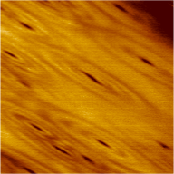
Real-space imaging of a nematic quantum liquid
DMR 1420541
Interactions among electrons can give rise to a variety of exotic quantum phases in solids. An intriguing example is the formation of “nematic” electronic states, whose wave functions break the rotational symmetry of the host material. By examining electronic behavior on the surface of bismuth at high magnetic field, the Princeton MRSEC group showed that a combination of strain and electron-electron interactions lifts the degeneracy of electronic states in this material. Imaging with a scanning tunneling microscope revealed anisotropic wave functions with a different orientation for each broken-symmetry state (Fig. 1).
These results represent the first time that the role of electronic interactions in the formation of a nematic state can be directly quantified in experiment. Moreover, cyclotron orbits have not been previously imaged in any other material.
B. E. Feldman et al., Science 354, 316 (2016).
Ali Yazadani, Princeton University
25 nm
Local density of states on the surface of bismuth at magnetic field B = 12.9 T and energy E = 780 µeV. Dark concentric ellipses reflect the shape of individual electronic states. The anisotropy points in different directions for states at other energies.

