Slide 1
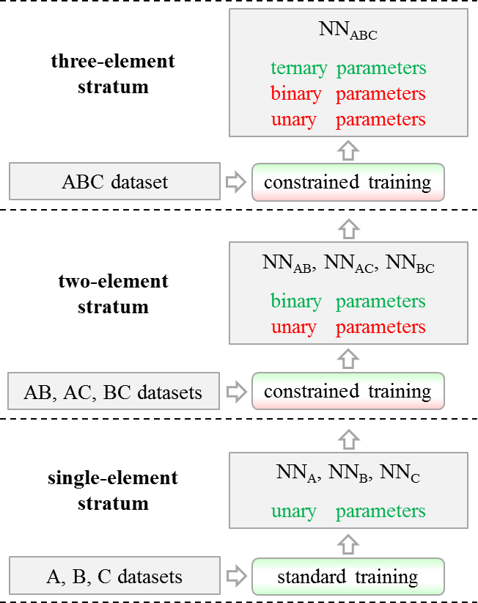
A Machine Learning Framework for Acceleration of Materials Prediction
DMR 1410514
Alexey Kolmogorov, SUNY at Binghamton
Interatomic models based on neural networks (NNs) have emerged as an attractive alternative to traditional potentials. Providing near first-principles accuracy, NNs can be used to speed up structure prediction by orders of magnitude. However, multicomponent-material NN models have had to be developed ‘from scratch’ for every new chemical element set.
We have introduced and tested a hierarchical training procedure to develop NNs from the bottom up: first for elemental materials, then for binaries, and so on. This ‘stratified’ approach allows one to speed up the training process and to build a standardized library of interatomic models for large sets of chemical elements. We have illustrated the robustness of the resulting NN models by performing evolutionary structure searches for multicomponent alloys.
A new stratified procedure for training neural network-based interatomic models for multicomponent materials
Notes:
Phys. Rev. B 95, 014114 (2017) [https://journals.aps.org/prb/abstract/10.1103/PhysRevB.95.014114]

Slide 2
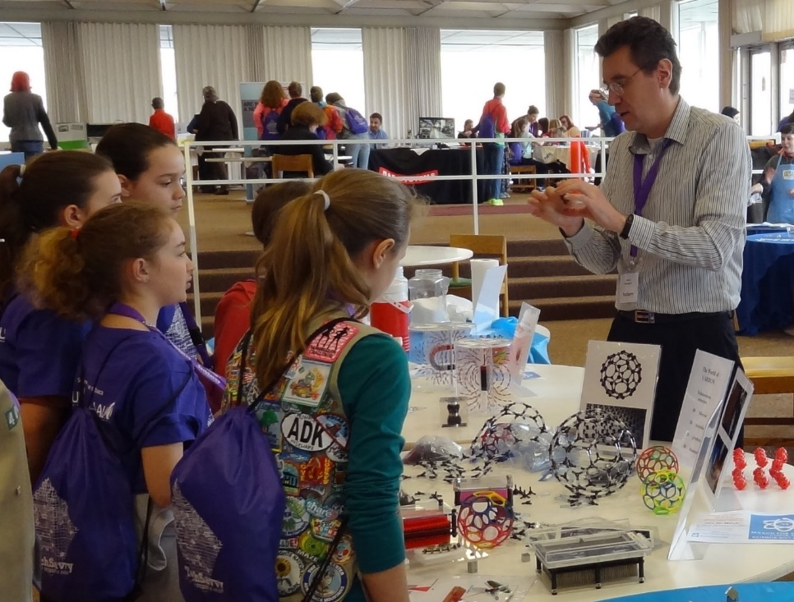
A Machine Learning Framework for Acceleration of Materials Prediction
DMR 1410514
Alexey Kolmogorov, SUNY at Binghamton
As part of the planned outreach activities, the PI has participated in 2017 AAUW TC3 Tech Savvy Program STEM Fair. The event hosted over 150 girls from grades 6-9, parents, and teachers in the upstate New York area. The PI introduced participants to the basics of materials physics and demonstrated how computational research has changed the process of materials discovery.
Several undergraduate students, including two female Computer Science majors, have learned about the developed neural network formalism and contributed to the NSF-funded project. One graduate student from an underrepresented group in STEM was supported by the NSF award.
Demonstration of materials physics basics to students from 6-9 grades at the 2017 AAUW TC3 Tech Savvy Program STEM Fair. The outreach involved over 150 girls from upstate New York schools.

