Slide 1
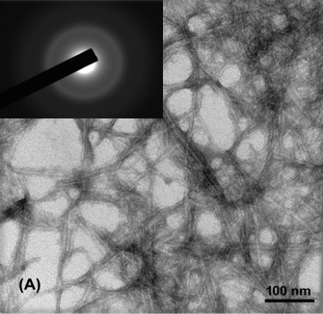
Structure and Property Study of Nanocelluloses and Their Use in Water Purification
DMR 1409507
Benjamin S. Hsiao, Stony Brook University
Nanocelluloses can be derived from a wide range of biomass, including underutilized agriculture waste. These nanomaterials have tremendous untapped potentials for water purification applications. A simple approach was developed by us to prepare carboxycellulose nanofibers directly from untreated biomass using nitric acid or nitric acid-sodium nitrite mixtures. Experiments indicated that this approach greatly reduced the need for multi-chemicals, and offered significant benefits in lowering the consumption of water and electric energy, when compared with conventional multiple-step processes at bench scale (e.g. TEMPO oxidation). Additionally, the effluent produced by this approach could be efficaciously neutralized using base to produce nitrogen-rich salts as fertilizers. Nanofibers with low crystallinity were proven to be effective for removal of heavy metal ions (e.g. lead) for drinking water purification.
Fig. 1 Mechanism of oxidation of cellulose using nitric acid/sodium nitrite (top); TEM image of carboxycellulose nanofibers obtained from untreated jute.

Slide 2
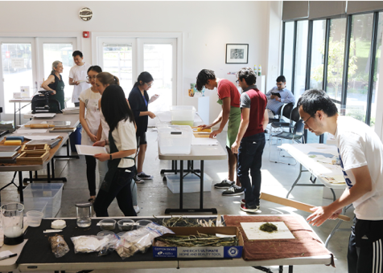
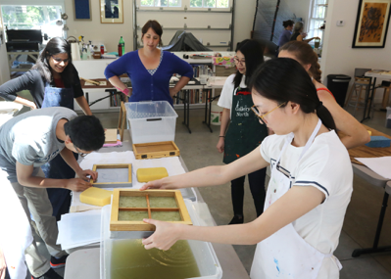
Structure and Property Study of Nanocelluloses and Their Use in Water Purification
DMR 1409507
Benjamin S. Hsiao, Stony Brook University
PI’s research team, supported by this grant, include 2 visiting/senior scientists and 2 PhD graduate students. In this summer, the team mentored 5 undergraduate students, 7 high school students working on several different projects, ranging from extraction of nanocelluloses from agriculture waste (maize reed, millet reed, sorghum reed and bean straws) to removal of toxic metal ions (e.g. lead and chromium) and bacteria in drinking water. In 2016, 4 summer high school researchers from his lab have won semi-finalist/finalist titles in Regeneron STS Scholars and Siemens competitions. PI is also working with Stony Brook's New York State Center for Clean Water Technology (CCWT). Hsiao now regularly engages with the general public, government agencies, and business partnerships regarding the impact of nitrogen removal in groundwater and coastal waters, as well as commercial opportunities in the water technology sector.
Fig. 2 Paper filter making workshop for post-docs, undergraduate and graduate students, using different biomass samples, for water purification applications.

