Slide 1
Nanoscale electric fields in self-assembled optoelectronic biomaterials
DMR 1407493
John D. Tovar, Johns Hopkins University
This program allowed us to engineer electrical and photonic energy migration capabilities into peptide-based nanomaterials that mimic the structural components found in the extracellular matrix. Previously, we demonstrated co-assemblies comprised of a high-energy donor (e.g. top molecule in (a)) and a low-energy acceptor (e.g. bottom molecule in (a)) whereby excitation of the high-energy dye could be funneled to the acceptor. Furthermore, we demonstrated how the acceptor dye could act as an excited-state electron donor to another peripheral dye (e.g. middle molecule in (a)). In a recent report, we demonstrated how to control the nature of the co-assembly process by way of kinetic control. We thus achieve self-sorting or intimate blending based on the assembly conditions.
REF: Ardoña et al. “Kinetically-controlled coassembly of
multichromophoric peptide hydrogelators and the impacts on energy transport,” J. Am. Chem. Soc. 2017, in press
(DOI: 10.1021/jacs.7b04006)
Peptides used for energy-funneling nanomaterials (top) and schematics (b) illustrating the possible self-sorted (left) and co-assembled (right) outcomes.

Slide 2
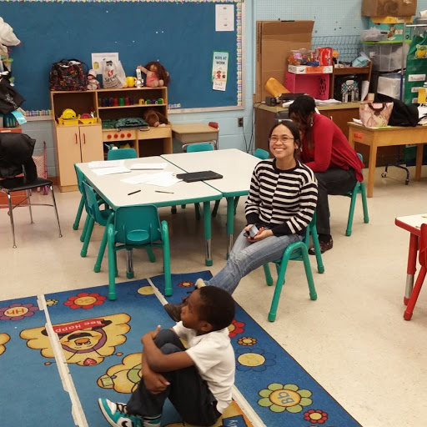
Nanoscale electric fields in self-assembled optoelectronic biomaterials
DMR 1407493
John D. Tovar, Johns Hopkins University
This program has enabled several important aspects of broader impacts. The research has been published in top journals, including a recent article in JACS, and has been presented as part of several lectures and conferences. The lead student supported by this program is a female Philippine national who will be taking on a postdoc at Harvard Wyss Institute this fall and is planning to pursue academic careers.
The research mission has been furthered through two important activities: the organization of a special issue in “Peptide Materials” appearing in Organic and Biomolecular Chemistry as well as an upcoming Symposium at the Washington DC Fall 2017 ACS meeting.
The lead student on this project, Herdeline Ann Ardoña, was just selected to give a short talk at the Physical Organic GRC! This talk summarized her collaboration with Prof. Dave Adams and his group then in Liverpool UK, where she had a chance to spend one month on an international collaboration. Herdeline has also participated in JHU educational outreach efforts with local elementary schools (above).

