Slide 1
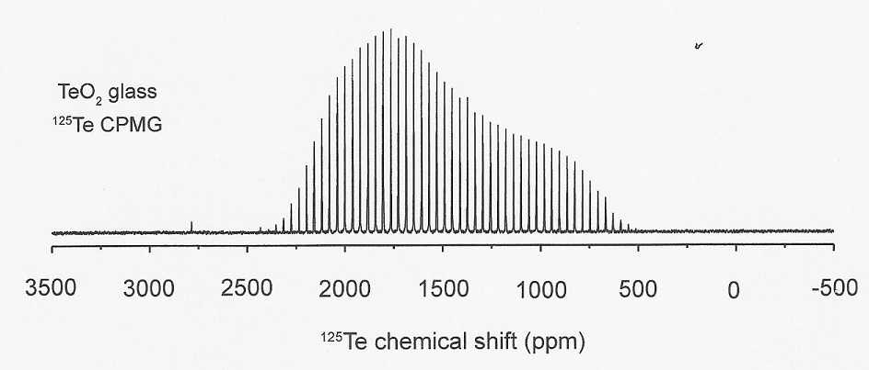
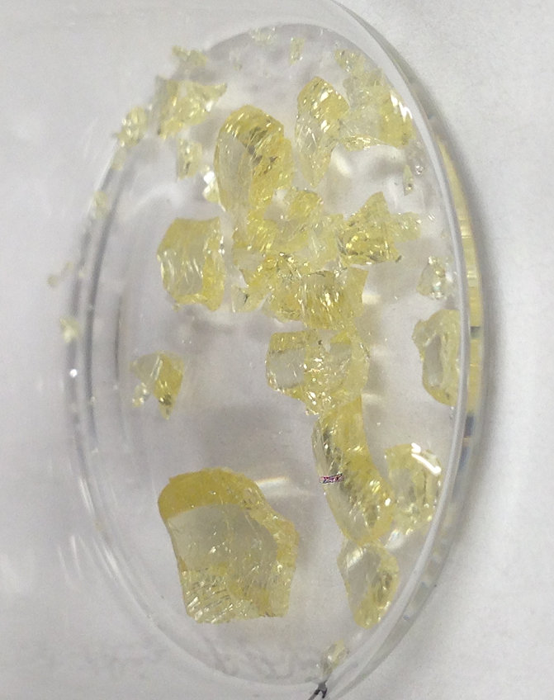
Cutting Edge Research on Glass by Coe College Undergraduates and a High School Student
DMR 1407404
The Structure of New Tellurium Dioxide Glass
Tellurium dioxide (TeO₂) is a poor glass former and requires rapid cooling to create. Yet, it is a key component of important optical glasses.
Recently, a number of ways were used to produce single component glass through roller quenching, laser levitation, and crucible quenching in ice water. The latter method was developed by Tagiara and Kamitsos¹ and offers the advantage of producing gram quantity yields. After reproducing this method, TeO₂ glass in gram amounts with ¹⁷O enrichment was prepared.
¹⁷O and ¹²⁵Te NMR were performed² and confirmed the structure of the glass to be four-coordinate tellurium similar to that in γ-TeO₂, a result that clears up much literature confusion.
¹ N. Tagiara, D. Pallas, E. Psycharis, A. Kryitsis, E. Kamitsos, “Synthesis, thermal, and structural properties of pure TeO₂ glass and zinc-tellurite glasses J. Non-Cryst. Solids 2017, 457 116-125.
² M.Garag, U.Werner-Zwanziger, J.W. Zwanziger, A. DeCeanne, B. Hauke, K. Bozer, and, S. Feller “On the short-range order of TeO₂ glass, submitted to The Journal of Physical Chemistry (2017).
Steven A. Feller, Coe College
A montage of research on amorphousTeO₂: Top: ¹²⁵Te NMR on a-TeO₂, bottom left: First ¹⁷O NMR on glassyTeO₂ and bottom right: bulk glassy TeO₂ made at Coe (NMR spectra obtained in collaboration with the J. Zwanziger group, Dalhousie Univ., Halifax, NS, Canada, photo of glass by Anthony DeCeanne of Coe College.)
Notes:
It took a few years of diligent work beginning by Coe undergraduates Brittney Hauke and Anthony DeCeanne to form these glasses in platinum crucibles. Iowa City West high schooler Katie Bozer significantly helped as well. This is a good example of an international collaboration between the Feller group at Coe College and the Zwanziger group at Dalhousie Univ in Halifax.

Slide 2
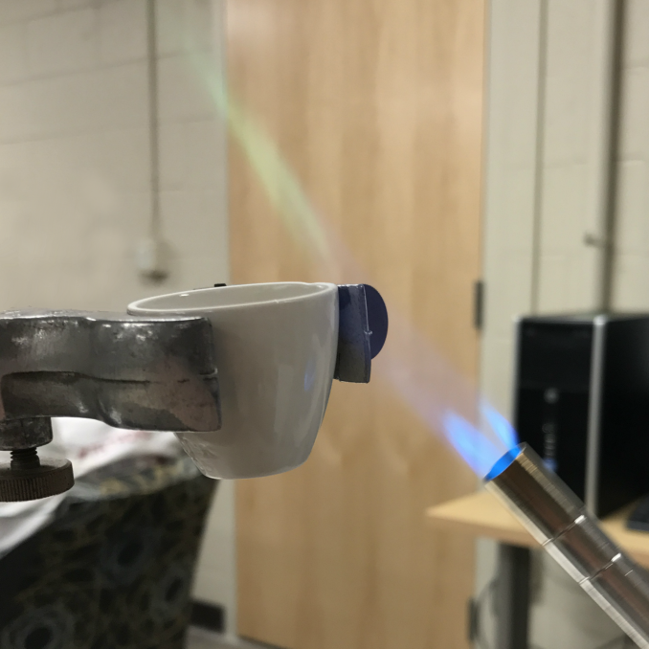
An Exciting Outreach Project by Ariel Crego, a Physics Student at Coe College
DMR 1407404
Making glass in elementary school: Your Very Own Borate Glass
A new Science Outreach Catalyst Kits (SOCKs) that features making boron oxide glass has been produced by Coe College undergraduate Ariel Crego. For widespread distribution across the nation, this is now featured on the website of the Society of Physics Students, an American Institute of Physics organization¹.
The glass may be inexpensively made using boric acid powder, a propane torch, a ring stand, and a porcelain crucible. The reaction that occurs is:
2H₃BO₃ (sand)→ B₂O₃ (glass) + 3H₂O (steam).
Students can see the evolution of the water and the remaining glass. Fibers can be pulled easily and, if desired, impurities may be added to induce color in the glasses.
¹https://www.spsnational.org/programs/outreach/borate-glass
Steve A Feller, Coe College
Making glass in elementary school: Your Very Own Borate Glass (photo by Ariel Crego, Coe College). In this activity elementary students and their teachers learn to make one of nature’s simplest glasses: boron oxide (B₂O₃). Several experiments maybe performed that augment the basic demonstration that glass is easy to form.
Notes:
The glass takes just 15 minutes to form and the grade school children are excited to see actual glass formed. After the glass is formed the reaction is easily reversed through the addition of a few drops of water; the children can see whitish boric acid form where the water strikes the hygroscopic boron oxide glass. The students easily see the evolution of water from the crucible as the glass forms. Full details as well as background information as found at https://www.spsnational.org/programs/outreach/borate-glass

