Slide 1
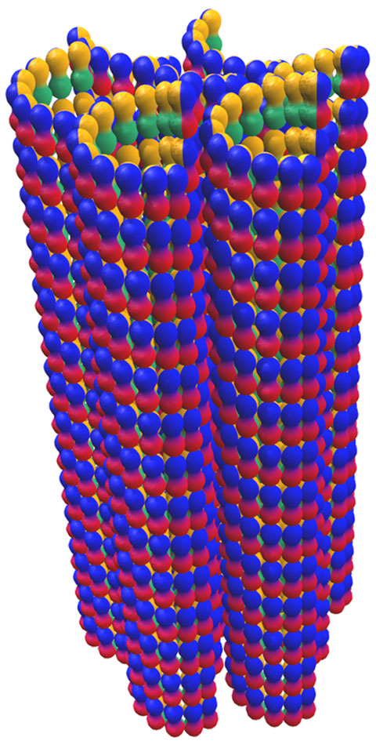
Protein-mediated Microtubule Bundling is Suppressed by Tubulin-Binding Molecules Modulating Microtubule Dynamics
Cyrus R. Safinya, University of California-Santa Barbara, DMR 1401784
Intellectual Merit
Microtubules are a component of the eukaryotic cytoskeleton involved in dynamical cell functions (intracellular trafficking, chromosome segregation,…). Microtubule bundles (see Figure) play a critical role in neurons where they stabilize the axonal shaft required for proper inter-neuron communication.
Bundled MTs
The precise nature of bundling forces mediated by microtubule-associated proteins remains controversial.
Remarkably, our studies have led to the discovery that microtubule bundling is dependent on the concentration of a tubulin binding molecule which counteracts protein bundling forces.
Figure (Left) Plot of the inner radius, <R_{in}^{MT}>, of microtubules (MTs) with increasing amounts of the bundling protein Tau (x-axis corresponds to Tau/tubulin molar ratio) shows the increase in inner radius with the addition of protein. The data are from synchrotron x-ray studies. The four curves (bottom to top) correspond to decreasing amounts of “taxol”, a tubulin binding molecule that suppresses MT dynamics (red, blue, green, orange correspond to 1/1; ¼; 1/8; 1/32 taxol/tubulin ratios). Remarkably, the plots reveal that taxol suppresses the bundling action of the protein and only at the lowest amounts is protein Tau able to assemble MT bundles (hatched region). (Right) Schematic drawing depicting a microtubule (MT) bundle. Each MT consists of linear protofilaments formed from stacks of tubulin dimers (red/blue spheres).
The findings pave the path for a mechanistic understanding of microtubule bundling – a structure that plays a critical role in maintaining stable axonal compartments in neurons.
DMR
PUBLICATION: Choi, M. C.; Chung, P. J.; Song, C.; Miller, H. P.; Kiris, E.; Li, Y.; Wilson, L.; Feinstein, S. C.; Safinya, C. R.: Paclitaxel suppresses Tau-mediated microtubule bundling in a concentration-dependent manner. Biochim. Biophys. Acta - General Subjects 2017, 1861, 3456-3463. DOI: 10.1016/j.bbagen.2016.09.011.
DIVISION OF MATERIALS RESEARCH
DIRECTORATE FOR MATHEMATICAL AND PHYSICAL SCIENCES
Notes:
Dear Alex: The slide briefly describes our experiments, which were designed to discover the conditions for microtubule bundle formation. Single microtubules are typically used in cells as rails to move molecules (bound to molecular motors) to specific locations in the cell. Microtubule bundles play important structural roles in the axon compartment of nerve cells. Axons are crucial in enabling the transfer of signals from one neuron to a neighboring neuron. The identities of combinations of molecules involved in producing bundles are not known and is actively sought after by researchers worldwide. Our studies led to the finding that the molecule paclitaxel (which goes by the trade name taxol and is used in cancer chemotherapy) is able to suppress the action of proteins believed to be important in the bundling process. The findings pave the path for a mechanistic understanding of microtubule bundling – a structure that plays a critical role in maintaining stable axonal compartments in neurons. Best regards, Cyrus (Alt Text is set up on both slides)

Slide 2
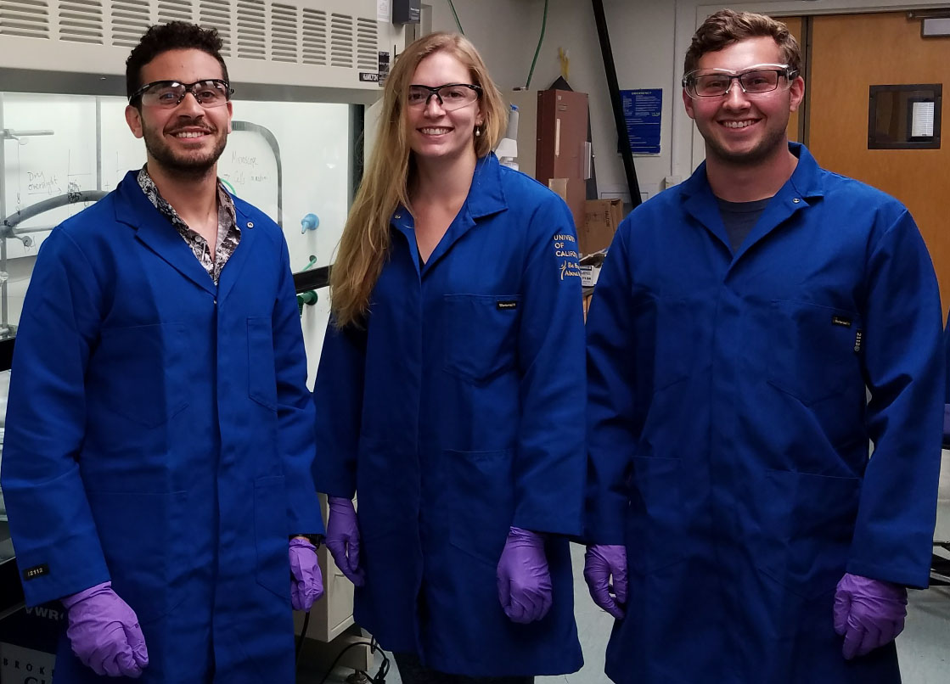
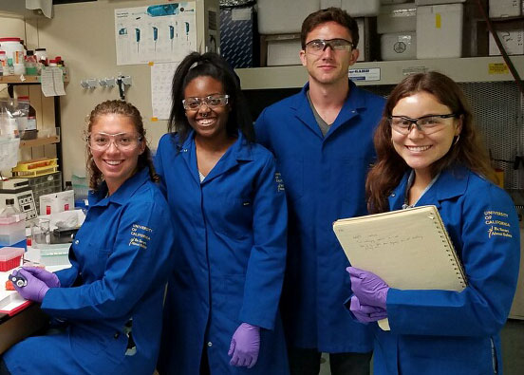
Modern Scientific Methods to Enable the Understanding of Self-Assembly in Biomaterials
Cyrus R. Safinya, University of California-Santa Barbara, DMR 1401784
Broader Impacts
Education: Undergraduate students and teachers are educated in state-of-the-art interdisciplinary methods to discover nature’s rules for assembling nanoscale biomolecular building blocks into functional materials.
Outreach:
Chemistry PhD student Victoria Steffes (top photo) mentored UC Irvine chemical engineering student Kirolos Kelada (left, top photo) and UCSB physics student Scott MacDonald (right, top photo) on a project utilizing imaging and x-ray scattering techniques to study the stability of liposomes (spherical membranes) as carriers of hydrophobic drugs in cancer therapeutics. Kirolos participated in the UC LEADS Program (UC Leadership Excellence through Advanced Degrees).
Justine Paul (left, bottom photo, bioengineering student from Syracuse University) participated in the Future Leaders in Advanced Materials (FLAM) Program. She worked with her mentor PhD student Christine Tchounwou (2nd from left, bottom photo, Biology) on understanding the behavior of chemically altered tau and its interactions with microtubules in solutions closely mimicking conditions in neurons.
PhD student Bretton Fletcher (bottom photo, Biomolecular Science & Engineering Program) mentored biology student Anaiancy Ramirez (right, bottom photo) in methods involving expressions of wild type and chemically altered isoforms of microtubule associated protein Tau. Anaiancy is part of the California Alliance for Minority Participation Program (CAMP).
DMR
DIVISION OF MATERIALS RESEARCH
DIRECTORATE FOR MATHEMATICAL AND PHYSICAL SCIENCES
(For more information see http://www.mrl.ucsb.edu/~safinyaweb/people.htm)

