Slide 1
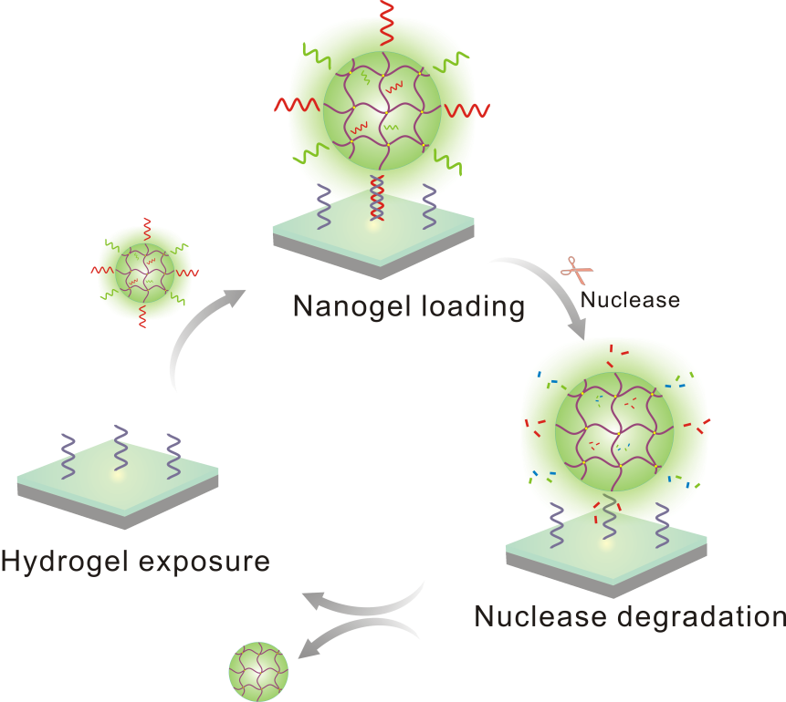
INSPIRE: Programming Materials via Biomolecular Engineering
DMR 1322332
Yong Wang, Penn State Univ University Park
Nature and biology are used as fundamental design guidelines and the knowledge of multiple disciplines are intimately integrated to develop a novel biomaterial that can function as a small octopus does during its defense against predators. This biomaterial is developed for detecting or killing abnormal cells, or monitoring the behavior of the cells.
The major work we finished last year was to demonstrate that a DNA-functionalized programmable surface can catch and release nanoparticles for drug release and cell regulation. This programmable material system hold great potential for drug delivery.
Illustration of programmable change of the surface via reiterative nanogel attachment and release. (1): cODN₁ exposure; (2) nanogel adsorption; (3) nanogel release.

Slide 2
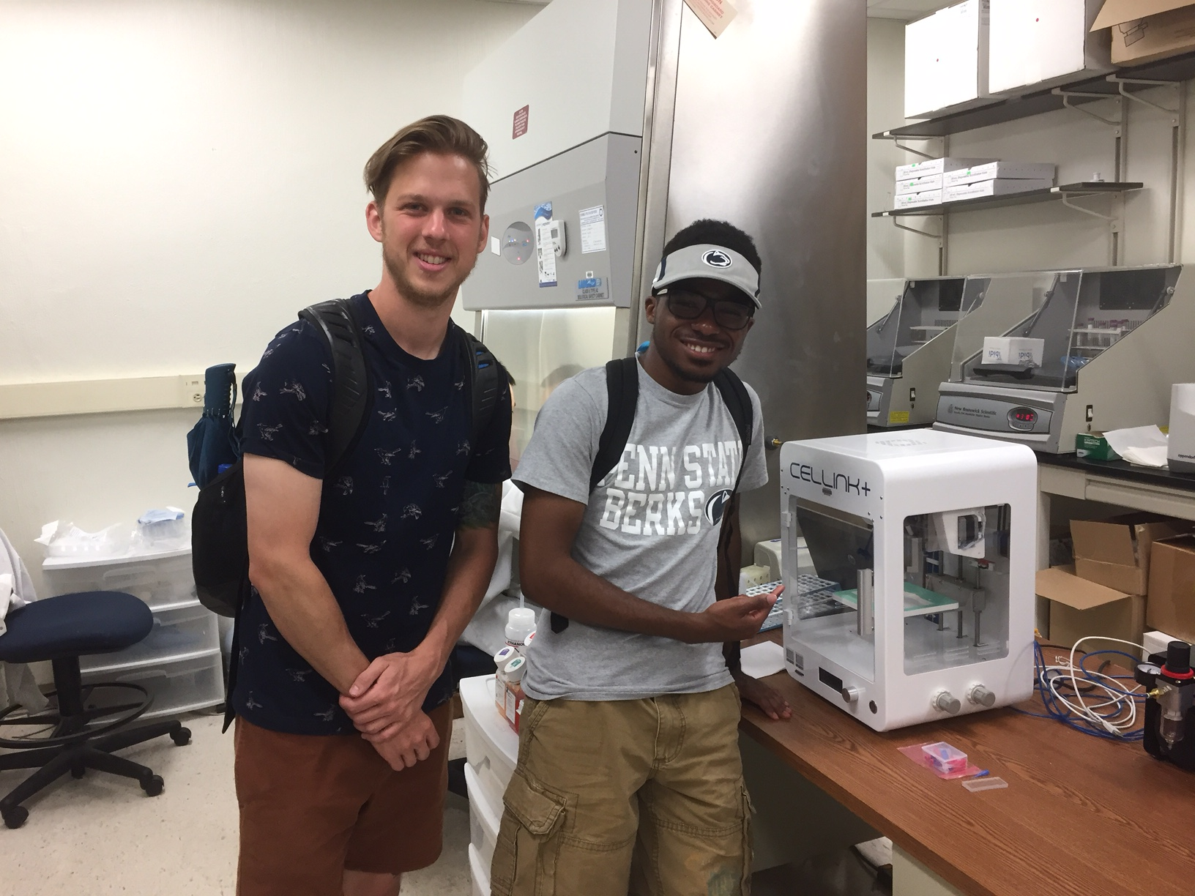
INSPIRE: Programming Materials via Biomolecular Engineering
DMR 1322332
Yong Wang, Penn State Univ University Park
An interdisciplinary research team has been established with PhD students and undergraduate students including a minority student.
Our work has been disseminated internationally through invited presentations and high-quality journal papers:
Nanoparticle-programmed surface for drug release and cell regulation via reversible hybridization reaction. ACS Appl. Mater. Interfaces 9(5), 4467-4474, 2017
2017 MC REU Scholars are participating multi-campus research experience for undergraduate program and learning in the lab how to apply 3D printing techniques to develop programmable biomaterials.

