Slide 1
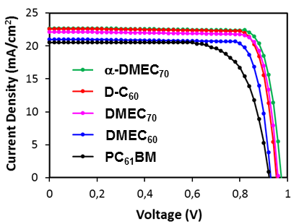
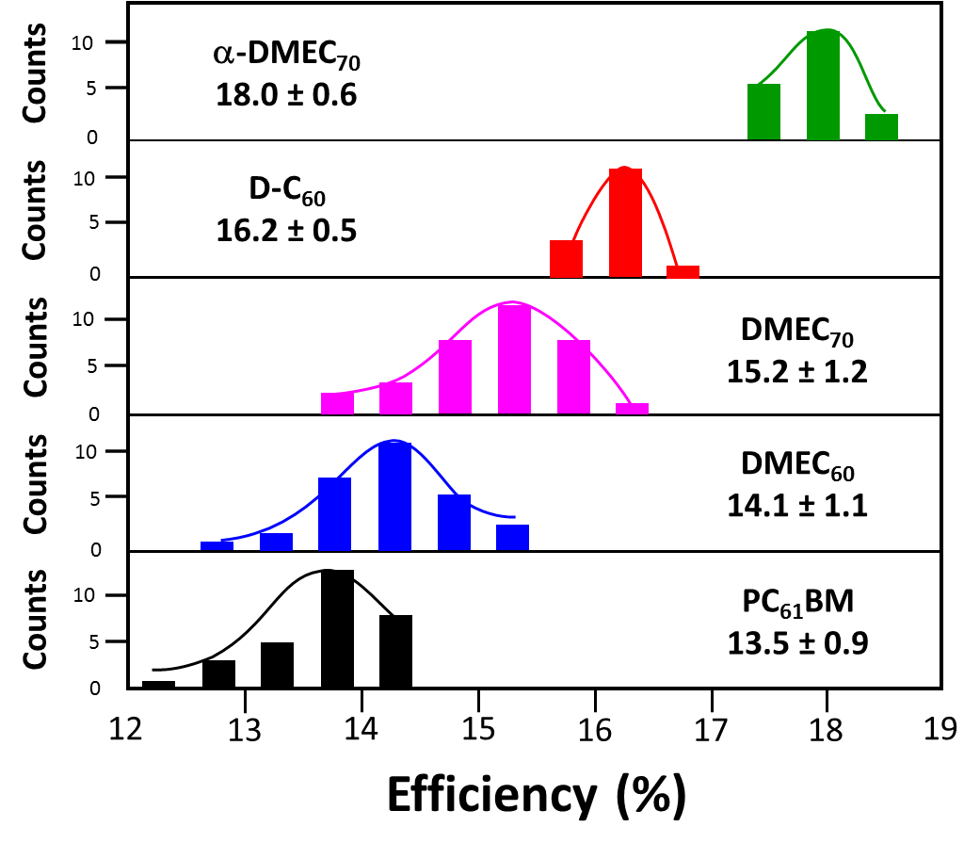
Functionalized Fullerenes for Selective Electron Extraction in Inverted Perovskite Solar Cells
DMR 1205302
Luis Echegoyen, University of Texas at El Paso
Perovskite solar cells (PSCs), have shown a remarkable increase in photoconversion efficiency (PCE), from 3.8% in 2009, to 22.1% in 2016. The good electron transporting and solution processable properties of fullerene derivatives make them the most popular electron transporting materials (ETMs) in PSCs. The influence of different adducts on the PCEs of fullerene-based PSCs has not been fully explored to date.
Outcome: We reported new functionalized fullerene derivatives, and PCEs up to 18.6% were obtained when they were used as the ETMs in PSCs.
1. Chengbo Tian, Edison Castro, Tan Wang, German Betancourt-Solis, Gloria Rodriguez, and Luis Echegoyen. ACS Appl. Mater. Interfaces, 8 (45), 31426-31432, 2016.
2. Chengbo Tian, Kevin Kochiss, Edison Castro, German Betancourt-Solis, Hongwei Han, and Luis Echegoyen. J. Mater. Chem. A, 5, 7326-7332, 2017.
Fullerene Derivatives
J-V curves
Efficiencies

Slide 2
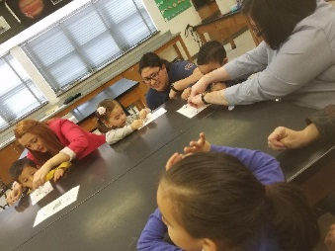
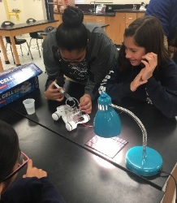
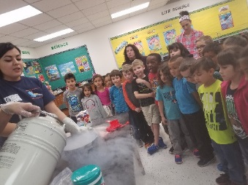
PREM Outreach Activities
DMR 1205302
Overview: In February 2015, the PREM students launched the new outreach program by developing the following modules: Hydrogen Car, Light the Way, States of Matter, and Van De Graff Shock. The students developed hands-on activities which allowed the program to shift away from laboratory tours. The modules are presented to students in the local school districts by PREM research students, with 100% participation. Our goal is to ignite curiosity through hands-on experiences in order to foster the next generation of scientists and engineers. Students who participate in the outreach activities are encouraged to ask questions and guess an answer (Hypothesis), conduct the activity (Procedure), discuss their observations (Result), and talk about real life applications (Conclusion). They become researchers during the outreach activities.
Outcome: The program has reached 2,087 students in 2016-2017 alone. 92% of the students surveyed would recommend the activity.
Broader Impact: We have expanded by including elementary school students in the outreach activities. Teachers and counselors have taken the opportunity to expand on the outreach topics during their instruction time. We have developed a network with the school district and expect to continue the expansion of the program.
Luis Echegoyen, University of Texas at El Paso
Transition – Laboratory Tours to Hands-On Activity
 | Hands-On Activity | Laboratory Tour
2014-2015 | 350 | 596
2015-2016 | 1209 | 0
2016-2017 | 2087 | 0
Number of Students Reached for 2016-2017
Gender | # of students
Female | 970
Male | 960
Unreported | 157
Total | 2087
Ethnicity | # of students
Hispanic/Latino | 1362
African American | 98
Native Hawaiian/ Pacific Islander | 12
Caucasian | 95
Native American | 34
Asian American | 36
Multiracial or Other | 224
Unknown/ Rather not share | 226
School Level
Elementary School (PreK-5th) | 540
Middle School (6th-8th) | 915
High School (9th-12th) | 444
Combined (6th-12th) | 188

