Slide 1
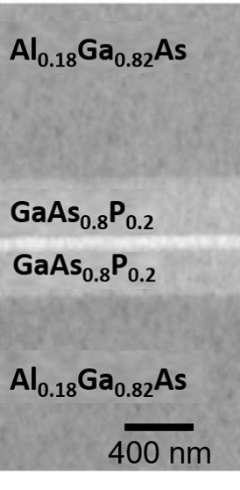
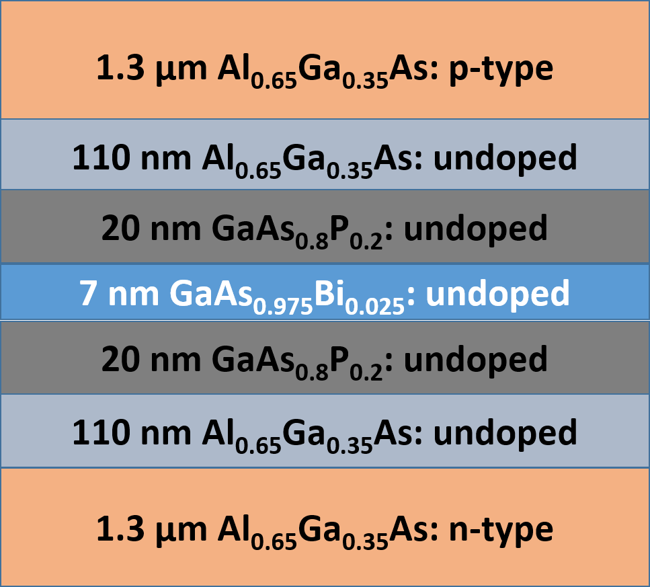
New Approaches to Highly Efficient Telecommunication Lasers
DMR 1121288
Nicholas L. Abbott, University of Wisconsin-Madison
New materials allow for the development of advanced technologies with faster and more energy efficient performance. Through the formation of intricate layers (just a few atoms thick) of exotic elements, including elements called gallium and bismuth, researchers at University of Wisconsin-Madison have developed a new laser structure. The laser can emit light at wavelengths that are hard to generate with existing lasers. When integrated into existing technologies, these new materials have the potential to save energy, improve communications, and enhance medical diagnostics. The researchers are working with companies to make that happen.
Notes:
Image needs alternative text.

