Slide 1
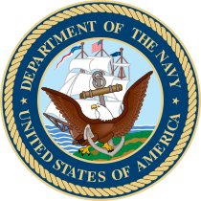
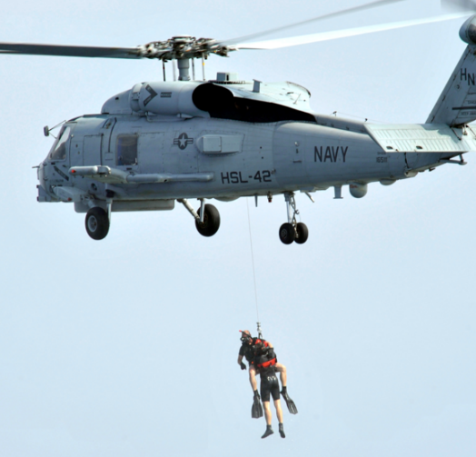
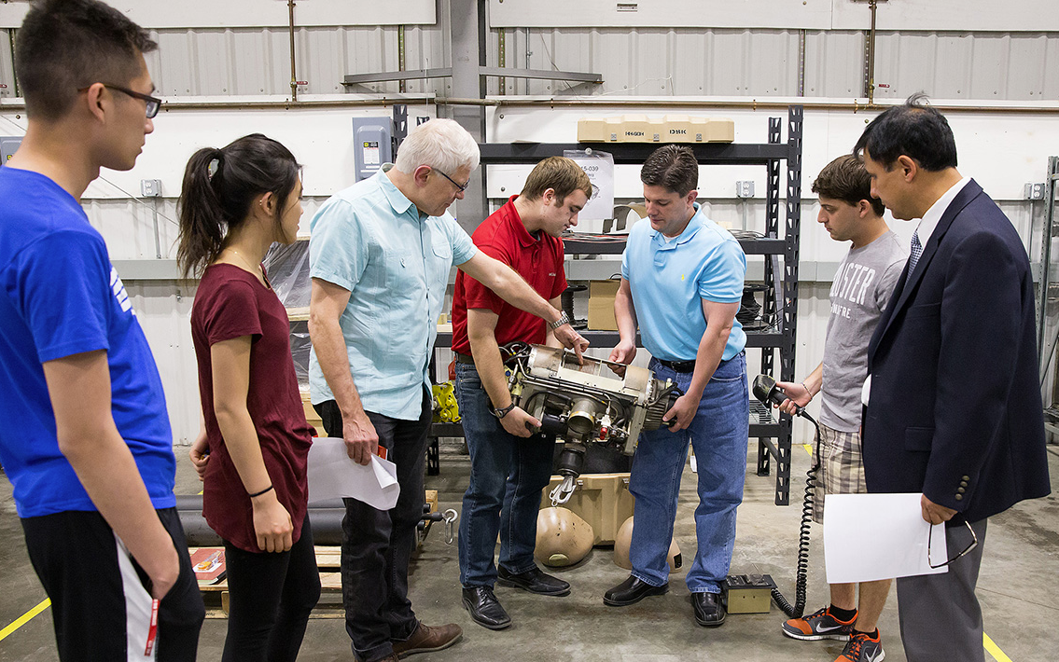
CCMR to the Rescue!
DMR 1120296
Frank W. Wise, Cornell University
When Navy Aviation rescue swimmers are dangling above the ocean suspended from a helicopter, getting “zapped” by a bolt of static electricity created by the helicopter should be the last thing on their minds. To ensure the safety of its rescuers, the US Navy asked the CCMR to help develop non-conductive synthetic cables to replace their current steel cables.
The CCMR enlisted Prof. S. Leigh Phoenix, a cable expert, and Advanced Design Consulting (ADC, Lansing NY), a local company. The team worked with Cortland Cable (Cortland NY), a cable manufacturer, to find the perfect rope. Using a system developed by ADC, the team developed and tested synthetic cable replacements that are non-conductive, lighter, and stronger than their steel counterparts. The team also developed a new winch drive specifically for use with synthetic cables.
The joint effort of Cornell and 2 New York companies will keep Navy rescue swimmers safe as they complete their dangerous missions.
ADC Engineers, Prof. Phoenix (pointing), and Cornell students
(ADC's facility, Lansing, NY)
Notes:
Helicopters develop a static charge as they fly. When rescue swimmers are lowered to the water on a steel cable, they are at risk of getting “zapped” by a static discharge. To prevent this, the Navy wanted to develop a non-conductive cable and winch system that has the same performance as the current design.
During a preliminary JumpStart project, the team considered strength and mechanical stability of rope designs based on polymer fibers and jacketing materials. Promising designs were manufactured by Cortland Cable, Cortland, NY, as potential replacements of the Navy stainless steel cable in current hoist designs. In parallel, ADC obtained a NAVY contract to develop such a rope that would require minimal modification to current hoist systems. This contract enabled ADC to start an extensive ICP project with Prof. Leigh Phoenix. The ICP continues the integration into ropes of new commercial synthetic fibers having much improved strength and packing efficiency. Development of cable and hoist test capabilities and add-on sheave driven tension control are also underway. The rope must be non-conductive and dimensionally equal to the current steel cable, and satisfy mechanical requirements for strength, fatigue, abrasion resistance, and resist burrowing from collapse of hexagonal packing during winding, a problem common to polymer cable designs. Researchers worked on several prototypes and the liquid crystal polymer fiber, Vectran, initially seemed most promising. However, designs involving an extruded polyester jacket resulted in a rope strength falling 15% below the required minimum. The team finally turned to the latest commercial versions of Ultra High Molecular Weight Polyethylene (UHMWPE) fiber (Spectra) that has strength 30% higher than available just four years ago, and with improved packing efficiency as well. The resulting ropes were 50% stronger than the Vectran design, and in hoist testing at NAVY facilities the rope functioned with transverse stability not seen in previous polymer designs. Researchers see room for more improvement.

