Slide 1
International collaboration in the Antarctic for global science
Dr. Karl Erb
Director
Office of Polar Programs
National Science Foundation (USA)
Notes:
Karl
In the program, the title assigned to you for your talk is “Addressing Global Science Questions Through International Collaboration,” which in my opinion is weak because of the dead words “addressing” and “questions.”
The title of the abstract I sent Walton is “Increasing global science effectiveness through international collaboration.”
I wish I’d thought of the one that’s in the above PowerPoint earlier, because I like it better than the other two.
Guy

Slide 2

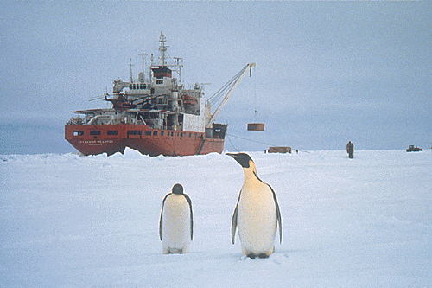
Russian/U.S. Weddell Sea expeditions
1981: Soviet icebreaker; 13 USA and 13 USSR scientists
1992: Russian and U.S. icebreakers; camp on sea ice; 17 USA and 15 Russian scientists

Slide 3
Multinational Antarctic research papers, 1980-2004
1980
2004
--after Dastidar and Ramachandran, 2008

Slide 4
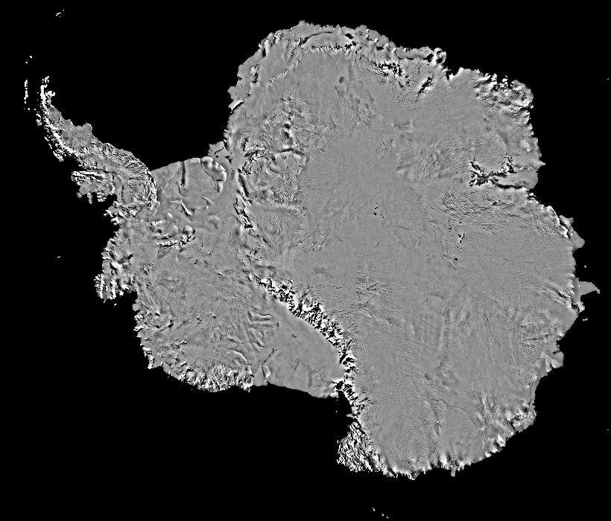
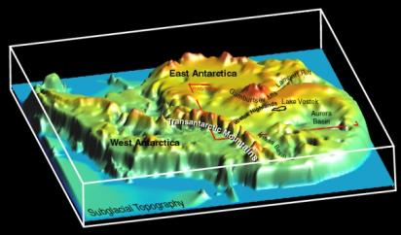
Antarctic Ice Sheet Drainage
East Antarctic Ice Stream Province
Lambert Glacier/Amery Ice Shelf Drainage
China - PANDA
US-ASEP
US-AGAP
Pine Island/Thwaites Glacier Drainage
Aka Amundsen Sea Embayment Province of WAIS
Siple Coast Ice Streams
Mertz Glacier Drainage
Byrd Glacier Drainage
Notes:
4
Ice sheet/ice shelf systems
US/UK project on Amundsen Sea sector of West Antarctica would be usefully compared to Amery Ice Shelf part of China’s PANDA project
US Antarctic Gamburtsev Project in central East Antarctica is collaborative with the inland or Dome A part of China’s PANDA project
US-ASEP = US Amundsen Sea Embayment Project
US-AGAP = US Antarctic Gambursev Province project
PANDA = China/PRIC Prydz Bay Amery Ice Shelf and Dome-A project

Slide 5
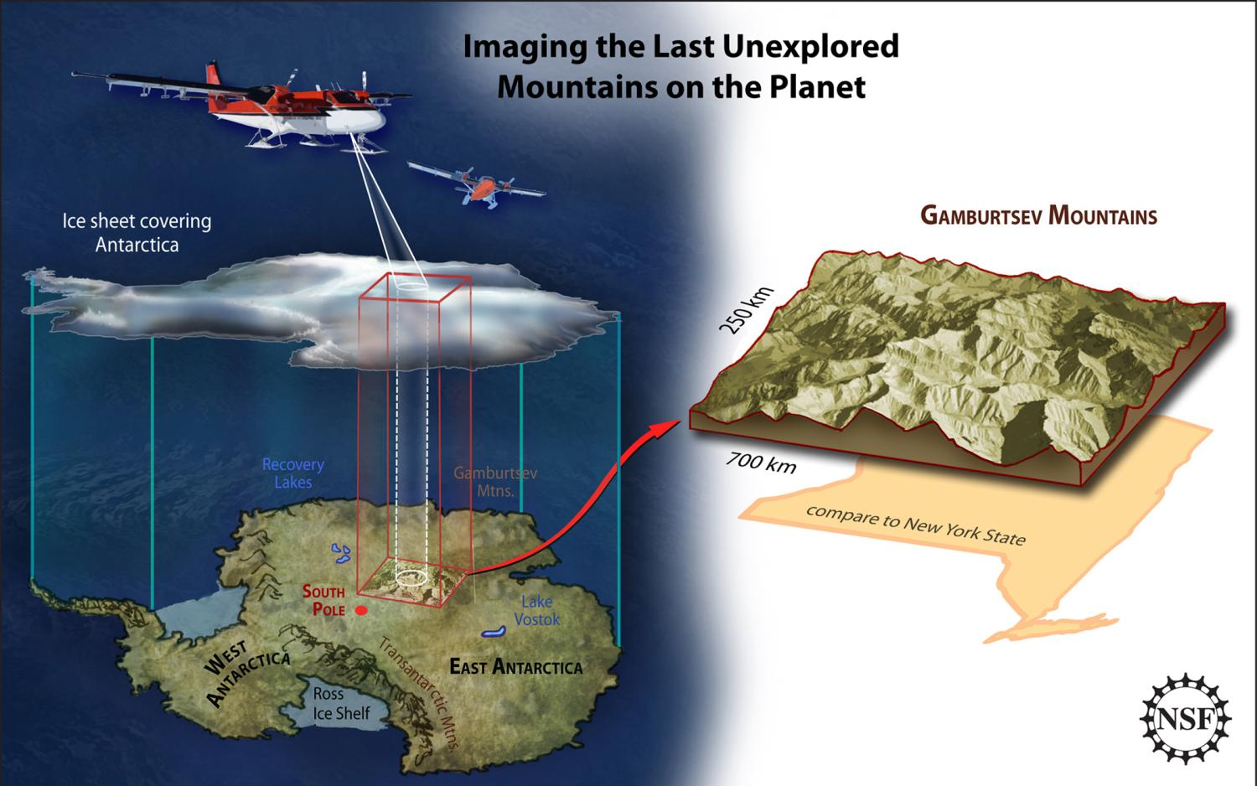
Location of first ice sheet (~34 million years ago)
Tectonic enigma
Potentially very old ice
USA, UK, Russia, Germany, China, Australia
Notes:
James Hansen’s “lessons from the Cenozoic”: A large ice sheet did not form in Antarctica until CO₂ had declined to about 400-600 ppm about 34 My ago. When CO₂ rebounded, by perhaps ~200 ppm (Pagani et al., 2005), the ice sheet largely disappeared, indicating that ice sheet growth is reversible if forcing increases. Natural rates of change of CO₂ then were negligible compared to human emissions, which exceed 3 ppm/yr with ~2 ppm remaining in the air. “Humans are now in control of the carbon cycle, and, as a result, in control of climate.” (Hansen and Sato, 2007)
“The sudden widespread glaciation of Antarctica and the associated shift towards colder temperatures at the Eocene/Oligocene boundary (~34 million years ago) is one of the most fundamental reorganizations of global climate known in the geologic record. . . . In our model, declining Cenozoic CO₂ first leads to the formation of small, highly dynamic ice caps on high Antarctic plateaux. At a later time, a CO₂ threshold is crossed . . . causing ice caps to expand rapidly . . . eventually coalescing into a continental-scale East Antarctic Ice Sheet. . . . Opening of Southern Ocean gateways plays a secondary role in this transition.” (DeConto and Pollard, Nature, 2003)

Slide 6
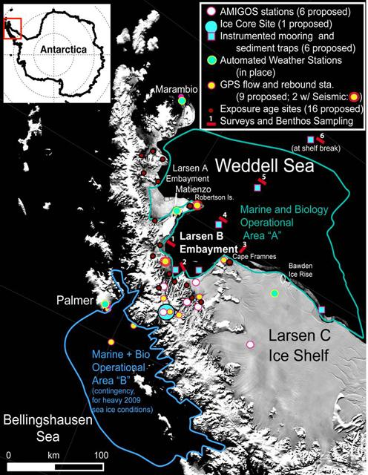
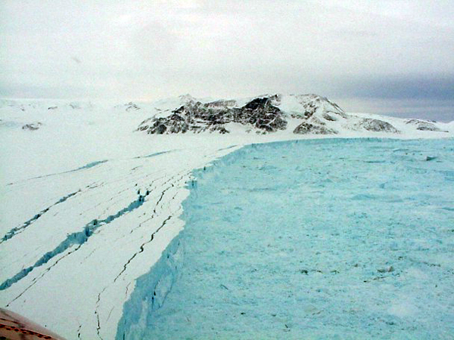
Larsen Ice Shelf System, Antarctica (LARISSA) project
Argentina
Belgium
Korea
Ukraine
United States
Larsen Ice Shelf breakup, 2002

Slide 7
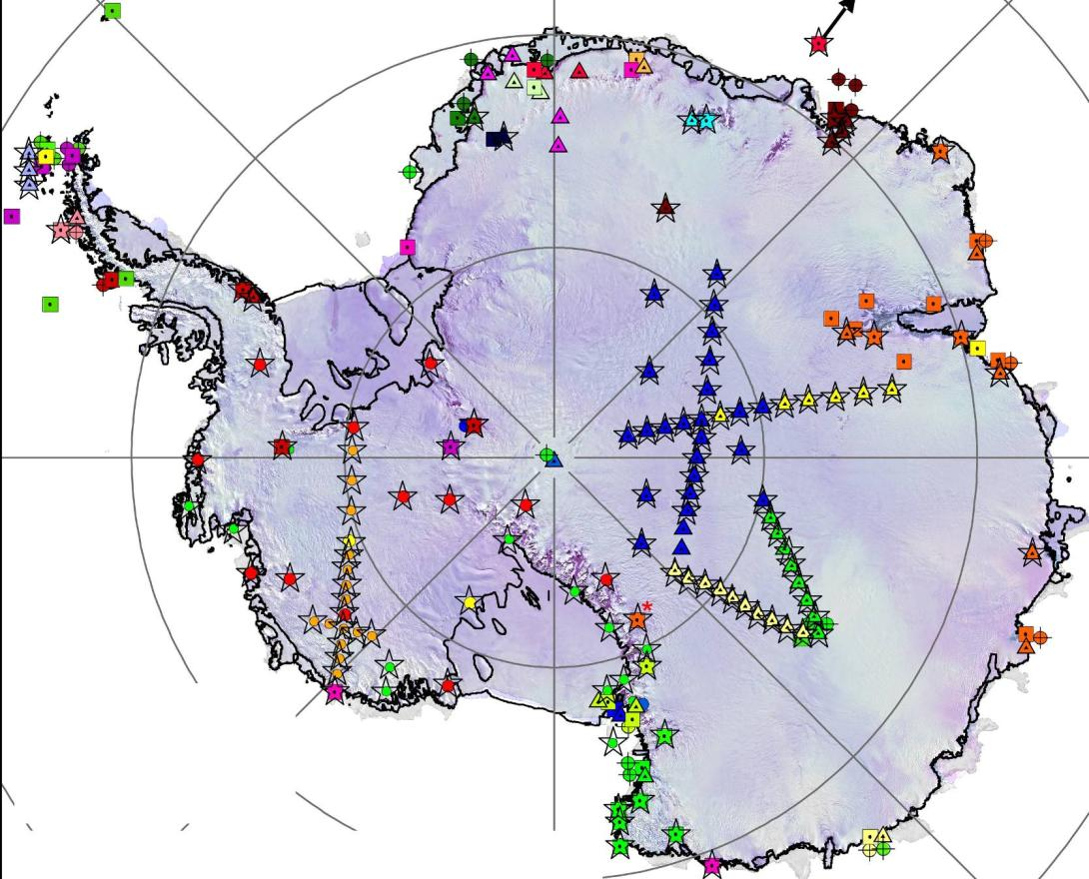
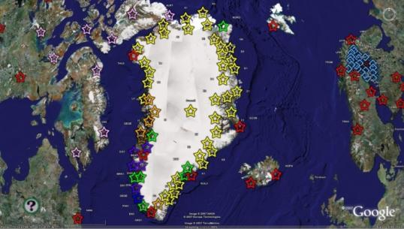
PoleNet
Greenland and Antarctica
Notes:
7

Slide 8
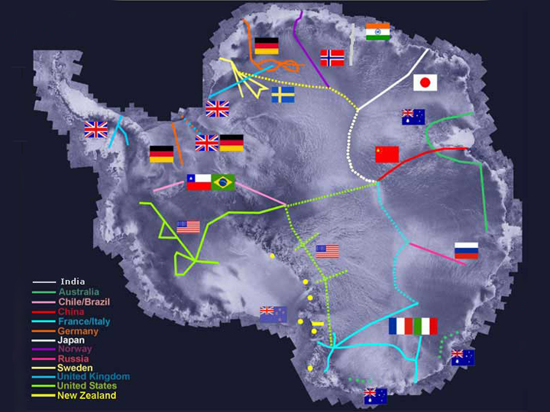
ITASE: International Trans-Antarctic Scientific Expedition

Slide 9

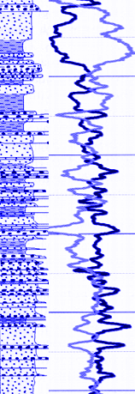
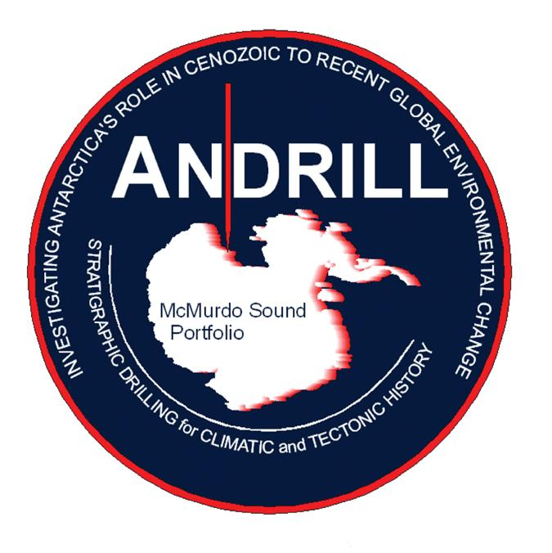
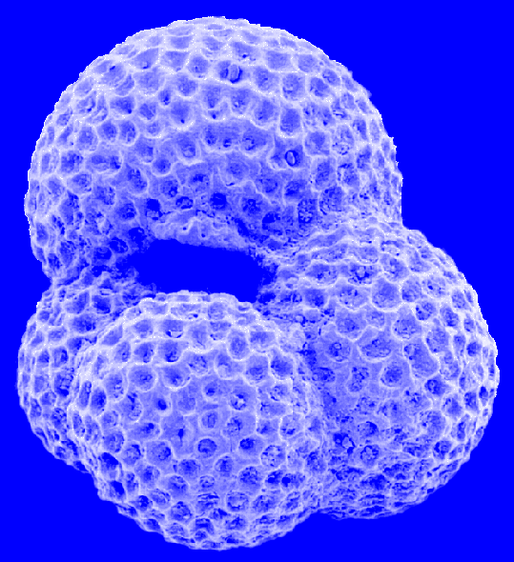
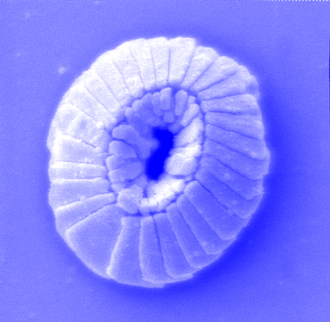
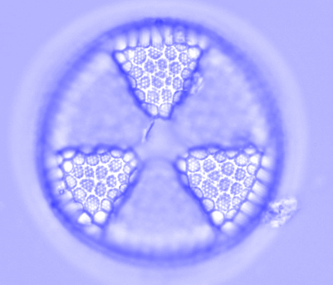

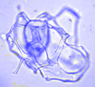
Antarctic Continental Margin Stratigraphic Drilling
Germany
Italy
NZ
UK
USA
Notes:
9
Principal ANDRILL partners: Germany, Italy, NZ, UK, USA
EuroANDRILL Consortium
EuroANDRILL is a new initiative to create a European network with the goal to increase future involvement of European countries in the ANDRILL.
Project Partners:
Dr. Fabio Florindo, Italy
Dr. Carlota Escutia, Spain
Prof. Marc De Batist, Belgium
Dr. Gerhard Kuhn, Germany
Prof. Jan Backman, Sweden
Prof. Henk Brinkhuis, Netherlands
Prof. Jane Francis, United Kingdom
Prof. Andrezej Gazdzicki, Poland
Dr. Catherine Ritz, France
Dr. Kari Strand, Finland
Dr. Frank Rack, United States of America
Prof. Timothy Naish, New Zealand
Dr. German Leitchenkov, Russia

Slide 10
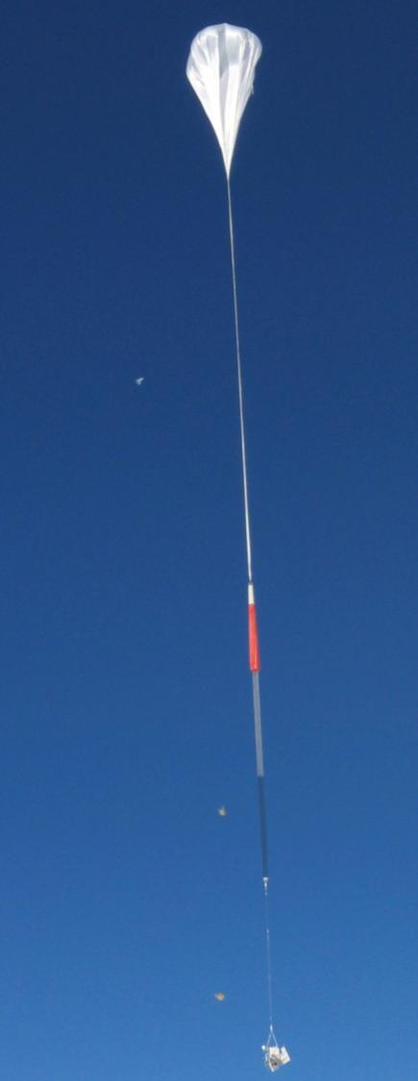
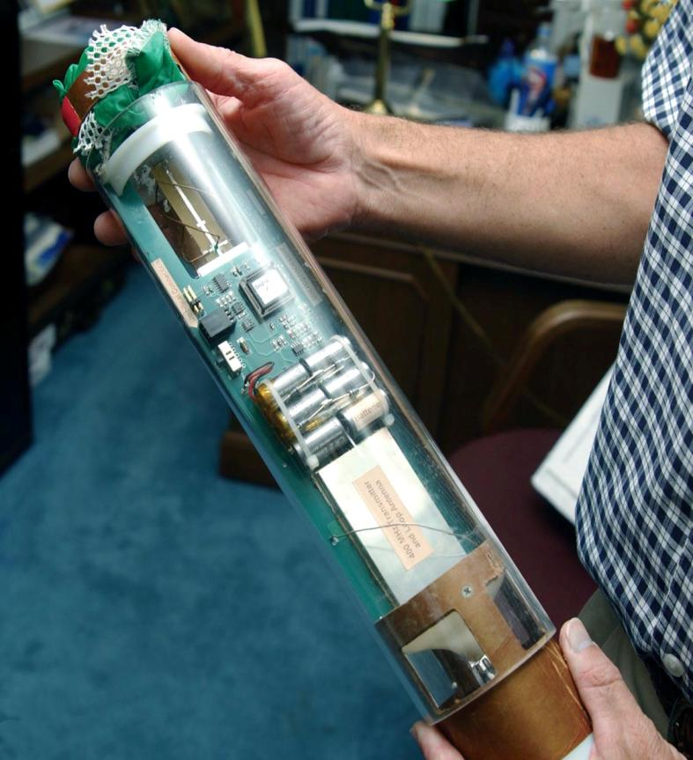
Concordiasi science payload, McMurdo
France-USA study of climate

Slide 11
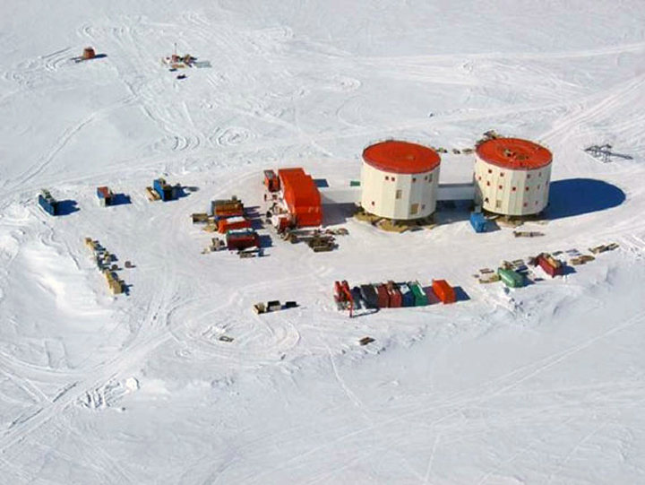
Concordia: Italian and French station at Dome C, East Antarctica

Slide 12
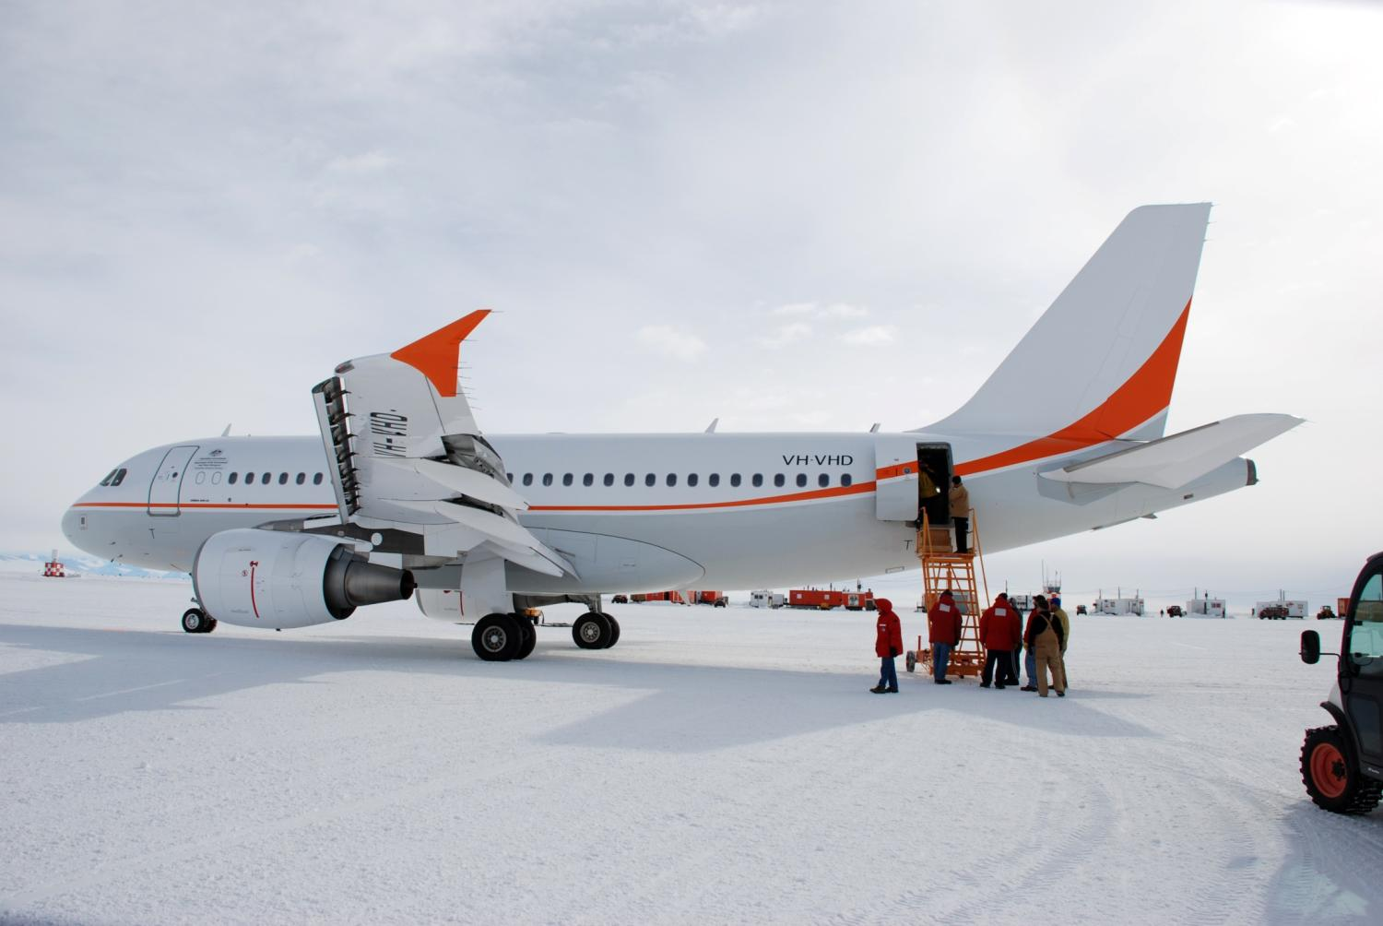
Australian Airbus A319 on sea ice runway, McMurdo, Antarctica

Slide 13
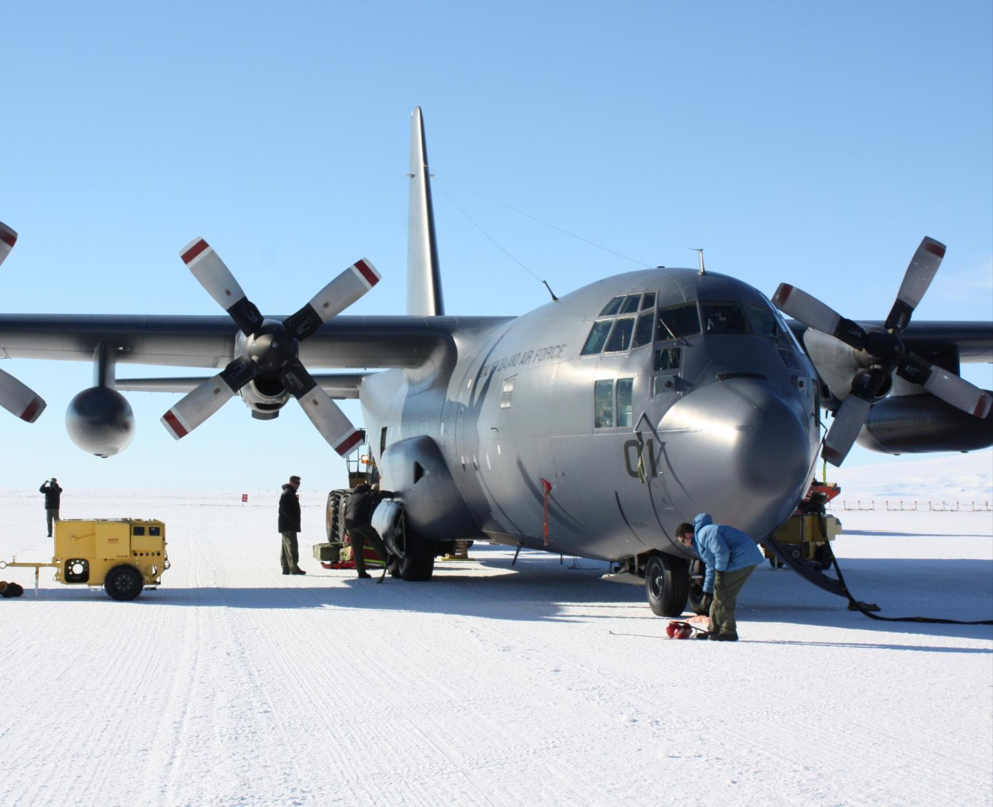
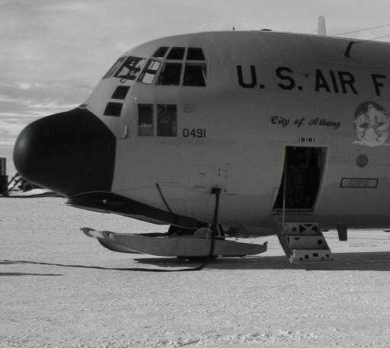
N.Z. Air Force C-130 on ice runway, McMurdo
(wheels only)
LC-130 (ski-equipped)

Slide 14
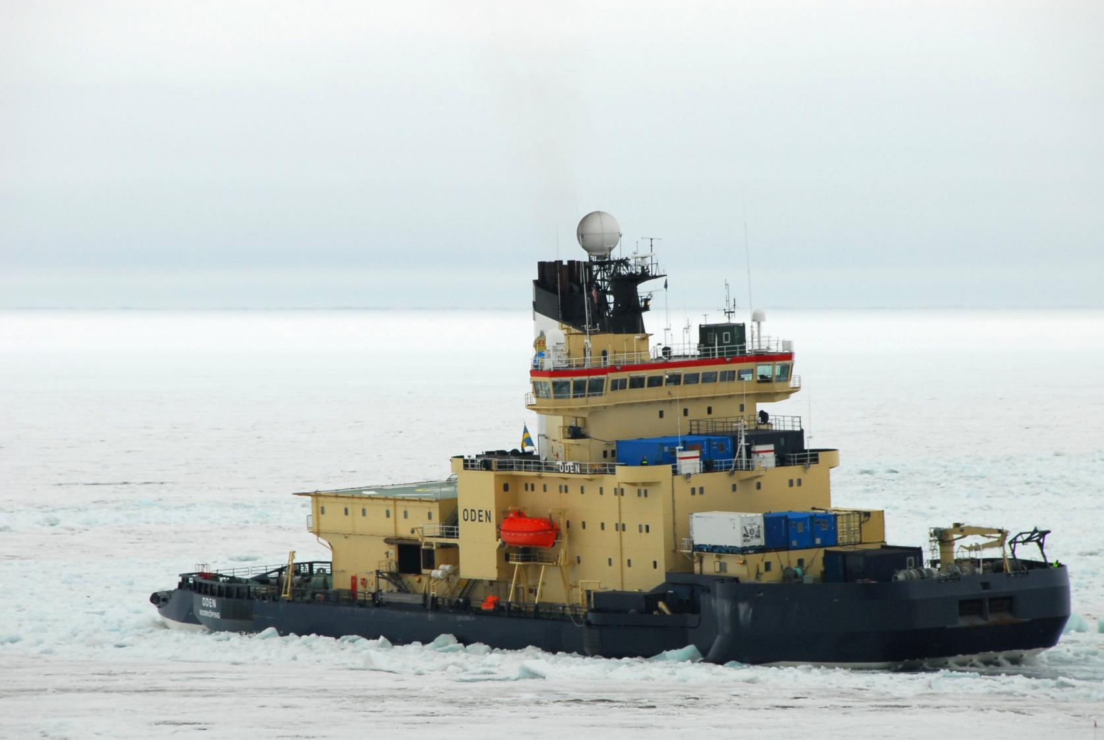
Swedish icebreaker Oden in the Ross Sea, Antarctica

Slide 15
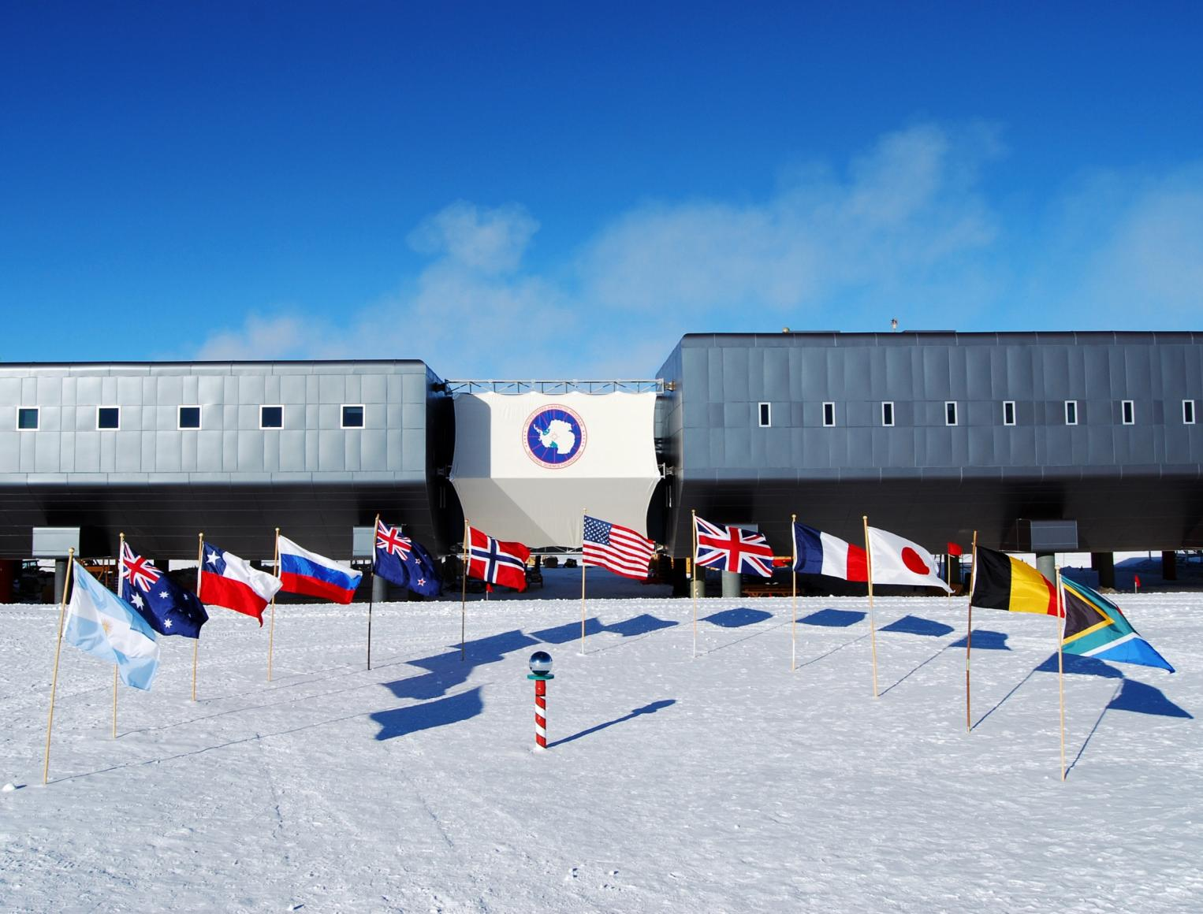
National flags of the original Antarctic Treaty signatories
Amundsen-Scott South Pole Station, U.S. Antarctic Program
Notes:
Left to right::
Argentina, Australia, Chile, Russia, New Zealand, Norway,
USA, UK, France, Belgium, South Africa

