Slide 1
Navigating EAR-Instrumentation and Facilities (EAR-IF)
Amanda Keen-Zebert, PhD, MBA
Program Director, EAR-IF Program
Geosciences Directorate, Earth Sciences Division

Slide 2
EAR-Instrumentation and Facilities Cluster
EAR Division Director
Dena Smith-Nufio
Program Directors
EAR-IF, MRI David Lambert, Luciana Astiz, Amanda Keen-Zebert
EAR MSRI-1, -2 Paul Cutler
EAR Major Research Equip. & Facilities Construction
Maggie Benoit

Slide 3
EAR-Instrumentation and Facilities Cluster
Thank You and Happy Retirement to
Russ Kelz!

Slide 4
YES!
(probably, maybe)
Slides from this webinar will be posted
YES!
(probably)
A recording will be posted
Check the EAR-IF website under ‘Additional Program Resources’

Slide 5
During a lapse
in NSF operations
Electronic systems for proposal preparation and submission will remain available, (i.e., Research.gov, and Grants.gov).
Recipients may continue performance under their NSF awards to the extent funds are available, and the period of performance of the grant or cooperative agreement has not expired.
More information on NSF operations for recipients and panelists, and employees will be posted at https://www.nsf.gov/
Responses to any inquiries will be deferred until normal operations resume.
All panels (including virtual panels) will be cancelled and/or rescheduled.

Slide 6
Thank you for registering, attending, and sending questions in advance!
Questions can be posted in the Q/A function in Zoom
We will answer questions at the end as time allows
For questions specific to your project, please email us
Notes:
Thank you for registering, for coming, and for sending us your questions.

Slide 7
Agenda:
Scope and Overview
Types of proposals reviewed
Merit Review Process
Selection Considerations
Proposal Elements
Postdoctoral Plan
Data Management Plan
Letters of Collaboration
Notes:
Thank you for registering, for coming, and for sending us your questions.

Slide 8
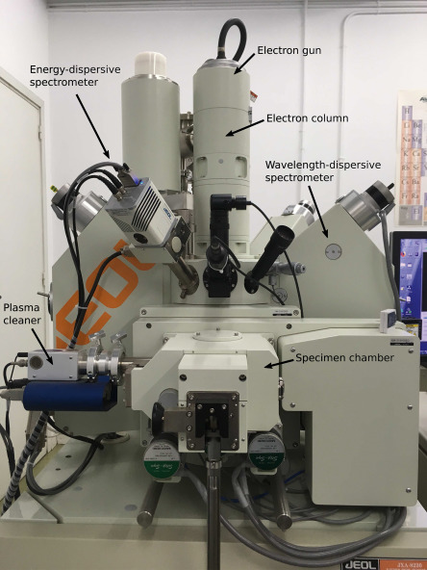
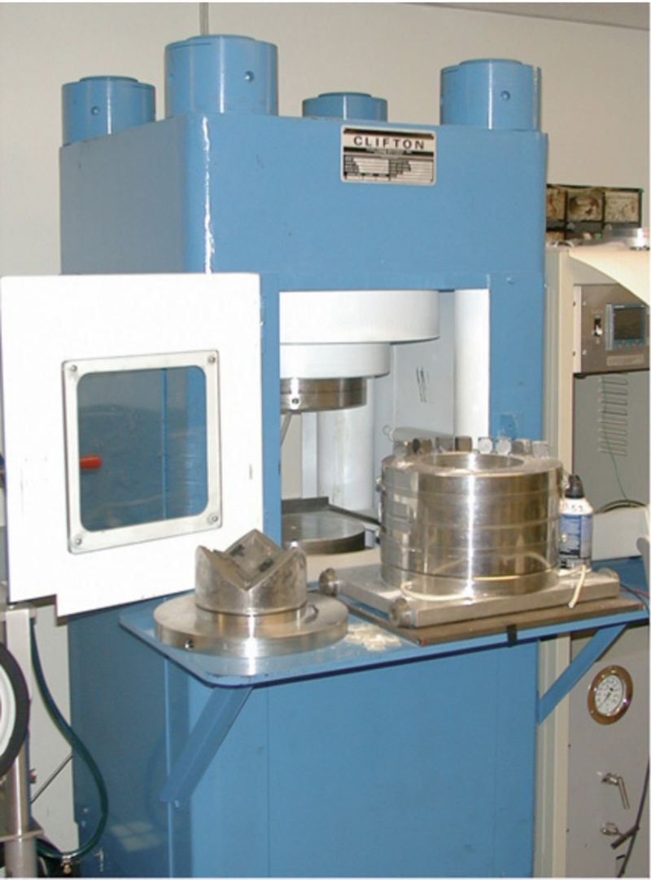
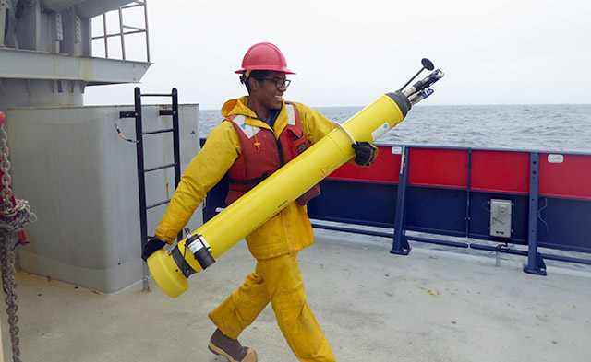
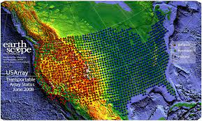
NSF Infrastructure and Facilities Spectrum
EAR
Instrumentation &
Facilities
Major
Research
Instrumentation
Mid-Scale
Research
Infrastructure 1
Mid-Scale
Research
Infrastructure 2
Major Research
Equipment & Facilities
Construction
$ Varies per
Track
Up to $4M
Up to $20 M
$20 M-$100M
Greater than $100M

Slide 9
NSF Infrastructure and Facilities Spectrum
Paul Cutler
pcutler@nsf.gov
Maggie Benoit
mbenoit@nsf.gov
EAR
Instrumentation &
Facilities
Major
Research
Instrumentation
Mid-Scale
Research
Infrastructure 1
Mid-Scale
Research
Infrastructure 2
Major Research
Equipment & Facilities
Construction
$ Varies per
Track
Up to $4M
Up to $20 M
$20 M-$100M
Greater than $100M

Slide 10
NSF Infrastructure and Facilities Spectrum
EAR
Instrumentation &
Facilities
Major
Research
Instrumentation
Mid-Scale
Research
Infrastructure 1
Mid-Scale
Research
Infrastructure 2
Major Research
Equipment & Facilities
Construction
$ Varies per
Track
Up to $4M
Up to $20 M
$20 M-$100M
Greater than $100M

Slide 11
EAR Instrumentation & Facilities
(EAR-IF) Solicitation: 22-577
Earth Sciences Division Program
Funds multiple types of activities, instruments, and community facilities
Annual budget of ~$21m
No deadline for proposals

Slide 12
EAR Instrumentation & Facilities
EA
ITD
TS
CFS
CDP
Equipment Acquisition or Upgrade
Instrumentation and/or
Technique Development
Technician Support
Community Facility Support
Continental Drilling Planning Grants

Slide 13
EAR Instrumentation & Facilities
EA
Equipment Acquisition or Upgrade
$600k maximum
Additional $25k for broadening participation and/or outreach
$75k maximum for computational equipment
$100k maximum for EA/Ed
Notes:
EAR IF supports equipment acquisition or upgrade to advance laboratory and/or field investigations and student research training opportunities in the Earth sciences

Slide 14
EAR Instrumentation & Facilities
EA
Equipment Acquisition or Upgrade
New research equipment or the
Upgrade of existing equipment
Used analytical equipment acquisition, shipping, and making suitable for
research use

Slide 15
EAR Instrumentation & Facilities
EA
Equipment Acquisition or Upgrade
EA/Ed: Proposals from community colleges and minority serving non-Ph.D.-granting institutions of higher education where the intended uses of the equipment are solely or predominantly focused on educational applications.

Slide 16
EAR Instrumentation & Facilities
ITD
Instrument and/or Technique Development
$600k maximum
Additional $25k for broadening participation and/or outreach
New standards development
Inter-laboratory comparisons
Notes:
EAR/IF accepts proposals seeking support for the development of new instrumentation, techniques and associated software that extend or will improve current research capabilities in the Earth sciences. EAR/IF will also consider the development of analytical standards and/or interlaboratory method comparisons under this category.

Slide 17
EAR Instrumentation & Facilities
ITD
Instrument and/or Technique Development
Demonstrate new/improved capability
Collaborations between academic and industrial partners are allowed
No support for commercial development of instrumentation or capabilities
Notes:
Investigator(s) seeking to develop new instrumentation, techniques, and/or associated software should demonstrate that development would result in a new or improved capability that does not currently exist.

Slide 18
EAR Instrumentation & Facilities
TS
Technician Support
$200k/year maximum
5-year duration
Must be a single new 100% FTE
Technician salary, fringe, and
related costs
Notes:
The intent of the EAR/IF Technician Support opportunity is to establish a single, new, full-time technician position to advance research productivity
and student training at solicitation eligible institutions that already have required analytical, experimental or computational equipment. EAR/IF will NOT consider proposals for support of existing technicians. Technical support may result in specialized analytical, experimental or computational capabilities and/or services that would be made available to users beyond the proposing investigator(s) but it is not a requirement.
EAR/IF expects that proposers will have demonstrated laboratory management experience, necessary infrastructure, and a documented ability to conduct measurements, experiments, or develop and run computer codes that support innovative research in Earth Sciences.

Slide 19
EAR Instrumentation & Facilities
CFS
Community Facility Support
3 tracks at different stages
Reporting guidelines for community facilities

Slide 20
EAR Instrumentation & Facilities
CFS
Community Facility Support
Track 1- Community Facility Concept
Proposals should follow guidelines for Conference proposals in the PAPPG Chapter II.E.9
$200k maximum
Notes:
Track I proposals offer the opportunity for: support of workshop(s) focused on identifying unmet community needs for centralized Earth science Facility capabilities; developing or identifying possible solution(s) to meet an articulated need; assessing potential demand for a new Community Facility; and exploration of models for community access, management and operation needs including necessary instrumentation, required staffing, and expected services, and estimates of associated costs. Track I Community Facility Concept proposals should follow guidelines for Conference proposals found in PAPPG Chapter II.E.9.

Slide 21
EAR Instrumentation & Facilities
CFS
Community Facility Support
Track 1- Community Facility Concept
Workshop(s):
Identify and articulate a community need
Developing or identify possible solution
Assessing demand for a new Community Facility
Exploration of models for community access, management and operational needs
Notes:
Track I proposals offer the opportunity for: support of workshop(s) focused on identifying unmet community needs for centralized Earth science Facility capabilities; developing or identifying possible solution(s) to meet an articulated need; assessing potential demand for a new Community Facility; and exploration of models for community access, management and operation needs including necessary instrumentation, required staffing, and expected services, and estimates of associated costs. Track I Community Facility Concept proposals should follow guidelines for Conference proposals found in PAPPG Chapter II.E.9.

Slide 22
EAR Instrumentation & Facilities
CFS
Community Facility Support
Track 2- New Community Facility: Development and Operation
$1m annual budget
5 year maximum

Slide 23
EAR Instrumentation & Facilities
CFS
Community Facility Support
Track 2- New Community Facility: Development and Operation
Following a compelling Track 1 Workshop Report
Initial Development, operational, and management support for a new community facility
Meets needs for access to complex instrumentation and/or services through centralized support
Notes:
Track II proposals offer the opportunity for initial development, operational, and management support of a new Earth science Community Facility
that has been identified as a community need as documented through a compelling Track I workshop report. Track II proposals should present
feasible, cost effective, and carefully considered solutions to meet community needs for open access to complex and expensive instruments or
services that are not broadly available domestically to the U.S. Earth science community or for which a case for centralized support can be made
that promotes broadening access and efficiencies in meeting community needs.

Slide 24
EAR Instrumentation & Facilities
CFS
Community Facility Support
Track 3-Community Facility Renewal
$1.5 m annual budget
5 year maximum

Slide 25
EAR Instrumentation & Facilities
CFS
Community Facility Support
Track 3-Community Facility Renewal
Continued Operational Support
Demonstrated history of professional, effective, and efficient management and operations
Importance to NSF-supported Earth science community
Record of contribution
Appropriate facility metrics and reporting
Notes:
Track III proposals offer the opportunity for continued operational support of an established Earth science Community Facility that has
demonstrated: a history of professional, effective, and efficient management and operations; the importance of the Facility to the NSF-supported
Earth science community as evidenced through quantitative reporting of historical user support and the provenance of user research funding; a
record of facilitating research that results in significant scholarly publication, both in impact and quantity; leadership in Facility-relevant
technological development and accomplishments; exemplary and measured records of success in advancing the training and development of a
diverse, next-generation geoscience workforce; and demonstrated and sustained efforts to address belonging, accessibility, justice, equity,
diversity, and inclusion (BAJEDI) across all Facility activities.
These are typically 5-year renewals with an evaluation in year 3 to determine a request to renew.

Slide 26
EAR Instrumentation & Facilities
CDP
Continental Drilling Planning
New workshops
Community planning activities
Site surveys
Equipment design
Drilling plan
Budget preparation
Notes:
Interested investigators are encouraged to learn more about internationally and domestically supported continental
drilling support entities including the International Continental Drilling Program and the Continental Scientific Drilling Facility at the University of
Minnesota.

Slide 27
EAR Instrumentation & Facilities
CDP
Continental Drilling Planning
Proposals should follow guidance for Planning Proposals contained in
PAPPG Chapter II.E.1
Notes:
Interested investigators are encouraged to learn more about internationally and domestically supported continental
drilling support entities including the International Continental Drilling Program and the Continental Scientific Drilling Facility at the University of
Minnesota.

Slide 28
EAR Instrumentation & Facilities
EA
ITD
TS
CFS
CDP
Equipment Acquisition or Upgrade
Instrumentation and/or
Technique Development
Technician Support
Community Facility Support
Continental Drilling Planning Grants

Slide 29
The EAR/IF program will NOT Support
EA track: Personnel or publication costs
EA and ITD: Costs of instrument service contracts or service agreements
(Those costs are allowable in proposals for Community Facility Support (Track II and III).

Slide 30
The EAR/IF program will NOT Support
All Tracks:
Construction or renovation of laboratory space
Direct costs of maintaining infrastructure or building systems or general-purpose systems or platforms.
This includes items such as HVAC, telecommunications, electrical systems, fume hoods, elevators, storage systems.

Slide 31
EAR Instrumentation & Facilities
(EAR-IF)
No deadline for proposals
Usually, 2 panels per year
Potential for co-review and co-fund:
Other programs (GEO/EAR)
EPSCoR
Other agencies (e.g. NASA)

Slide 32
NSF Infrastructure and Facilities Spectrum
EAR
Instrumentation &
Facilities
Major
Research
Instrumentation
Mid-Scale
Research
Infrastructure 1
Mid-Scale
Research
Infrastructure 2
Major Research
Equipment & Facilities
Construction
$ Varies per
Track
Up to $4M
Up to $20 M
$20 M-$100M
Greater than $100M

Slide 33
Major Research Instrumentation (MRI) Solicitation: 23-519
NSF-wide program managed by Office of Integrative Activities
Program Directors:
Randy Phelps
Jonathan Friedman

Slide 34
Major Research Instrumentation (MRI) Solicitation: 23-519
OIA MRI budget is set by Congress
Divisions receive an allocation
Allocation is split between degree-granting and non-degree granting institutions
EAR-IF and EPSCoR contribute
Notes:
Allocations from OIA are based on a proportion of the total proposal funds requested that the division is reviewing. Allocation is awards. EAR-IF received ~2.6 m in FY23 and awarded ~$4m in MRI awards through program and co-funding contributions. split proportionally between a)non-PhD/MSIs and b) PhD/non-degree institutions. EPSCoR also contributes to co-funding awards.

Slide 35
Major Research Instrumentation
Track 1
Proposals budgets greater than $100,000 and less than $1,400,000
Each institution may submit 2
Notes:
Track 1 proposals requesting funds from NSF less than $100,000 will be accepted only from: a) eligible performing organizations requesting instrumentation supporting research in the disciplines of mathematics or social, behavioral and economic sciences; or b) non-Ph.D.-granting institutions of higher education requesting instrumentation supporting research in any NSF-supported disciplines.

Slide 36
Major Research Instrumentation
Track 2
Proposal budgets greater than or equal to $1,400,000 up to and including $4,000,000
Each institution may submit 1

Slide 37
Major Research Instrumentation
Track 3
Proposal budgets greater than or equal to $100,000 and less than or equal to $4,000,000 for the acquisition or development, purchase, installation, operation & maintenance of equipment to conserve or reduce consumption of helium
Each institution may submit 1

Slide 38
Major Research Instrumentation
Target window for proposal submission (Oct 16-Nov 15, 2023)
Proposals are submitted to OIA with Division preference indicated
Don’t wait until the deadline
Email a program officer for fit
Notes:
OIA responsible for compliance, funds and portfolio monitoring. Proposals are typically reviewed in the Division(s) selected by PI and May be co- reviewed.
Divisions recommend awards (w/ OIA concurrence) and declines.

Slide 39
Program Directors
EAR-IF, MRI David Lambert
dlambert@nsf.gov
Luciana Astiz
lastiz@nsf.gov
Amanda Keen-Zebert akeenzeb@nsf.gov
EAR
Instrumentation &
Facilities
Major
Research
Instrumentation
$ Varies per
Track
Up to $4M

Slide 40
Review Process
EAR-IF typically uses both:
Ad Hoc (aka ‘mail’ reviews)
Panel Review
Please volunteer to be a reviewer and/or panelist!

Slide 41
Merit Review
All proposals are evaluated equally on
Intellectual Merit
Broader Impacts
Both should be compelling!

Slide 42
Merit Review
Broader Impacts
https://new.nsf.gov/funding/learn/broader-impacts
The Broader Impacts discussion is a critical component of any proposal submitted to the U.S. National Science Foundation.
It answers the following question:
How does your research benefit society?

Slide 43
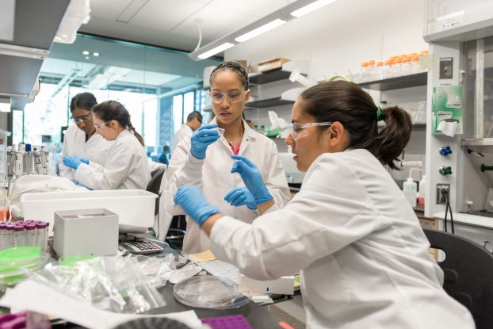
Merit Review
Broader Impacts
Inclusion
STEM education
Public Engagement
Societal Well-Being
STEM Workforce
Partnerships
National Security
Economic Competitiveness
Infrastructure

Slide 44
Solicitation specific criteria EAR-IF 22-577
Planned uses of requested facilities, instruments, or software must include basic research on Earth
processes SUPPORTED BY PROGRAMS OF THE DIVISION OF EARTH SCIENCES.

Slide 45
Solicitation specific criteria EAR-IF 22-577
Human resource development and education.
Efforts to support participation of underrepresented groups in laboratory and/or field instrument use and training are encouraged.

Slide 46
Solicitation specific criteria EAR-IF 22-577
EAR/IF asks reviewers to evaluate all proposals submitted to the program on:
Intrinsic merit of the Earth Science research that will benefit
Number of investigators who will substantially benefit, and the strength of their Earth Science research programs

Slide 47
Solicitation specific criteria EAR-IF 22-577
EAR/IF asks reviewers to evaluate all proposals submitted to the program on (contd):
Adequacy of the management plan describing the ability to operate and maintain complex equipment during its expected lifetime
The adequacy of the facilities, equipment, and other resources provided as institutional support to carry out the proposed management plan

Slide 48
Solicitation specific criteria MRI 23-519
Refer to MRI website
https://new.nsf.gov/funding/opportunities/major-research-instrumentation-program-mri
Consult with MRI Program Directors
Randy Phelps
Jonathan Friedman

Slide 49
Project Considerations
Science questions should lead
Plan for the whole lifecycle
To be competitive for larger programs, a coherent, integrated whole with strong project management must be presented

Slide 50
Project Considerations
Enable frontier science research and education
Compelling research needs and priority within the community
Appropriately broad user community

Slide 51
Project Considerations
Consider your audience
Think like a reviewer

Slide 52
Proposal Elements
Read the Solicitation
Varied specific requirements and recommendations for different tracks

Slide 53
Proposal Elements
Postdoctoral Researcher Mentoring Plan
Any proposal that requests funding to support a post-doctoral researcher is required to include a postdoctoral researcher mentoring plan
(see PAPPG Chapter II.C.2.j ).

Slide 54
Proposal Elements
Data Management Plan
All NSF proposals must include a Data Management Plan (DMP) no more than 2 pages (see PAPPG Chapter II.C.2.j ).
Become familiar with community data and informatics efforts supported by NSF Programs such as the EAR Geoinformatics
Program or through other agencies.

Slide 55
Proposal Elements
Data Management Plan
The Division of Earth Sciences has a specific Data and Sample Policy that applies to workflows for using instrumentation to generate data for research.
Proposals to EAR/IF should describe in an included DMP how a supported project will address the EAR Data and Sample Policy.
https://www.nsf.gov/geo/geo-data-policies/ear/index.jsp

Slide 56
Proposal Elements
Letters of Collaboration
Limited to stating the intent to collaborate
Should not contain endorsements or evaluation of the proposed project.
The recommended format for letters of collaboration is as follows:
"If the proposal submitted by Dr. [insert the full name of the Principal Investigator] entitled [insert the proposal title] is selected for funding by NSF, it is my intent to collaborate and/or commit resources as detailed in the Project Description or the Facilities, Equipment and Other Resources section of the proposal."

Slide 57
Proposal Elements
List of Suggested Reviewers or Reviewers Not to Include (optional)
Take the option!
Include non conflicted suggested reviewers, affiliation, email address

Slide 58
Proposal Elements
Several proposal elements specific to each track and program
Read the solicitation
Email us for help, clarifications, questions

Slide 59
Program Directors
EAR-IF, MRI David Lambert
dlambert@nsf.gov
Luciana Astiz
lastiz@nsf.gov
Amanda Keen-Zebert akeenzeb@nsf.gov
EAR
Instrumentation &
Facilities
Major
Research
Instrumentation
$ Varies per
Track
Up to $4M

Slide 60
YES!
(probably)
Slides from this webinar will be posted
YES!
(probably)
A recording will be posted
Check the EAR-IF website under ‘Additional Program Resources’

Slide 61
During a lapse
in NSF operations
Electronic systems for proposal preparation and submission will remain available, (i.e., Research.gov, and Grants.gov).
Recipients may continue performance under their NSF awards to the extent funds are available, and the period of performance of the grant or cooperative agreement has not expired.
More information on NSF operations for recipients and panelists, and employees will be posted at https://www.nsf.gov/,
Responses to any inquiries will be deferred until normal operations resume.
All panels (including virtual panels) will be cancelled and/or rescheduled.

Slide 62
Subscribe to the EAR Newsletter for news on upcoming EAR events including EAR-IF Office Hours
To subscribe to EAR’s informational listserv, send an email to listserv@listserv.nsf.gov with the following text in the body of the message:
Subscribe Earth your name
[for example: Subscribe Earth Florence Bascom]

