Slide 1
Workplace Equity for Persons with Disabilities in STEM and STEM Education (NSF 23-593)
Mark H. Leddy, PhD, MS, Lead Program Director
Christopher L. Atchison, PhD, Program Director
Division of Equity for Excellence in STEM
Directorate for STEM Education
National Science Foundation
Solicitation Webinar
July 13, 2023

Slide 2
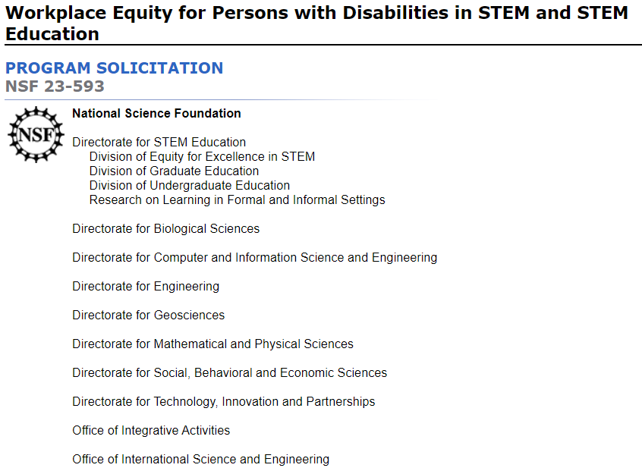

Slide 3
3 Research Themes
Studying barriers and/or solutions to diversity, equity, inclusion and accessibility (DEIA).
Applying intersectional social identity perspectives to investigate characteristics and conditions that limit and/or improve DEIA.
Conducting use-inspired and solution-oriented translational research about DEIA.

Slide 4
6 Key Project Design Components
Researchers, experts, and/or organizations with disability experience.
Disability type(s) to be investigated.
STEM and/or STEM education workplace(s) and/or postsecondary training setting(s).
Theoretical and/or conceptual framework(s), research hypotheses, questions, designs, methodologies, data analyses, and data interpretation plans.
Assessment of project success.
Accessible dissemination of knowledge and/or practice outcomes to traditional and new audiences.

Slide 5
Eligibility Information: Who May Submit
Institutions of higher education
Non-profit, non-academic organizations
For-profit organizations, including small businesses
State & local governments, including school districts
Tribal governments

Slide 6
PI and Organizational Eligibility Information
NO limits or restrictions on who may serve as PI.
NO limits or restrictions on the number of proposals per organization.
NO limits or restrictions on the number of proposals per PI or Co-PI.

Slide 7
5 Proposal Types
Research
Synthesis
Conference
EArly-concept Grants for Exploratory Research (EAGER)
Rapid Response Research (RAPID)

Slide 8
Full Proposal Deadline and Target Date
Research and Synthesis Full Proposals
Due Tuesday, September 19, 2023
By 5pm submitter’s local time
Conference, EAGER, and RAPID Proposals
Target date is Tuesday, September 19, 2023
May be submitted before, on, or after target date

Slide 9
NSF Merit Review Criteria
Intellectual Merit: This criterion encompasses the potential to advance knowledge.
Broader Impacts: This criterion encompasses the potential to benefit society and contribute to the achievement of specific, desired societal outcomes.
Data Management and Postdoctoral Researcher Mentoring Plans
Additional Solicitation Review Criteria
Notes:
.

Slide 10
Elements of NSF Merit Review Criteria
What is the potential for the proposed activity to:
a. Advance knowledge and understanding within its own field or across different fields (Intellectual Merit); and
Benefit society or advance desired societal outcomes (Broader Impacts)?
To what extent do the proposed activities suggest and explore creative, original, or potentially transformative concepts?

Slide 11
Elements of NSF Merit Review Criteria
Is the plan for carrying out the proposed activities well-reasoned, well-organized, and based on a sound rationale? Does the plan incorporate a mechanism to assess success?
How well qualified is the individual, team, or organization to conduct the proposed activities?
Are there adequate resources available to the PI (either at the home organization or through collaborations) to carry out the proposed activities?

Slide 12
Research & Synthesis Specific Review Criteria
Researchers, experts, and/or organizations with disability experience.
Disability type(s) to be investigated.
STEM and/or STEM education workplace(s) and/or postsecondary training setting(s).
Theoretical and/or conceptual framework(s), research hypotheses, questions, designs, methodologies, data analyses, and data interpretation plans.
Assessment of project success.
Accessible dissemination of knowledge and/or practice outcomes to traditional and new audiences.

Slide 13
Authentic Leadership and Partnerships
Include people with disabilities on the project team:
Researchers and senior staff
Other personnel, staff, and expert consultants
Postdoctoral research scholars
Graduate students
Undergraduate students
Advisory board members

Slide 14
Disability Types
D/deafness or hearing loss
Blindness or visual impairment
Physical
Mental health
Medical or other health-related disabilities
Neurodiverse or cognitive conditions: Dyslexia, Autism spectrum disorders, Learning Disabilities, and others
Multiple disabilities

Slide 15
Workplaces and Training Settings
Private, public, & government-funded research centers and laboratories, businesses, & industries
Undergraduate, graduate & postgraduate college & university classrooms, labs, & research facilities
Field stations & remote sites, observatories, polar facilities, research aircraft, & sea-going vessels
PreK-12 classrooms & learning environments
Tribal & indigenous facilities & environmental settings

Slide 16
Theoretical and Conceptual Frameworks
Robust research hypotheses, questions, designs, methodologies, data analysis & data interpretation
Required foundation for robust research methods
May also align with indigenous traditional ecological knowledge & community-based participatory research
Intersectional perspective, framework, or theory
Critical disability theory
Universal design principles

Slide 17
Project Assessment and Evaluation
Plan for soliciting & addressing feedback, for example:
Internal and/or external advisory board(s)
Internal and/or external evaluation plan(s)
Other evaluative mechanisms
Rationale for assessment mechanisms
Plan for objective assessment activities
Description of how assessment will inform project modifications and improvements

Slide 18
Dissemination for Knowledge Advancement
How results, findings, outputs, and outcomes advance knowledge AND contribute to practice or policies
Creative approaches to reach broad audiences, in addition to peer-reviewed publications
Communication plan: Specific audiences, channels, media, and technologies
Bring findings to mainstream communities in 508 compliant and accessible formats

Slide 19
Research Theme 1: Barriers and Solutions
Studying the Barriers and Solutions to Diversity, Equity, Inclusion, and Accessibility in STEM and STEM Education Workplaces and Training Settings for Persons with Disabilities

Slide 20
Research Theme 2: Intersectional Perspectives
Applying Intersectional Social Identity Perspectives to Investigate Characteristics and Conditions of STEM and STEM Education Workplaces and Training Settings for Persons with Disabilities

Slide 21
Research Theme 3: Adapt, Adopt, Translate
Conducting Use-Inspired and Solution-Oriented Translational Research about Diverse, Equitable, Inclusive, and Accessible STEM and STEM Education Workplaces and Training Settings for Persons with Disabilities

Slide 22
Research Examples: Barriers
Physical and technological barriers limiting work or training, and/or restricting equipment use
Socio-cultural factors adversely impacting thoughts, attitudes, and behaviors about people with disabilities
Policies and practices that are implicitly or explicitly biasing against people with disabilities

Slide 23
Research Examples: Solutions
Solutions to eliminate physical or technological barriers that restrict equipment use
Intervention to mitigate negative socio-cultural factors impacting attitudes and behaviors
Policy and practice changes that mitigate or eliminate biases that limit persons with disabilities

Slide 24
Proposal Preparation and Submissions Instructions
Research.gov or Grants.gov submissions
Project Summary
Project Description
Budgets and Budget Justification
Special Information and Supplementary Documentation

Slide 25
Research.gov or Grants.gov submission
NSF FastLane is no longer a submission option
Research.gov
NSF Proposal and Award Policies and Procedures Guide (PAPPG)
Required use for collaborative proposals
Grants.gov
NSF Grants.gov Application Guide
Notes:
.

Slide 26
Project Summary Guidelines
Overview (Research issue or project purpose)
Research theme & 6 project design components
Intellectual Merit (Advance knowledge potential)
Research goals, hypotheses, questions, designs, methodologies, data analyses, data interpretation
Broader Impacts (Benefit society & outcomes)
Outcomes for individuals & communities; brief communication & dissemination plan overview

Slide 27
Project Description Guidelines
Introduction
Literature review
Research plan
Assessment and evaluation plans
Leadership, management & organization resources
Dissemination & communication plan
Results from prior NSF Support
Broader Impacts

Slide 28
Budgets and Budget Justification
Voluntary committed cost sharing is prohibited
Budget request is driven by scope of activities
Include Line E. Travel, 1. Domestic for an annual two-day awardee meeting
PI +1 project team member
All undergraduates, graduate students, & postdoctoral researchers working on the project

Slide 29
Special Information and Supplementary Documentation
No appendices
No letters of support or endorsement
Data Management Plan
Postdoctoral Research Scholar Mentoring Plan
Letters of collaboration

Slide 30
Special Award Conditions
The grantee is required to share requested materials and data, as allowed by the policies of the institutions, organizations, or federally recognized Tribal and Indigenous communities, with an NSF funded resource hub and/or a third-party evaluator if and when requested to do so.

Slide 31
Requests for Reasonable and Accessibility Accommodations
NSF Proposal and Award Policies and Procedures Guide (PAPPG): Chapter II, Section A.2.
Proposal accommodations: NSF Office of Equity and Civil Right’s Disability Program Manager at rarequest@nsf.gov
Accessibility accommodations: NSF Section 508 Compliance Officer at kotts@nsf.gov
At least 30 calendar days prior to a proposal deadline

Slide 32
Facilitation Awards for Scientists and Engineers with Disabilities (FASED)
Proposal & Award Policies & Procedures Guide (PAPPG)
NSF 23-1, Chapter II, F.7.

Slide 33
Directorate for STEM Education Dear Colleague Letters
Dear Colleague Letter: Research to Improve STEM Teaching, Learning, and Workforce Development for Persons with Disabilities (NSF 21-114)
Dear Colleague Letter: Persons with Disabilities – STEM Engagement and Access (NSF 21-110)

Slide 34
Workplace Equity for Persons with Disabilities in STEM and STEM Education (NSF 23-593)
Mark H. Leddy, mleddy@nsf.gov, (703) 292-4655
Christopher Atchison, catchiso@nsf.gov, (703) 292-2154
Division of Equity for Excellence in STEM
Directorate for STEM Education, National Science Foundation
Solicitation Webinar, July 13, 2023

