Slide 1
Division of Environmental Biology Virtual Office Hour
Things I wish I learned earlier about NSF!
Please submit questions via the Q&A button available to you on Zoom.
Please set to “Send anonymously”

Slide 2
Welcome! Division of Environmental Biology
NSF staff in attendance today:
Jeremy Wojdak (host) – Population and Community Ecology
Chris Balakrishnan – Systematics and Biodiversity Science
Kim Hughes – Evolutionary Processes
Kendra McLauchlan – Ecosystem Science
Facilitators – Megan Lewis, Christina Washington, and Bill Lawson
Notes:
Jeremy

Slide 3
DEB Virtual Office Hour
DEB Office Hours: second Monday of each month, 1-2pm Eastern
Upcoming Topics:
September 11: Macrosystems Biology and NEON-Enabled Science (MSB-NES)
October 16*: Welcome to DEB
November 13: Partnership to Advance Conservation Science and Practice (PACSP) Update
December 11: Introduction to the Directorate for Technology, Innovation and Partnerships (TIP)
*indicates time and date change
Notes:
Jeremy

Slide 4
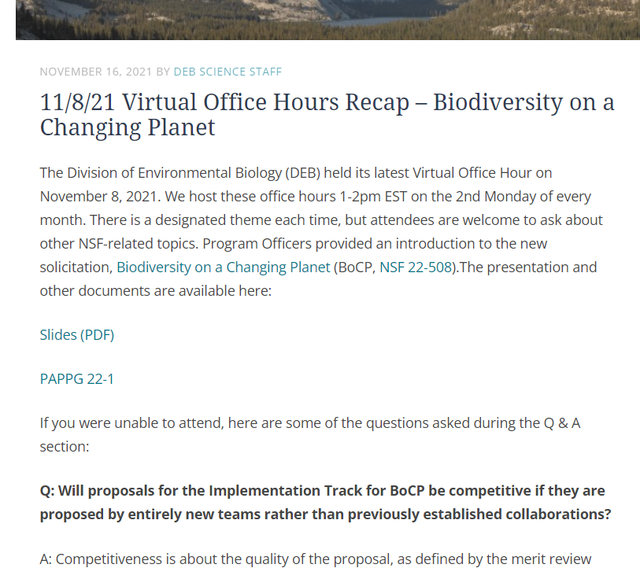
DEB Blog posts upcoming topics, registration, and recap posts
https://debblog.nsfbio.com/office-hours/
Notes:
Jeremy
(second block on right animates in to emphasize that slides and Q&A are posted on blog after each VOH)

Slide 5
BIO News and Updates
Visit www.nsf.gov and scroll down until you see the Sign up and social media banner, click on the yellow box, and follow the prompts.
Volunteer to review: DEB: https://www.surveymonkey.com/r/DEBexpertise
Notes:
Anne

Slide 6
Recent Funding Opportunities
Find links to all recent solicitations and DCL at the left side of the BIO webpage under Funding
Remember – Many BIO solicitations have no deadlines and no submission limits.
NSF 23-549 – Division of Environmental Biology Core Programs - No deadline
NSF 22-591 – Opportunities for Promoting Understanding through Synthesis (OPUS) – No deadline
NSF 22-504 – Macrosystems Biology and NEON-Enabled Sciences (MSB-NES) – Deadline Nov 13
NSF 20-579 – Dynamics of Integrated Socio-Environmental Systems (DISES) – Deadline Nov 15
NSF 22-513 – Organismal Response to Climate Change (ORCC) – Deadline Nov 21
DCL 23-055 – Bioinspired Design Collaborations to Accelerate the Discovery-Translation Process (BioDesign)
DCL 23-092 – Dear Colleague Letter: Availability of Earth Observation Data for NSF-Funded Researchers
DCL 22-122 – Planning Proposals to Catalyze Innovative and Inclusive Wildland Fire Science through Diverse Collaborations
BIO 18-001 – Biological Sciences Temporary/Rotator Program Officer
Notes:
Jeremy
Trying a new intro slide order.... VOH focuses, then DEB blog, then NSF-wide newsletter, THEN content, starting with all the solicitations then our topic of the day...
-Be sure to check out last month’s blog post with a slide presentation and Q&A for the CAREER program as that deadline approaches.

Slide 7
***New DEB Core Program Solicitation*** NSF 23-549
Data Management Plan: New guidance for specimen management.
IntBIO Track: An Integrative Research in Biology (IntBIO) track invites submission of collaborative proposals to tackle bold questions in biology that require an integrated approach to make substantive progress.
must span two or more sub-disciplinary boundaries in biology
Projects suitable for review in a single existing BIO program should be submitted to that program (i.e., and not IntBIO)
Small Grants: Complete research projects, up to $200,000
Safe and Inclusive Work Environments for off-site research required upon submission****
Check out the DEB Blog for more information
Notes:
Chris:
DMP: “For projects that involve collecting or generating specimens (e.g. organisms, parts of organisms, fossils including trace fossils, microbial isolates, etc), the Data Management Plan must include a description of how the specimens and associated data will be accessioned into and maintained in an established biological collection.”
IntBIO: “Proposals submitted to the IntBIO Track must span two or more subdisciplinary boundaries in biology. Projects suitable for review in a single existing BIO program should be submitted to that program and not to the IntBIO track. Proposers are strongly encouraged to contact a MCB Program Director prior to submission to obtain advice on suitability of the project idea for the IntBIO Track.” AND “The IntBIO Track is common to each of the core research program solicitations in the Divisions of Environmental Biology, Integrative Organismal Systems, and Molecular and Cellular Biosciences.”
Small Grants: this isn’t a change, but a reminder that in DEB we have a mechanism for smaller grants, these aren’t pilot studies or collecting prelim data, but full fledged research projects that happen to be small. This mechanism is largely about communicating our receptivity to smaller grants. But nothing precludes a PI from submitting a $205,000 core proposal, or $400,000, or whatever. Ask for what you need. But don’t inflate budgets that make it hard for us to say yes.
Safe and inclusive are now required for submissions to the core solicitation. Please note that CAREER, RUI, and some other proposal categories are submissions to other, Foundation-wide solicitations, and not yet required to submit SAI. Read solicitation carefully, and ask a program officer if in doubt.

Slide 8
Learning the “culture” of NSF
Formal documentation
Proposals & Awards Policy and Procedures Guide (PAPPG)
Solicitations
Dear Colleague Letters
Research.gov/ Fastlane systems
NSF outreach
Blogs
Virtual Office Hours
Conferences
Individual meetings with program officers
Participation
Proposal submission
Receiving reviews/ panel Summaries
Award management
Reports, requests, supplements
Writing ad hoc reviews
Panelist service
Notes:
Jeremy:
NSF is a government bureaucracy, and it all seems pretty formal from the outside. But nonetheless, cultures develop and when you are first learning about NSF opportunities, it can seem a bit like a maze of terms, acronyms, and jargon… and you can feel like an “outsider”. Just as a simple example, while a normal proposal to NSF has a page length and some formatting guidelines, the actual construction of a typical proposal is very constrained. Most proposals “look alike” in terms of sections, emphasis, etc. but that isn’t specified – it isn’t required – but it is an emergent cultural artifact of the process that you can’t learn from the outside. Some people are fortunate in that they get a lot of exposure to the NSF system as graduate students, postdocs, or as early-career faculty…. But that kind of mentoring is heterogeneous, and from our side, we recognize that everyone could benefit from learning more about how NSF works. There are perhaps three main mechanisms by which you can learn about NSF – the formal documentation that is issued from NSF, our own attempts at bridging the gaps to the community through outreach, and by participating by submitting proposals, managing an award, providing a review, or serving as a panelist.
Today we hope to provide little windows into how NSF works, drawing from our own experiences as PIs and now as program officers. This is meant to be informal, and we’ll ask our panel for their reflections and encourage you to ask lots of questions via the Q&A function in Zoom.

Slide 9
NSF is a customer service-oriented organization
Myth: Program officers are too busy to talk with people about their grant ideas.
Truth: PO’s welcome PI emails and frequently meet via Zoom to discuss proposals, awards, even nascent ideas, and we enjoy it!
Myth: NSF loves to say no.
Truth: Limited budgets and high proposal pressure mean we must decline many submissions, but POs are deeply interested in fostering the success of the community.
Providing funding calls that match where the community/research is going and opportunities for PIs to improve their submissions
Listening to emergent obstacles/openings from people doing the work
Myth: NSF is a monolith.
Truth: There is tremendous diversity in process, emphasis, and expectations. Think adaptive radiation!
Notes:
Kendra: {Have a couple people share their experience, perhaps someone (Jeremy) who never called a PO as a PI… emphasize that we are on the same team in a way, in that when great research comes to our program and we fund it, that is a measure of OUR success as well. We want to cultivate great proposals and fund great projects. }
The first two points are meant to provide an explanation or rationale for why people should feel ok reaching out to POs. We always say “talk to your PO!” but if people are intimidated they may still resist… but especially point two makes it clear we want to foster/improve proposals and projects.
The third point is meant to make people aware of inappropriate generalizations: “An NSF proposal has to… “ or “NSF likes x, y, z…” what is true in one area may not be true elsewhere, and it pays to understand programs. The heterogeneiety is adaptive – different programs have different goals, objectives, constraints, challenges, communities to serve… one size fits all would fit none.

Slide 10
Preparing to submit a proposal
Which solicitation? Be objective and honest with yourself…
It is very common for someone to love their idea, and convince themselves it “fits” (i.e., is responsive to) any solicitation. A great idea submitted to the wrong program can fail.
Revising a draft before submission: Be strategic with your “friendly” reviews
Give people specific tasks that honor their expertise
Big picture colleague? Point them to your conceptual framework
Disciplinary expert? Point them to your methods
Helps avoid mere copy-editing reviews
Struggling with the process? You are not alone!
A great resource for proposal submission and grant administration advice are the websites published by SRO’s of research-intensive institutions.
Notes:
Kendra:
Same as previous...
First point is meant to help people avoid sending ecotoxicology, marine, pure management, pure conservation, etc. etc. etc. proposals that don’t actually fit our programs, even if they are very cool research.
Second point – call on Jeremy… this point was just about having colleagues help you write a proposal. Asking for a friendly review before you submit, but without direction, often leads to copy editing. Asking specific people for specific feedback produces better results.
Third point – of course there is official NSF guidance, help lines for Research.gov, etc. etc. But SROs write guidance for POs in practical ways given their deep experience with many submissions. Can be a rich source of info, but as with all free advice… be carfeul!

Slide 11
Getting reviews back after a proposal submission
If your proposal went to panel, the panel summary should be given more weight than individual reviews.
Should represent a comprehensive assessment of the factors that mattered for the recommendation.
Some critiques in individual reviews, if not mentioned in the panel summary, may not have been viewed BY THE PANEL as that important.
Sometimes a review is off-track – that doesn’t mean the panel, or the program officers accepted it as valid without question.
If you find yourself “But we said that on page 11!!! Didn’t they read!?!?”…
It probably means you can improve the clarity of your communication. Make that your default assumption.
Notes:
Chris B

Slide 12
Award administration: Congratulations! Now the real work begins….
Reporting
Due vs. overdue
Download the template on day one, know what you’ll need to collect and report, makes yearly reports a breeze
Supplements
Many programs now ask that you include REU/RET/ROA/RAHHS supplements in the original proposal
Less work for everybody, and the desire to include these participants is easy to anticipate
Some needs are emergent
Career-Life Balance
REPS
Accomplishment/opportunity based
Successful supplements are usually tied to core NSF priorities…
Broadening participation
Workforce
Needs of the scientific community
Notes:
Kim:
{Again, we can share stories… but cover the ambiguity about due vs. overdue reports, and how disruptive an overdue report can be. We can add any number of things about supplements… internally reviewed, typically <20% of the original budget, easiest to justify if tied to key NSF priorities… not just “we can do more with more money”, because everyone can. }

Slide 13
Award administration: Congratulations! Now the real work begins….
Notifications and Requests
No-cost extensions
Change in scope/PI/methods/ person-months allocated
Delays/problems
Notes:
Kim
{Again, we can share stories… cover typical notifications, requests, etc. How NCE”s are really used, what changes require N&R and which don’t, etc. etc.
Share that delays and problems aren’t meant to make a record for which there will be punitive action, they really are so that we are aware of problems and can connect PIs with resources to fix those problems when possible… we are very vested in your success, and when appropriate, can find ways to help alleviate bottlenecks…. IF IF IF we know about them.
Share this link
Research.gov - About Notifications and Requests

Slide 14
Questions?
Submit your questions via the Q&A box on your screen and set to “Send anonymously”
Upvote questions by clicking the thumbs up icon next to the question you most want answered
Notes:
Jeremy

