Slide 1
CISE Seminar on GlobalCenters
CISE Seminar on
Global Centers
Use-Inspired Research
Addressing
Global Challenges in
Climate Change and
Clean Energy
NSF 23-557
Notes:
Welcome! On behalf of the Global Centers team I want to thankyou for joining us today.
This webinar is a high level discussion of this new program and an overview of the opportunities for US researchers to partner with collaborators in our partner organizations in Canada, the UK, and Australia.

Slide 2
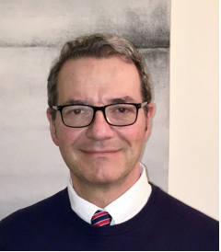
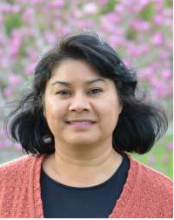
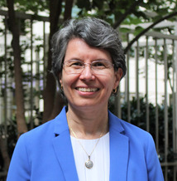
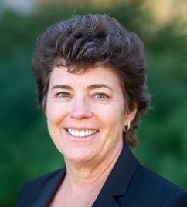
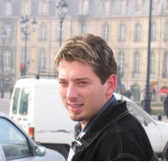
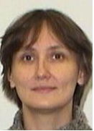
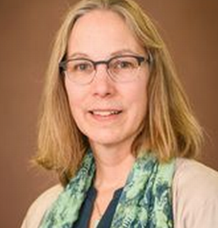
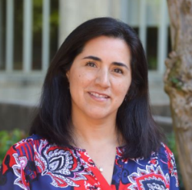
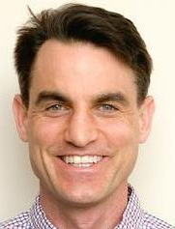
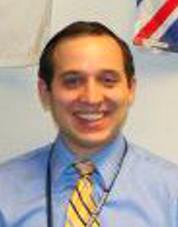
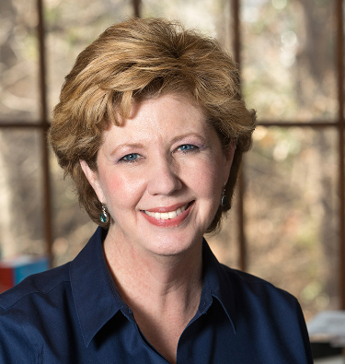
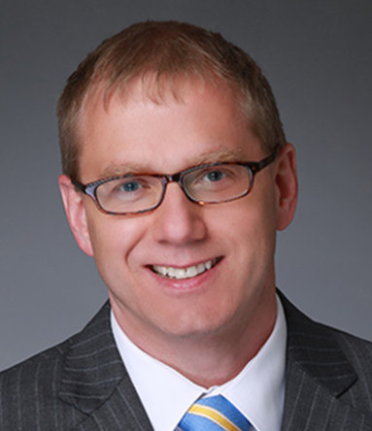
NSF Program Officers
Paul Raterron (OISE)
Karen Lips (OISE)
Wenda Bauchspies (OISE)
Cassidy Burke (OISE)
Mamta Rawat (BIO)
Damian Dechev (CISE)
Elsa Gonzalez (EDU)
Crystal Leach (ENG)
Lina Patino (GEO)
Yulia Gel (MPS)
Jeremy Koster (SBE)
Michael Reksulak (TIP)
Notes:
My name is Karen Lips and I am one of the Program Officers for the Global Centers program. I am joined by my colleagues Wenda Bauchspies, Paul Raterron, and Cassidy Burke, as well as Program Officers who serve as representatives to the Global Centers program from participating directorates across NSF.
We’d like to also thank our international partners XXX for joining us. I’d like to ask them to briefly introduce themselves.

Slide 3
NSF-led initiative in Partnership with International Funders
National Science Foundation (NSF)
Commonwealth Scientific and Industrial Research Organisation (CSIRO)
Natural Sciences and Engineering Research Council (NSERC) and Social Science and Humanities Research Council (SSHRC)
UK Research and Innovation (UKRI)
Notes:
We will first give a high level overview of the program, followed by a Q&A during which Program Officers will answer your questions. You can drop questions into the Q&A feature throughout the talk and we will bring them forward after the presentation. We will try to answer all your questions, but time is limited and we may not get to them all.
If we don’t get to your question, you can check our website, write to the Global Centers email (GlobalCenters@nsf.gov), or check the FAQ on our website. In addition, we have a series of Office Hours scheduled weekly between now and the deadline of May 10th where you can met Program Officers us and ask questions regarding the proposal development process.

Slide 4
Vision for the Global Centers Call
Climate change is a global threat that impacts the natural and human world
Global Centers offer a bold vision for high impact, use-inspired basic research in Climate Change (CC) and Clean Energy (CE) science
They leverage international partnerships on any area of NSF-funded science
They address grand challenges with benefits to society
Centers may be physical or virtual
Notes:
The National Science Foundation (NSF) Global Centers Program is an ambitious new initiative to fund international, interdisciplinary collaborative research centers that will apply best practices of broadening participation and community engagement to develop use-inspired/applied research on climate change and clean energy, leading to foreseeable benefits to society.
This Program will prioritize research collaborations which foster team science, community-engaged research, and use knowledge-to-action frameworks. The proposed research work should maximize the benefits of international, interdisciplinary collaborations.
Project outcomes should help the assessment or mitigation of Climate change impacts on society, people, and communities and/or development of Clean Energy solutions.
Through this partnership US researchers can join partners in Canada, the UK, and Australia to mitigate climate change impacts and develop Clean Energy solutions.

Slide 5
Global Centers: Key Goals
Climate change is complex, and solutions require synergistic partnerships
Tackle challenges that require involving more than a single institution or a single discipline
Demonstrate how international collaboration will produce innovative research and education outcomes
Identify who are the relevant stakeholders and how they will help drive the science research priorities
Have a vision and strategy for potential growth, scaling up, and building a relevant community
Notes:
* Addresses Global Challenge on CC and CE: research can be local, but with global implications.

Slide 6
How can CISE community participate?
Observations
Data Aggregation
Computational Modeling
Interventions
Analysis & Reasoning
Recent National Academies report on Next Generation Earth Systems Science at the National Science Foundation:
Advocates for a systems approach to studying the Earth
Computation provides the framework for putting together the complex pieces of Earth Systems Science, supporting data collection and analysis, generating forecasts, and interpreting model results
CISE
Notes:
Inter-, multi-, or trans-disciplinarity; importance of integrating the social, behavioral, and economic sciences
Stakeholders beyond academia: private and public sector
Clear plan to integrate DEIA into the research and training
Workforce development: education, training, & building a community to continue work beyond the funding period

Slide 7
Computation and Information Science Topics
Advances in high-speed communication networks and cloud infrastructure for efficient data collection, storage, and aggregation
Novel data science solutions, including Artificial Intelligence (AI), to enable advanced analysis, prediction and deeper understanding of CC and CE
State-of-the-art data-driven computational modeling, high precision simulation and virtualization
Notes:
Inter-, multi-, or trans-disciplinarity; importance of integrating the social, behavioral, and economic sciences
Stakeholders beyond academia: private and public sector
Clear plan to integrate DEIA into the research and training
Workforce development: education, training, & building a community to continue work beyond the funding period

Slide 8
Computation and Information Science Topics
Topics related to ensuring resilience of critical infrastructure (e.g. energy, food, water) to climate driven events
Smart sensor-based networks or self-adaptive robots for data collection in potentially hazardous areas
Emerging technologies like digital twins to create global-scale interactive models for climate prediction and reduction of GHG
Notes:
Inter-, multi-, or trans-disciplinarity; importance of integrating the social, behavioral, and economic sciences
Stakeholders beyond academia: private and public sector
Clear plan to integrate DEIA into the research and training
Workforce development: education, training, & building a community to continue work beyond the funding period

Slide 9
Relevant Solicitations
Relationship between sustainability and computing is bi-directional
Computing for sustainability (e.g. Global Centers)
Sustainability of Computing: Design for Environmental Sustainability in Computing (NSF 23-532)
Goal: address the substantial environmental impacts that computing has through its entire lifecycle from design and manufacturing, through deployment into operation, and finally into reuse, recycling, and disposal.
Notes:
Inter-, multi-, or trans-disciplinarity; importance of integrating the social, behavioral, and economic sciences
Stakeholders beyond academia: private and public sector
Clear plan to integrate DEIA into the research and training
Workforce development: education, training, & building a community to continue work beyond the funding period

Slide 10
Relevant Solicitations
2023 International Joint Initiative for Research in Climate Change Adaptation and Mitigation Competition
Collaboration among research funders from Brazil, Canada, Germany, Norway, South Africa, Switzerland, the United Kingdom and the United States to leverage international expertise to tackle the global challenges caused by climate change.
Notes:
Inter-, multi-, or trans-disciplinarity; importance of integrating the social, behavioral, and economic sciences
Stakeholders beyond academia: private and public sector
Clear plan to integrate DEIA into the research and training
Workforce development: education, training, & building a community to continue work beyond the funding period

Slide 11
Track 1: Implementation
Track 1 : Joint Funding opportunity with International Partners; 4-5 years; NSF will fund up to $5 million per award
FY23 Partner funding agencies:
Australia: CSIRO, AUD$7M
Canada: NSERC, CAD$15M; SSHRC, CAD$5M
United Kingdom: UKRI, £18M

Slide 12
Track 1: Implementation
Must involve the U.S. and at least 1 partner country; may involve other partner countries
Research topics must be aligned with those identified by NSF and the funding partner agencies (see Solicitation Section II.D.1.c)
Additional documentation needs to be submitted to funding partner agencies (Section II.D.1.c)
NSF funds US-based researchers
Foreign Funding partners (Australia, Canada, UK) fund their researchers
Notes:
Attention: The main thrust of the project must be carried out by teams in partner countries.
For successful proposal, foreign collaborators in Australia, Canada, and the UK will be supported by their respective country agencies.

Slide 13
Track 2: Community-driven Design
Track 2 : Community-driven, NSF-funded collaborations; 2 years, up to $250,000 per award
Encourage development of international research collaborations
Broaden participation: diversity of researchers, institutions, and stakeholders
Identify areas of interest and potential partners for future research collaborations such as Global Centers Track 1

Slide 14
Track 2: Community-driven Design
Must address use-inspired research in climate change and/or clean energy
Coordinate efforts to design a Global Center for the next NSF Global Centers competition
May involve scientists and stakeholders from any country globally, notably those based in regions of the world disproportionately affected by climate change
Notes:
Attention: Track 2 awards do not guaranty Track 1 awards in the next competition.

Slide 15
Proposal Development
Project Description (20 pages)
Describe academic and non-academic partners and roles
Describe partnerships that build on existing NSF investments (e.g., major facilities, etc.)
Describe partnerships that broaden participation
Articulate how the partnerships will be nurtured to build long lasting relationships
Describe the metrics of success and planned evaluation
Notes:
Articulate how any existing broadening participation efforts of partners will be leveraged and amplified by hub activities.
What will constitute success for a center? How will the multiple and integrative activities of a center be evaluated?
How will the broadening participation efforts be assessed?

Slide 16
Who May Submit Proposals
No restrictions on who may serve as Principal Investigator (PI)
An individual may be listed as PI or co-PI on no more than one proposal
Institutions of Higher Education (IHEs) - Two- and four-year IHEs (including community colleges) accredited in, and having a campus located in the US.
Non-profit, non-academic organizations: Independent museums, observatories, research laboratories, professional societies and similar organizations located in the U.S. that are directly associated with educational or research activities.
Notes:
Please note that an individual can be PI or co-PI on only one proposal, either Track 1 or Track 2. Please also note that PIs can be employed in non-profit, non-academic organization such as …

Slide 17
Diversity, Equity, Inclusion, and Access
Broadening participation and stakeholder engagement are key values to be integrated into the design of the Centers and the research objectives.
Prioritize scientific questions that include a diversity of individuals in the scientific enterprise
Diversifying the research workforce through a variety of approaches that support sustainable inclusion in the workplace (e.g., citizen science, partnerships, community engagement)
Notes:
“Broadening participation, […] includes rethinking how one identifies, approaches, and prioritizes scientific questions to involve a diversity of individuals in the scientific enterprise.
Diversifying the research workforce through a variety of approaches that support sustainable inclusion in the workplace is an important component of broadening participation.
Stakeholder engagement through citizen science, partnerships, community engagement and many more types of activities that help drive research priorities will also support and facilitate broadening participation in STEM.”

Slide 18
NSF Merit Review Criteria
Intellectual Merit (IM): the potential to advance knowledge
Broader Impacts (BI): the potential to benefit society and contribute to the achievement of specific, desired societal outcomes
Proposal & Award Policies and Procedures Guide (PAPPG 23-1) Chapter III.A.2
Notes:
Attention: Track 2 awards do not guaranty Track 1 awards in the next competition.

Slide 19
Solicitation-Specific Review Criteria
Interdisciplinarity: How will the Center utilize interdisciplinary and/or convergence approaches?
Use-inspired: What are the foreseeable societal benefits of the research outcomes?
International: Why is the international partnership required? Roles of the foreign partners?
Stakeholders: Roles of the multi-sector stakeholders (e.g., academia, private & public sectors, communities)?
DEIA: How will DEIA be integrated into the research and education efforts?
Vision for growth: Strategy for building a relevant community?
Notes:
20 pages
Interdisciplinarity (How will the Center utilize interdisciplinary and/or convergence approaches?)
* Use-inspired nature (What are the foreseeable societal benefits of the research outcomes?)
* International partnership (Why is the international partnership required? Roles of the foreign partners?)
* Roles of stakeholders (Roles of the multi-sector stakeholders, e.g., academia, private sector, public sector, philanthropies, communities?)
* Fostering DEIA (How will DEIA be integrated into the research and education efforts?)
* Vision for growth (Strategy for building a relevant community potentially able to carry out the work beyond the funding period?)

Slide 20
Supplementary Documentation
Specific to Global Centers proposals (in addition to PAPPG 23-1 requirements):
Letters of collaboration (Track 1, 2 pages each)
Student Mentoring Plan for the U.S. undergraduate and graduate students
Foreign Collaborator, Organization & Funding Information (Track 1)
Project Management Plan (3 pages)
Safe and Inclusive Work Environment Plan (if off-campus research, 2 pages)
Notes:
Letter of collaboration for all collaborators involved in proposed work, except for foreign collaborators from partner countries involved in implementation Track 1 proposals*. Must indicate 1) what infrastructure, resources, expertise etc. will be available to participants at the international site, 2) what roles the foreign collaborators will play in the project, and 3) how foreign collaborators and/or their organizations will benefit from participation in the project.

Slide 21
Foreign collaborators: Bio-sketches & Budget
Track 1 proposals must provide:
Biographical sketches of all participating investigators affiliated with a foreign organization in partner countries (NSF format)
A detailed budget for the funds requested by the foreign collaborators from partner funding agencies in Australia, Canada, UK
If missing budget: Return without review
Details in Solicitation Section V.A.8: “Supplementary Documentation”
Notes:
* Interdisciplinarity (How will the Center utilize interdisciplinary and/or convergence approaches?)
* Use-inspired nature (What are the foreseeable societal benefits of the research outcomes?)
* International partnership (Why is the international partnership required? Roles of the foreign partners?)
* Roles of stakeholders (Roles of the multi-sector stakeholders, e.g., academia, private sector, public sector, philanthropies, communities?)
* Fostering DEIA (How will DEIA be integrated into the research and education efforts?)
* Vision for growth (Strategy for building a relevant community potentially able to carry out the work beyond the funding period?)

Slide 22
NEW: Safe & Inclusive Working Environments
If off-campus or off-site research:
Data/information/samples being collected off-campus or off-site, e.g., fieldwork and research activities on vessels and aircrafts
Must submit a Plan for Safe and Inclusive Work Environments (2 pages)
Replaces the required plan associated with the certification in Chapter II.E.9 of the PAPPG 23-1
Details in solicitation Section V.A.8
Notes:
New requirement, specific to recent solicitation including this one.

Slide 23
Funding Foreign Organizations or Individuals
“NSF rarely provides direct funding support to foreign organizations […]
However, where the proposer considers the foreign organization or foreign individual’s involvement to be essential to the project and proposes to provide funding through the NSF budget, they must explain why support from the foreign counterpart’s in-country resources is not feasible and why the foreign organization or foreign individual can carry out the activity more effectively than a U.S. organization.”
PAPPG 23-1 Chapter I.E.2

Slide 24
Program Timeline
Due date for all full proposals: May 10, 2023
10 May: Track 1 submission deadline
12 April – 10 May: Track 2 submission window
June – July: NSF Merit Review Process for all proposals
July: ranking completed, funding partners finalize Track 1 portfolio; NSF finalizes Track 2 portfolio
August – September: First awards in FY2023

Slide 25
Upcoming Office Hours
(all times Eastern)
1. 14 April 2023 2:00 – 3:00 p.m.
2. 18 April 2023 3:30 – 4:30 p.m.
3. 28 April 2023 2:00 – 3:00 p.m.
4. 2 May 2023 3:30 – 4:30 p.m.
Notes:
Please note the special focuses on…

Slide 26
Thank you!
Add Questions to Q&A
CISE Specific Questions
ddechev@nsf.gov
globalcenters@nsf.gov
NSF Global Centers homepage
https://beta.nsf.gov/funding/opportunities/global-centers-gc
International Funding Partners Webpages
https://www.csiro.au/GlobalCenters
https://www.nserc-crsng.gc.ca/Innovate-Innover/NSF-NSF/index_eng.asp
https://www.ukri.org/opportunity/global-centers-in-clean-energy-and-climate-change

Slide 27
Blank slide

Slide 28
Blank Slide

Slide 29
Blank Slide

Slide 30
Collaborations

Slide 31
CISE: Computer and Information Science and Engineering Directorate
Division of Computer and Network Systems (CNS)
CNS invents new computing and networking technologies, while ensuring their security and privacy, and finds new ways to make use of current technologies.
Division of Computing and Communication Foundations (CCF)
CCF advances computing and communication theory, algorithms for computer and computational sciences and architecture and the design of computers and software.
Division of Information and Intelligent Systems (IIS)
IIS studies the interrelated roles of people, computers and information to increase the ability to understand data, as well as mimic the hallmarks of intelligence in computational systems.
Office of Advanced Cyberinfrastructure (OAC)
OAC supports and coordinates the development, acquisition and provision of state-of-the-art cyberinfrastructure resources, tools and services essential to the advancement and transformation of science and engineering.

Slide 32
Global Centers should…
Climate change is complex, and solutions require synergistic partnerships
Tackle challenges that require involving more than a single institution or a single discipline
Demonstrate how international collaboration will produce innovative research & education outcomes
Identify who are the relevant stakeholders and how they will help drive the science research priorities
Have a vision and strategy for potential growth, scaling up, and building a relevant community
Notes:
* Addresses Global Challenge on CC and CE: research can be local, but with global implications.

Slide 33
Key Elements of the Global Centers
Inter-, multi-, or trans-disciplinarity; importance of integrating the social, behavioral, and economic sciences
Stakeholders beyond academia: private and public sector
Clear plan to integrate DEIA into the research and training
Workforce development: education, training, & building a community to continue work beyond the funding period
Notes:
Inter-, multi-, or trans-disciplinarity; importance of integrating the social, behavioral, and economic sciences
Stakeholders beyond academia: private and public sector
Clear plan to integrate DEIA into the research and training
Workforce development: education, training, & building a community to continue work beyond the funding period

Slide 34
Priorities for Global Centers
Proposers are strongly encouraged to use the full range of STEM disciplinary and multi-disciplinary approaches, including the social, behavioral, and economic sciences which are particularly relevant in the framework of the Global Centers call.
Broadening participation in STEM is a priority for NSF and Funding Partner Agencies. Proposers are strongly encouraged to engage with underrepresented communities in meaningful ways.
Notes:
Proposers are strongly encouraged to account in their project for the “Human Factor:”
“The diverse needs, priorities, experiences, and perspectives of impacted communities will be essential components to drive innovative research to mitigate impacts of climate change on human and natural systems, promote adaptation to climate change, and explore clean energy alternatives.”

Slide 35
Wide Scope of Research Topics
Research themes may include a wide range of topics; see examples in solicitation Section II.D.1.
Must address Global Challenges in CC and/or CE
Any field or fields of science, engineering, or education research supported by NSF
For Track 1 proposals, must align with the involved funding partners’ priorities (see Section II.D.1.c)

Slide 36
Wide Scope of Research Topics
Partnering Funding Agencies all recognize the need to involve the social, behavioral, and economic sciences
For example, in identifying pathways to decarbonization, topics may include net-zero pathway science using assessment models which consider clean energy sources and technologies together with social and economic drivers

Slide 37
Solicitation Specific Review Criteria
Interdisciplinarity
Use-inspired nature
International partnership
Roles of stakeholders
Fostering DEIA
Vision for growth
Notes:
* Interdisciplinarity (How will the Center utilize interdisciplinary and/or convergence approaches?)
* Use-inspired nature (What are the foreseeable societal benefits of the research outcomes?)
* International partnership (Why is the international partnership required? Roles of the foreign partners?)
* Roles of stakeholders (Roles of the multi-sector stakeholders, e.g., academia, private sector, public sector, philanthropies, communities?)
* Fostering DEIA (How will DEIA be integrated into the research and education efforts?)
* Vision for growth (Strategy for building a relevant community potentially able to carry out the work beyond the funding period?)

