Slide 1

Division of
Molecular and Cellular Biosciences (MCB)
Virtual Office Hours
Welcome to the MCB Virtual Office Hours, we will begin at 2pm EDT!
Today’s topic:
Funding opportunities at NSF for broadening participation
Notes:
When we begin, ask NSF people to introduce themselves and thank Mariam for running the show.

Slide 2

MCB Virtual Office Hour
Question and Answers Session:
Click on the Q&A icon on the bottom of your Zoom screen, shown here:
A Q&A box should appear on your screen. Please enter your question or comment in the box. You may select to submit your question anonymously.
Submit your questions via the Q&A function.
*For specific questions about your research,
please contact a Program Director.

Slide 3


Molecular and Cellular Biosciences (MCB)
Supports quantitative, predictive and theory-driven research to understand complex living systems at the molecular, subcellular, and cellular levels
Encourages use of approaches at intersections of biology and other disciplines
Promotes activities that build capacity and ensure diversity, equity and inclusion in the scientific enterprise.
Molecular Biophysics
Genetic Mechanisms
Cellular Dynamics and Function
Systems and Synthetic Biology
FY 2020 Research
Budget
$152 M
~35%
Success rate
Average award size: >$200 K/year
613
Proposals
250
Awards
Award duration: 2-5 years
17
Panels
Award size: up 10%
Decision time: down 20%
https://www.nsf.gov/funding/programs.jsp?org=MCB
Notes:
Script
The mission of the Molecular and Cellular Biosciences Division is to support…READ FIRST TWO POINTS IN BLUE BOX…
And, as with all NSF programs, the support for research goes hand in hand with support for training the next generation of scientists and creating a diverse and inclusive scientific community.
MCB comprises 4 clusters covering broad research areas or themes: Molecular Biophysics…READ LIST IN RED.
During the pandemic, our proposal review process is being conducted online without any hitch, thanks in no small part to you, the peer reviewing community.
In FY20, MCB had a research budget of $152 M. The Division received 613 proposals that were reviewed across 17 panels. The yield was 250 awards, equivalent to a success rate of ~35%.
There have been some significant changes that benefit the scientific community since the BIO Directorate instituted a no-deadline proposal submission policy in 2019:
First, you can submit your proposal for review whenever you think it is in good shape.
The award size has increased by 10%, and it takes 20% less time to arrive at a decision (avg b/w 5-6 mo). For the most part this is because the number of proposals submitted for review has decreased.
And, as noted earlier, the FY22 NSF budget is likely to increase. So, this is a very good time to send your best research ideas to MCB.
As you consider an application, keep in mind that the average award size is more than $200K/year and the award duration can range anywhere from 2 years for an exploratory high-risk/high reward type project to 5 years for a CAREER project.
-----------------------------

Slide 4
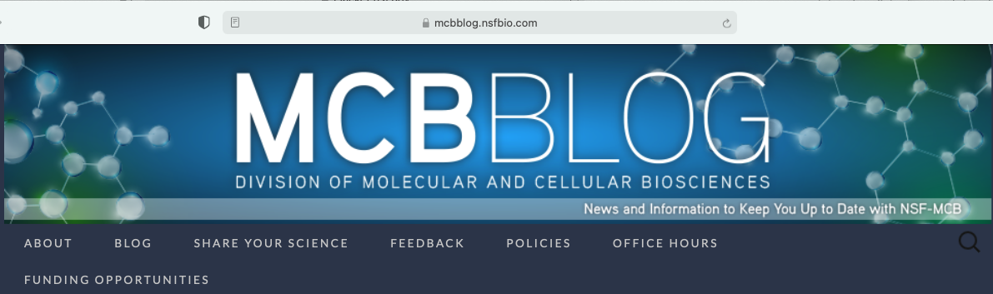
MCB Virtual Office Hour
Today’s Topic:
Funding opportunities at NSF for broadening participation
Copy of this and past presentations at: https://mcbblog.nsfbio.com/office-hours/

Slide 5
The NSF Broadening Participation portfolio
  How does NSF define Broadening Participation?
  Programs that are primarily focused on broadening participation;
  Programs that have broadening participation as one of several emphases; and
  Dear Colleague Letters expressing interest in specific aspects of broadening participation.
Notes:
This is the outline for today’s webinar. These slides will be available to you after the webinar through the MCB Blog.

Slide 6
Broadening participation
An element of broader impacts with the goal of discovering and nurturing talent
Emphasis on individuals who belong to groups underrepresented in science
  David Asai “PEERs:” Persons Excluded because of Ethnicity or Race
  The National Center for Science and Engineering Statistics:
    Three racial or ethnic minority groups whose representation in Science & Engineering education or employment is smaller than their representation in the U.S. population.
    Alaska Natives, Native Americans, Black or African Americans, Hispanics.
    Sometimes NCSES also includes women, people with disabilities, and veterans as underrepresented.

Slide 7

Focused Programs for Broadening Participation
Focused programs have an explicit broadening participation program goal. The majority of each award's budget goes to broadening participation activities and could involve research on broadening participation.
Credit: ©2019 Regents of the University of California
See https://www.nsf.gov/od/broadeningparticipation/bp_portfolio_dynamic.jsp

Slide 8
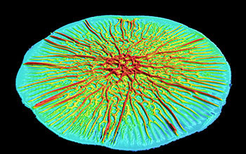
NSF-wide Focused Programs for Broadening Participation
ADVANCE: Organizational Change for Gender Equity in STEM Academic Professions
EPSCoR Research Infrastructure Improvement Program Track-1
Established Program to Stimulate Competitive Research: Workshop Opportunities (EPS-WO)
Historically Black Colleges and Universities - Excellence in Research
Credit: Chenyi Fei, Department of Molecular Biology, Princeton University
Notes:
ADVANCE The NSF ADVANCE program goal is to broaden the implementation of evidence-based systemic change strategies that promote equity for STEM faculty in academic workplaces and the academic profession.
EPSCoR Track 1 Through this program, NSF facilitates the establishment of partnerships among academic institutions and organizations in governmental, non-profit, and commercial or industrial sectors that are designed to effect sustainable improvements in a jurisdiction's research infrastructure, Research and Development (R&D) capacity, and hence, its R&D competitiveness.
EPS-WO EPSCoR welcomes proposals for workshops that focus on innovative ways to address multi-jurisdictional efforts on themes of regional to national importance with relevance to EPSCoR's goals and NSF's mission.
HBCU EiR supports capacity building by funding research projects. The goal is to establish stronger connections between researchers at HBCUs and NSF's research programs.
Now Bianca's turn

Slide 9
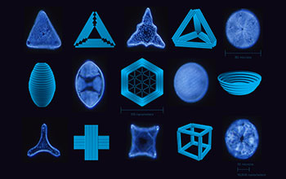
BIO Focused Programs for Broadening Participation
Postdoctoral Research Fellowships in Biology
Credit: Xiaoguo Liu: Biodesign Center for Molecular Design and Biomimetics. Shireen Dooling: Biodesign Center at Arizona State University
Notes:
The Directorate for Biological Sciences (BIO) awards Postdoctoral Research Fellowships in Biology (PRFB) for research and training in selected areas and with special goals for human resource development. For applications under this solicitation, one of the three areas is (1) Broadening Participation of Groups Underrepresented in Biology.

Slide 10
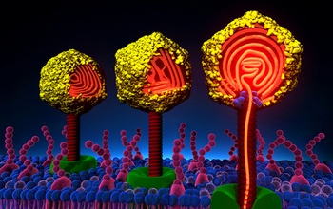
Education & Human Resources Focused Programs for Broadening Participation
Alliances for Graduate Education and the Professoriate
HBCU Undergraduate Program
Improving Undergraduate STEM Education: Hispanic-Serving Institutions
Louis Stokes Alliances for Minority Participation
NSF Scholarships in Science, Technology, Engineering, and Mathematics
Tribal Colleges and Universities Program
Credit: Alex Evilevitch and Ting Liu
Notes:
The AGEP program goal is to increase the number of historically underrepresented minority faculty in STEM. The program seeks to funds grants that advance and enhance the systemic factors that support equity and inclusion and, consequently, mitigate the systemic inequities in the academic profession and workplace.
HBCU-UP provides awards to strengthen STEM undergraduate education and research at HBCUs.
The goals of the HSI program are to enhance the quality of undergraduate STEM education and to increase the recruitment, retention, and graduation rates of students pursuing associate's or baccalaureate degrees in STEM.
The LSAMP program provides funding to alliances that implement comprehensive, evidence-based, innovative, and sustained strategies that ultimately result in the graduation of well-prepared, highly-qualified students from underrepresented minority groups who pursue graduate studies or careers in STEM.
The main goal of the S-STEM program is to enable low-income, talented domestic students to pursue successful careers in promising STEM fields. The program provides awards to Institutions of Higher Education to fund scholarships and to adapt, implement, and study effective evidence-based curricular and co-curricular activities that support low-income students.
TCUP supports transformative capacity-building, community engagement, or research projects at federally-recognized TCUP institutions in the social & behavioral sciences and STEM.

Slide 11

Emphasis Program for Broadening Participation
Emphasis programs have an additional review criteria about broadening participation.
Notes:
https://www.nsf.gov/od/broadeningparticipation/bp_portfolio_dynamic.jsp

Slide 12
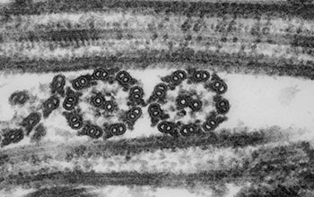
NSF-wide Emphasis Programs for Broadening Participation
Graduate Research Fellowship Program
Innovations in Graduate Education Program
International Research Experiences for Students
Major Research Instrumentation Program
National Nanotechnology Coordinated Infrastructure
Partnerships for Innovation
Research Experiences for Undergraduates
Science and Technology Centers: Integrative Partnerships
Sustainable Regional Systems Research Networks
Credit: Louisa Howard, Dartmouth College
Notes:
https://www.nsf.gov/od/broadeningparticipation/bp_portfolio_dynamic.jsp

Slide 13

BIO Emphasis Programs for Broadening Participation
Center for Advancement and Synthesis of Open Environmental Data and Sciences
Emerging Frontiers in Research and Innovation 2021
Mid-Career Advancement
Research Experiences for Teachers Sites in Biological Sciences
Credit: Katy Hennig, University of South Florida

Slide 14
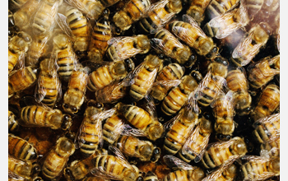
Education & Human Resources Emphasis Programs for Broadening Participation
Advancing Informal STEM Learning
Computer Science for All
Re-entry to Active Research Program
Robert Noyce Teacher Scholarship Program
Secure and Trustworthy Cyberspace Frontiers
Credit: L. Brian Stauffer, University of Illinois News Bureau
Notes:
https://www.nsf.gov/od/broadeningparticipation/bp_portfolio_dynamic.jsp

Slide 15
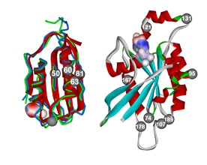
Dear Colleague Letters addressing Broadening Participation
Dear Colleague Letters advise the scientific community about funding opportunities.
Credit: George Makhatadze, Rensselaer Polytechnic Institute
Notes:
https://www.nsf.gov/od/broadeningparticipation/bp_portfolio_dynamic.jsp

Slide 16

BIO Dear Colleague Letters About Broadening Participation
Research Assistantships for High School Students (RAHSS) - BIO supplements
Research Experience for Teachers (RET): Funding Opportunity in the Biological Sciences
Credit: Karen Levy, Emory University
Notes:
Goal of the RAHSS is to Foster interest in the pursuit of studies in the Biological Sciences; and to broaden participation of high school students, particularly those who are from underrepresented groups, persons with disabilities, and women in sub-disciplines where they are underrepresented.
The goal of the Research Experiences for Teachers (RET) activity is to enhance the professional development of K-12 science educators through research experiences at the emerging frontiers of science in order to bring new knowledge into the classroom. NSF especially encourages working with teachers who serve under-resourced populations.

Slide 17
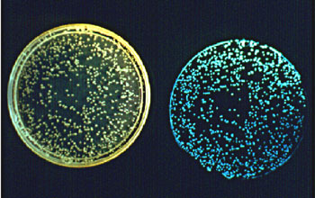
Education & Human Resources Dear Colleague Letters About
Broadening Participation
Dear Colleague Letter: Broadening Participation in STEM Entrepreneurship and Innovation (BPINNOVATE)
Research to Improve STEM Teaching and Learning, and Workforce Development for Persons with Disabilities
Credit: Courtesy J. W. Hastings, Harvard University, through E. G. Ruby, University of Hawaii
Notes:
NSF invites proposals identifying contextual factors and mitigation strategies to enhance participation and success of various populations in STEM entrepreneurship and innovation.
NSF invites proposals focused explicitly on advancing knowledge about STEM teaching, learning, and workforce development for individuals with disabilities.

Slide 18
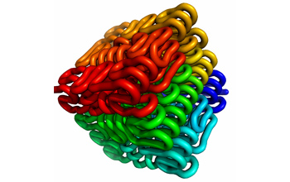
For further information concerning NSF's Broadening Participation programs, please contact:
Dr. Suzanne Iacono
National Science Foundation
Phone: 703-292-8040
E-mail: broadpart@nsf.gov
Credit: Leonid A. Mirny and Erez Lieberman-Aiden

Slide 19
MCB Virtual Office Hour
Question and Answers Session:
Click on the Q&A icon on the bottom of your Zoom screen, shown here:
Submit your questions via the Q&A function.
A Q&A box should appear on your screen. Please enter your question or comment in the box. You may select to submit your question anonymously.
*For specific questions about your project,
please contact a Program Director.
Notes:
While we’re waiting for Qs to come in, the following slide has information about the next VOH…

Slide 20
MCB Virtual Office Hour
Up Next
Wed, August 11, 2021 (2-3 pm EDT)
Topic: Beyond Core Funding Opportunities – EAGER, RAPID, RAISE, RCN, Conference/Workshop
Feel free to email topic suggestions to:
Lourdes Holloway: lhollowa@nsf.gov or
Sonam Ahluwalia: sahluwal@nsf.gov
https://mcbblog.nsfbio.com/office-hours/
Notes:
If we have time, explicitly invite the community to give us their thoughts about how they view NSF’s current broadening participation activities.

Slide 21
Extra slides: Cluster descriptions

Slide 22
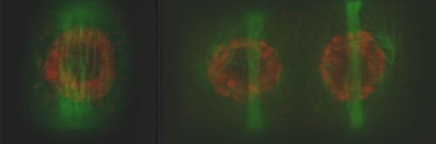
Cellular Dynamics and Function
The cluster seeks theory-driven investigations of diverse cellular and subcellular systems. Research proposals are encouraged that use multidisciplinary physical, chemical, mathematical and computational approaches to provide novel techniques and integrative insight into fundamental cellular functions. Innovative proposals using plants, microbes, and nontraditional model species are encouraged. Proposals that rely heavily on descriptive approaches are given lower priority.
The cluster encourages proposals in the following areas:
Predictive understanding of the behavior of living cells through integration of modeling and experimentation.
Evolutionary approaches to understanding the rules governing cellular functions.
Integration of function with emerging cellular properties across broad spatiotemporal scales, including ideas that consider cellular organization from the standpoint of soft condensed matter.
Name | Email | Phone
Charles Cunningham | chacunni@nsf.gov | (703) 292-2283
Steven Clouse | sclouse@nsf.gov | (703) 292-8440
Rita Miller | rimiller@nsf.gov | (703) 292-2918
Richard J. Cyr | rcyr@nsf.gov | (703) 292-8400

Slide 23
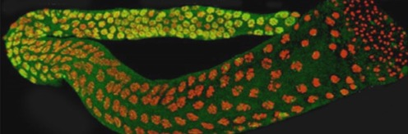
Genetic Mechanisms
The cluster supports inventive studies investigating fundamental mechanisms of evolution, organization, dynamics, and utilization of genetic information. Projects that employ theoretical, computational, and experimental approaches to integrate structural, biochemical, genetic, and "-omic" data are encouraged, particularly to discover rules explaining the maintenance and expression of genomes. Interdisciplinary research is encouraged, as is development and use of innovative in vivo and in vitro technical and computational approaches to address compelling questions.
Funding priority is given to proposals that employ quantitative frameworks, and promise significant advances and high impact in the following areas:
Chromatin- and RNA-mediated regulatory mechanisms.
Dynamics & spatiotemporal coordination of genome replication, DNA repair, chromatin modification, transcription, and translation
Origin and evolution of genetic polymers, including DNA, RNA and proteins.
Name | Email | Phone
Manju Hingorani | mhingora@nsf.gov | (703) 292-7323
Karen C. Cone | kccone@nsf.gov | (703) 292-4967
C. Phoebe Lostroh | clostroh@nsf.gov | (703) 292-7145
Steve DiFazio | sdifazio@nsf.gov | (703) 292-4517

Slide 24
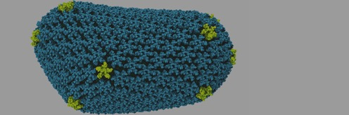

Molecular Biophysics
The cluster supports fundamental research into the interplay between structure, dynamics and function of biomolecules. Research projects with the goal of establishing the fundamental principles of biomolecular interactions, regulation of biological function at the molecular level, or using these principles to design new functions are of interest to the cluster. Theory-driven, predictive and verifiable investigations that utilize robust experimental and computational approaches in a synergistic fashion receive the highest priority. The cluster encourages studies under physiological conditions or those that mimic the native physiological environment, as well as research at the interface of biological sciences with the physical, chemical, mathematical and engineering sciences. Proposals involving mechanistic biochemistry or the study of systems from which broad biophysical principles cannot be derived are given lower priority.
Proposals in the following areas are particularly encouraged:
Large scale computations that incorporate constraints obtained from a variety of experimental techniques.
Methodological developments that inform biomolecular dynamics on multiple time- and length-scales in order to decipher their role in molecular recognition and function.
Determination of the structure and interactions of very large bio-relevant assemblies in atomic or molecular detail.
Name | Email | Phone
Wilson Francisco | wfrancis@nsf.gov | (703) 292-7856
Engin Serpersu | eserpers@nsf.gov | (703) 292-7124
Jaroslaw (Jarek) Majewski | jmajewsk@nsf.gov | (703) 292-7278
Marcia Newcomer | mnewcome@nsf.gov | (703) 292-4778

Slide 25


Systems and Synthetic Biology
The cluster supports proposals that use the tools of systems and synthetic biology for a comprehensive understanding of complex interactions within biological systems across different scales. Proposals using experimental and computational approaches in a synergistic fashion are a high priority. The cluster seeks proposals using tractable established or emerging model systems that focus on: regulatory and metabolic network dynamics; fundamental rules governing complex behavior; and microbial communities and their interactions.
The cluster encourages proposals in the following areas:
Mechanistic modeling of regulatory, signaling, and metabolic networks and the interactions among networks.
The origins of life, the minimal cell and emerging behaviors of complex interactions.
Novel experimental and computational tool development, including those that facilitate exploration and discovery of fundamental molecular scale mechanisms.
Molecular to system-wide scale rules of assembly and function in natural or synthetic microbial communities and symbiotic partnerships.
Name | Email | Phone
David A. Rockcliffe | drockcli@nsf.gov | (703) 292-7123
Elebeoba (Chi-Chi) May | emay@nsf.gov | (703) 292-2100
Anthony Garza | agarza@nsf.gov | (315) 254-1114
Arcady Mushegian | amushegi@nsf.gov | (703) 292-8528

