Slide 1
The Imaging X-ray Polarimetry Explorer
IXPE
Martin C. Weisskopf
NASA Marshall Space Flight Center
Presentation to the Astronomy and Astrophysics Advisory Committee
September 29, 2021

Slide 2
Introduction
IXPE will add two physical parameters to our study of X-ray sources
  Previously position, intensity, spectroscopy, and time variability
  New will be the level of polarization and the position angle or equivalently, the two Stokes parameters Q and U
Polarimetry in the classical X-ray band (2-10 keV)
  The one solid result to date
IXPE
  How it works
  The science

Slide 3
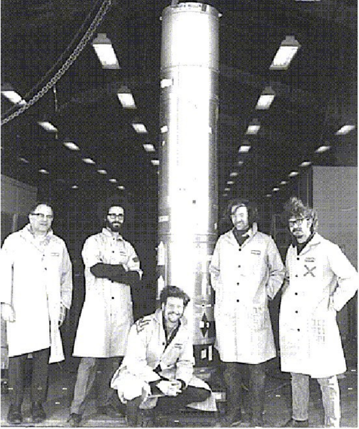
Rocket 17.09 (1971)
Crystal & Thomson-scattering polarimeters
Crab detection!
  P = 15% ± 5%
  φ = 156° ± 10°
Yes, I am the handsome one

Slide 4
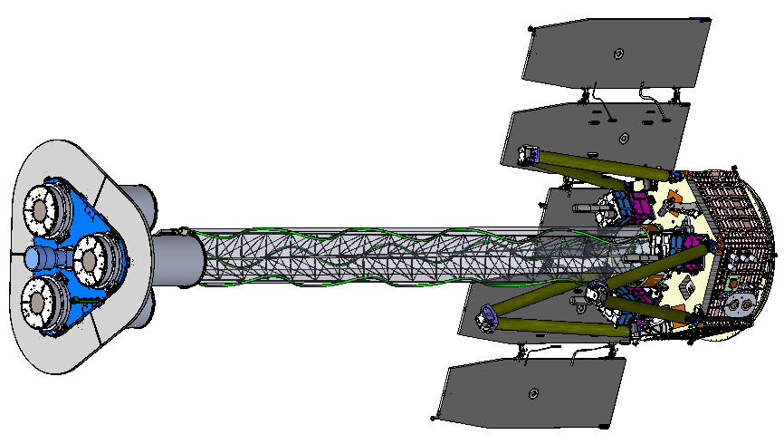
IXPE Deployed
Detector Unit
(1 of 3)
Miror Module Assembly
(1 of 3)
Forward Star Tracker
5.2 m total length
4.0 m focal length

Slide 5
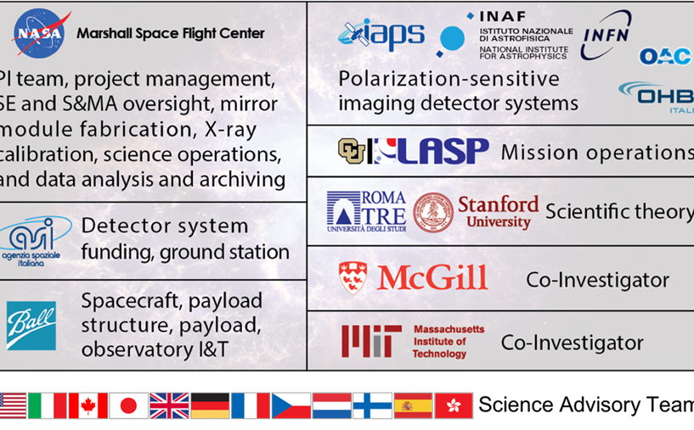

The IXPE Team
Science Advisory Team currently comprises > 90 scientists from 12 countries

Slide 6
Mission Description
Launch December 2021 on a Falcon 9 from KSC
600-km circular orbit at a nominal 0° inclination
2-year baseline mission, optional extension with GO program
Point and stare (with dither) at pre-selected targets
Malindi ground station - primary (Singapore - secondary)
Mission Operations Center (MOC) at the University of Colorado, Laboratory for Atmospheric and Space Physics (LASP)
Sciences Operations Center (SOC) at MSFC
Data archiving at NASA’s HEASARC
  During the first 3 months of the mission, including one month of orbital checkout, all IXPE data shall be made publicly available at the HEASARC within 30 days of the end of an observation, which is defined as when data for 90% of the scheduled observation time are received by the MOC.
  After the first 3 months of the mission, data shall be made available to the HEASARC within 1 week of the end of an observation, which is defined as when data for 90% of the scheduled observation time are received by the MOC.

Slide 7
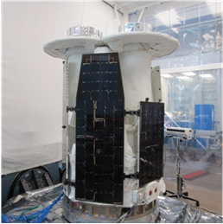
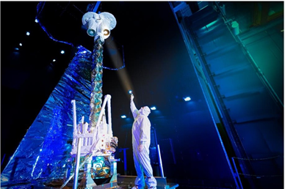
It’s Built!

Slide 8
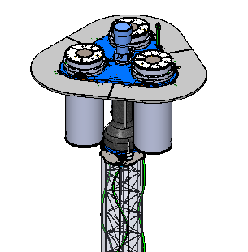
Shield and Collimator, in Addition to Imaging, also Suppress Background
Off-axis background
Shield
Detector unit
On-axis Target
X-ray
Shield
Mirror Module Assembly

Slide 9
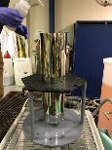
Mirror Production Process
Mandrel fabrication
1. Machine mandrel from aluminum bar
2. Coat mandrel with electroless nickel (Ni-P)
3. Diamond turn mandrel to sub-micron figure accuracy
4. Polish mandrel to 0.3-0.4 nm RMS
5. Conduct metrology on the mandrel
Mirror-shell forming
6. Passivate mandrel surface to reduce shell adhesion
7. Electroform Nickel/Cobalt shell onto mandrel
8. Separate shell from mandrel in chilled water
Ni/Co electroformed IXPE mirror shell
(+)
(-)
(+)

Slide 10
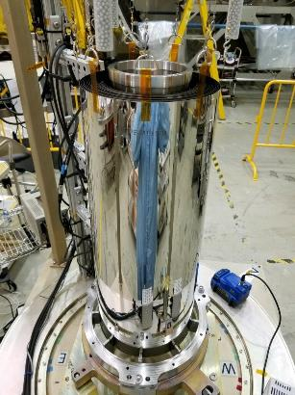
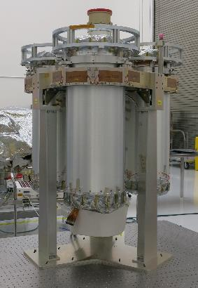
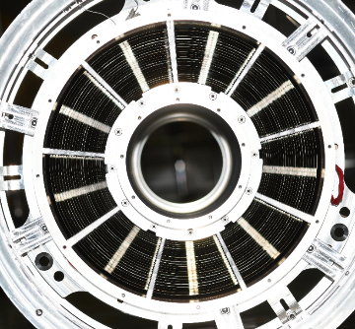
The Optics

Slide 11
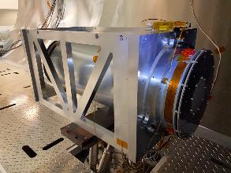
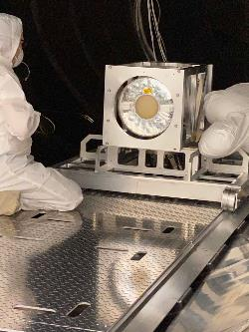
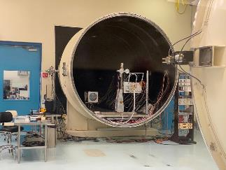
Stray Light Test Facility
X-ray calibration of the MMAs at MSFC’s 100-m X-ray test facility

Slide 12
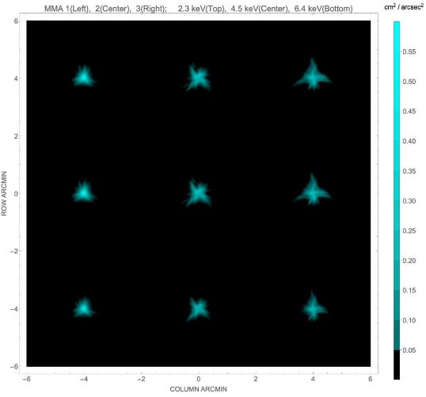
Angular Resolution
MMA | #1 | #2 | #3
6.4 keV | 18.9″ | 24.8″ | 24.2″
4.5 keV | 18.9″ | 25.0″ | 26.9″
2.3 keV | 18.7″ | 24.5″ | 26.7″
Values in the table are half-power diameters (HPDs) for the individual MMAs alone. These need to be adjusted slightly for alignment errors, detector resolution, focus etc. to determine the on-orbit system-level resolution .
Based upon X-ray calibration and analysis, the system-level performance is 28″ HPD

Slide 13
Mirror Module Assembly Properties
Property | Value
Number of modules | 3
Mirror shells per module | 24
Inner, outer shell diameter | 162, 272 mm
Total shell length | 600 mm
Inner, outer shell thickness | 180, 250 µm
Shell material | Nickel cobalt alloy
Effective area per module | 160 cm² (2.3 keV) 190 cm² (3-6 keV)
Angular resolution | ≤ 27 arcsec HPD
Detector limited FOV | 12.9 arcmin
Focal length | 4 m
Mass (3 assemblies) | 95 kg with contingency

Slide 14
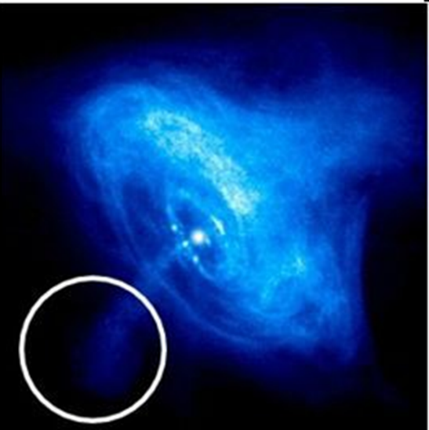
Imaging Polarimetry
30″ half-power diameter on Chandra image of the Crab Nebula

Slide 15
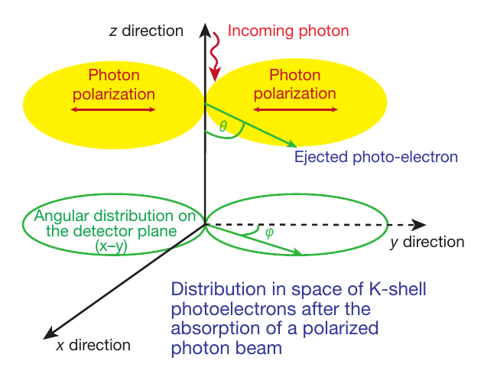
Detection Principle
The detection principle is based on the photoelectric effect

Slide 16
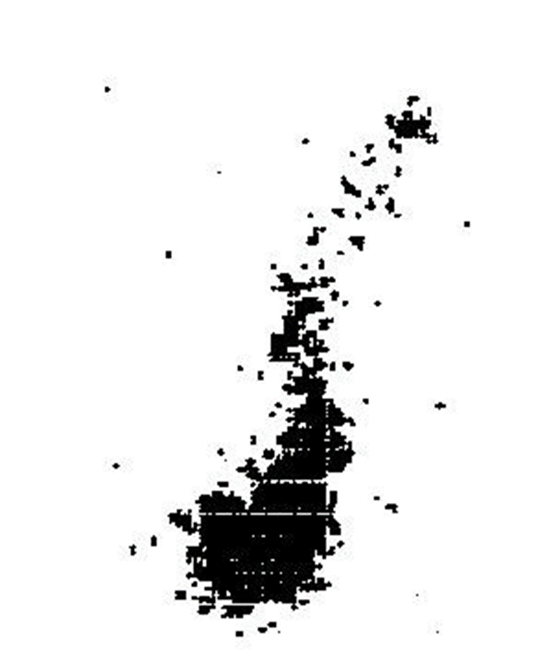

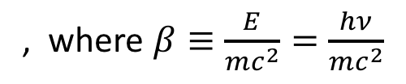
The Polarization-Sensitive Detectors
The initial direction of the K-shell photoelectron is determined by the orientation of the incident photon’s electric vector
Initial direction of photoelectron
Site of initial ionization and Auger electron cloud
The distribution of the photoelectron initial directions determines the degree of polarization and the position angle
, where $β≡\frac{E}{mc^{2}}=\frac{hν}{mc^{2}}$

Slide 17
Detector Properties
Parameter | Value
Sensitive area | 15 mm × 15 mm (13 x 13 arcmin)
Fill gas and composition | DME @ 640 millibar
Detector window | 50-µm thick beryllium
Absorption and drift region depth | 10 mm
GEM (gas electron multiplier) | copper-plated 50-µm liquid-crystal polymer
GEM hole pitch | 50 µm triangular lattice
Number ASIC readout pixels | 300 × 352
ASIC pixelated anode | Hexagonal @ 50-µm pitch
Spatial resolution (FWHM) | ≤ 123 µm (6.4 arcsec) @ 2 keV
Energy resolution (FWHM) | 0.57 keV @ 2 keV (∝ √E)
Useful energy range | 2 - 8 keV

Slide 18
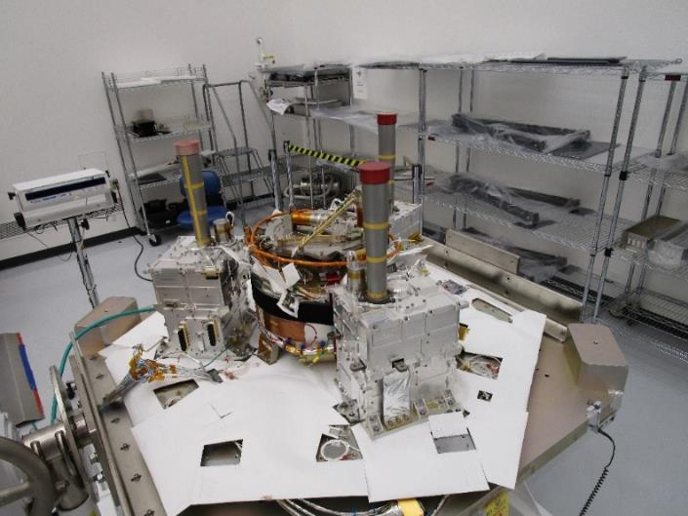
The Detectors
The Detector Units (DUs) mounted to the spacecraft top deck at Ball

Slide 19
Filter Calibration Wheel Assembly
Filter and Calibration Wheel (FCW), providing open, attenuator, and closed positions, plus four ⁵⁵Fe-powered calibration sources:
  Cal A – Bragg-reflected polarized 2.98-keV (Ag-L𝛼 fluorescence) and 5.89-keV (Mn-K𝛼)
  Cal B – unpolarized 5.89-keV spot
  Cal C – unpolarized 5.89-keV flood
  Cal D – unpolarized 1.74-keV (Si-K𝛼 fluorescence) flood

Slide 20
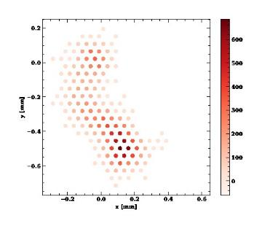
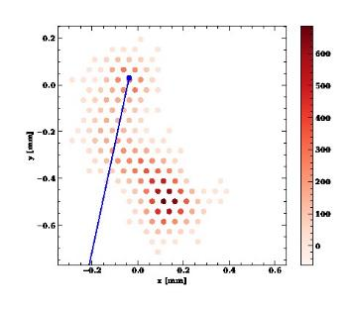
Analysis Based upon Neural Networks
Baseline “moments” analysis is a simple, effective, long-studied and well-understood method of extracting information from ionization tracks made by a photo-electron in the detector gas
Machine Learning (neural-network) techniques can extract more information from each track
  Improves position-angle (PA) measurements, especially at high energy
  Computes statistical and reconstruction errors for each event
  Mildly improves estimates of the energy and conversion point of each event

Slide 21
The Minimum Detectable Polarization (MDP)
R_{S} is the observed source counting rate
R_{B} is the observed background counting rate
t is the integration time
M is the modulation factor, i.e. the amplitude of the variation of the ensemble of position angles for a 100% polarized source
The power of the neural-network analysis for an ensemble of events in the case of IXPE is almost as if we were flying 4 rather than 3 optics/detector combinations!

Slide 22
Radio Pulsars
Radio Pulsars
  Perform X-ray phase-resolved polarimetry to test models for a radio pulsar’s X-ray emission
  Grey is optical, blue is IXPE
Emission geometry and processes are still unsettled.
Competing models predict differing polarization behavior with pulse phase.
X-rays provide clean probe of geometry.
Absorption likely more prevalent in visible band.
Radiation process entirely different in radio band.
  Recently discovered no pulse phase-dependent variation in polarization degree and position angle @ 1.4 GHz.
140-ks observation gives ample statistics to track polarization degree and position angle.

Slide 23
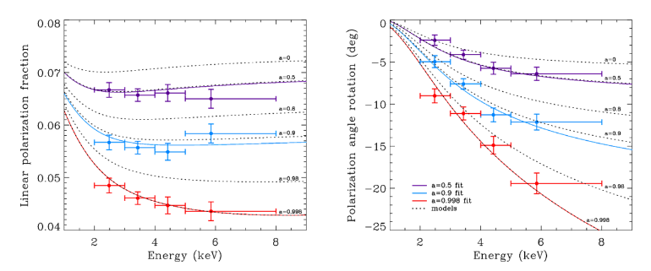
Microquasars
Microquasars
  Perform X-ray spectral polarimetry on microquasars to use the position angle to help localize the emission site (accretion disk, corona, jet)
  For a micro-quasar in an accretion-dominated state, scattering polarizes the disk emission.
  Polarization rotation versus energy is greatest for emission from inner disk.
    Inner disk is hotter, producing higher energy X-rays.
  Disk orientation from other experiments used to constrain GRX1915+105 model.
    a = 0.50±0.04; 0.900±0.008; 0.99800±0.00003 (200-ks observation)

Slide 24
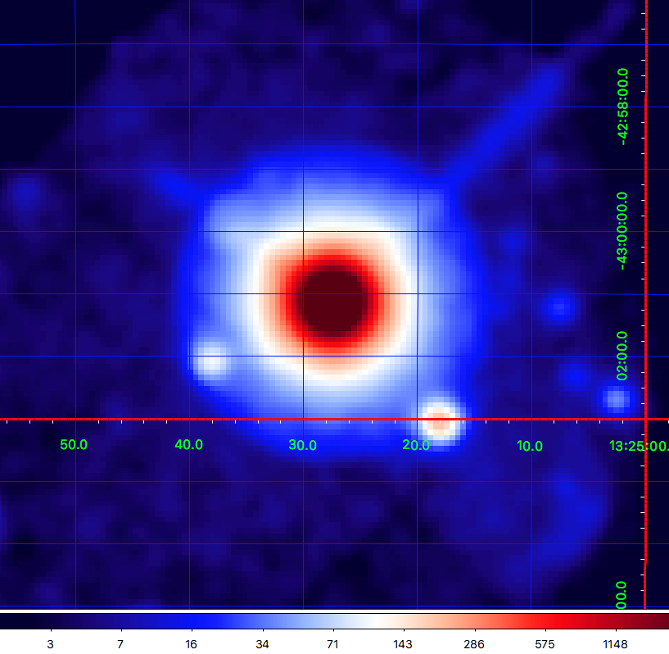
Active Galaxies: CEN A
Active galaxies are powered by supermassive BHs with jets
  Radio polarization implies the magnetic field is aligned with jet
  Different electron-acceleration models predict different dependence in X-rays
Region | MDP₉₉
Core | 1.4%
Knots C+F+G | 21%
ULXs | 25% 15%
ULX sources

Slide 25
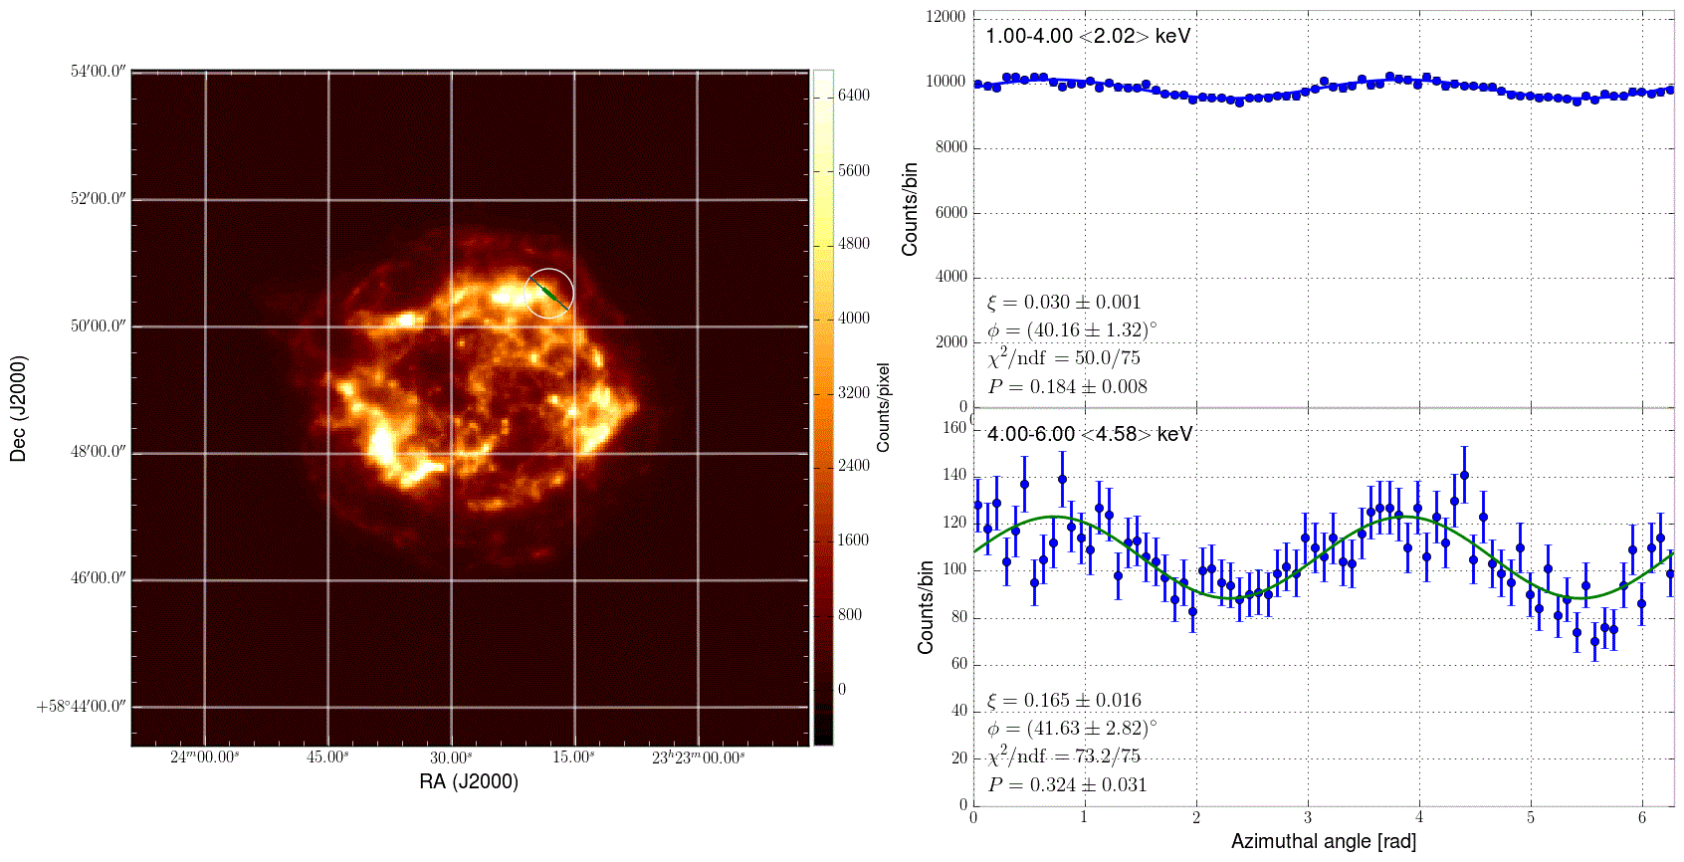
Supernova Remnants
Supernova Remnants (SNR – e.g. CAS-A)
  Use X-ray polarmimetric imaging to examine the magnetic-field topology in the X-ray emitting regions of (shell-type) SNR, which are candidate sites for cosmic-ray acceleration (Entire image measured simultaneously)
Lines and thermal continuum dominate 1-4 keV.
Non-thermal emission dominates 4-6 keV.

Slide 26
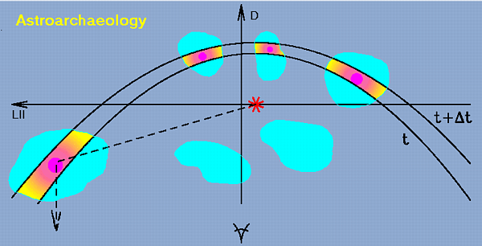
Was SGR A* recently 10⁶ × more active?
Galactic Center molecular clouds (MC) are known X-ray sources
  If the MCs reflect X-rays from Sgr A*, the X-radiation would be highly polarized perpendicular to plane of reflection and indicate the direction back to Sgr A*
    If true, Sgr A* X-ray luminosity was 10⁶ larger ≈ 300 years ago
    If not, still a discovery

Slide 27
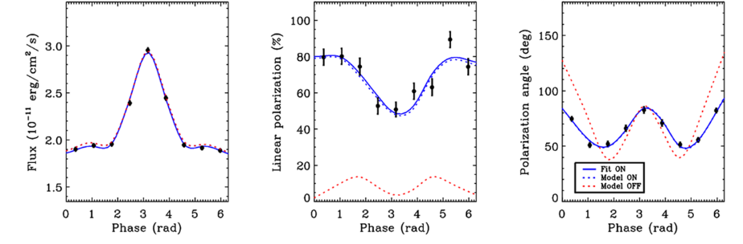
Test QED
Study magnetars (pulsing neutron stars with magnetic fields up to 10¹⁵ Gauss)
  Non-linear QED predicts magnetized-vacuum birefringence
    Refractive indices of the two polarization modes differ from 1 and from each other
    Impacts polarization and position angle as functions of pulse phase, but not the flux
    Example is 1RXS J170849.0-400910, with an 11-s pulse period
    Can exclude QED-off at better than 99.9% confidence in 250-ks observation

