Slide 1

Division of
Molecular and Cellular Biosciences (MCB)
Virtual Office Hours
Welcome to the MCB Virtual Office Hours, we will begin at 2pm EST!
Please submit questions by selecting the Q&A function
available to you on Zoom.
Notes:
Script (Bianca):
Welcome to today’s MCB virtual office hour. We will start in a couple pf minutes at 2 pm.

Slide 2

MCB Virtual Office Hour
Question and Answers Session
Click on the Q&A icon on the bottom of your Zoom screen, shown here:
A Q&A box should appear on your screen.
Please enter your question or comment in the box. You may select to submit your question anonymously.
Submit your questions via the Q&A function.
*For specific questions about your project,
please contact a Program Director.
Notes:
Script (Bianca):
Please note that you can post your questions at any time using the QnA function on your Zoom screen.
Once the presentation is complete, we will address your questions in the order they are received.

Slide 3

MCB Virtual Office Hour
Today’s Topic
Working with an NSF Program Officer
Program Officers:
Bianca Garner, Systems and Synthetic Biology/MCB
Manju Hingorani, Genetic Mechanisms/MCB
David Rockcliffe, Systems and Synthetic Biology/MCB
Admin Staff:
Mariam Tahir
Notes:
Script (Bianca):
As advertised, today we’re going to provide an introduction to the work of program officers at NSF, and offer some tips on how you might interact with us effectively.
Let us start by introducing ourselves…I am…
--------

Slide 4

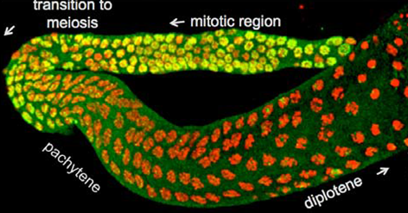
Molecular and Cellular Biosciences (MCB)
Supports quantitative, predictive and theory-driven research to understand complex living systems at the molecular, subcellular, and cellular levels
Encourages use of approaches at intersections of biology with other disciplines
~35%
success rate
$152 M
FY 2020 research
budget
250
awards
613
proposals
Award size increased by 10%
Time to award decision decreased 20%
17
panels
Notes:
Script (Bianca):
First, a brief snapshot of the Molecular and Cellular Biosciences Division of the Biological Sciences Directorate at NSF.
Our mission is to support “quantitative, predictive and theory-driven….READ TEXT IN BLUE BOX”
In Fiscal Year 2020, MCB had a research budget of $152 M. The Division received 613 proposals that were reviewed across 17 panels and resulted in 250 awards. This was equivalent to a success rate of ~35%.
Note that there have been some significant changes that benefit the scientific community since the BIO Directorate instituted a no-deadline policy a couple of years ago:
The award size has increased by 10%, and it takes 20% less time to arrive at a decision (avg b/w 5- 6mo). This is partly because the number of proposals submitted for review has decreased.
So, this is a very good time to send your best research ideas to MCB.

Slide 5
How to find MCB funding opportunities
https://mcbblog.nsfbio.com/funding-opportunities-2/
Notes:
Script (Bianca):
For those who are new to MCB, this is the Funding Opportunities web page on the MCB Blog.
Here you can find the most up-to-date, curated list of NSF funding opportunities that support research in the molecular and cellular biosciences.
--------

Slide 6
Funding opportunities of note
NSF 21-017
Planning for a Molecular and Cellular Science Information Synthesis Center (MoCeIS)
Supports planning conferences to build scientist networks focused on synthesis and integration of molecular and cellular data.
NSF 21-564
Future Manufacturing (FM)
Supports research and education of a future workforce to overcome scientific, technological, educational, economic and social barriers and enable new manufacturing capabilities.
NSF 21-508
Transitions to Excellence in Molecular and Cellular Biosciences Research (Transitions)
Supports mid-career or later-stage scientists to pursue exciting new avenues of inquiry and expand or transition their research toward greater impact.
NSF 21-543
Integrative Research in Biology (IntBIO)
Supports collaborative proposals that tackle bold questions in biology and require an integrated approach to make exceptional progress in a research area.
NSF 19-054
Models for Uncovering Rules and Unexpected Phenomena in Biological Systems (MODULUS)
Supports substantive collaborative research by mathematicians and biological scientists.
Notes:
Script (Bianca):
Some current funding opportunities are highlighted on this slide.
(CLICK TO ADVANCE) READ SLIDE TEXT.
Details about the program goals, deadlines (or the absence of deadlines) etc. are provided in each solicitation, as is PO contact information, if you have any questions.
--------

Slide 7
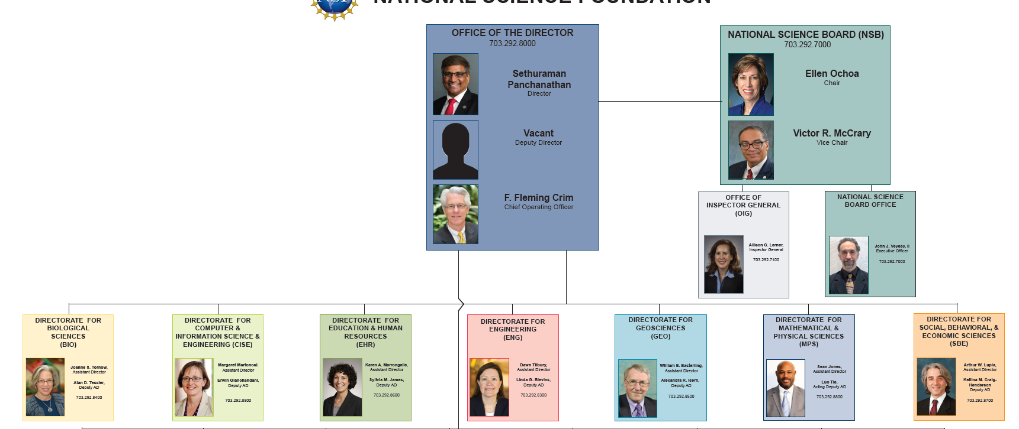
NSF organization
Director’s Office
National Science Board
Directorates
Biological Sciences
Molecular and Cellular Biosciences (MCB)
Integrative Organismal Systems (IOS)
Environmental Biology (DEB)
Biological Infrastructure (DBI)
Engineering
Chemical, Bioengineering, Environmental and Transport Systems (CBET)
Math & Physical Sciences
Chemistry (esp. CLP)
Physics (esp. PoLS)
Divisions
Notes:
Script (David):
To provide some context for today’s topic on National Science Foundation Program Officers, here is a brief overview of the organizational structure of the NSF:
The Office of the Director constitutes the top leadership of NSF, with the Director and Deputy Director appointed by the US president and confirmed by the Senate.
The National Science Board establishes NSF policies and serves in an advisory capacity to the US Congress and the President.
NSF is divided into seven directorates that support science and engineering research and education: - Biological Sciences, - Computer and Information Science and Engineering, - Education and Human Resources, - Engineering, - Geosciences, - Mathematical and Physical Sciences, and - Social, Behavioral and Economic Sciences.
Each Directorate has multiple Divisions that are defined by broad disciplinary areas.
(CLICK TO ADVANCE)
MCB is one of four Divisions in the BIO Directorate. The others are IOS, DEB, and DBI.
This slide also highlights Divisions in the Engineering Directorate (particularly the CBET program) and the Math and Physical Sciences Directorate (particularly Chemistry of Life Processes and Physics of Living Systems programs) that are of most interest to scientists in the MCB community.

Slide 8
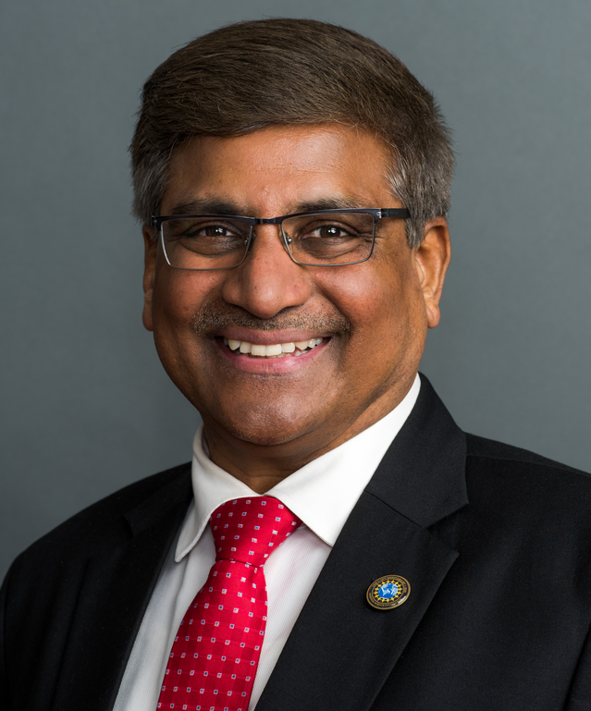
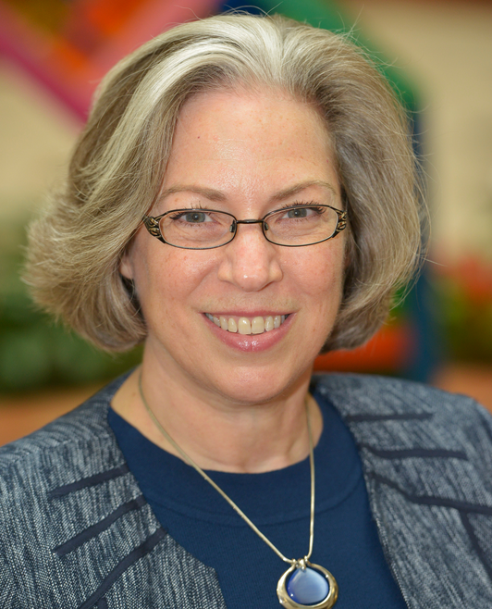
NSF organization: Scientific staff
President
Director
Dr. Sethuraman Panchanathan
Dr. Joanne Tornow
(BIO AD)
Assistant Director of a Directorate
Deputy Assistant Director
Division Director
Deputy Division Director
Program Officer
(Program Director)
Notes:
Script (David):
(CLICK TO ADVANCE)
This slide outlines the NSF scientific staff positions, starting with the NSF Director, Dr. Panchanathan, who was appointed just a few months ago to a 6-year term.
Each Directorate is headed by an Assistant Director – Dr. Tornow in the case of Biological Sciences – and a Deputy Assistant Director
Each Division is headed by a Division Director and a Deputy Division Director
And finally, each Division has multiple scientific Programs that are managed by Program Officers (aka Program Directors), usually working in small groups.

Slide 9
Program Officers: Who are we?
Permanent Federal employees
  Often former faculty members from academia
  Work full-time at NSF
  May conduct research part-time
Rotators
  Current faculty members in academia
  Work at NSF (often 2-3 year stints)
  Maintain research programs at their home institution
Notes:
Script (David):
Program Officers are….READ SLIDE TEXT
Notes:
Feel free to ad lib for a few seconds as you please. For example, could mention that:
NSF supports POs’ engagement in active research, for both permanent and rotating POs.
Serving as a rotating PO is a great opportunity to engage in science from a broader programming and policy perspective.

Slide 10
Program Officers: What do we do?
Program planning and management
  Maintain dynamic, high-quality and effective proposal merit review process.
  Serve as advisor to applicants and awardees, e.g., about NSF program objectives, priorities, requirements and policies.
Stewardship
  Conduct planning activities that support NSF’s mission to promote the progress of science and advance national welfare.
  Responsible for post-award management and oversight.
Notes:
Script (David):
The next couple of slides provide a broad outline of PO responsibilities.
Our main task is Program planning and management – which involves managing the review of proposals submitted to the NSF according to the merit review criteria of Intellectual Merit and Broader Impact. As part of this process, we also advise applicants and awardees about NSF program objectives, priorities, requirements and policies. This occurs through emails, calls, outreach visits to institutions and conferences, and events such as these virtual office hours.
We also serve as stewards of the NSF mission – by helping shape new funding opportunities, policy changes, and other strategic planning activities. We’re also responsible for management and oversight of NSF awards, for example through review of annual reports, post-award site visits etc.

Slide 11
Program Officers: What do we do?
Organization, Coordination and Liaison
  Provide leadership and direction to support the NSF mission.
  Communicate and coordinate within NSF, and with other Federal science agencies, the scientific community and the public.
Diversity and Outreach
  Foster diversity in the review process and the award portfolio.
  Conduct outreach that broadens participation in NSF activities.
  Professional Development
  Maintain current knowledge in scientific areas covered by the program, e.g., through participation in conferences, workshops, active research.
Notes:
Script (David):
As in any organization, communication and coordination are key elements for success.
POs play an important role in this regard by building and maintaining communication networks among the scientific and administrative staff of various programs, both within and outside NSF (e.g., other federal funding agencies), and with the scientific community. One important payoff, for example, is the ability to identify and invest resources in emerging areas of science.
Broadening participation is a primary goal for the NSF as part of its drive to push the frontiers of science and engineering.
POs work toward this goal in various ways, for example by fostering diversity in the merit review process and in the award portfolio, and by connecting with diverse communities through outreach activities.
We also prioritize professional development – especially remaining up-to-date on the current state of knowledge in fields supported by our programs, mainly by participating in conferences and in several cases through active involvement in research.

Slide 12
Why seek out a Program Officer?
NSF
Vjacheslav_Kozyrev/Shutterstock
Ongoing and new NSF funding opportunities (within and across programs); Program priorities; Merit review criteria (esp. Broader Impact); Budget; Opportunities to peer review; etc.
Notes:
Script (Manju):
So, the question of the hour is – why would you contact an NSF PO?
This cartoon illustrates a few reasons…(CLICK) well, perhaps not the latter three reasons…but we can share a lot of knowledge and some useful insights about NSF policies and practices, especially about
(CLICK) READ TICKER TAPE

Slide 13

When to engage with a Program Officer?
Before
  Introduce yourself
    Provide brief information about your background, current career stage/position (especially if new to NSF/program).
    Offer to participate in peer review (especially if new).
  Share short description of your research
    One-page summary of your project idea.
    What to include in the one-pager?
      See VOH Feb 12, 2020
  Seek input on what NSF program(s) fit your research
    Do some homework ahead of contact.
    Indicate which program(s) appear appropriate to you.
Notes:
Script (Manju):
There are many reasons and times when it helps to contact a PO, and they can be grouped into a couple categories –
Before you submit a proposal, and After the proposal review is complete.
Let’s start with ”Before”
Once you obtain general information from NSF websites and informational materials, it can be helpful to get advice that is tailored to your research and educational program, especially if you are new to NSF.
We recommend sending a short email with some information about your background (i.e., your research and educational interests). Again, if you are new to NSF, you may wish to offer to review proposals – as this is a great way to learn about the NSF review criteria and process.
If you wish to discuss your research ideas, it is extremely helpful to send a 1-page summary about the project you’d like to pitch to NSF. We hosted an office hour in Feb 2020 specifying what we like to see in this document. The slides are available at the MCB Blog on the Office Hours page and linked here.
Briefly, the summary should make the case for the Intellectual Merit of the project – so you should start with an introduction to the field leading up to your critical questions and hypotheses, provide an overview of how you plan to address them, and give a sense of the expected outcomes and impact. Also pay attention to NSF’s other merit review criteria of Broader Impact, and summarize your educational and outreach program and plans.
Be sure to highlight any features that add value – innovative/transformative aspects of the work, inter-disciplinary nature, if it crosses scales in biology, if it goes well above and beyond the norm for education, broadening participation, etc.
This is the core document that enables you to get input on whether and where at NSF your research program and project idea fit. We take your email and the 1-page summary seriously, and try to respond within a week or so. Part of the reason it takes some time is because we discuss your summary with colleagues within our program, and if the project is not a fit or it covers more than one program, we shop it around – across BIO, across other NSF directorates – to try and provide you with specific guidance on the most suitable program and PO to contact. Of course it helps if you do your homework and suggest potential programs before contacting us. This initial email exchange is often followed up with a phone conversation as needed.
And a bit of advice…it is better to send an email to a single PO per program. Wait for a response for at least a few days, maybe a week, before trying again or trying others. If you must write to multiple POs at the same time, use CC rather than BCC, so that we don’t duplicate our efforts in responding to you.

Slide 14

When to engage with your Program Officer?
After (Decline)
  Don’t give up
  Seek advice on what went wrong
    What are common messages in the reviews and panel summary?
      Inadequate preliminary data?
      Lack of focus?
  Seek advice on resubmitting the proposal
    What are important considerations?
    Submit to the same program or another?
    What aspects need substantive revision? Minor revision?
    What pitfalls can be avoided?
Notes:
Script (Manju):
Now let’s come to the “After”.
What do you do after a proposal has been declined.
After you work through the initial disappointment and frustration, you are more than welcome to write to us. Often these emails and conversations include a bit of debrief about what didn’t work for the proposal during review, and mostly focus on how to move forward in order to revise and resubmit a proposal.
For the debrief, we may be able to emphasize common messages in the reviews and panel summary that you really need to address (preliminary data, lack of focus, unclear rationale…), and perhaps provide some context for the decision – without breaching any confidentiality about the review process of course.
In terms of going forward, we may discuss some important issues – like whether you should submit to the same program or funding opportunity or consider alternatives? What aspects of the proposal need substantive or minor revision to address reviewer concerns and program priorities? What pitfalls can be avoided? All of these points can be covered in general or may be specific to your proposal.
For example, one issue we see often is that PIs submitting renewal proposals to the NSF will describe their past broader impact activities in great detail, but give short shrift to what they intend to do going forward. Even if you plan to continue mostly the same educational/training/outreach activities, you have to frame and describe them in the context of the proposed project and your goals for the next few years.
And hopefully at the end of this conversation with the managing PO, you are better informed about how to be more competitive in the next round of review.

Slide 15

When to engage with your Program Officer?
After (Award)
  What to expect?
    Possible budget revisions.
      See VOH Feb 10, 2021 on budget prep
    Resolution of any current/pending support overlap.
    Other: preparation of public abstract; timeframe for funding.
  Post-award reporting
    Annual report: progress on scientific and broader impact fronts.
    Problems and potential solutions.
  Stay in touch
    Hearing your success stories as they happen helps us convey the excitement of the science supported by NSF.
    Discuss funding opportunities - supplements, new ideas, programs etc.
Notes:
Script (Manju):
And now for the better “After” situation…
What happens when your proposal will be recommended for an Award.
The PO usually contacts you by phone, and after the initial happy noisemaking we get down to the business of required documents.
We may require a budget cut, depending on the parts of the project we find exciting, or due to budget limitations at our end – in that case a budget revision will be necessary.
But often revisions are needed because the PI or their grants officers do not provide sufficient or accurate information for the budget to pass muster at financial review.
Last month, staff from the Division of Grants and Agreements held an office hour to address some of these issues. You can find the slides and QnA at the MCB Blog (also linked here).
We’ll ask you to resolve any overlap in current or pending support (often this issue is addressed before review, since PIs are not allowed to submit duplicate or substantively overlapping proposals to both the BIO directorate and other funding agencies, e.g., NIH, simultaneously, unless they are beginning investigators (who do not have prior federal funding). But it may need fixing after review also.
We’ll discuss when the funds will become available, if the recommendation goes all the way to becoming an award.
And we’ll also ask you to prepare an abstract describing your project to the general public.
Other times you may contact the PO managing your award is when you submit your annual reports, wherein you summarize progress on both the research and broader impact fronts relative to what you had proposed. This is also an opportunity to record any problems you may have encountered, and how you’re addressing them – and if you might need accommodations – e.g., a supplement for broken down critical equipment or a no-cost extension (the past year has been an existential level exercise in dealing with unexpected problems!) We’ll plan an office hour in the near future about preparing informative annual reports.
And lastly, I want to emphasize that we welcome your staying in touch with us informally as well – especially when you experience exciting events such as the acceptance of a manuscript or a notable broader impact achievement.
In fact if you let us know in a timely manner, NSF media relations may choose to get involved and highlight your work. Even if that is not on the cards, knowing about your successes helps us share the excitement of the science we support, both internally within NSF and externally.
Of course, as you get generate ideas, you can start the communication cycle again by sending an email with a 1-pager to ask about funding opportunities and programmatic fit.

Slide 16
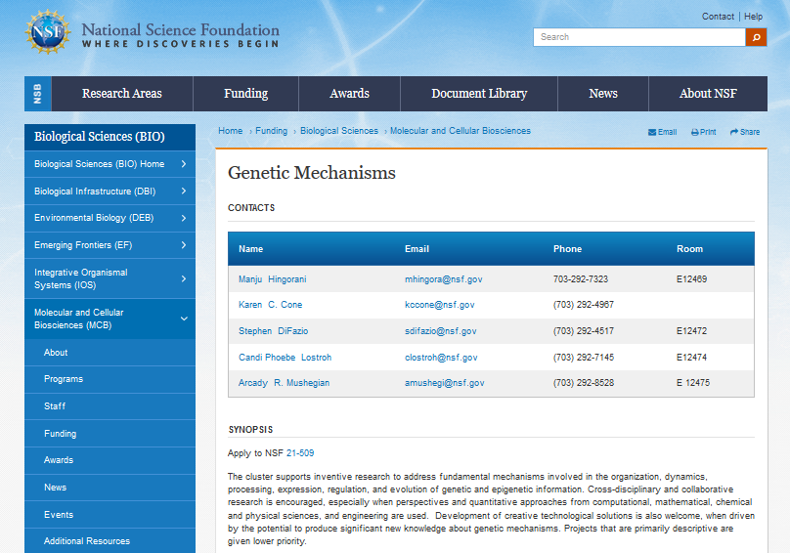

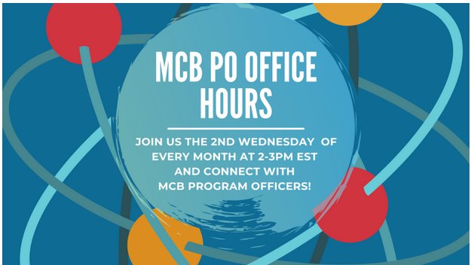
How to find us?
NSF Websites (nsf.gov)
Virtual Office Hours (access via Blogs)
Meetings and Conferences
Outreach Visits
Notes:
Script (Manju):
With that, let’s wrap up by listing the ways in which you can find Pos.
Individual program pages on the NSF website provide email and phone contacts for the managing POs.
We recommend that you sign up for email alerts from the MCB blog, which will also give you updates on future virtual office hours (where you can meet us) in addition to highlighting new funding opportunities in a timely manner.
Of course you can meet POs at conferences and through institutional outreach visits as well.

Slide 17
MCB Virtual Office Hour
Question and Answers Session
Click on the Q&A icon on the bottom of your Zoom screen, shown here:
A Q&A box should appear on your screen.
Please enter your question or comment in the box. You may select to submit your question anonymously.
Submit your questions via the Q&A function.
*For specific questions about your project,
please contact a Program Director.

Slide 18
MCB Virtual Office Hour
Next MCB Virtual Office Hour (2-3 pm EST):
Wed, April 14th, 2021
Topic: Getting to Know the Division of Biological Infrastructure (DBI) - Priorities and Opportunities
Notes:
While waiting for Qs to come in, here’s information about the next VOH…

Slide 19

National Science Foundation
Supports basic research and education via grants
Discipline-based structure
Cross-disciplinary programs
Annual budget ~$ 8 billion
>50,000 proposals; ~12,000 new awards per year supporting ~350,000 scientists, educators and students
Notes:
Extra slide

