Slide 1
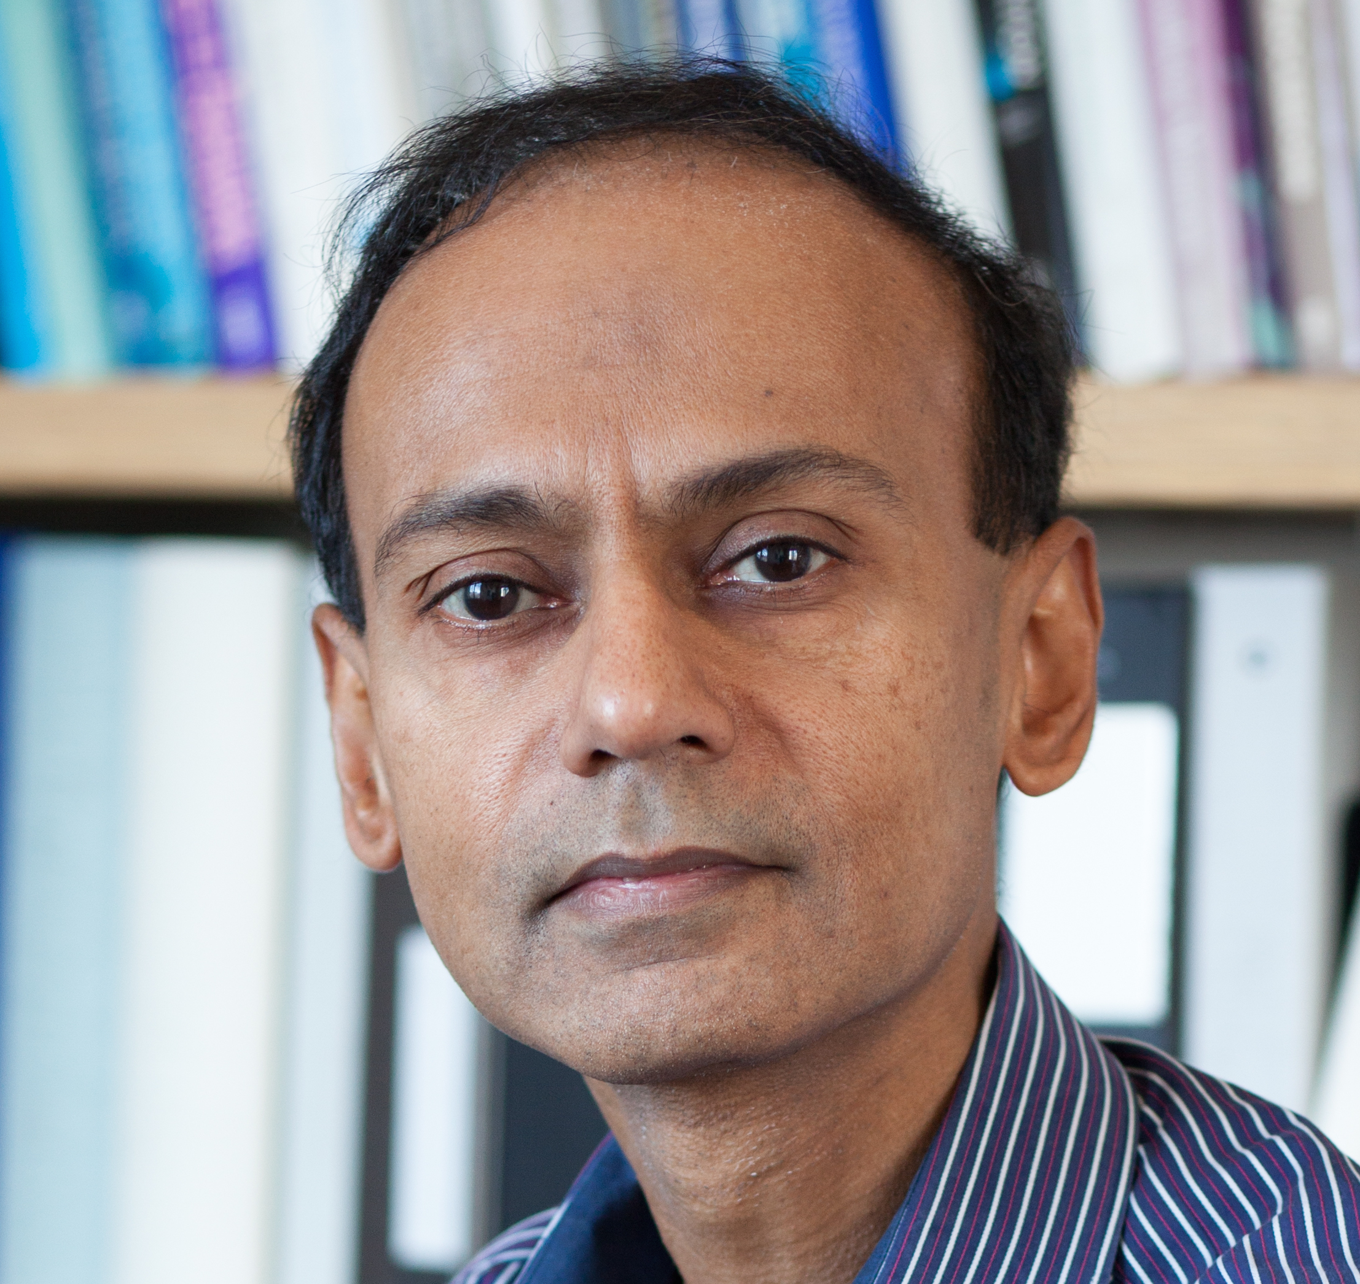
W ashington A rea T rustworthy C omputing H our
45th WATCH:
Secure Hardware and Cryptography: Contrasts, Synergies and Challenges
Srini Devadas
MIT
Thursday May 18, 12pm, Room 110
About the WATCH series:
Transforming today’s trusted but untrustworthy cyberinfrastructure into one that can meet society’s growing demands requires both technical advances and improved understanding of how people and organizations of many backgrounds perceive, decide to adopt, and actually use technology. WATCH aims to provide thought-provoking talks by innovative thinkers with ideas that illuminate these challenges and provide signposts toward solutions. The series is jointly organized by NSF’s Computer Science and Engineering (CISE) and Social, Behavioral, and Economic (SBE) Directorates and sponsored by the CISE Secure and Trustworthy Cyberspace (SaTC) Program. Talks will be recorded and made available over the Internet.
Abstract
Numerous cryptographic protocols and mechanisms have been developed to solve computer security challenges, and these techniques vary considerably with respect to security assumptions, performance tradeoffs, and applicability to problems. Secure hardware primarily uses the mechanism of isolation to solve a broad class of computer security problems, ranging from private information retrieval to verifiable computation. In this talk, I will contrast the two approaches by focusing on the application of remote outsourced computation. I will describe a spectrum of approaches that vary in their use of cryptography and isolation to achieve secure remote computation. I will end with describing challenges that remain in the deployment of secure hardware.
Speaker
Srini Devadas is the Webster Professor of Electrical Engineering and Computer Science at the Massachusetts Institute of Technology (MIT) where he has been on the faculty since 1988. Devadas's research interests span Computer-Aided Design (CAD), computer security and computer architecture. He has received the 2014 IEEE Computer Society Technical Achievement award, the 2015 ACM/IEEE Richard Newton technical impact award, and the 2017 IEEE Wallace McDowell award for his research. Devadas is a MacVicar Faculty Fellow and an Everett Moore Baker teaching award recipient, considered MIT's two highest undergraduate teaching honors.
Thursday, May 18, 2017
Questions/comments about WATCH?
Contact Fen Zhao (fzhao@nsf.gov)
NSF Stafford I Room 110, 12pm
Public Invited

